Slide 1
FaceBase Hub Updates of Year 4
Carl Kesselman

Slide 2
Overview of the past year
Growth in data collections and usage statistics
Major enhancements of the FaceBase database and service
Self-serve data curation tools released, conducted tutorials w/ spoke projects
Established common Bioinformatics Pipeline
Released Data Browser enhancements - including a new filtering interface
Updated TrackHub and introduced JBrowse - new plugin to access FB datasets directly
Conducted a usability survey of the FaceBase site and Data Browser

Slide 3
Data & Usage Statistics

Slide 4
Total Datasets
 | Categories | Entries
Datasets | -- | 777
Experiments | 12 assay/exp. types | 498
Biosamples info. | 4 species | 1,508
Data Files | 7 data types | 4,300 - seq: 1,676 - imaging: 1,666 - other: 958 = 6 TBs
A very diverse and growing collection of research data
Notes:
FB1 = ~ 2 TB
File counts by type:
mesh | processed | file | tracks | array | sequencing | imaging
------+---------------+----+---------+--------+----------------+---------
356 | 645 | 913 | 523 | 45 | 498 | 1320

Slide 5
Dataset Curation Status
FB2 datasets submitted: 142 (73 in Year 4)
Datasets submitted with self-curation tools in Yr 4: 66
Species | Curated | Released | Pending
Mouse | 61 | 15 | 0
Human | 8 | 22 | 1
Zebrafish | 35 | 0 | 0
Total: | 102 | 37 | 8
Notes:
Curated: FB2 Dataset that has been fully curated to the current FB2 model
Released: FB2 Dataset that appears in our catalog with minimal metadata information and is in the process of being curated
Pending: FB2 Dataset that appears in our catalog but some data and/or metadata needs to be completed

Slide 6
Data Download Statistics
User activity within the Data Browser for the past year:
1,053 data file downloads
21,992 thumbnails*
Usage of our Track Hub for the UCSC Genome Browser:
186,819 track downloads**
* Filtering out for generic placeholder thumbnails
** The Genome Browser reads byte ranges of the part of the file the user is actually looking at
Notes:
(Beyond Downloads) So these are the number of times files of datasets have been downloaded. But there’s more to measuring the impact of this site. If you’re researching a phenotype, once you’ve seen a good jpg on the webpage, do you really need to download the source file? So here’s usage stats for images as well as track hub, etc.. And note that the number of track file accesses is actually a quite accurate measure of usage because it specifically captures only what the user actually looked at.

Slide 7
Web traffic statistics for www.facebase.org
Analytics | 5/1/2016 - 4/26/2017 | 5/3/2017 - 5/3/2018
Pageviews | 42,373 | 61,179
Avg Session Duration | 6:07 | 3:39
“Users” | 7,905 | 14,764
Sessions | 12,227 | 21,810
Returning visitors | 60.53% | 14.8%
Evidence of continued growth in use year over year
Notes:
Y4: 35% of pageviews were on data browser pages

Slide 8
Data Service Enhancements

Slide 9
Challenges of representing diverse research data
Experiment types (partial listing!)
Genomics: microarray, RNA-seq, ChIP-seq, scRNA-seq, enhancer, whole exome sequencing
Imaging: microCT, microMR, optical projection tomography, laser capture microdissection, confocal fluorescent microscopy
Morphology and other: morphometric analysis, facial norms, clinical measures/syndromes
Organisms
Cross-species: Homo sapiens, Danio rerio, Mus musculus, Pan trog.
Data types (partial listing!)
Raw data: stranded, paired, single-ended reads; array (cel)
Processed data: aligned reads, quantification data
Images: 3D volumes, 2D thumbnails, Surface mesh/models
Notes:
This represents a sampling of the complexity of representing facebase research data

Slide 10
Requirements and tradeoffs in the re-design
Find cross-cutting data
Enough detail for re-use
Simple enough for data entry
Interoperate with external data standards
Support automated pipelines and more complex views of data
Key is to find a good tradeoff
Few details/simple
Easy/trivial to enter
Unable to reuse/automate
(w/out human interpretation)
Highly detailed/complex
Supports reuse/automation
Difficult to enter

Slide 11
Significantly improved data representation
Findability/Accessibility: unified representation of diverse data (-seq, array, imaging, enhancer, morph., …)
Interoperability: controlled vocabularies (support for concept hierarchies, synonyms, relationships)
Reusability: machine-readable encodings of information about experimental results
Dataset
Experiment
Biosample
Replicate
Data
Data
Data
Critical for supporting Bioinformatics Pipeline and Streamlined Curation
Notes:
Vocabulary include: from Uberon, OCDM (coming soon), NCBI Taxon, HGNC, MGI, OBI, …
Data Types include: Raw Seq, Processed, Tracks; Array; Volumes, Surface Mesh, Images; Supplementary (all other)

Slide 12
Bioinformatics Pipeline

Slide 13
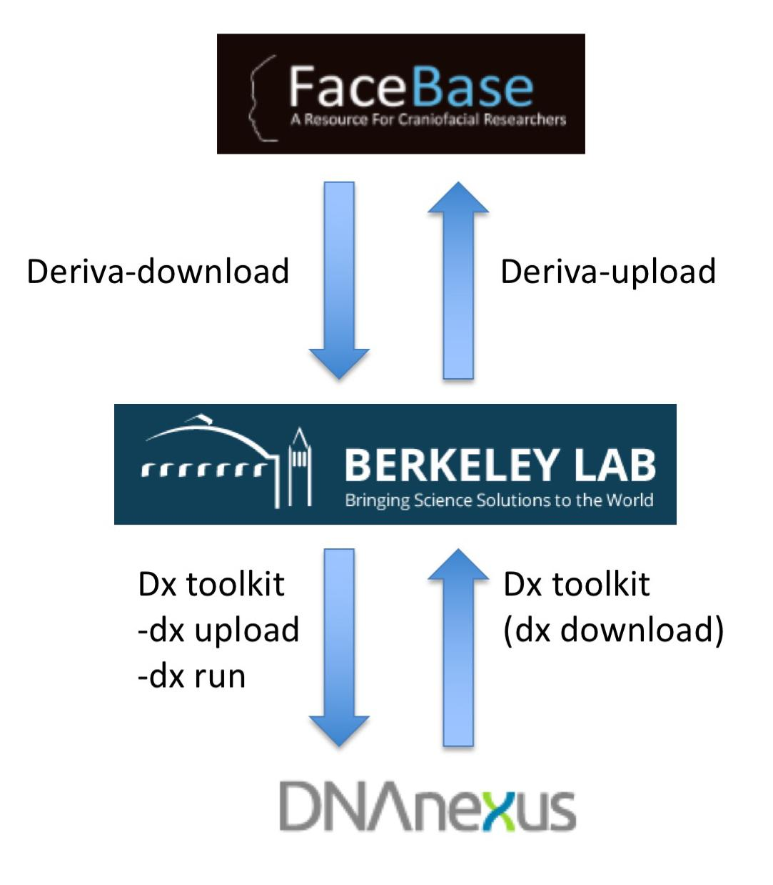
Developing the new Bioinformatics Pipeline
Rationale - ensure that sequencing data between spokes can be compared.
Solution - establish a common sequencing pipeline, (based on ENCODE) and operate on a cloud-based genome informatics service (DNAnexus).
Process - Visel’s lab in Berkeley administers the routing of sequencing data from FaceBase to DNAnexus and back.
To date - Preliminary testing is successful. Finalizing appropriate measures for safeguarding human data.
Roll out is expected in 3Q 2018.

Slide 14
Data Browser Enhancements

Slide 15
New features in the Data Browser
Redesigned search and filtering interface
Image navigation integrated into 3D surface model viewers
JBrowse gene browser enhancements
Improved page layout for dataset details
Performance improvements

Slide 16
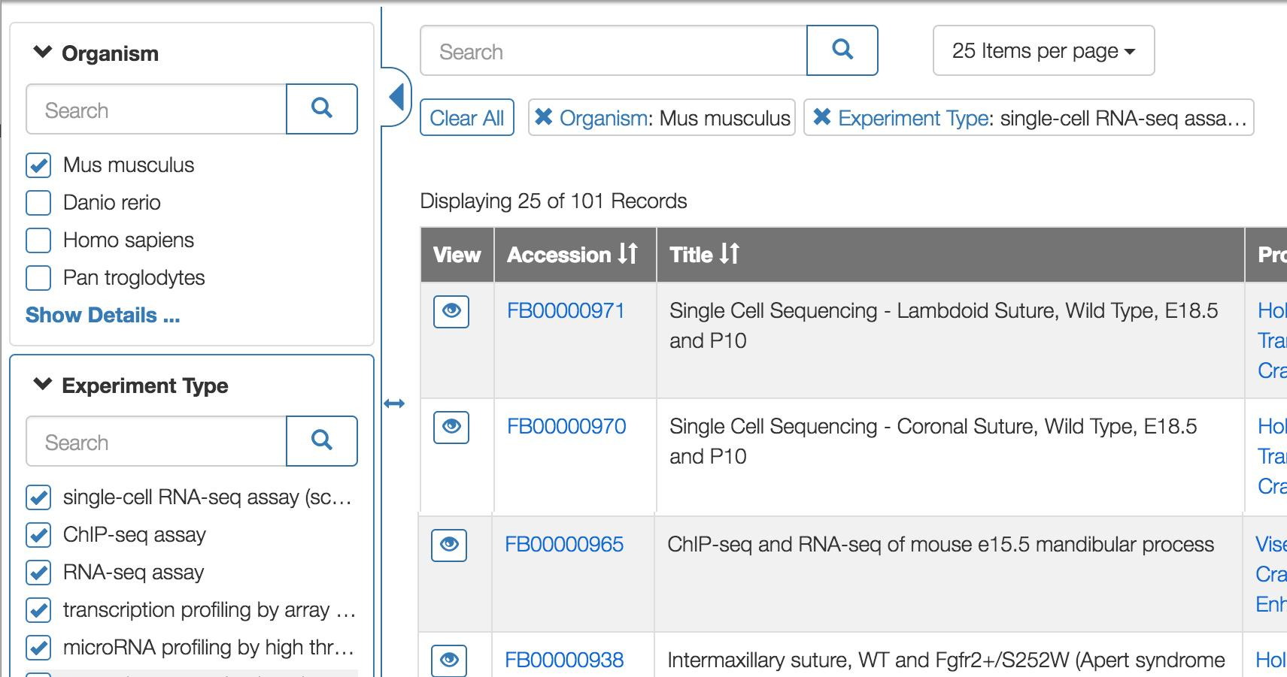
Redesigned search and filtering interface
Filter through the data via familiar-looking shopping-cart-like categories and lists that can be selected and de-selected to find the specific type of data you’re looking for.

Slide 17
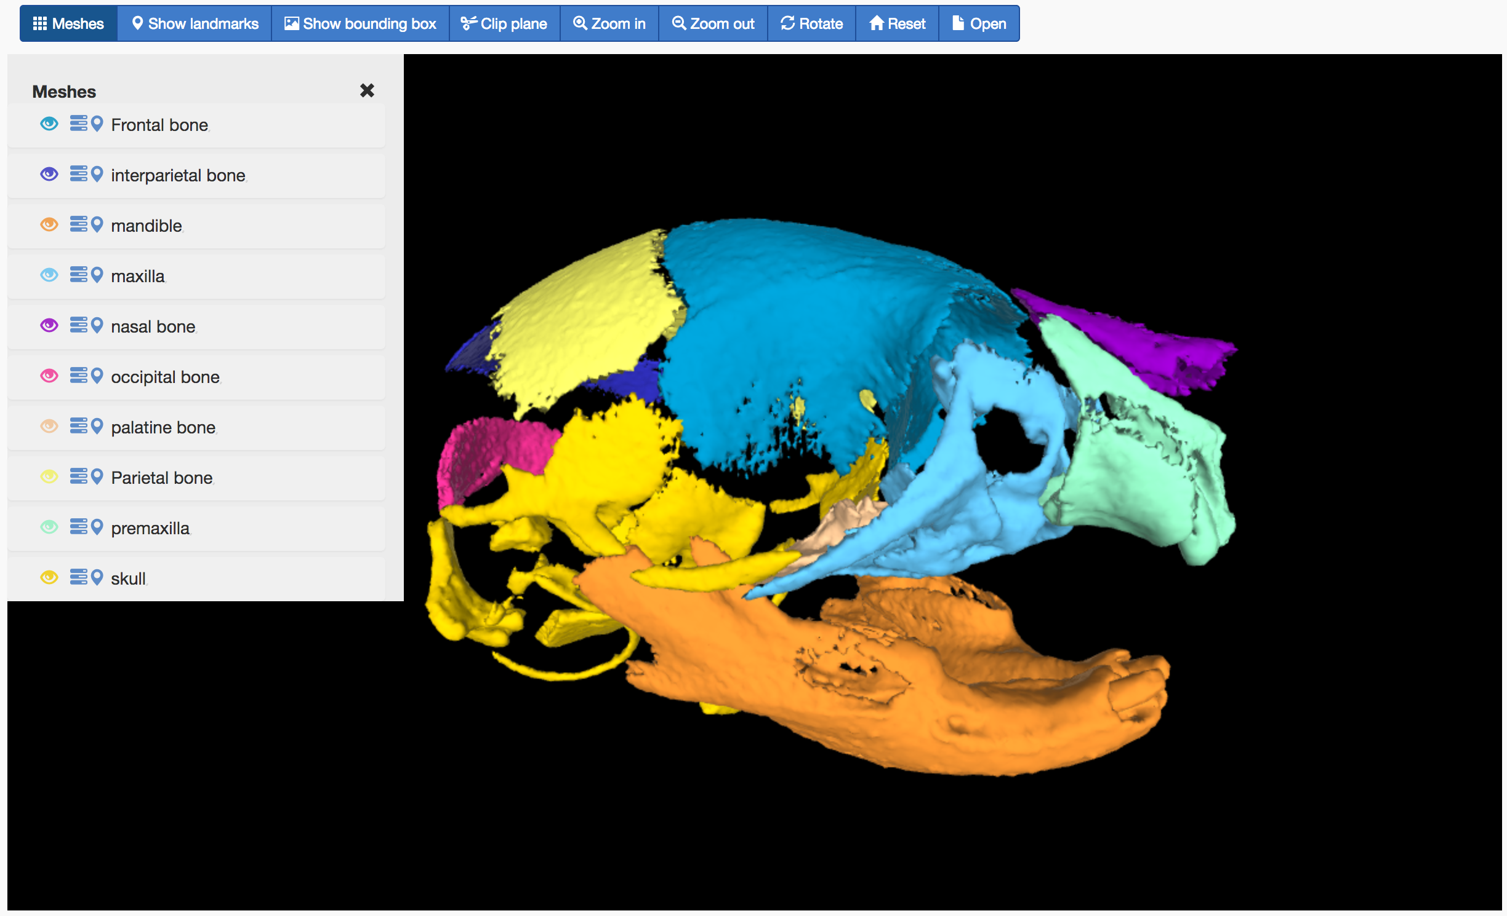
Image Navigation via surface model viewer
Building on the surface model viewer we introduced last year.
Connecting anatomical regions to the database.
Clicking an image of an anatomical region pulls up the list of all datasets with data related to that region.
Available on ALL facebase dataset pages
Notes:
DEMO IMAGE (shown): https://dev.facebase.org/~mei/mesh-viewer/view.html?model=https://dev.facebase.org/data/mesh/JI296CCMB/3model.json

Slide 18
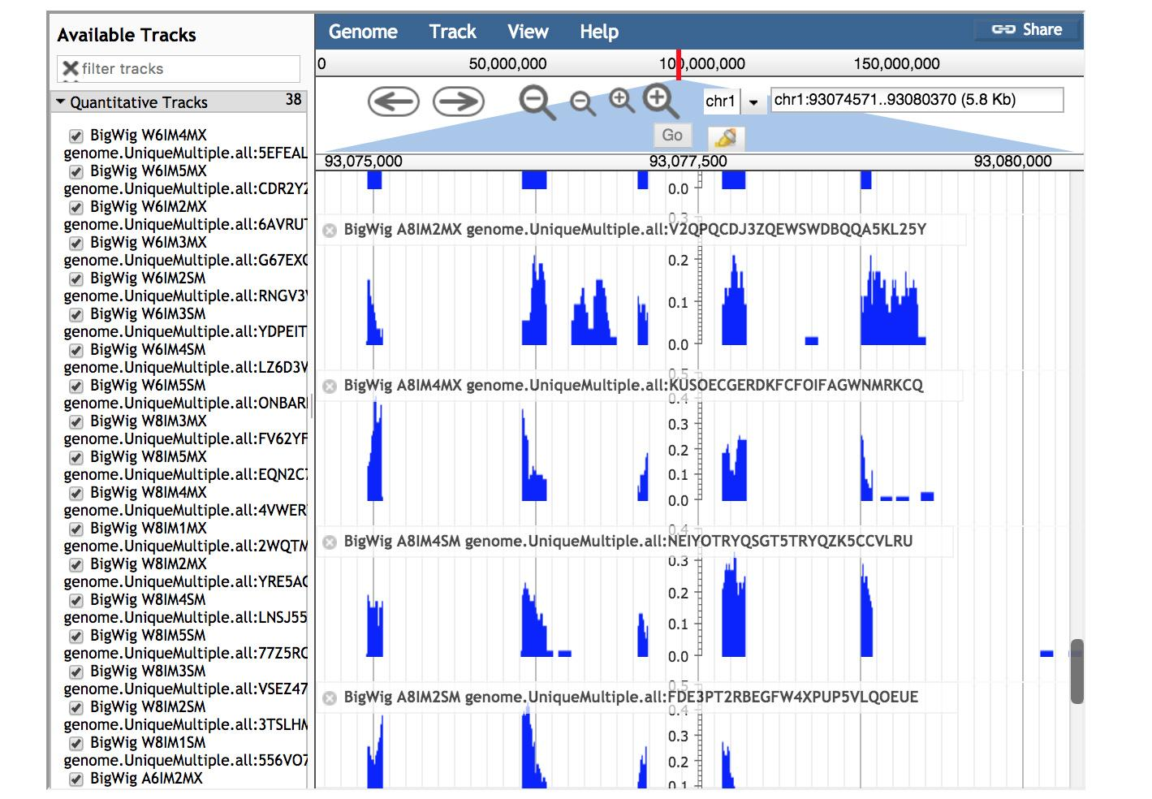
JBrowse dynamic plugin for FaceBase
The FaceBase integrated Genome Browser is now available for all relevant datasets and is updated dynamically
Updates to the data are immediately displayed.
Year 5: integrating even further with the database to create customized comparison views across datasets.
Notes:
Main thing here is we created a JBrowse FaceBase plugin. Rather than config files, instead all tracks are pulled dynamically from the database. So changes will be reflected immediately. We can continue to enhance the viewer with information in the database, as well so create customized comparison views across data in FaceBase.

Slide 19
Data Submission

Slide 20
Self-serve Data Curation Tools
Rolled out over last summer
  Added “constraints” to ensure data integrity; automatic accession numbering of datasets
Online data entry forms and file upload fields
  Improved filtering of related data to streamline data entry
Desktop tools to upload bulk data files from Windows and Mac
  Automatically link data files into dataset details; auto-linking of thumbnails, meshes, etc.
Command line client for remote servers
User training
  Individual tutorials with spokes
  Curation wiki: https://github.com/informatics-isi-edu/facebase-curation/wiki
Self-curated datasets are rolling out: 66 datasets to date
Self-serve curation is key to scaling FaceBase to support new data submitters

Slide 21
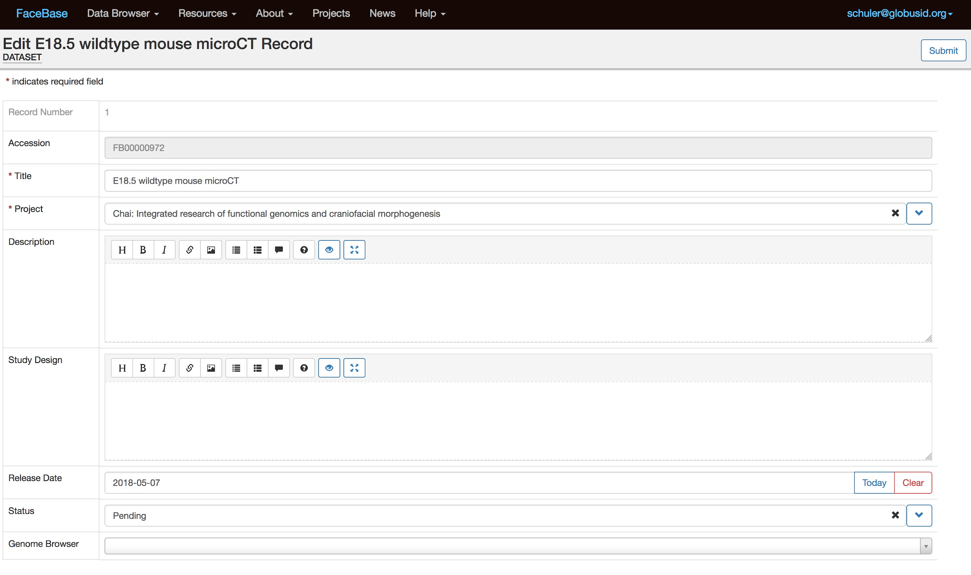
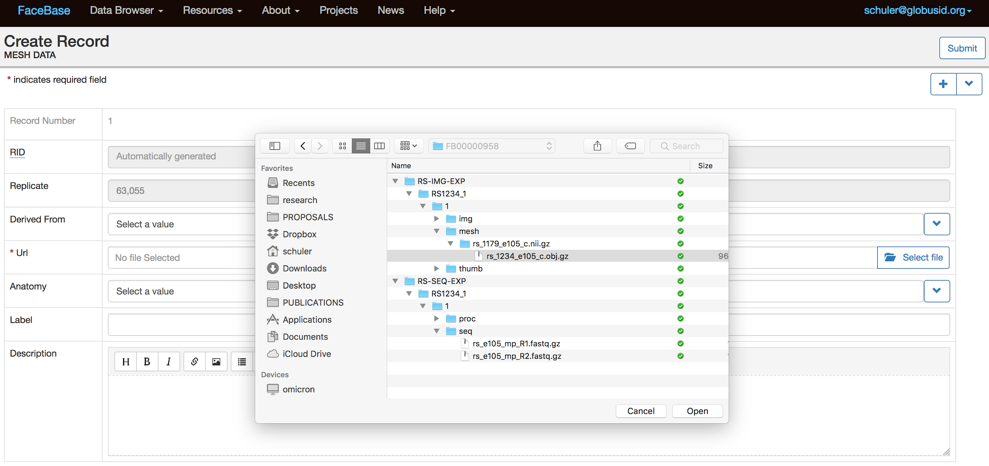
Online Data Curation Forms & File Upload
Online Metadata Entry Forms
Add, edit and delete any metadata entries at any time yourself: datasets, experiments, biosamples, replicates, etc.
Online File Upload Forms
All (approved) data types supported
3D models w/ config. (color, opacity, etc.)
Tracks (instantly available in browser)
Processed data, Raw seq files, etc.

Slide 22
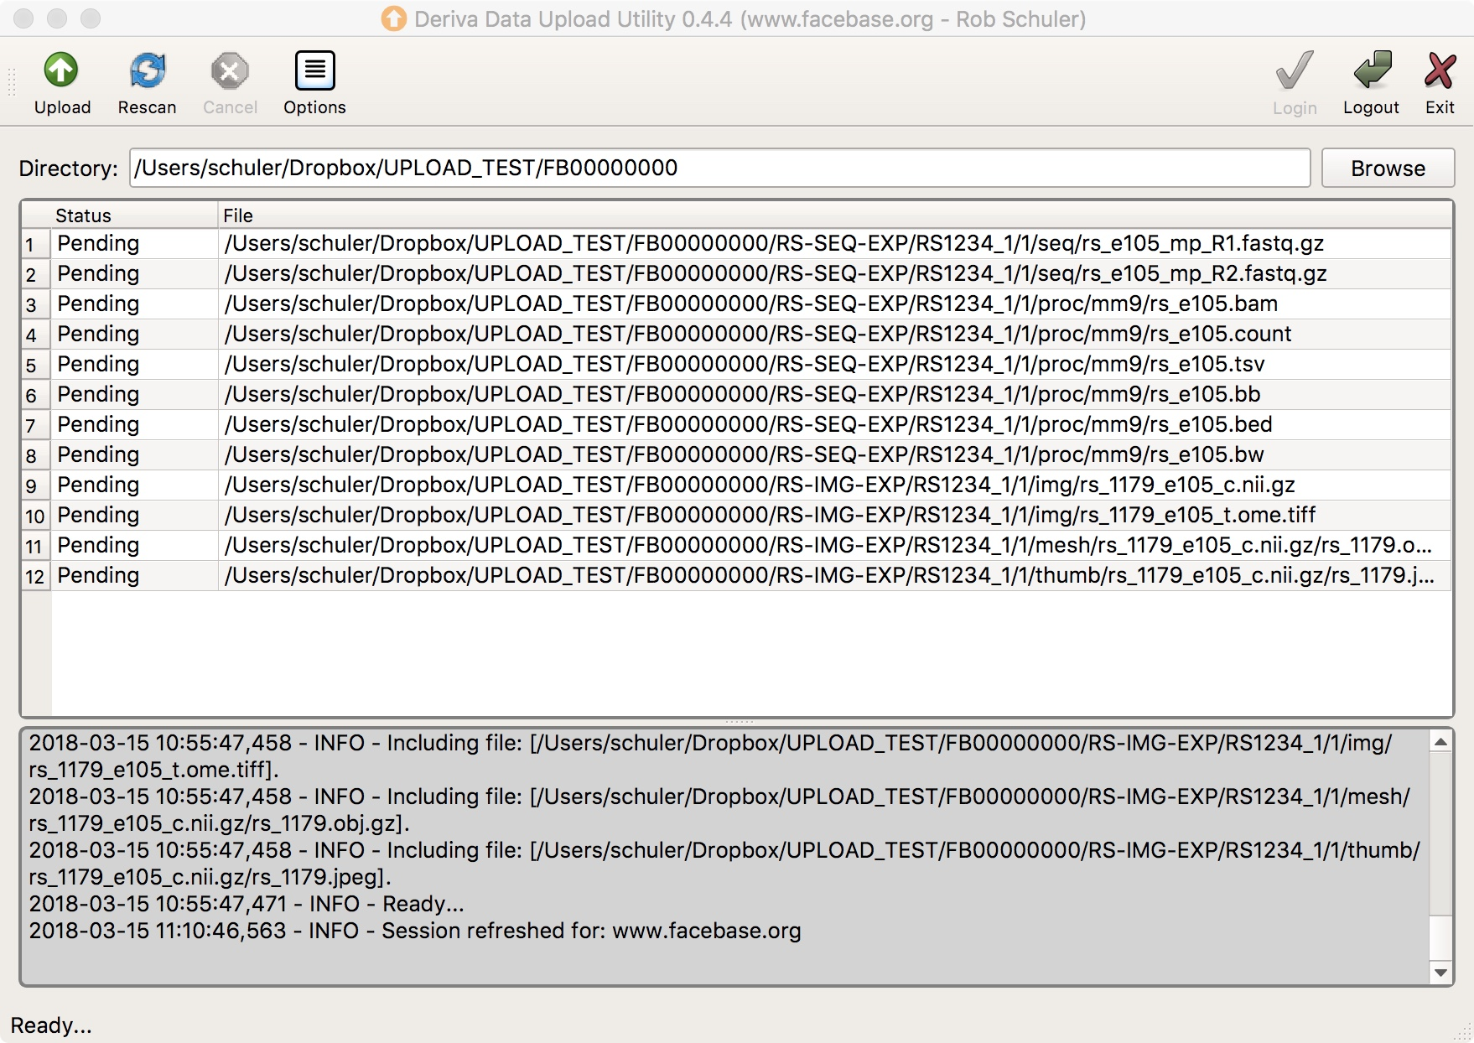
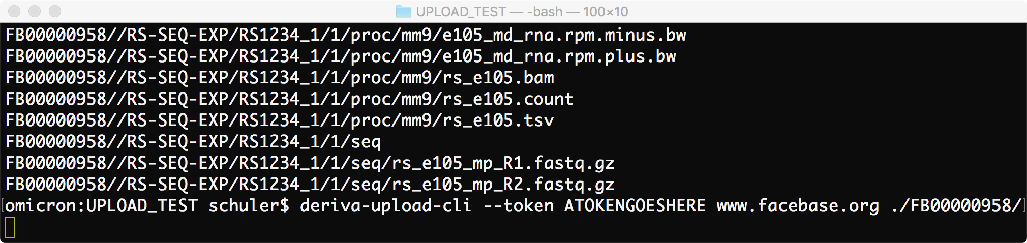
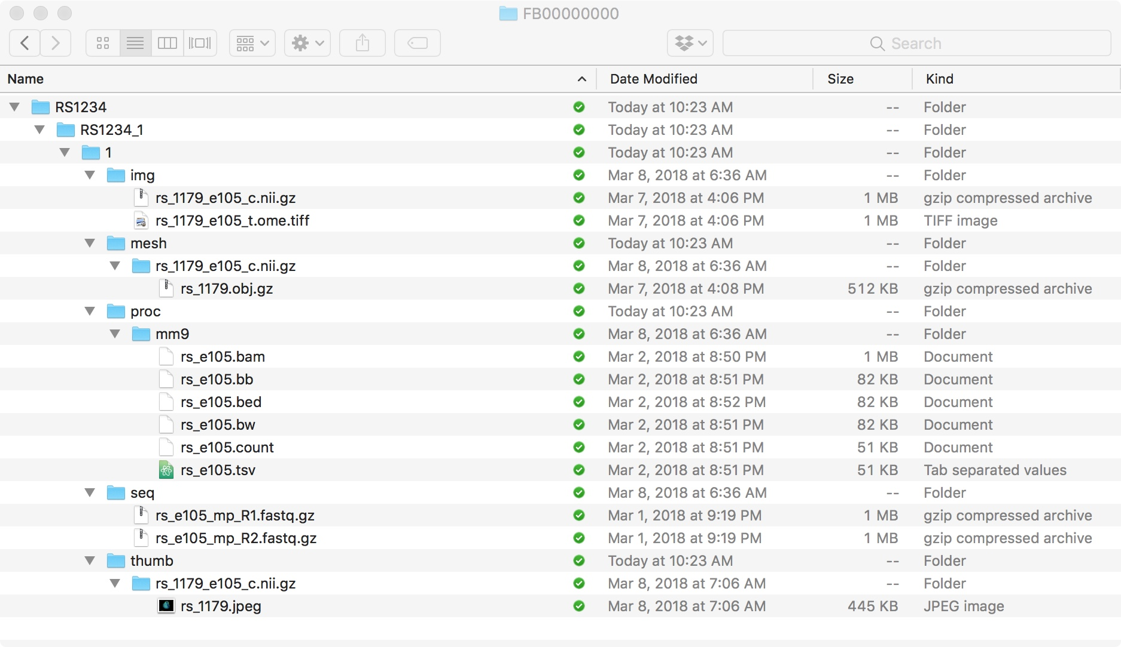
Desktop & Command-Line Data Upload Tools
Desktop Client
Graphical client for Windows & Mac users
Command-line Client
CLI for uploading directly from a computer cluster or other remote server
Common data file layout supported by desktop and command-line tools

Slide 23
Demonstration
www.facebase.org
Notes:
https://www.facebase.org/~schuler/anav.html
https://www.facebase.org/image-nav-demo.html

Slide 24
For Year 5...
Bioinformatics Pipeline: coordinate curation of data and operation of pipeline, full automation.
Vocabulary enhancements: integration with MONDO, other vocabs., improve semantic search
Anatomical/visual search/navigation
Image visualization and display: 3D mesh, imaging results across datasets, control vs mutant
Bulk download capability
Dashboards, email notifications and quality control metrics
JBrowse integration and enhancements: ie, cross-dataset browsing of genomic data
FAIR Identifiers and Resolver
Historical information tracking
Ongoing usability improvements (new in-depth external user interviews for usability)

Slide 25
Q & A
Let us know your questions, comments, feedback at:
help@facebase.org

