Slide 1

RNA dynamics in the developing mouse face
University of Colorado Anschutz Medical Campus
Joan Hooper, Kenneth Jones, Hong Li, Trevor Williams
FaceBase Annual Meeting
Los Angeles, CA
5/15/2018

Slide 2
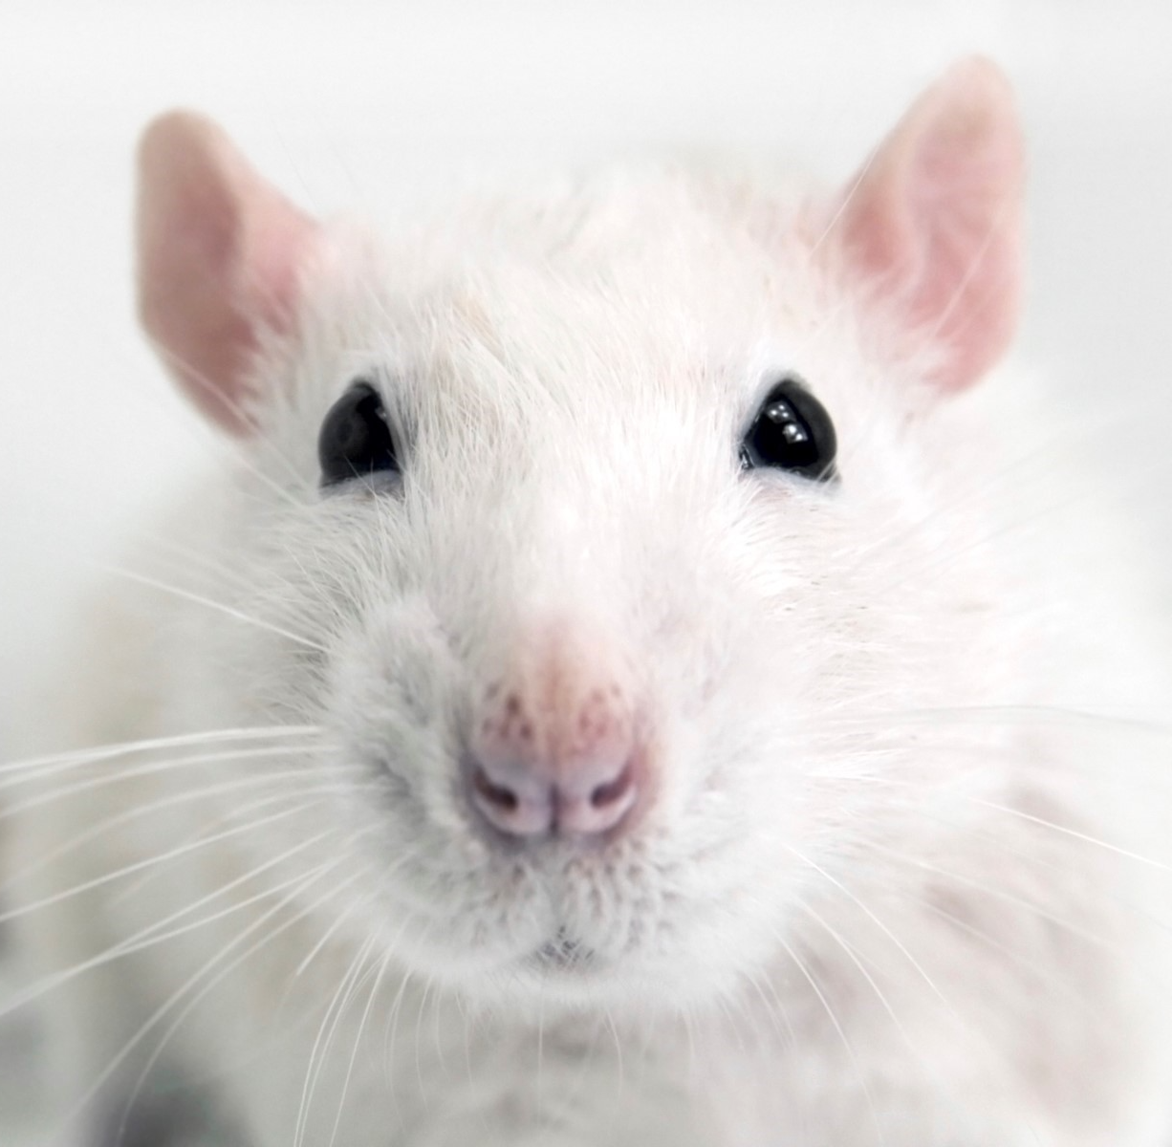
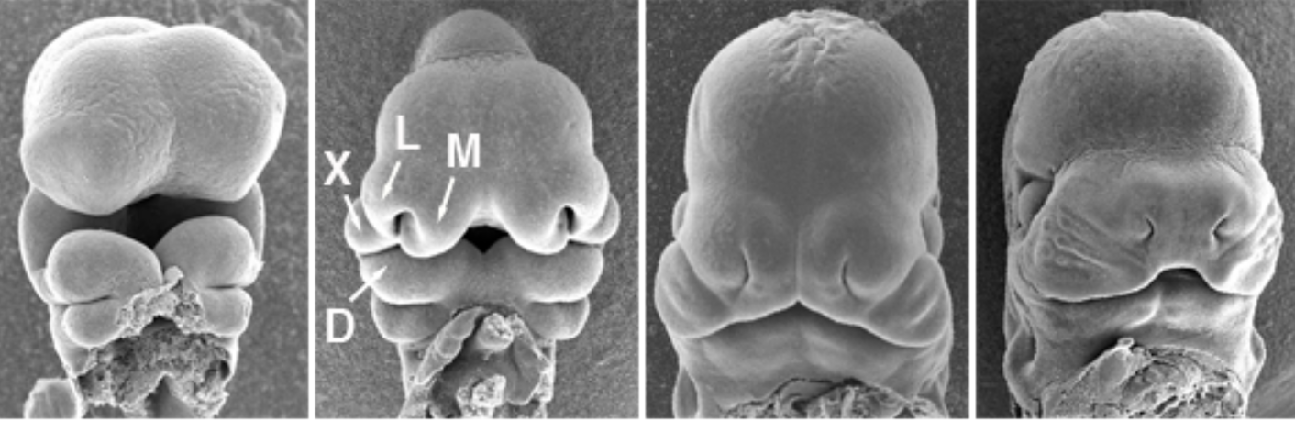

Describing the developmental programs
Aim 1: transcriptome
larger RNAs
smaller RNAs
Aim 2: isoform features
promoters (TSSs),
UTRs, splicing
Aim 3: translation
dynamics
mRNA stability
& localization
transcription regulatory networks
translation
regulatory networks
encoded
protein diversity
scRNAseq of λ junction
Notes:
Our project addresses the developmental programs that build the face in the mouse.
What are the genes and gene regulatory networks that shape the faical prominences and enable the various tissues to give rise to different derivatives
What isoform features distinguish the various tissues and prominences over time?
How might they affect mRNA localization, translation dynamics, encoded proteins, etc?
How does translation dynamics decode the latent infromation in the transcriptome?
Many of the small RNAs in Aim 1 (including RNA BPs, small RNAs, as well as ribosomal diversity, tRNAs, RNA modifications) integrate with the isoform features in aim2 to affect protein abundance.
The outcome- facial development- clearly integrates all these features and our project is to delinieate their respective contributions
In the last year, we have also added a higher resolution transcriptome study of the fusing upper lip/primary palate

Slide 3

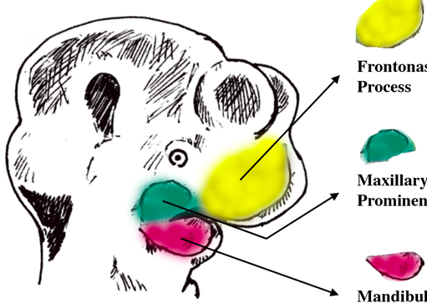
APPROACH
E10.5
Ect + Mes
FnP
E11.5
MxP
dispase
E12.5
MnP
RNA
or
ribosome-associated mRNAs
RNAseq
small RNA profiling
translation rates
Notes:
Helen!!!
everythng in triplicates

Slide 4
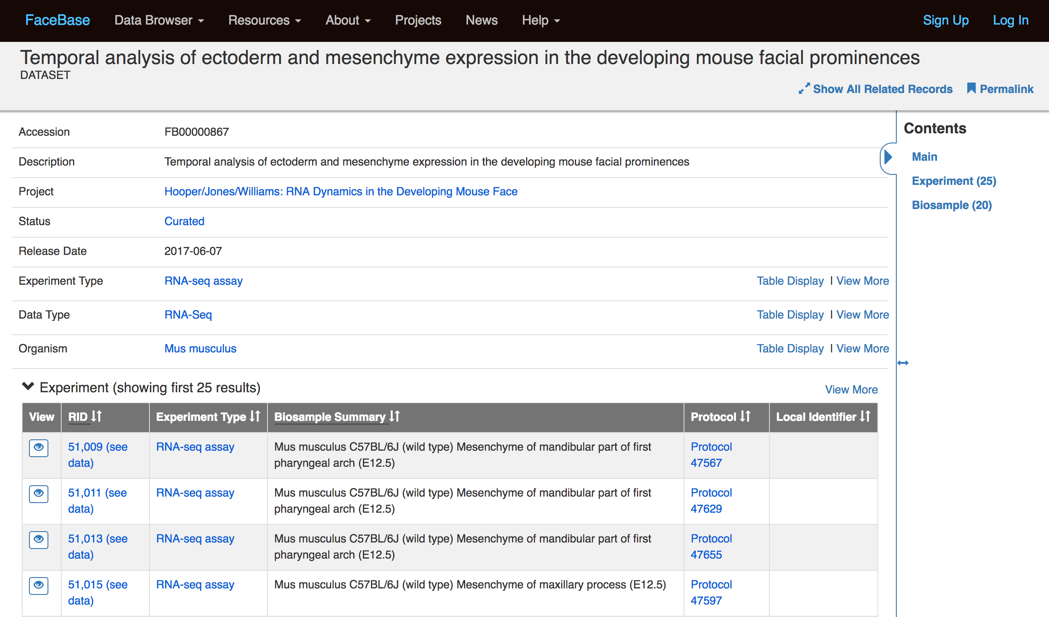
Aim 1a: Transcriptome data at Facebase
Complete
Notes:
Transcriptome data from pA primed RNAs for 20 conditions- in triplicate- weve talked about this before in detail- is now available at the Hub

Slide 5
Aim 1b. mouse face small RNA profiling
RNA type | # loci | detected* | DiffExp** | FC >=2 | # unique seq
miRNA | 1915 | 985 | 597 | 481 | 481
miRNA hairpin | 1277 | 337 | 172 | 43 | 43
sno & scaRNA | 1470 | 307 | 158 | 30 | 19
snRNA | 1385 | 942 | 483 | 86 | 29
tRNA | 504 | 355 | 224 | 171 | 36
rRNA | 422 | 305 | 194 | 0
total | 6973 | 3231 | 1828 | 811 | 608
mouse small RNA microarray:
Complete
Validation of selected snoRNAs, snRNAs and miRNAs by qPCR and in situ hybridization.
Upload expression data and supporting custom microarray data to the Hub.
in progress
Notes:
The small RNAs profiling, including miRNAs, sno and sca RNAs, and various other RNAs associated with translation wh have also talked about in previous years- is also complete
Its valadition is nearing completion and the final data will soon be available at the hub.
p <= 0.05 for DABG in at least 3 samples
** fdr <= 0.05

Slide 6
Aim 2: Isoforms, a major mode of regulation
FC > 2,
p.adj < 0.01
FDR < 0.05 ,
△PSI > 10%
Comparison:
E11.5 MxP Ectoderm vs. Mesenchyme
Alternative splicing is a major mode of gene regulation.
Notes:
Our 2nd aim is looking at the isoforms.
This is a mode of regulation that acts in parallel with differential expression, o different sets of genes.
Here is an example from E21.p Maxillary process, comparing Ect and Mes, where we find almost 2000 DE genes, almost 800 with isoform differences and little overlap between the two gene sets.
PSI : percentage spliced in.

Slide 7
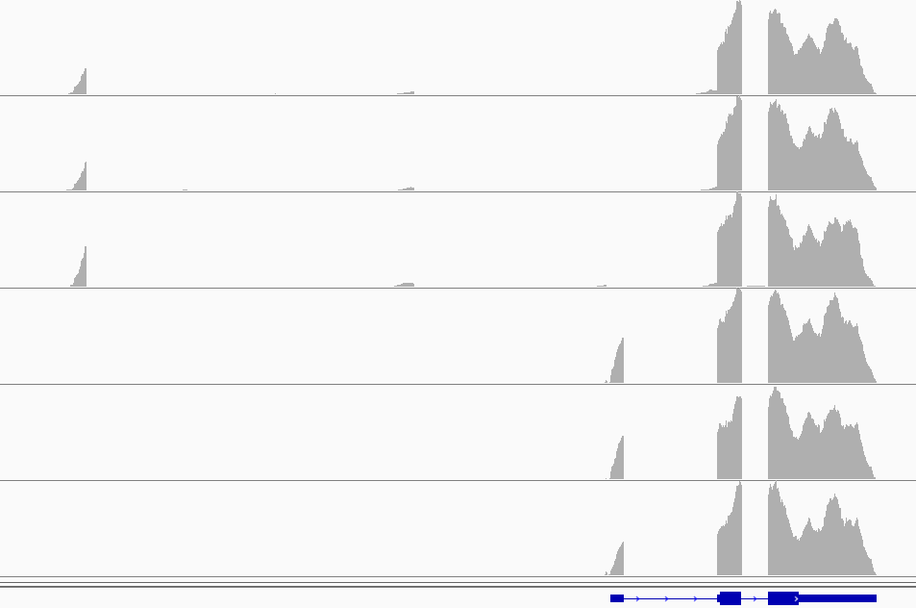
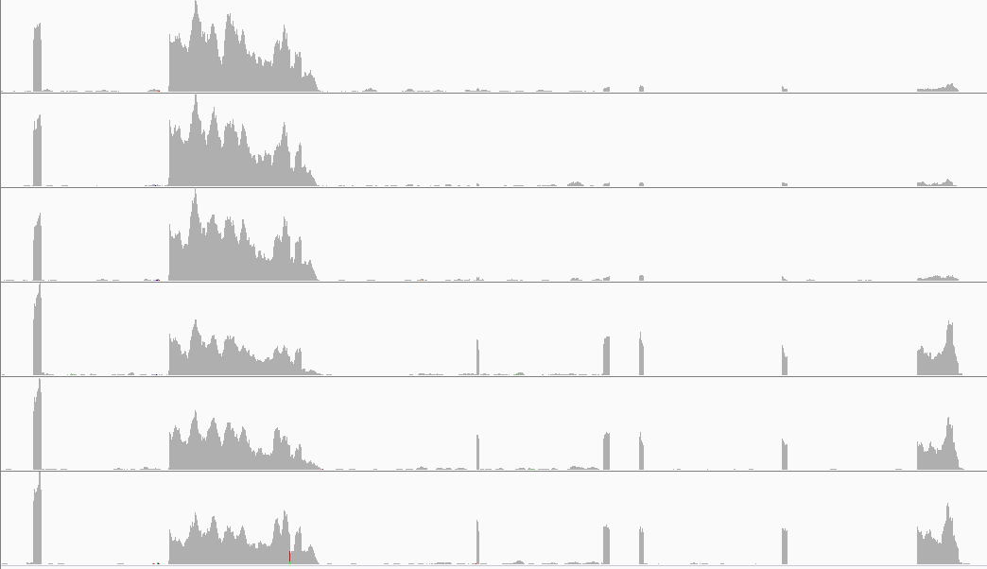
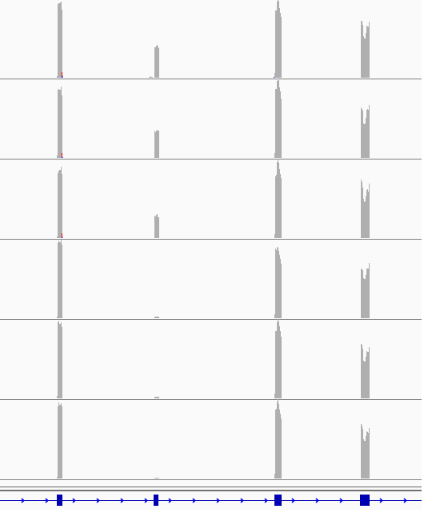
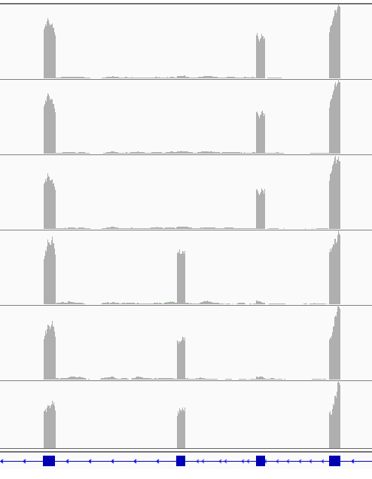
Differential splicing, first and last exons
Differential
promoter
usage
S100a16
Differential
3’ end
usage
Lrrfip1
Ecto
…...........
Mes
Ecto
Differential
splicing
…............
Mes
Lef1
Fgfr2
Notes:
Various flavors of isoform differences and what they actually look like in the data?
We have differential promoter usage, different 3’ ends- both exons and polyadenylation sites within last exons, and alternative splicing within the genes that affet the encoded protein products.

Slide 8
Exon skipping during facial development
retained in:
Mes
E10.5
E12.5
Ect
Esrp
Ect
Mes
10.5 | 11.5 | 12.5 | 10.5 | 11.5 | 12.5
FDR < 0.05 and △PSI > 10% across all comparisons
Notes:
Exon skipping is a major form of alternative splicing and here we have pulled together all the exon skipping events to show how skipping shows similar profiles to differential expression, with differencesa strong program of between tissues and also a strong program af changes with age.
I wanted to remind ou that this has important consequences as the Esrp splicing factors (skipped exons in ectoderm derivitives) are required for proper facial morphogenesia nd without them we see cleft lip.

Slide 9
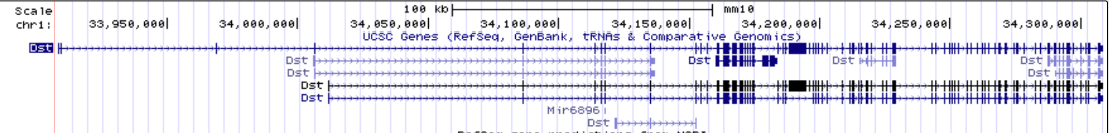
validation of an ectoderm-specific last exon
ectoderm-specific exon
shared exons
Notes:
The isoform analysis is finished and we are in the validation phase- here illustrated with
different spliced isoforms of Dst, Dystonin. The “total probe” detects isoforms expressed in the ectoderm (including tooth buds), as well as the mesenchyme of the tongue and upper face. The ectodermal isoform probe again detects the ectoderm and its derivatives (including the nasal epithelia) in the upper face, but not for example the tongue mesenchyme.

Slide 10
Aim 2 bonus: Improved gene models
ENSEMBL
gene models
FANTOM5
TSSs
Gruber
pA sites
spliced
ESTs
diff exon
usage
estimates
promoter,
splicing &
UTR dynamics
face
RNASeq
data
Improved
gene models
diff splice
estimates
Notes:
A bonus of this analysis has been improved gene models.
We found many isoform differneces that wer not in the current Ensembl gene models but were supported by other datssets.
We incorporated all of these into improved gene models for isoforms in the face. We’ll be working with the hub on how to best make these available.

Slide 11
Aim 2: Differential splicing & UTRs
Improved gene models for isoforms used in the face, including 5’ ends, 3’ ends and alternative splicing.
Isoform usage by tissue, age and prominence.
Genome-wide validation of E12.5 isoform usage via transcriptome microarray.
Validation of selected tissue specific isoforms (novel first exons, novel last exons, novel retained introns) by pRT-PCR.
Validation of selected tissue specific isoforms via in situ hybridization.
Complete
Complete
Complete
Complete
in progress

Slide 12
Describing the developmental programs
Aim 1: transcriptome
larger RNAs
smaller RNAs
Aim 2: isoform features
promoters (TSSs),
UTRs, splicing
Aim 3: translation
dynamics
2018
mRNA stability
& localization
transcription regulatory networks
translation
regulatory networks
encoded
protein diversity
scRNAseq of λ junction
Notes:
A major motivator for Aim 1 was to have gene expression info to build transription regulatory networks.
But that also requires info about promotor usage (TSS usage)
A major motivator for the small RNA profiling was to have miRNA/mRNA regulatory networks- which requires info about 3’ UTR usage.
How big a deal is this? Ballpark ~half of mammalian genes have annotated alternative promoters. Ballpark ~ half of alternative transcription starts are unannotated.
Ballpark- similar diversity and lack of annotation at 3’ ends.
It also matters because
less than half of protein abundance is predicted by abundance of its encoding mRNA, and most of that disconnect is due to differneces in translation rates
UTRs have HUGE impact on miRNA regulatory repretoirs, translation rates, etc.
There is definitely potential for predicting protien abundances based on the LEVEL of the transript AND the flavor of its UTRs.

Slide 13
Lip fusion involves dynamic LOCAL cell interactions
Song (2009)
E10.5
E10.5 E11
E10.75
E11.5
Bmp4
Aldh1a3 Fgf8
TOPgal
Song (2009)
Irf6: Knight (2006)
Dupé (2003)
Notes:
LIP fusion requirestwo things-
appropriate growth and morphogenesis that brings the facial processes in to apposition, THEN
epithelial interactions that merge apposing epithelia and then clear them from the fusion zone

Slide 14
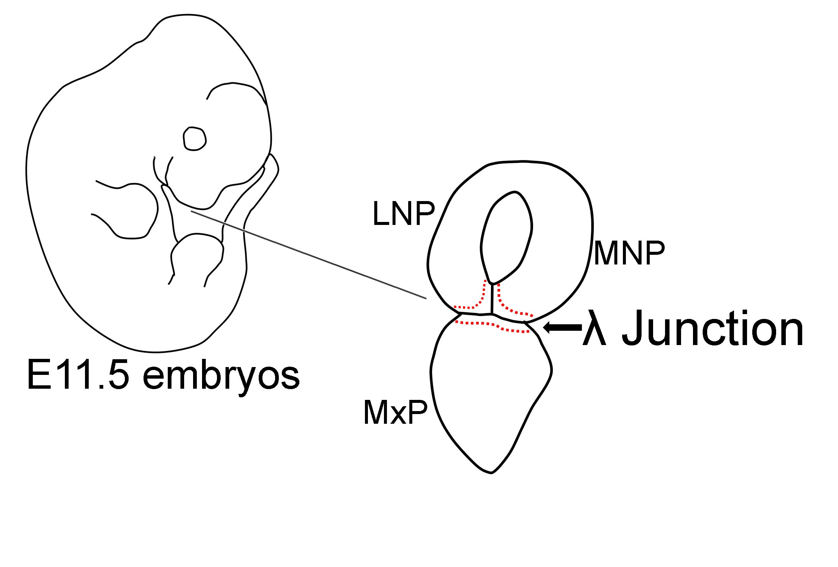
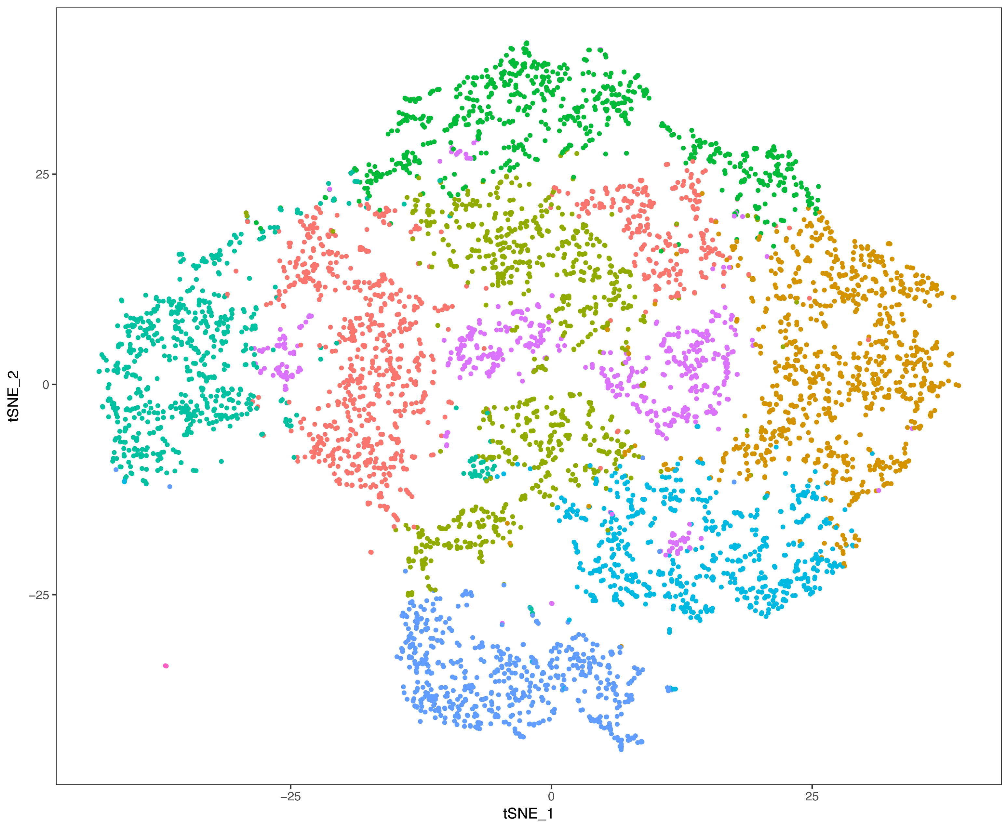
Single cell RNA-seq of λ junction
5536 mesenchymal cells
Vasculature/blood
7966 λ junction cells in 6 clusters
943 ectodermal cells

Slide 15
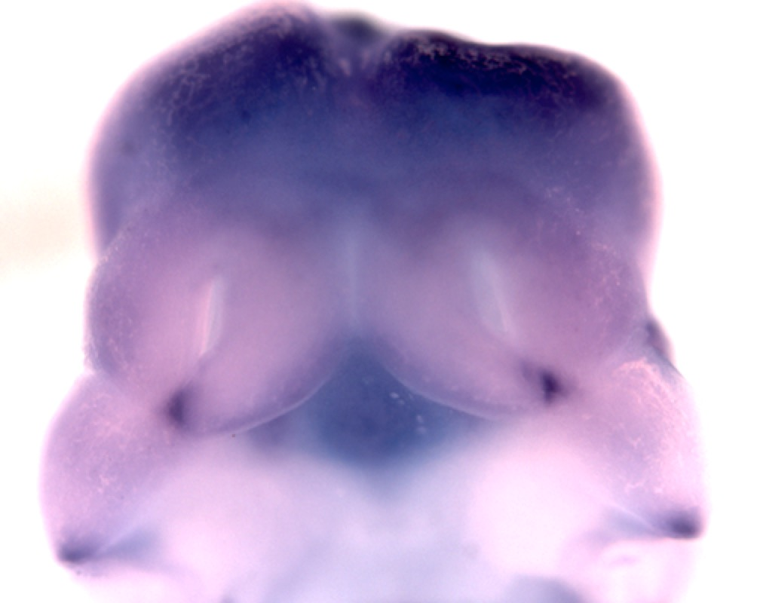
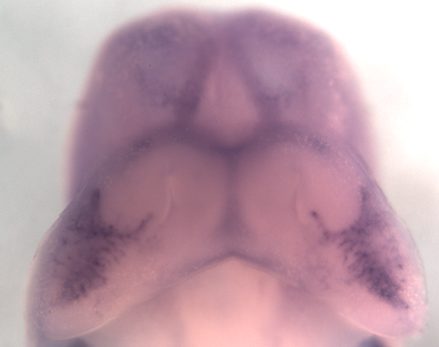
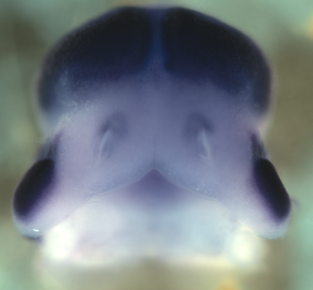
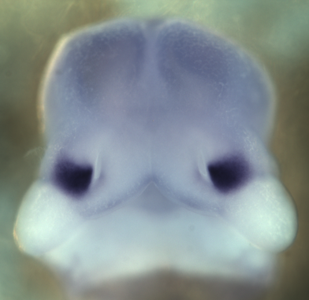
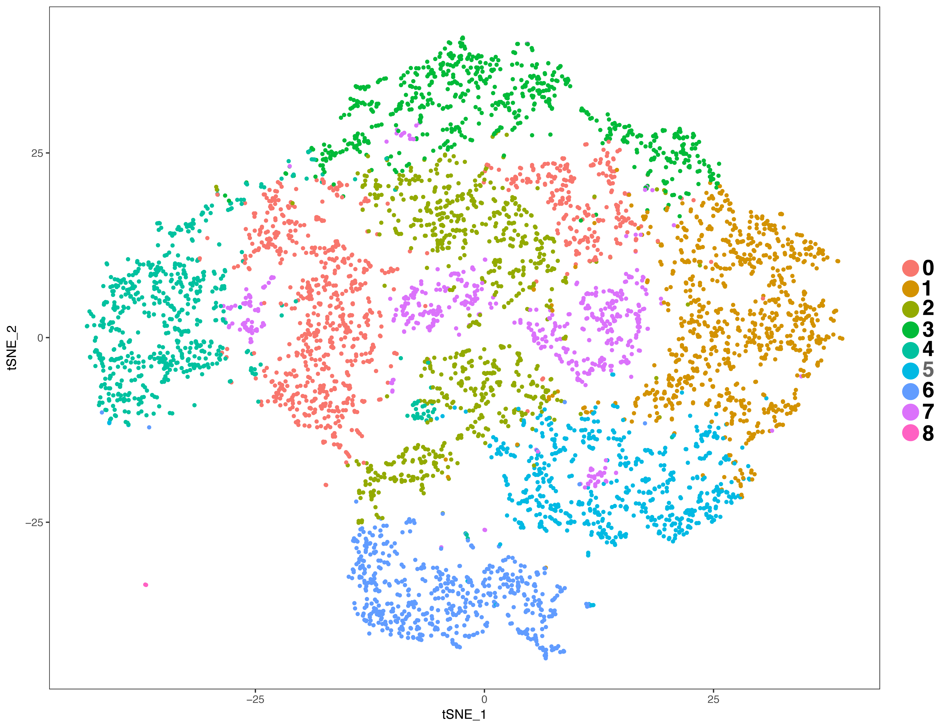
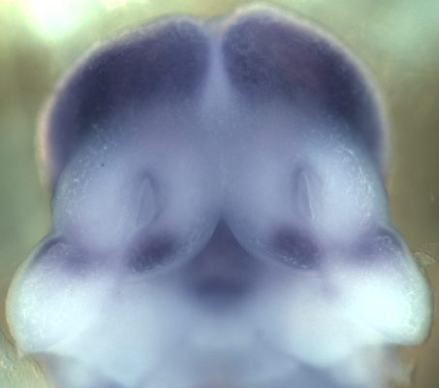
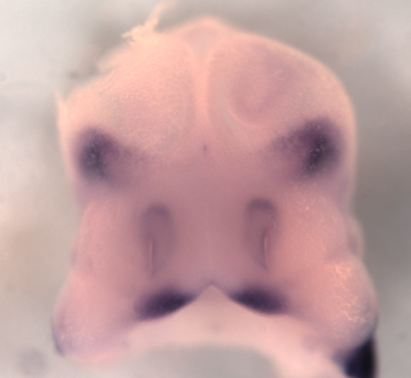
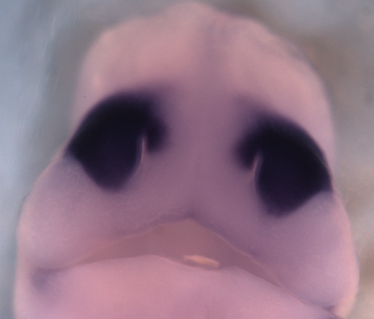

Mesenchymal Clusters and Representative Expression Patterns
Aldh1a2 (Clstr 2)
Sox10 (Clstr 8)
Emx2 (Clstr 3)
Rnf128 (Clstr 0)
Cxxc4 (Clstr 2)
Dlx6 (Clstr 1)
Pax7 (Clstr 0, 4)
Shox2 (Clstr 5)

Slide 16
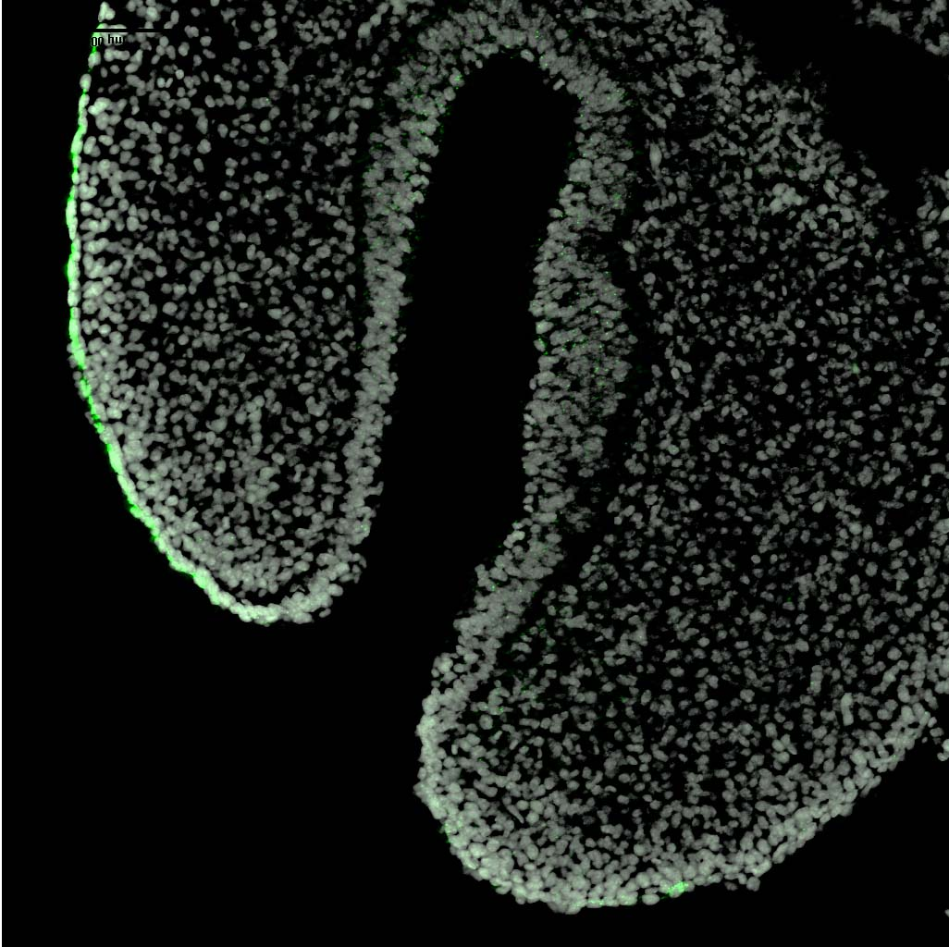
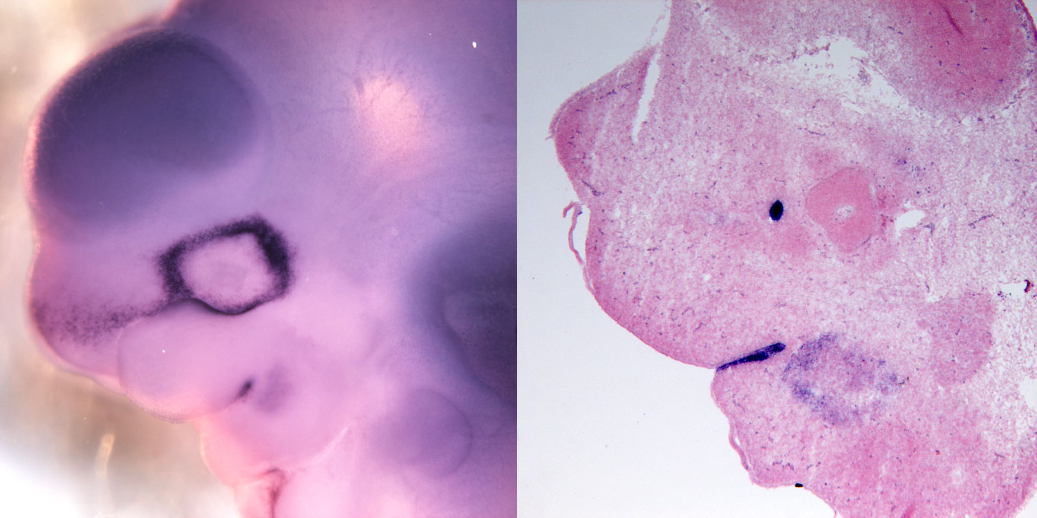
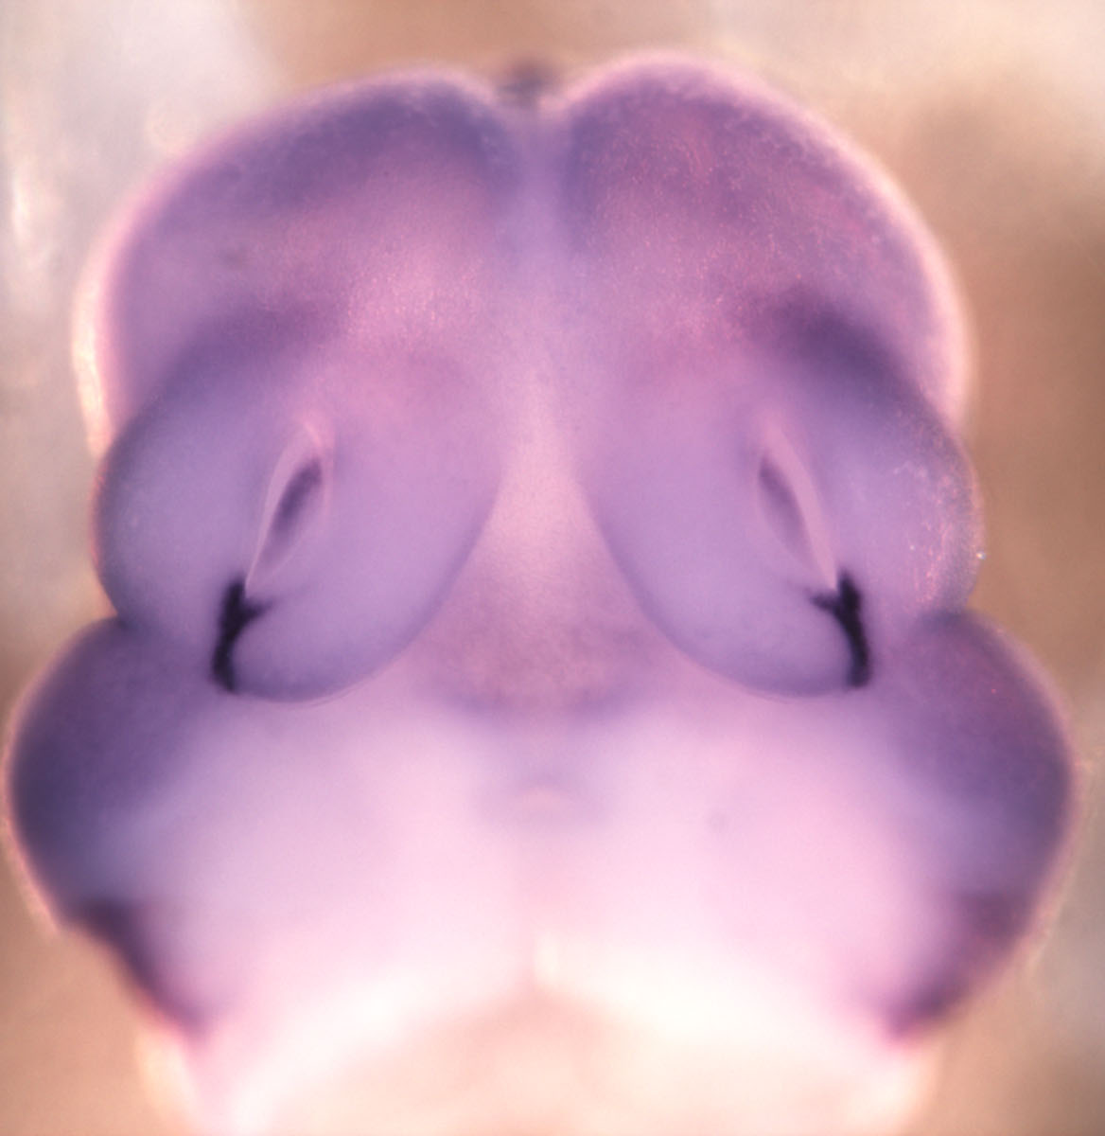
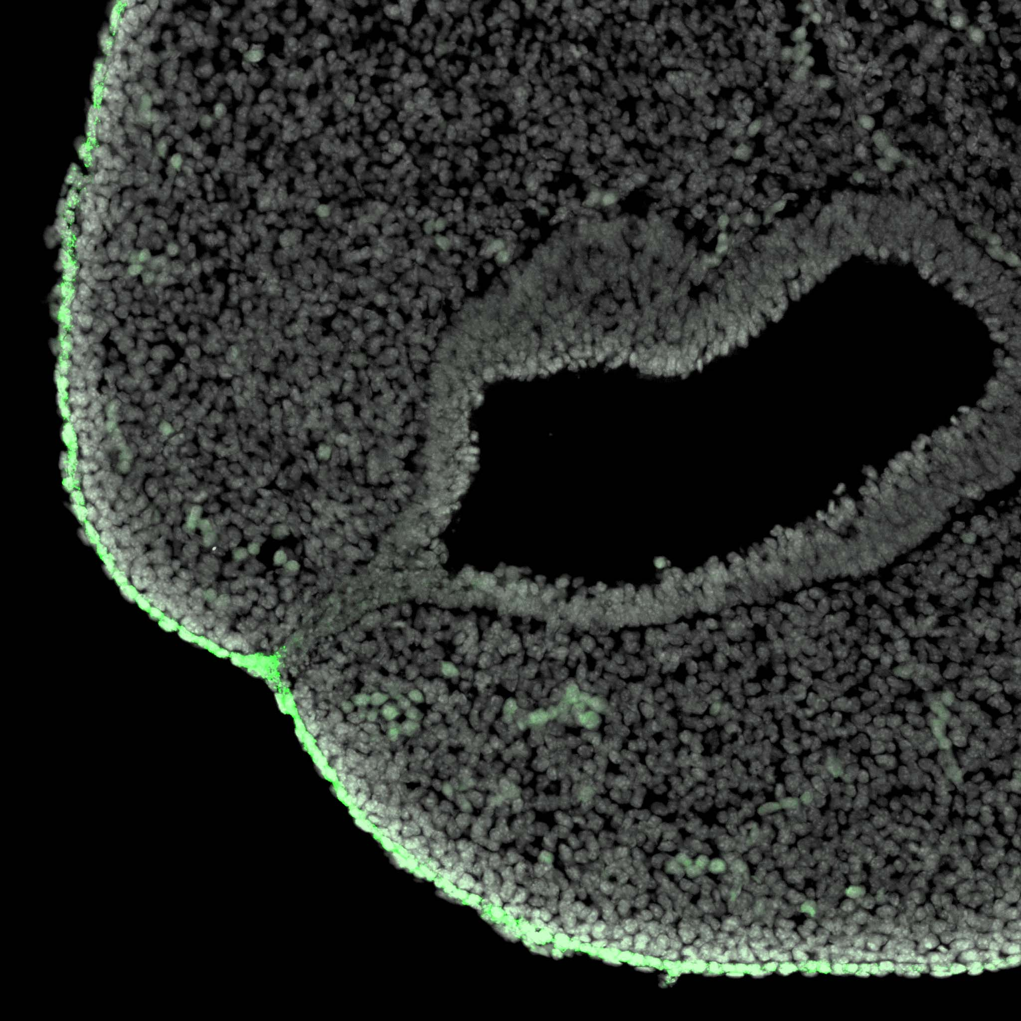
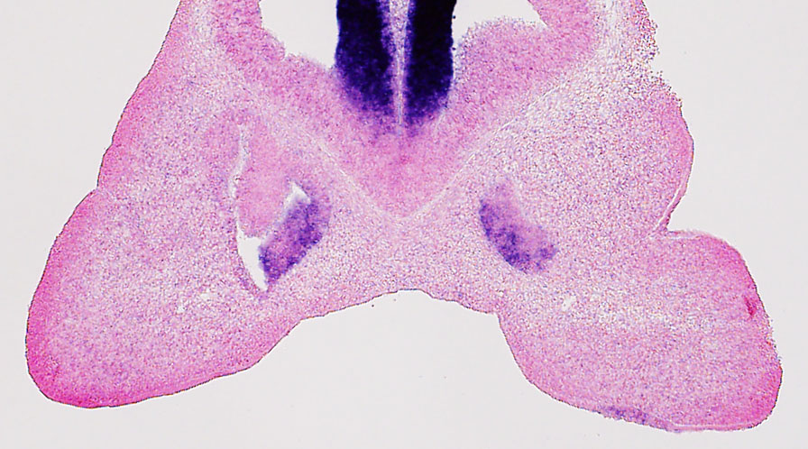
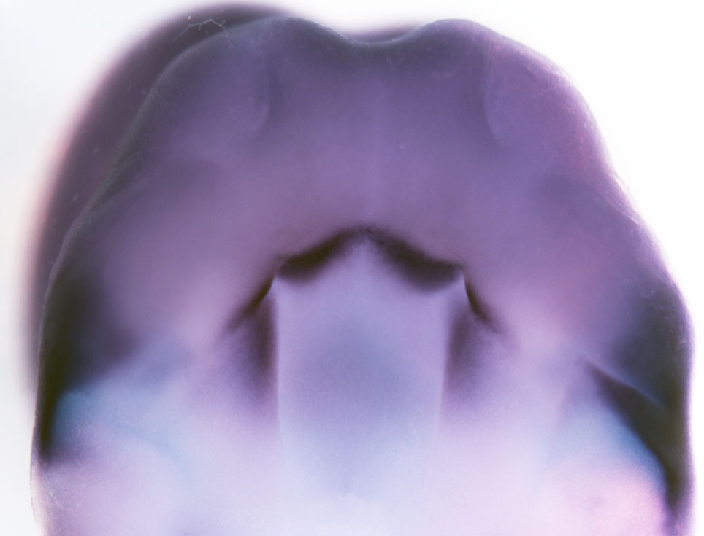
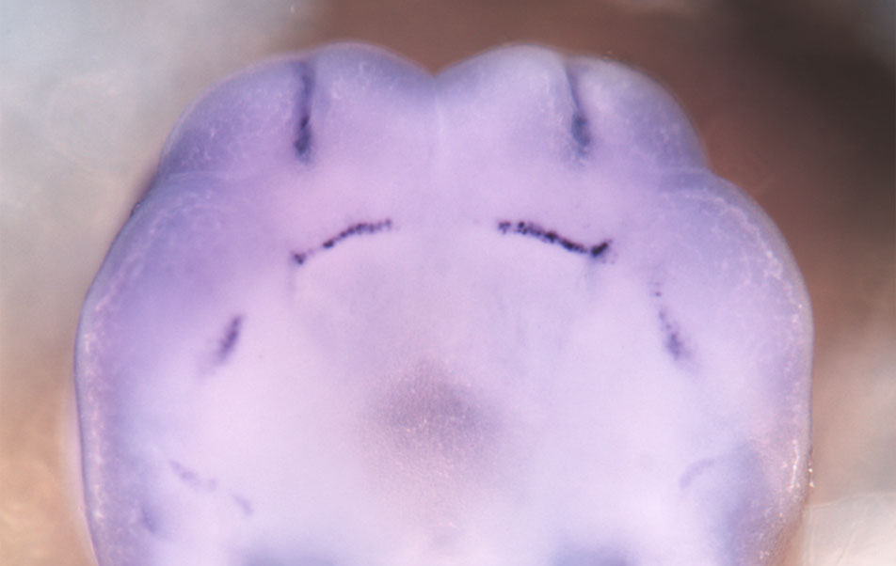
Ectodermal Clusters and Representative Expression Patterns
Gabrp
Barx2
Adamts9
periderm
fusion zones
Wnt9b
surface
ectoderm
Fgf17
nasal placode
Dkk4
dental lamina
Barx1
palate

Slide 17
Adamts9: a cleft lip gene!

Slide 18
Genes associated with Cleft Lip are enriched in λ junction cell clusters

Slide 19
Periderm at the seam is ‘special’ and initiates fusion
Normal Polarized
Periderm
E10.75
E10.5
Non-polarized
Periderm
Actively Fusing
Periderm
(Gaare & Langman, 1977; Millicovsky & Johnston, 1981; Song, 2009)
Notes:
Polarized
To non-polarized
Filopodia
Cellular Lamellar Extensions
Extrusions
Fusion begins around E10.5 (~6 tail somites) in a triangle at the bottom of the deep narrow groove between MNP and LNP. ~20 epithelial cells (periderm) retract microvilli and extend filopodia, which meet across the gap and bring together the apposing epithelia. This propagates out from the center of the λ, ‘zipping up’ the merging epithelia (Millicovsky & Johnston, 1981; Gaare & langman 1977).

Slide 20
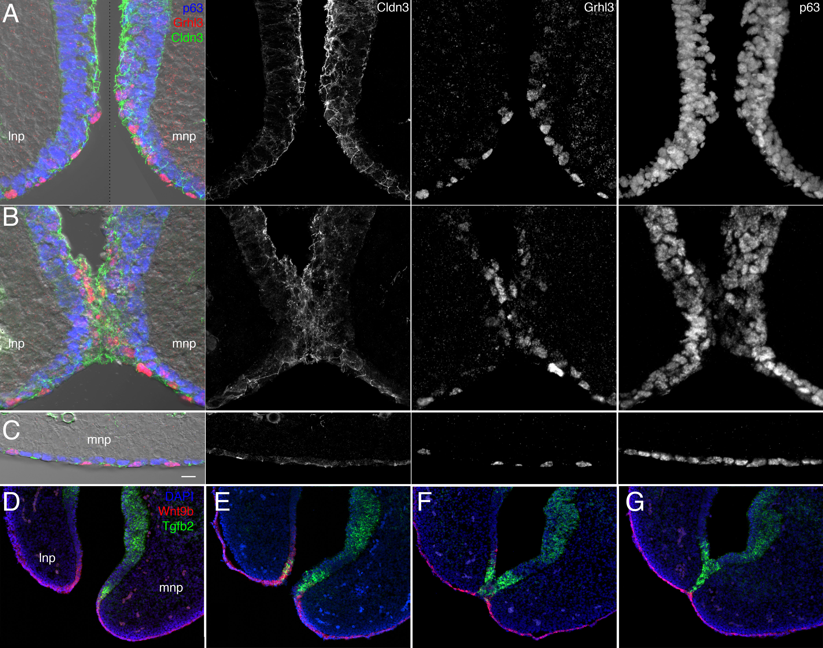
periderm initiates fusion

Slide 21
A special popluation of basal cells
at the fusion zone

Slide 22
A Model of 1º Palate Fusion
most epithelia
fusion zone
Tfap2a
Irf6
Grhl3
Tfap2a
Irf6
Grhl3
periderm
Jag2,
etc
Jag2,
etc
Tgfb2
Tfap2a
Trp63
Tfap2a
Irf6
Trp63
basal
Wnt9b,
etc
Tgfb2,
etc
mes
Bmp4,
etc
Lef1
Msx2
Notes:
Many have shown the Wnt signlangin g actiatino b catenin in the basal cells is essentail prereuisite for fusion.
We have two populations fo basal cell
Wnt signalng is improtatn from transion form inacctive basal cells to the fusion –permissibe basal cels
Periderm is identical cells that get flipped - junctions go, filopodia appear.
Notch signalin from inactive basal cells keeps associatd perider inactive
Active cells lack all those inactive fusion-refractory signals so that their associated periderm switches to the fusion competence
Periderm stable highly polarized to Wound healing motile
Retraction collective migration

Slide 23
Describing the developmental programs
Aim 1: transcriptome
larger RNAs
smaller RNAs
Aim 2: isoform features
promoters (TSSs),
UTRs, splicing
Aim 3: translation
dynamics
2018
mRNA stability
& localization
transcription regulatory networks
translation
regulatory networks
encoded
protein diversity
scRNAseq of λ junction
Notes:
A major motivator for Aim 1 was to have gene expression info to build transription regulatory networks.
But that also requires info about promotor usage (TSS usage)
A major motivator for the small RNA profiling was to have miRNA/mRNA regulatory networks- which requires info about 3’ UTR usage.
How big a deal is this? Ballpark ~half of mammalian genes have annotated alternative promoters. Ballpark ~ half of alternative transcription starts are unannotated.
Ballpark- similar diversity and lack of annotation at 3’ ends.
It also matters because
less than half of protein abundance is predicted by abundance of its encoding mRNA, and most of that disconnect is due to differneces in translation rates
UTRs have HUGE impact on miRNA regulatory repretoirs, translation rates, etc.
There is definitely potential for predicting protien abundances based on the LEVEL of the transript AND the flavor of its UTRs.

Slide 24
Year 5 milestones
Aim 1. Transcriptome
  Finish validation in situ hybridizations for small RNAs
  Upload small RNA data to Hub
  Upload λ junction scRNAseq data to Hub
Aim 2. Isoforms
  Finish validation in situ hybridizations for novel features
  Upload improved gene models to hub
  Upload RNAseq-based isoform data to Hub
  Upload supporting E12.5 MTA-based isoform data to Hub
Aim 3. Translation efficiency
  Ribosomal profiling of E12.5 ectoderm vs. mesenchyme

Slide 25
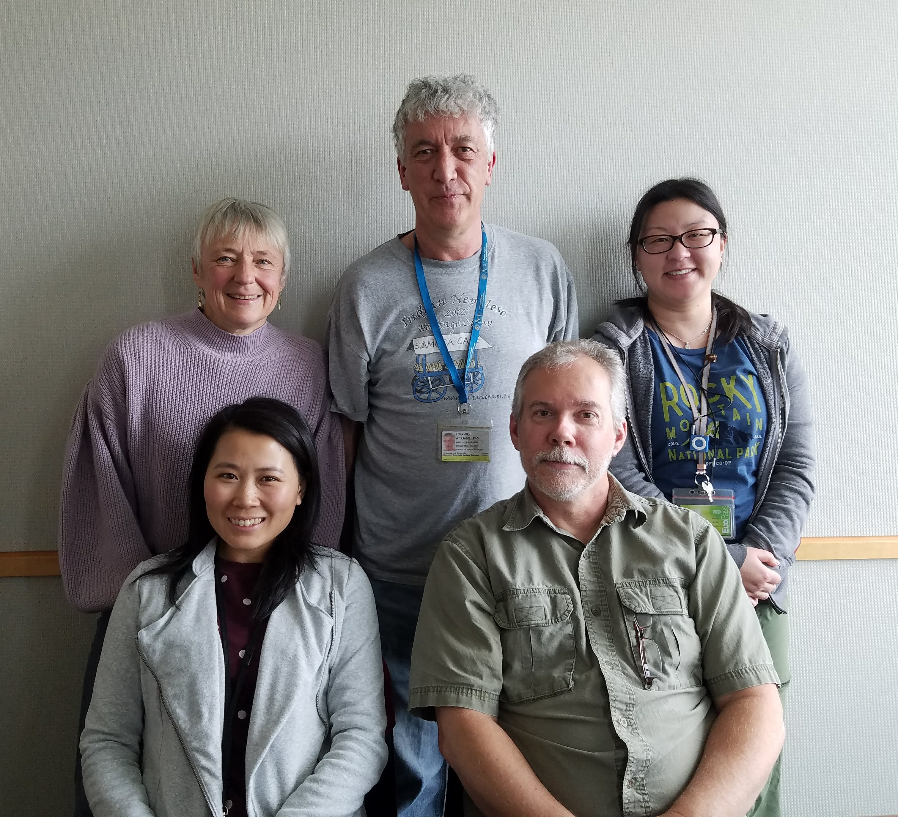




Eric Van Otterloo
Hong Li
Irene Choi
Linnea Schmidt
Francis Smith
Ken Jones
Joan Hooper

Slide 26
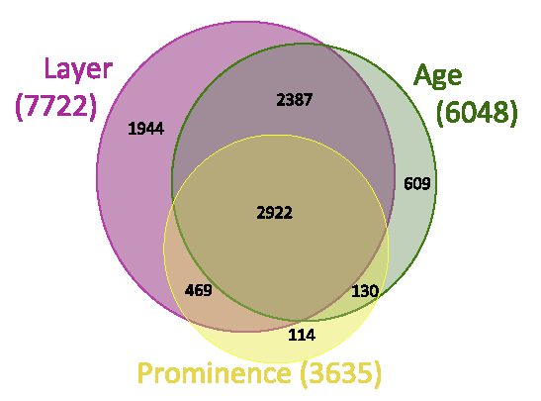
Aim 1: Transcriptome dynamics
  We have generated a comprehensive transcriptome to explore the gene expression networks of mouse facial development across time, prominence and tissue layer.
  We have added single cell-resolution transcriptome data at the λ junction.

Slide 27
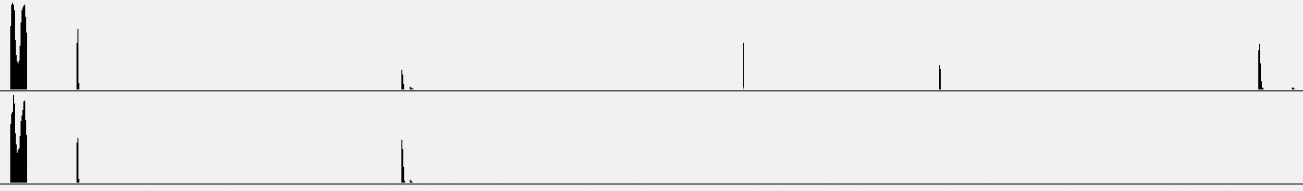
Aim 2: Gene models and isoform usage
  Many genes are regulated through alternative isoforms .
  Improved gene models relevant to facial development, including new first exons, last exons, retained introns, transcripts, exons and splices.
  Differential usage of isoform features across time, tissue and prominence.
  Alternative first exons, combined with adjacent promoter/enhancer elements, TF expression and signaling profiles can be used to construct gene regulatory networks relevant to the face.
  Alternative splicing, combined with SF expression and cis-regulatory elements can be used to construct splicing regulatory networks.
Ecto
Mes

Slide 28
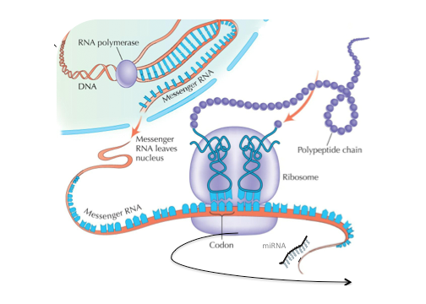
Aim 3: translation efficiency
  We will characterize translation efficiency at key times in key tissues - then integrate with alternative splicing, UTR regulatory features and trans-acting regulatory factors (e.g. RNA binding proteins, miRNAs) to define a post transcriptional regulatory network relevant to the mechanisms of face formation.

