Slide 1


Rapid Identification and Validation of
Human Craniofacial Development Genes
4rd FaceBase Annual Meeting
USC
May 15-16, 2018
Richard Maas, M.D., Ph.D. Eric Liao, M.D., Ph.D.
BWH Division of Genetics / HMS MGH Dept. of Plastic Surgery / HMS
Joan Stoler, M.D. Catherine Nowak, M.D.
Boston Children’s Hospital / HMS Boston Children’s Hospital / HMS
Pedro Sanchez, M.D. Ophir Klein, M.D., Ph.D.
Children’s Hospital Los Angeles / USC Depts. Orofacial Sciences and Peds, UCSF

Slide 2
FaceBase Craniofacial Gene Discovery Spoke Project:
Specific Aims
Identify genes in patients with likely monogenic disease and in cases that are bioinformatically tractable
1.
High throughput WES/WGS
Identify variant containing genes
Functional analyses
Add’l cases, zebrafish
3.
2.

Slide 3

Bioinformatically solvable genetic paradigms
Dominant
Recessive
Dominant
Transmitted mutations
Rare cpd het.
and homo. mutations
De novo mutations
~50 variants transmitted,
solve statistically
0-3 mutations
3-5 cpd het or 1-2 homo mutations
Assumptions
Monogenic inheritance
Complete penetrance
Limit to protein coding mutations, splice site mutations, structural variants

Slide 4
FaceBase Project Throughput, to date …
Goal: To solve ~25 cases over 5 years, 5 cases/yr
Assume: ~25% success rate
Therefore: Accept and sequence about 100 cases
Trio assumption: Consent and sequence ~250 individuals
Models / fxnal expts / causality: As appropriate to the case
May 2018
Cases evaluated 130
Cases rejected: 17
Cases deferred: 13
Cases accepted: 100
Waiting for consent, samples or seq. 50
Cases seq’d: 50 (48 WES, 2 WGS)
Samples seq’d: 150 (145 WES, 45 WGS)
Cases analyzed: 46
Cases solved, tent. solved: 14, 10
Models (zebrafish) 14

Slide 5
FB cases solved* or ‘provisionally solved’ to date …
Case No. Gene Phenotype and Dx
01 * PIEZO2 Distal arthrogryposis 5
10 * RSPRY1 Spondyloepimetaphyseal dysplasia, facial dysmorphism
11 SMARCA4 Nasal maxillary hypoplasia, facial asymmetry, single central incisor
21 * DCHS1 van Maldergem syndrome plus
23 CARD8 Lobar holoproscencephaly
31 * MAP3K7 Facial dysmorphosis, macrocephaly, small stature, hypotonia, DD
38 * CDH1 Blepharo-cheilo-dontic (BCD) syndrome
40 * POLR1A Acrofrontofacionasal dysostosis
44 * ALX1 Bilateral cleft lip and palate, Amish family
45 * FGFR2 Craniosynostosis plus
46 DYNC1H1 Craniofacial microsomia, vertebral segmentation defects, abnl. speech
50 * ACTB DD, ID, facial dysporphism, heart, renal defects, growth retardation
51 PLXNA3 / NRG2 Facial dysmotphism, hypotinia, stabismus, plagiocephaly, CNS lesions
55 * NFIX Marshall Smith syndrome
58 * FBN2 VACTERL plus
64 FREM2 Craniosynostosis, CL/P, VPI
67 MED13L PRS, CP, congenital cardiac defect, ocular anomalies, hearing loss, DD
70 TUBB3 Facial dysmorphism, EOM defects, scoliosis, contractures
74 * STXBP3 Plagiocephaly, VEO-IBD, sensorineural hearing loss
101 * PAX6 CP, aniridia, bilateral club feet, plagiocephaly, cataracts
110 * SHROOM3 CL/P, alveolar cleft
114 HECTD1 Hemifacial microsomia w/ anophthalmia, microtia, absent radius, DORV
115 HNRNPK Facial dysmorphism, DD, ,hearing loss, hypotonia
122 HECTD4 / DNAH17 Frontonasal dysplasia, scoliosis, hearing loss, alopecia,, hyoplastic nose
SMARCA4
CARD8
POLR1
ALX1
NFIX
MED13L

Slide 6
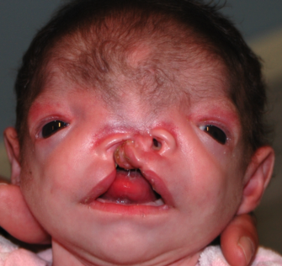
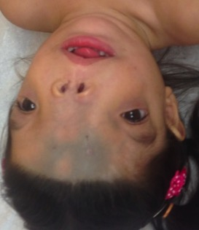
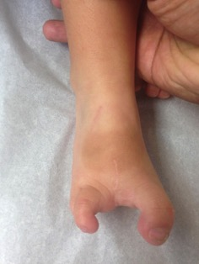
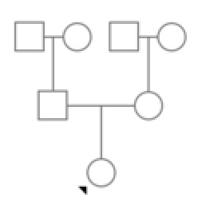
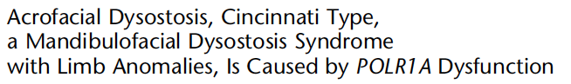
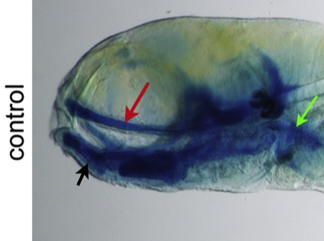
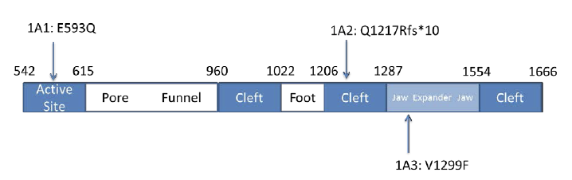
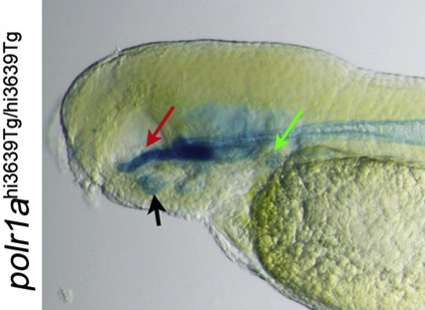
FB40
Pedro Sanchez
Some New Cases …
Diagnosis: Acrofrontofacionasal Dysostosis ?
Cleft palate, hypertelorism, absent nasal bone, contractures, absent toes
Presumed AR or de novo
De novo N1043Y mutation in POLR1A, largest RNA polymerase I subunit
Associated with Acrofacial dysostosis - Cincinnati type
Weaver et al., Am. J. Hum. Genetics 96, 765–77, 2015
p.N1043Y
The American Journal of Human Genetics 96, 765–774, May 7, 2015

Slide 7
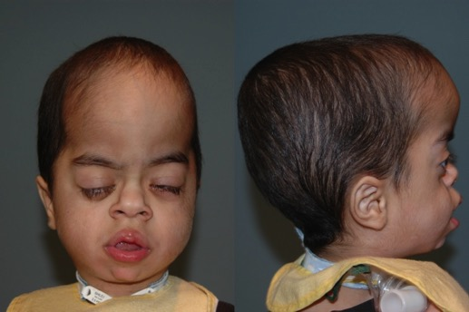
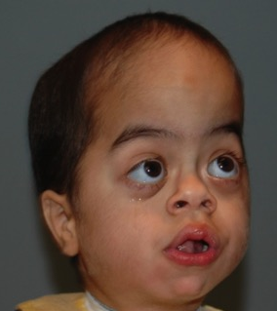
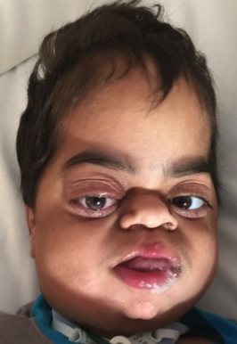
FB55
Pedro Sanchez
Sagittal craniosynostosis, Robin sequence, macrocephaly, and brain glioma
Non-enhancing vermian-right cerebellar mass
Proptosis, bilateral cryptorchidism, global DD, excessive wrinkling of palmar skin, prominent fingertip pads, optic nerve hypoplasia, generalized hirsutism
Presumed AR or de novo
NFIX – de novo splice donor mutation exon 6
Marshall Smith syndrome, w/ ~50 cases worldwide; allelic to Sotos 2 and Malan syndromes
C
AG / GT
NFIX
5’
3’
Exon
1 2-4 5 6 7 8 10

Slide 8
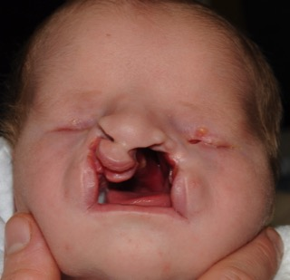
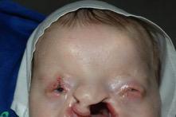
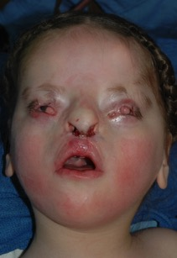
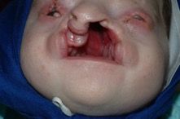
FB44: Oblique Facial Clefting
Eric Liao
Amish family
EB
3 m
BB
6 y
Homeodomain
OAR domain
ALX1
aa no.
1 132 191 326
L165F
Helix I
Helix II
Helix III
Alx1
Alx3
Alx4
KRRHRTTFTS LQLEELEKVF QKTHYPDVYV REQLALRTEL TEARVQVWFQ NRRAKWRKRE
---N----ST F--------- ---------A --------D- ---------- ----------
---N------ Y--------- ---------A -----M--D- ---------- ----------

Slide 9
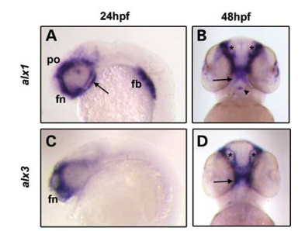
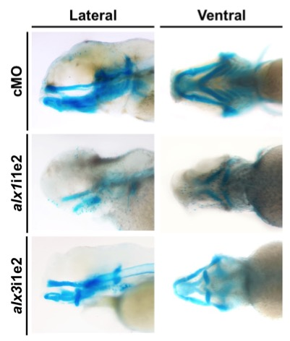
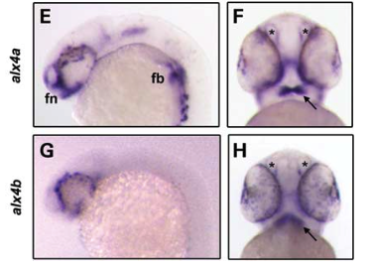
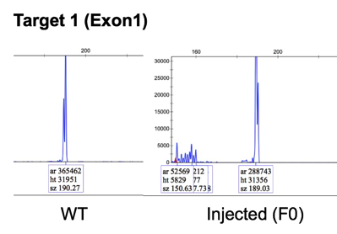
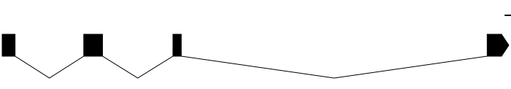
Disruption of alx1 phenocopies FN dysplasia
Chromosome 18
Chromosome 18
5’ 3’
gRNAs
Exon 1 Guide: CCATGGACAGATCGTCTCCG
Exon 2 Guide: CCGCACAACCTTCACGAGCG

Slide 10
Some new cases …
1. SMARCA4: FB11 - Maxillary hypoplasia w/ facial asymmetry, CMI
    2. CARD8: FB23 - Lobar holoproscencepahly (HPE)
3. MED13L: FB67 - PRS, CP, cardiac and ocular defects, hearing loss, DD

Slide 11
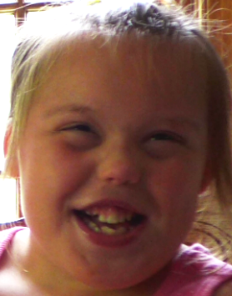
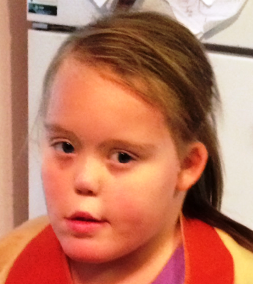
FB11: Nasal maxillary hypoplasia and facial asymmetry
Referring Physician: Catherine Nowak, MD
Gender: Female
Current Age: 9 yrs., 4 mos.
Ethnicity: Caucasian / Latino
Dysmorphic Features
Microcephaly and deformational plagiocephaly, facial asymmetry
Hypoplastic nose with upturned tip, narrow nares
Small abnormal ears, Single central incisor.
Class III malocclusion
Other pertinent findings
Myopia and astigmatism
Hypoplasia of lacrimal ducts
Growth retardation
Conductive hearing loss
Obstructuve sleep apnea
Hypoplasia of corpus callosum
Global developmental delay / nonverbal

Slide 12
FB11: Family history and prior genetic testing
3 Generation pedigree non-contributory
Availability of family members for sequencing: mother, father, sister, MGPs
Chromosomal: Amnio: 46, XX,del(10)(p11):3 cells/1 colony, pseudo- mosaicism. Postnatal study:normal 46,XX at a 525 band level.
500K SNP microarray normal (2007); repeat CMA normal 2012.
Single Genes: Rett/Angelman: MECP2, FOXG1, STK9, TCF4 & UBE3A
PWS/AS methylation; CHARGE/CHD7
Holoprosencephaly gene panel: SHH, ZIC2, SIX3, TGIF1, PTCH1, GLI2, CDON.
Metabolic: UOA, UAA, PAA, CDG, lactate, 7-dehydrocholesterol, GH, IgFBP3, IGF1 (low normal), VLCFA, pristanic, phytanic, carnitine profile, serum acylcarnitines, and urine acylglycines. CPK = 263 (26-174).
Previous Studies: Cranial MRI: subtle dysgenesis, thin corpus callosum; skeletal survey with no dysplasia: 11 paired ribs. C-spine normal; Initial bone age somewhat delayed, follow-up normal.

Slide 13
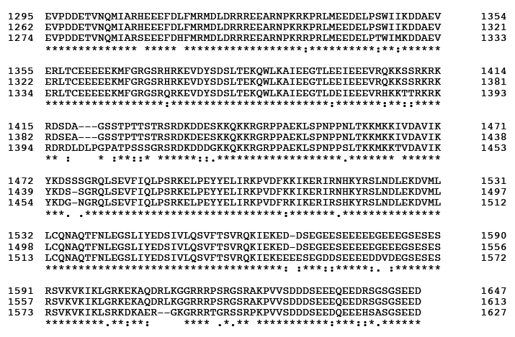
Conservation of SMARC4 human, mouse, zebrafish (~90% identity)
SMARCA4: SWI/SNF related, matrix associated, actin-dependent regulator of chromatin, subfamily a, member 4
SMARCA4 C-terminus …
H
M
Z
H
M
Z
D1432N
H
M
Z
H
M
Z
H
M
Z
H
M
Z

Slide 14
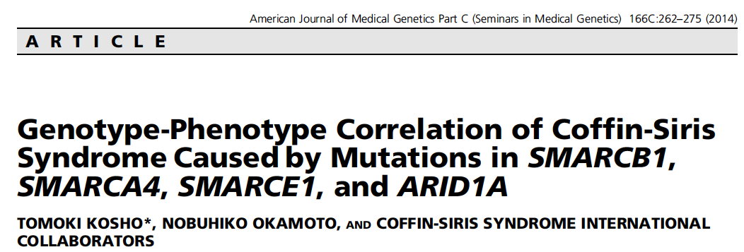
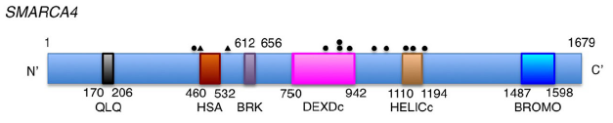
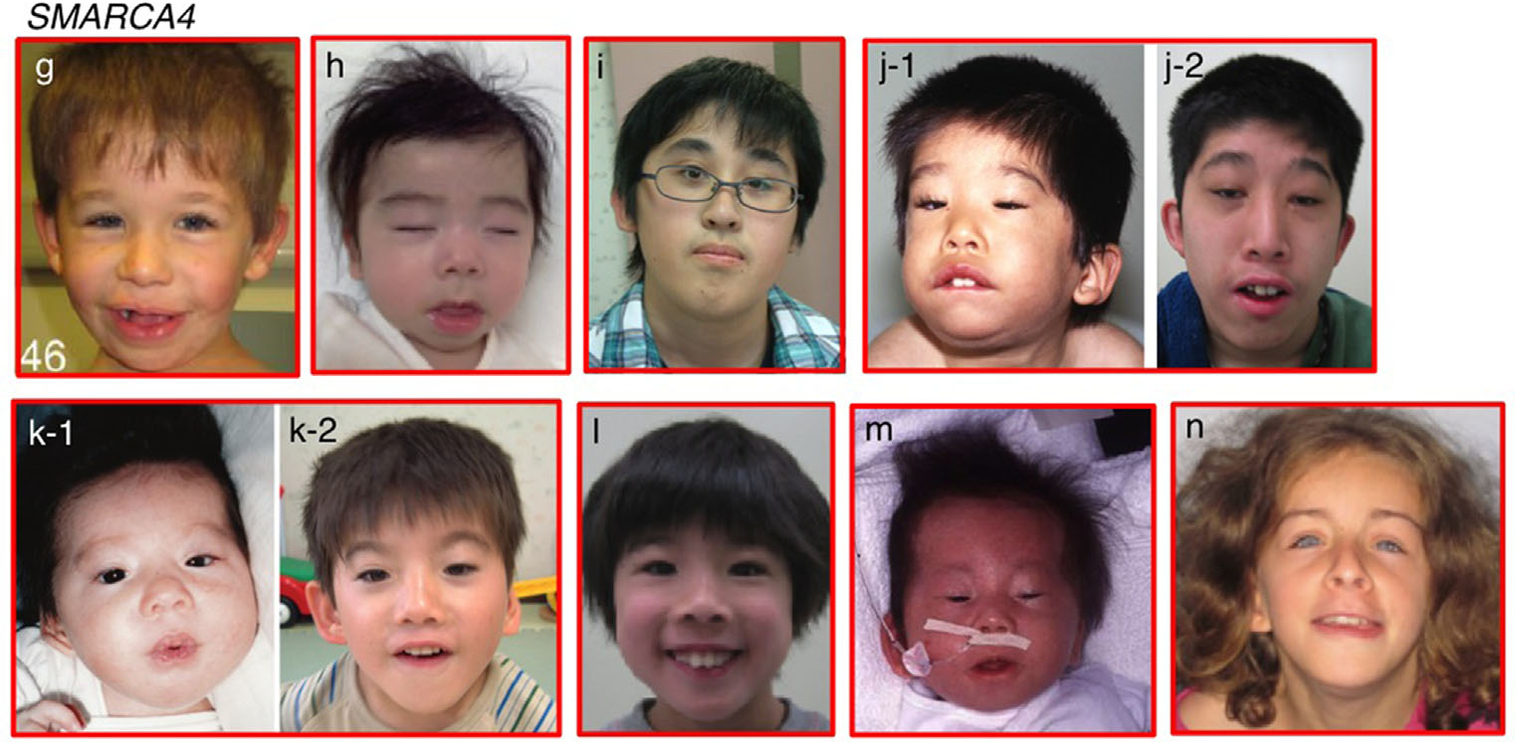
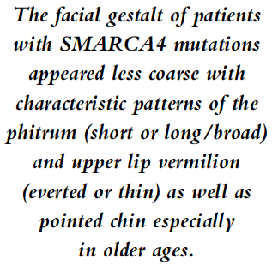
FB11 and SMARCA4
Helicase C-terninus
aa 1084 - 1246
Bromo domain
aa 1477 - 1547
Dlx1 interaction region
aa 1247 - 1446
D1432N

Slide 15
Patient Review # 10
FB23: Midline CL/CP and lobar HPE
Referring Physician: Stoler
Gender: Male
Current Age: 18 months
Ethnicity: Italian, Irish and French Canadian
Case Summary: Dysmorphic Features: significant midface hypoplasia, nasal
hypoplasia, hypertelorism, midline cleft lip and cleft palate,
lobar holoprosencephaly
Patient Medical History
Midline cleft lip and cleft palate, s/p repair
Lobar holoprosencephaly
Hypoplastic nose and midface
Unilateral renal agenesis with Grade III-IV reflux of the right kidney

Slide 16
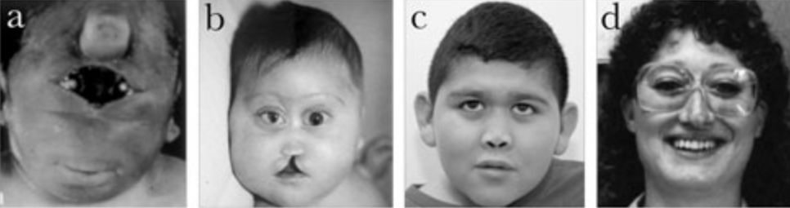
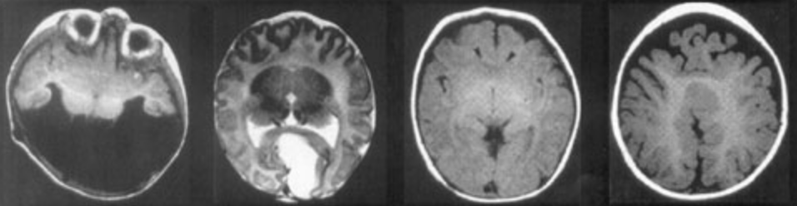
Holoproscencephaly (HPE):
Continuum of Severity
severe
mild
Alobar
Semilobar
Lobar
MIHV
Raam, Solomon & Muenke, Ind. Ped. 48, 457-66, 2011

Slide 17
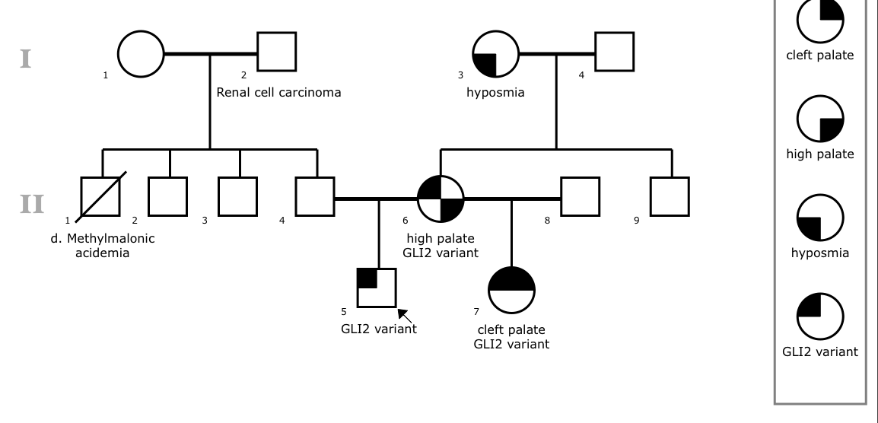
FB23: Family history and prior genetic testing
Midline CL/CP, lobar HPE, single kidney
Previous Genetic Testing: maternal VUS in GLI2 (p.Arg754Gln)
Paternal 15.4 kb loss at 10q23.31 (max coordinates 89693518-89708908)
Other HPE genes negative: (DISP1, FGF8, FOXH1, NODAL,
PTCH1, SHH, SIX3, TDGF1, TGIF1, ZIC2)
Previous Studies: normal 7-dehydrocholesterol
Environmental Triggers: n/a

Slide 18
FB23: WES results
Mutation Type Chr. Position Change Mut. Type Protein Change
De novo
CARD8 chr19 48733704 C>A missense L236F
CPNE1 chr20 34215309 G>A missense R382C
Homozygous
No good candidates
Cpd. Heterozygous
LYST chr1 235875386 T>C missense Y3299C
LYST chr1 235875399 G>C missense P3295C
SIPA1L1 chr14 72138367 T>A missense F929L
SIPA1L1 chr14 72090805 C>T missense P557L
STARD9 chr15 42974353 A>G missense Q706R
STARD9 chr15 42978892 A>G missense K1706E

Slide 19
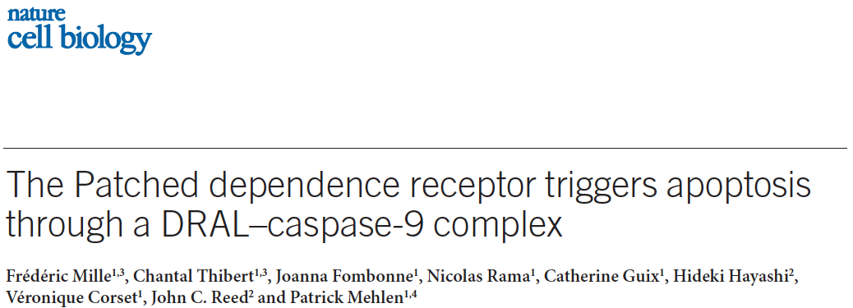
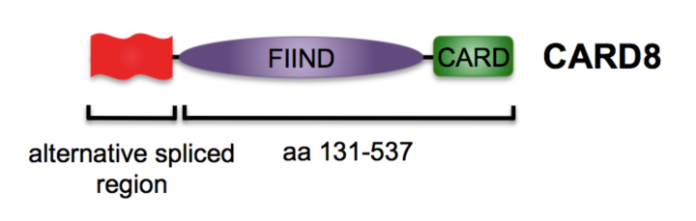
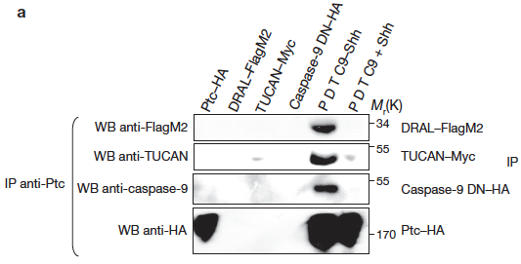
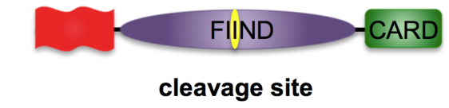
FB23: CARD8
Shh = morphogen and pro-survival factor; unoccupied Ptc = pro-apoptotic (e.g. chick embryos)
Shh C-terminus interacts with DRAL, CARD8 and Caspase 9 ➔ Ptc-mediated cell death
CARD = Caspase activation and recruitment domain
Ptc i.p. pulls down DRAL, CARD8, Caspase 9; Card8 i.p. pulls down Ptc and Caspase 9
Deletion of CARD8 FIIND domain abrogates Ptc-DRAL interaction with CARD8
L236H
L236F (L342F) functions as a dominant GOF to trigger Ptc-mediated apoptosis

Slide 20
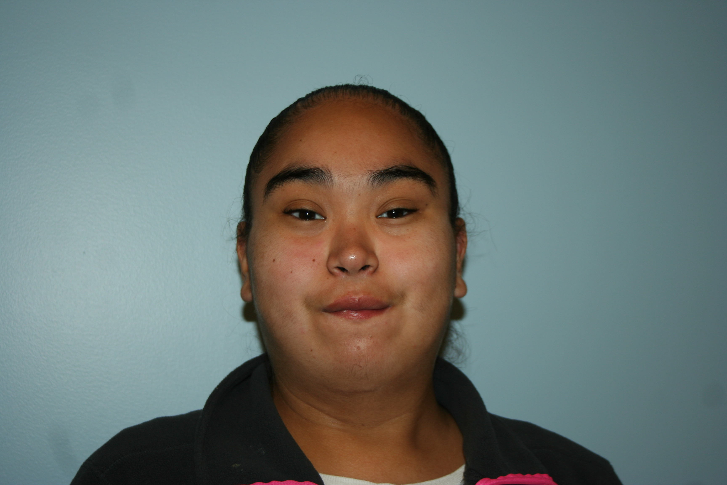
FB67: PRS, syndromic
Clinical History
  Pierre Robin Syndrome, cleft palate s/p repair, congenital cardiac defect: ASD s/p repair, obesity, mild obstructive sleep apnea, ocular anomalies (hyperopia, esotropia), minor hearing loss, and significant cognitive and speech delay. She is currently in special ed. w/ very limited verbal skills.
Prior Evaluations
  Brain MRI: negative
  Skeletal survey: negative
Genetic Testing
  Metabolic work-up inc. ammonia, lactate, serum
  amino acids, LFTs, karyotype, subtelomeric FISH,
  FISH for 22q11 deletion syndrome and 105 oligo-
  array CGH all normal.
Differential Dx / Disease Mechanism
  Kabuki syndrome
Female, Age 19 yo
Notes:
- How is the patient’s presentation typical or atypical for considered diagnoses?
- Please list the candidate genes/pathways that may contribute to the condition
- Please list/explain the genetic tests performed on the proband/family.
Chromosomal analysis
Microarray analysis
Gene-panel sequencing
Exome and Genome sequencing

Slide 21
Clinical Features and HPO Terms
Clinical Diagnosis | HPO Terms | HPO Numbers
Pierre Robin sequence | Pierre Robin sequence | HP:0000201
Cleft palate | Cleft palate | HP:0000175
ASD | Atrial septal defect | HP:0001631
Obesity | Obesity | HP:0001513
Mild obstructive sleep apnea | Obstructive sleep apnea | HP:0002870
Ocular anomalies | Abnormality of the ocular region | HP:0000315
Sensorineural hearing loss | Sensorineural hearing impairment | HP:0000407
Cognitive and speech delay | Global developmental delay | HP:0001263

Slide 22
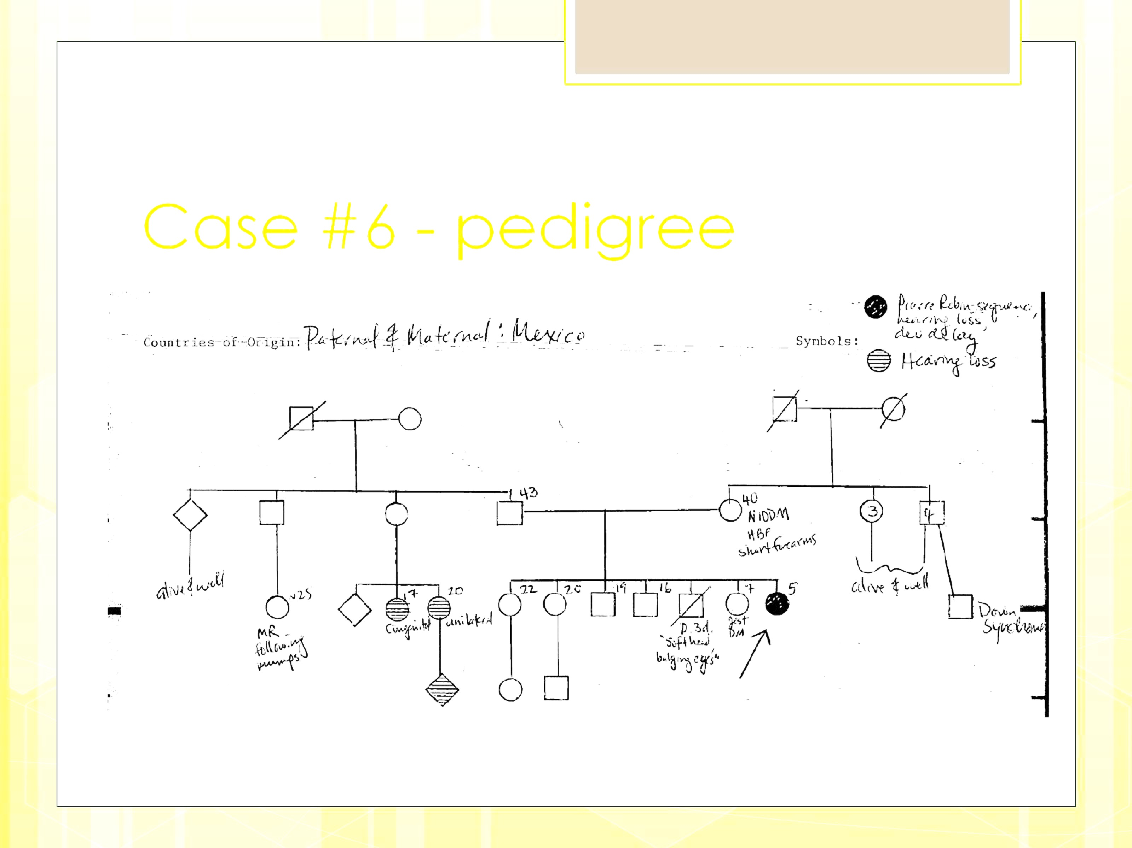
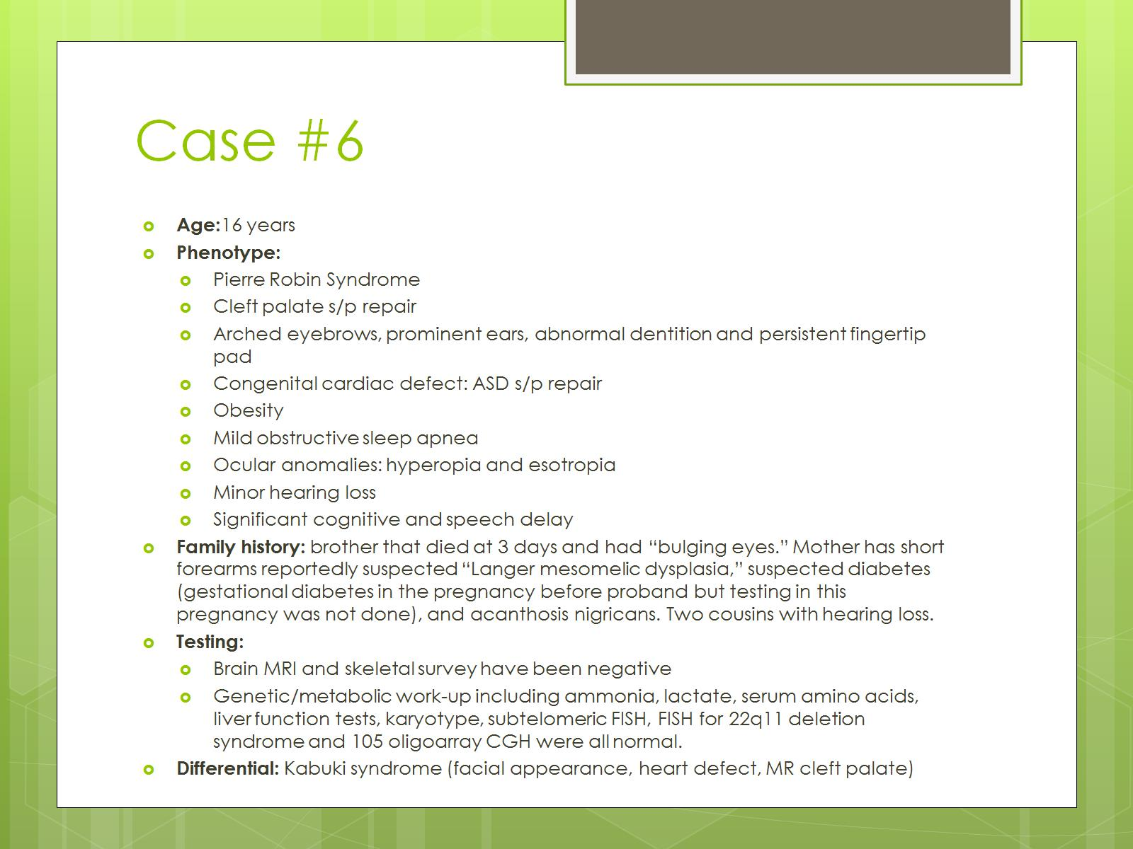
FB67: Family History
Countries of origin (paternal and maternal): Mexico
PRS, Hearing loss,
Develop. delay
Hearing loss

Slide 23
FB67: Sequencing Summary
Sequencing
 | Done? (Y / N) | Reanalysis by BGM? (Y / N) | WES / WGS | Lab | # Sequences | Complete trio? | Relatives Sequenced
Sequencing (via UDN, BGM, FB): | Yes, FB | Yes | WES | Yale | 3 | Yes | Proband Parents
Analysis Method | Filter (gnomAD) | # Genes
De Novo dominant |  | 2
Compound heterozygous | 1% | 5
Homozygous recessive | 1% | 0

Slide 24
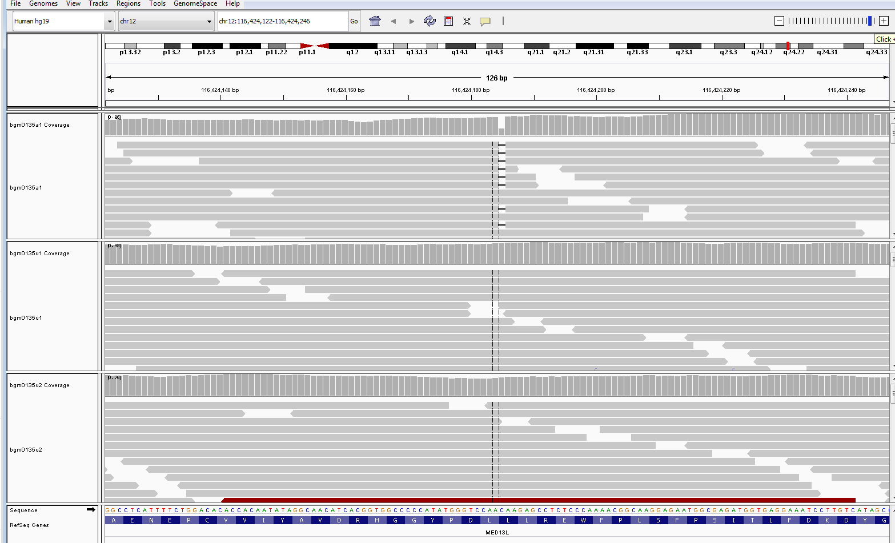
Haploinsufficiency for MED13L due to c.4431delC
Gene: | Chr. | cDNA change (c._____) | Protein change (p.____) | AF (PopMax) | AF (hom) | AF (het) | pLI
MED13L | 12 | c.4431delC | p.L1408X | 0 | 0 | 0 | 1
ANKAR | 2 | Ext. splice site |  | 0 | 0 | 0 | 0
De novo
Proband
c.4431delC
Parent 1
Parent 2

Slide 25
MED13L haploinsufficiency
C. Cafiero et al. (2015) EJHG
intellectual disability
distinctive facial appearance: brachycephaly,
horizontal eyebrows, high forehead, bitemporal
narrowing, long eyelashes, depressed nasal
bridge, mid-face hypoplasia, prognathism
congenital heart diseases found in some
subjects w/ various degree of severity
cleft palate, ataxia, epilepsy and childhood
leukemia in single cases
c.3765delC: DD, cleft palate, club foot, hypotonia, conductive HL, ALL
c.607dupT: DD, seizures, microcephaly, PFO
c.4420A>T (nonsense): DD, seizures, T2-hyperintense foci, underlying low white matter volume

Slide 26
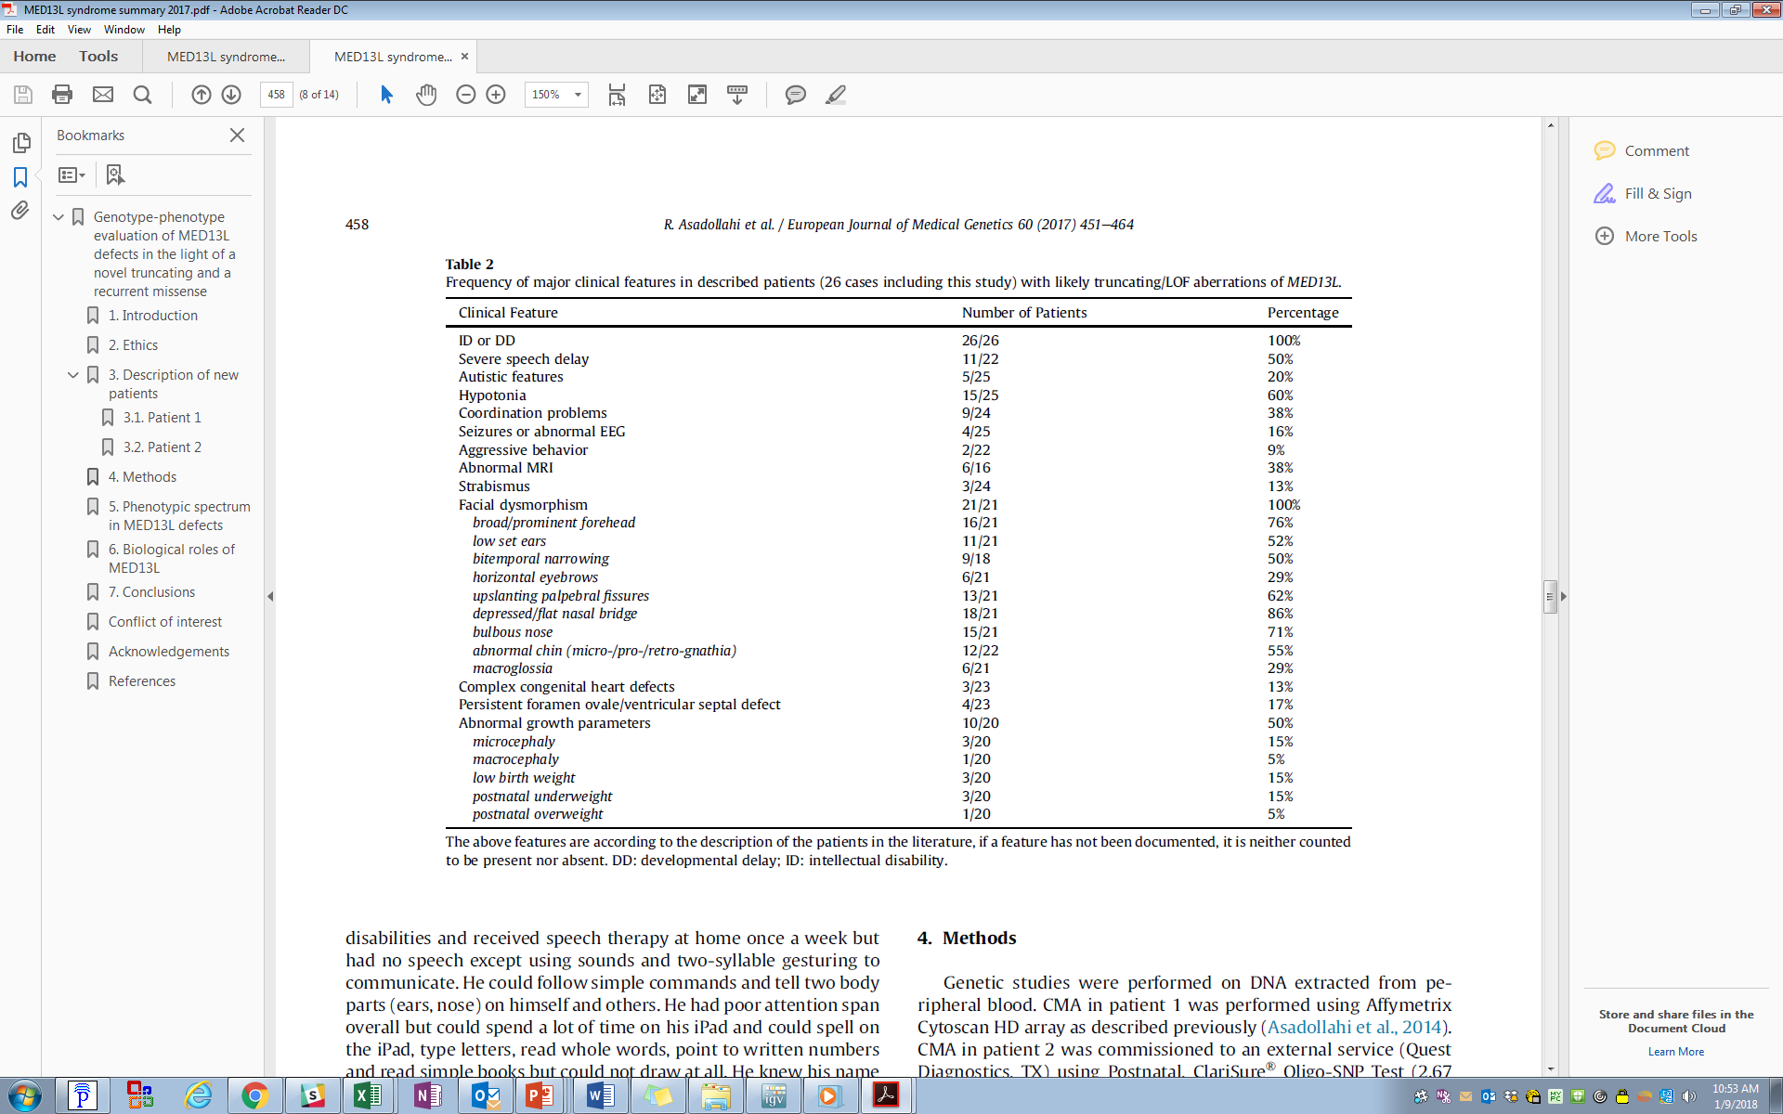
MED13L haploinsufficiency

Slide 27
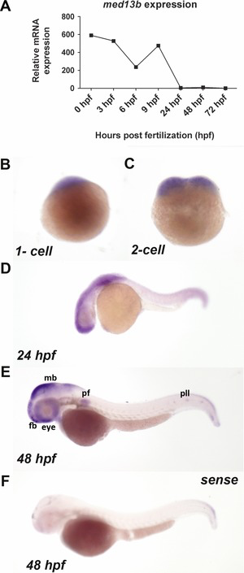
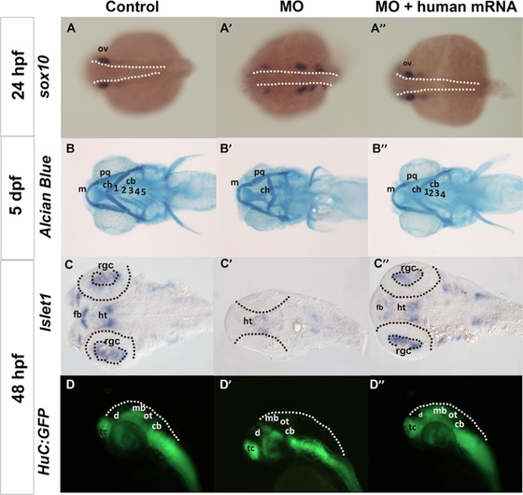
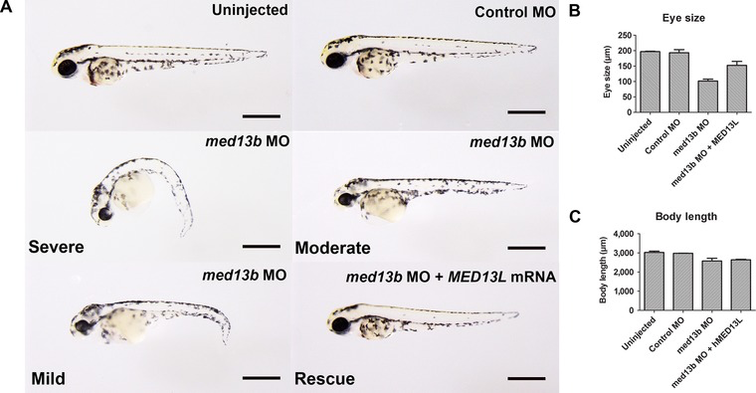
MED13b in the literature
A: Morpholino
injected med13b
B: Eye size
C: Body length
Migration of NCCs
A: qPCR of maternal expression
B-F: in situ hybridization
Utami et al., Hum Mutat. 35, 2014
Notes:
Impaired Development Of Neural-Crest Cell Derived Organs and Intellectual Disability Caused By MED13L Haploinsufficiency
Image 1
A-F med13b mRNA expression across developmental stages in zebrafish.
B-C show maternal expression in 1-cell and 2-cell stage at the blastomeres.
D -E 24 and 48 HPF, the expression was restricted to forebrain (fb), mid-hindbrain boundaries (mhb), eyes, pectoral fin (pf), and posterior lateral line (pll).
F: Sense probe- negative control
Image 2
Suppression of med13b resulted in developmental defects affecting head, eyes, and body axis.
rescue construct- Reintroduction of human MED13L mRNA (150 pg) restored the zebrafish wild-type phenotype.
med13b MO resulted in hypomorphic head, microphtalmia, curved body axis, and pericardial edema.
Image 3
med13b is required for proper NCCs migration and neuronal distribution in zebrafish head morphogenesis and craniofacial prominence.

Slide 28
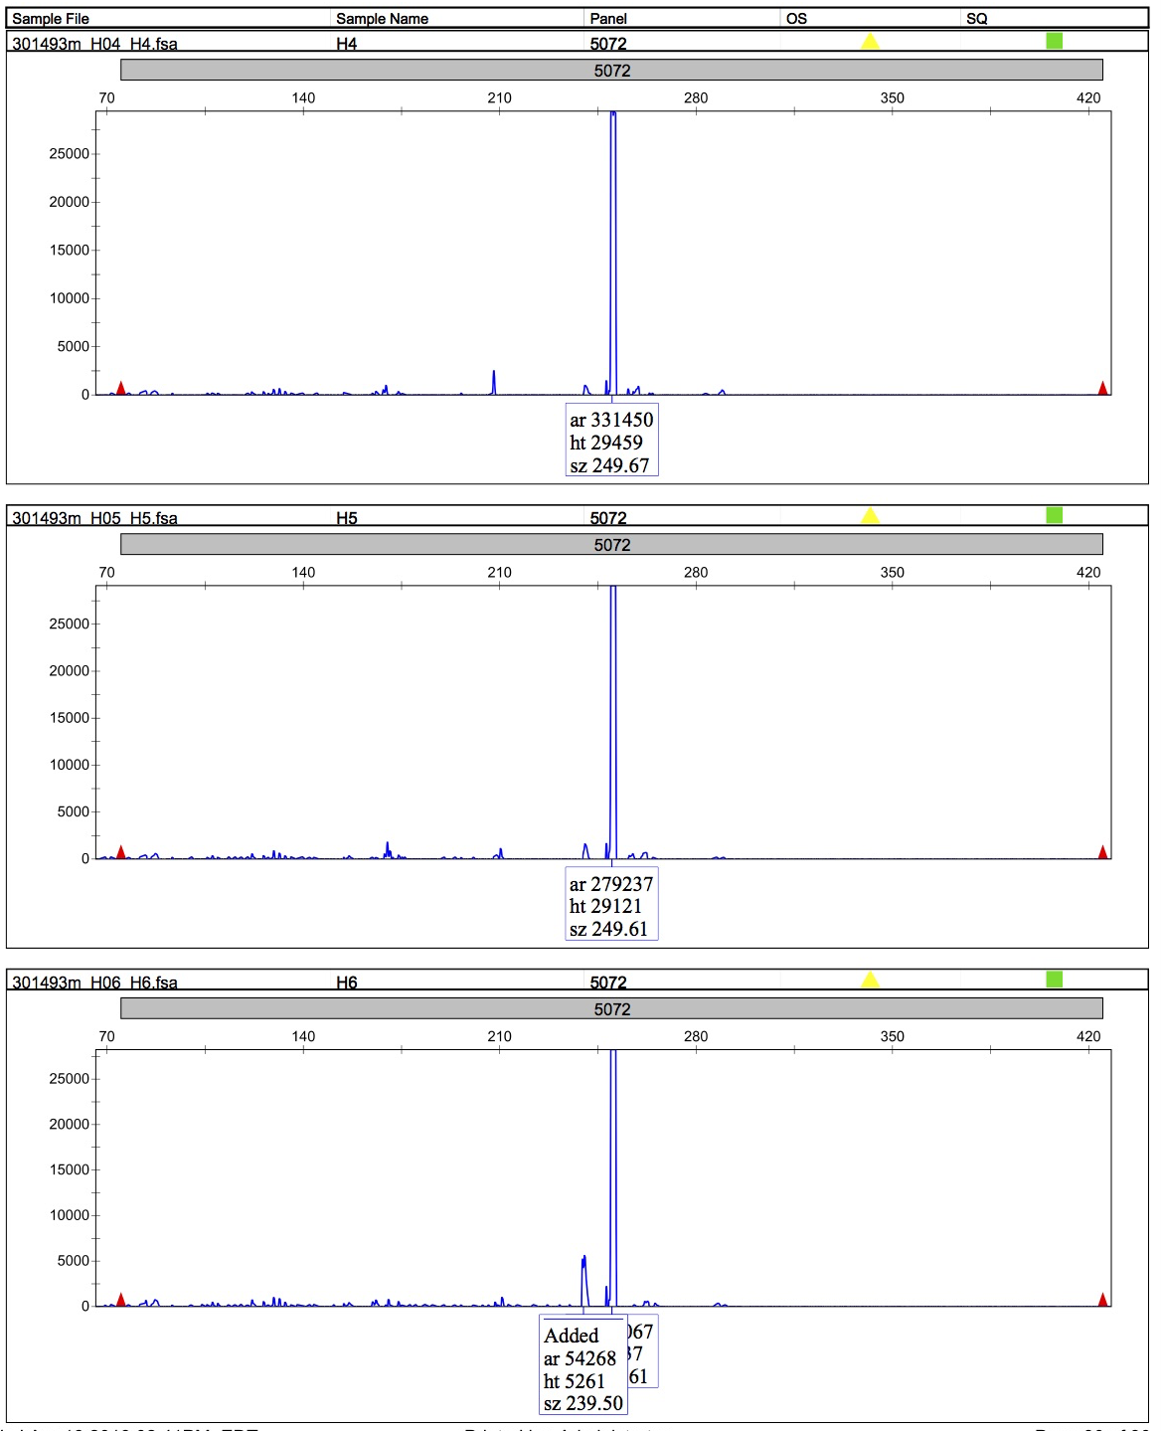
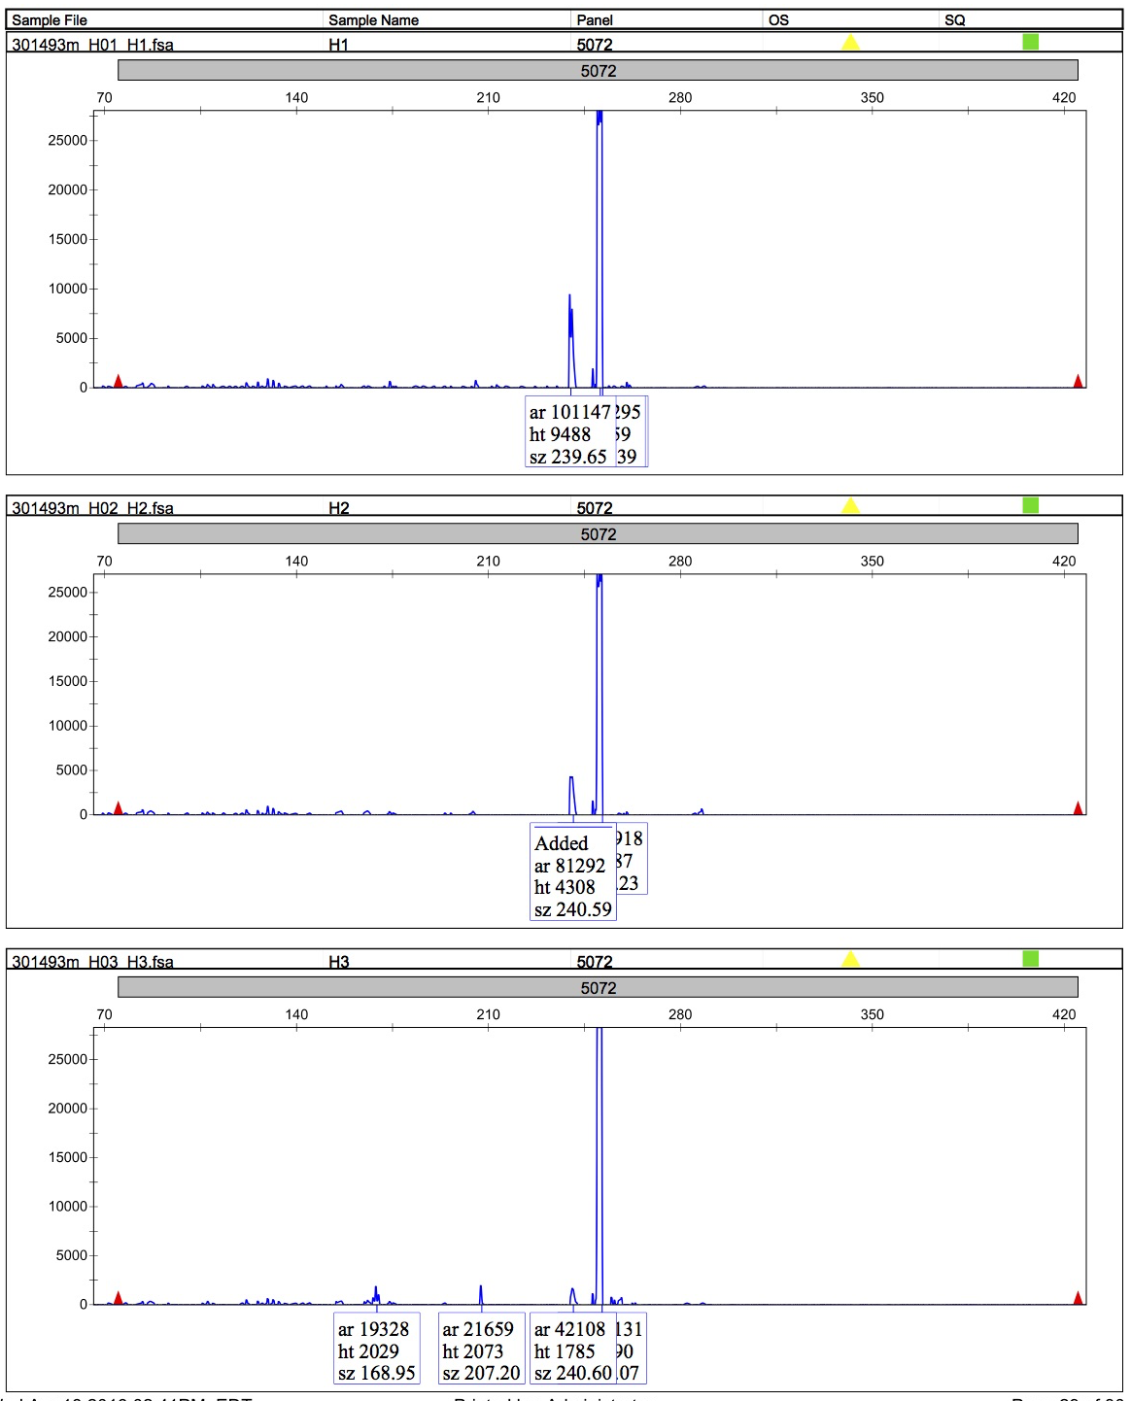
FB67: MED13L ~ zebrafish med13b
Exon 2
Guide 1: 5’-AGCTCTGGATCTTCTGGTGGGGG-3’
Exon 3
Guide 2: 5’-GAGGATGGTTCGTGGGAGAGCGG-3’
Guide 3: 5’-CCACTTGCCGATGCGAACGAAGG-3’
Exon 4
Guide 4: 5’-CACGAAGAACGTGAAGGAGCAGG-3’
Control
Injected (F0)
Notes:
MED13b is the MED13L orthologue in zebrafish
We designed guide upstream, closer to the 5’ UTR
Guides were designed in the predicted functional domain of gene
Guides designed in same exon can be injected together

Slide 29
Summary
1. WES is a powerful tool for diagnosing unknown craniofacial dysmorphoses.
Variable expressivity is common in craniofacial disorders, and may reflect
modifier genes, somatic mosaicism, stochasm, environmental or other
factors.
3. New craniofacial disease gene discovery is much more difficult and
time consuming than simply extending the phenotypic spectrum of known
disease-causing genes.
4. Importance of the trio for WES / WGS interpretation.
5. Variants in paralogs of known disease genes are good candidates for
disorders with related phenotypes.
6. Downstream functional analyses need to be customized for each case.

Slide 30





Acknowledgements – FaceBase Team
Clinical and Experimental Group
Richard Maas, MD, PhD
Nikkola Carmichael, MS, CGC
Kameron Kooshesh, BS
Laurel Fuentes, BS
Chia Cheng Li, DMD, PhD
Liron David, PhD
Joan Xi, BS
Eric Liao, MD, PhD
Kana Ishii, MD
Megan Rebello
Nikhil Sobti
Joan Stoler, MD
Stephanie Lucia, BA
  Brandon Kusako, BASc
Catherine Nowak, MD
Pedro Sanchez, MD - CHLA
Ophir Klein, MD, PhD - UCSF
Hazel Perry, MS, CGC
Fowzan Alkuraya, MD
Genome Analysis Group
Joel Krier, MD, MMSc
Shamil Sunyaev, PhD
Dana Vuzman, PhD
Agnes Toth-Petroczy, PhD
Nikkola Carmichael, MS, CGC
Alireza Haghighi, MD, DPhil
Corneliu Bodea, PhD
Andrew Bjonnes, MSc
Anwoy Mohanty, PhD
Chris Cassa, PhD
Onuralp Soylemez, PhD
Ivan Adzhubey, PhD
Administrative Team
Victoria Perroni
Cait Lieneck
Cris Williams and colleagues at the Hub
Plus many other clinical and computational colleagues!
NIH U01 DE024443
NIH U01 HG007690

