Slide 1
The Ontology of Craniofacial Development and Malformation
James Brinkley (PI)
Onard Mejino
Todd Detwiler
Structural Informatics Group
University of Washington
Seattle
Tim Cox
Michael Cunningham
Seattle Children’s Research Institute

Slide 2
Goals
Create an ontology for use by FaceBase
Standardized terms
  for annotation
  retrieval by keyword search
Relations
  representation of knowledge
  to allow semantic integration

Slide 3
OCDM
Human
CHO
CHDO
CHMMO
CHZMO
CHMO
mappings
mappings
CH3MO
CHZ2MO
CET
Mouse
Zebrafish
CMO
CMZMO
CZO
CMDO
CZDO
mappings
CMMO
CMZ2MO
CZMO

Slide 4
Milestones Years 1-3
Year
Task Dates
1. Conversion to OWL
a. CHO to OWL May 1, 2014 – Aug 1, 2014
b. OCDM to OWL June 1, 2014 – July 1, 2014
c. Review and Testing July 1, 2014 – Aug 1, 2014
d. Ongoing methodology Aug 1, 2014 – Ongoing
2. Canonical musculoskeletal system (MS) of head
a. CHO (Human) May 1, 2014 – Aug 31, 2014
b. CMO (Mouse) Sept 1, 2014 – Dec, 31, 2014
c. CZO (Zebrafish) Jan 1, 2015 – July 31, 2015
d. Termlists for Hub Feb 15, 2015 -- Ongoing
3. Embryonic development of MS of head
a. CHDO (Human) Aug 1, 2015 – Nov 30, 2015
b. CMDO (Mouse) Dec 1, 2015 – March 31, 2016
c. CZDO (Zebrafish) April 1, 2016 – Sept 30, 2016
4. Anatomy mappings
a. CHO with CMO (CHMMO) Oct 1, 2016 – Jan 31, 2017
b. CHO with CZO (CHZMO) Feb 1, 2017 – June 30, 2017
1
2
3

Slide 5
Milestones Years 4-5
Year
Task Date
5. Craniofacial malformation (facial and cranial vault dysmorphology)
a. CHMO (Human) July 1, 2017 – Nov 30, 2017
b. CMMO (Mouse) Dec 1, 2017 – March 31, 2018
c. CZMO (Zebrafish) April 1, 2018 – Aug 31, 2018
6. Malformation mappings
a. CHMO with CMMO Sept 1, 2018 – Dec 31, 2018
b. CHMO with CZMO Jan 1, 2019 – April 30, 2019
4
5

Slide 6
Topics
Multi-species malformation ontologies
Termlists for Hub
Ongoing methodology
Year 5 plans

Slide 7
Multi-species Malformation Ontologies of OCDM
Craniofacial Human Malformation Ontology (CHMO)
Craniofacial Mouse Malformation Ontology (CMMO)
Craniofacial Zebrafish Malformation Ontology (CZMO)

Slide 8
Multi-species Malformation Ontologies of OCDM
External sources
Craniofacial Human Malformation Ontology (CHMO)
  Human Phenotype Ontology (HPO)
  Disease Ontology (DOID)
Craniofacial Mouse Malformation Ontology (CMMO)
  Mammalian Phenotype Ontology (MP)
Craniofacial Zebrafish Malformation Ontology (CZMO)

Slide 9
Pathology Framework Rooted in Ontology Theory
Smith, Barry and Kumar, Anand and Ceusters, Werner and Rosse, Cornelius (2005) On carcinomas and other pathological entities. Comparative and Functional Genomics, 6 (7-8). pp. 379-387.

Slide 10
Pathology taxonomy
Pathological Entity
Disorder
Pathological Anatomical Entity

Slide 11
Pathological Entity
Disorder
Pathological Anatomical Entity
Pathological structure
Pathological space
Set of
pathological anatomical entities
Pathological subdivision of cardinal organ part
Pathological organ
Pathological orifice
Set of
pathological organs
Pathological lip
Hypoplastic mandible
Coloboma
Supernumerary teeth
Cleft lip

Slide 12
Pathological Entity
Pathological Anatomical Entity
Autoimmune disease
Scleroderma
Disorder
Disease
Infectious disease
Otitis media
Functional disorder
Structural disorder
Injury
Nasal fracture
Functional disorder subdivision of cardinal organ part
Functional disorder of organ
Genotypic abnormality
Phenotypic abnormality
Pathological disorder of ear
Pathological disorder of eye
Autosomal abnormality
Abnormality of anatomical structure
Syndrome
Hearing loss
Blindness
FGFR 1 abnormality
Craniosynostosis
Apert’s

Slide 13
Pathological Entity
Pathological Anatomical Entity
Autoimmune disease
Scleroderma
Disorder
Disease
Infectious disease
Otitis media
Functional disorder
Structural disorder
Injury
Nasal fracture
Functional disorder subdivision of cardinal organ part
Functional disorder of organ
Genotypic abnormality
Phenotypic abnormality
Pathological disorder of ear
Pathological disorder of eye
Autosomal abnormality
Abnormality of anatomical structure
Syndrome
Hearing loss
Blindness
FGFR 1 abnormality
Craniosynostosis
Apert’s

Slide 14
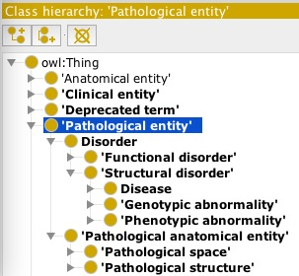
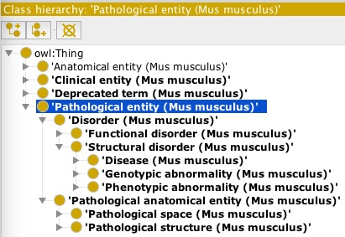
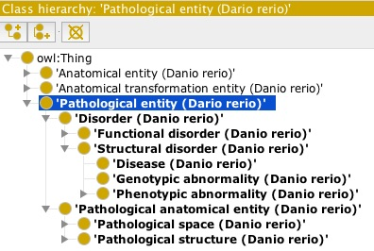
Multispecies Malformation Taxonomies
CHMO (Human)
CMMO (Mouse)
CZMO (Zebrafish)

Slide 15
Disorder
Pathological entity
Pathological anatomical entity
Structural Disorder
Phenotypic abnormality
Syndrome
Abnormality of anatomical structure
Pathological structure
Craniosynostosis
Coronal suture
Dysostosed suture
has_location
is_pathological_
transformation_of
has_component_
pathological structure
Bicoronal
craniosynostosis
Dysostosed right and left coronal suture
component_pathological_structure_in
has_phenotypic_
abnormality
phenotypic_abnormality_
observed_in
Apert syndrome

Slide 16
Craniofacial Human Malformation Ontology (CHMO)
Bicoronal
craniosynostosis
has_component_
pathological structure
Dysostosed
right and left coronal suture
component_pathological_structure_in
has_phenotypic_
abnormality
phenotypic_abnormality_
observed_in
Apert syndrome
has_genotypic_
abnormality
genotypic_abnormality_
observed_in
Fibroblast growth factor receptor 2 gene abnormality
protein_involved
Fibroblast growth factor receptor 2 (FGFR2)

Slide 17
Craniofacial Human Malformation Ontology (CHMO)
has_component_
pathological structure
Bicoronal
craniosynostosis
Dysostosed
right and left coronal suture
component_pathological_structure_in
has_phenotypic_
abnormality
phenotypic_abnormality_
observed_in
Beare-Stevenson
cutis gyrata syndrome
Apert syndrome
genotypic_abnormality_
observed_in
Crouzon syndrome
has_genotypic_
abnormality
genotypic_abnormality_
observed_in
Jackson-Weiss syndrome
Fibroblast growth factor receptor 2 gene abnormality
protein_involved
Fibroblast growth factor receptor 2 (FGFR2)
External sources: OMIM, PIR, UniProt, DOID, Orphanet

Slide 18
Craniofacial Human Malformation Ontology (CHMO)
Pathological entity
is_a
Phenotypic abnormality
Pathological anatomical entity
is_a
is_a
Abnormality of anatomical structure
Pathological structure
is_a
is_a
Craniosynostosis
has_location
Coronal suture
Dysostosed suture
is_pathological_
transformation_of
is_a
is_a
has_component_
pathological structure
Bicoronal
craniosynostosis
Dysostosed right and left coronal suture
component_pathological_structure_in
Focus:
Phenotypic abnormality
Pathological anatomical entity

Slide 19
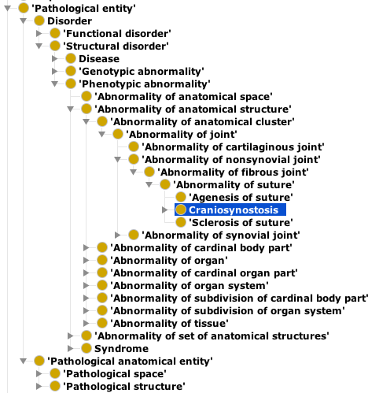
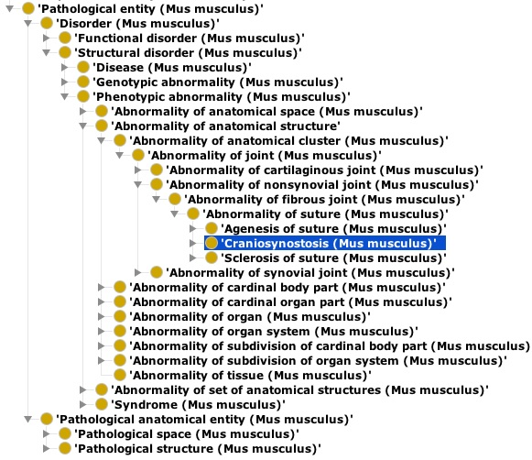
Phenotypic abnormality: Craniosynostosis
CHMO (Human)
CMMO (Mouse)

Slide 20
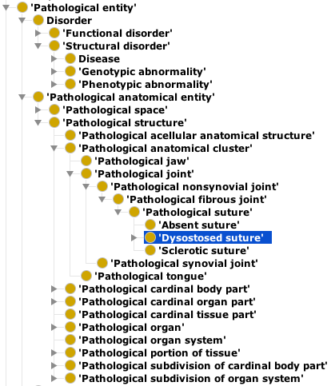
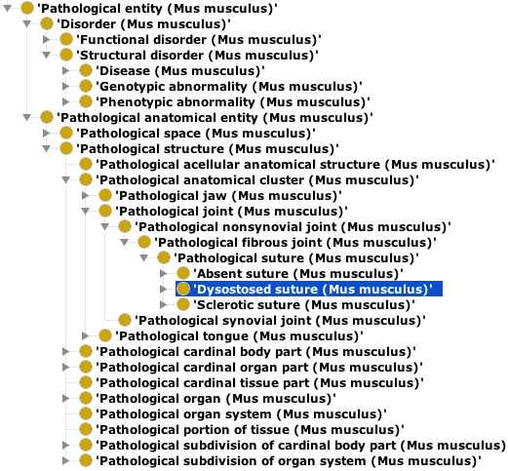
Pathological anatomical entity: Dysostosed suture
CHMO (Human)
CMMO (Mouse)

Slide 21
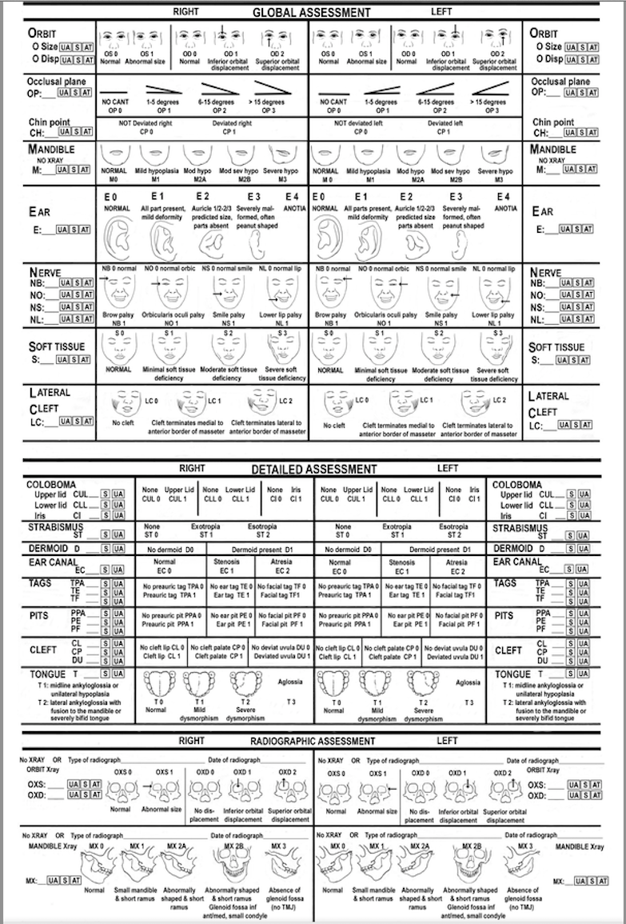
Clinical phenotypic abnormalities

Slide 22
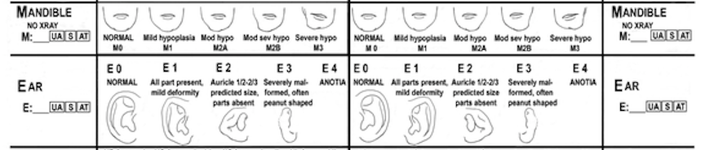
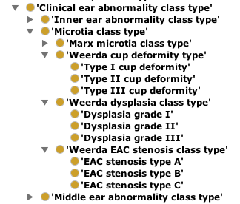
Phenotypic Abnormality
External Sources
Clinical Entity

Slide 23
Network of properties
Agenesis of mandible
Hypoplasia of mandible
Hyperplasia of mandible
Pathological small body of mandible
is_pathological_transformation_of
has_location
Agenesis of body of mandible
Hypoplasia of body of mandible
Hyperplasia of body of mandible
location_of
has_location
Body of mandible
location_of
Mandible
has_regional _part
has_location
Agenesis of ramus of mandible
Hypoplasia of ramus of mandible
Hyperplasia of ramus of mandible
Ramus of mandible
derives_from
location_of
derives
is_pathological_transformation_of
Ectomesenchyme of first pharyngeal arch
Pathological small ramus of mandible
derives_from
derives
derives
derives
Agenesis of maxilla
Hypoplasia of maxilla
Hyperplasia of maxilla
has_location
Maleus
Maxilla
location_of
Zygomatic bone

Slide 24
What Good is It?
How could our deliverables be used?
Representation of knowledge
  Like pathway databases
Data integration through knowledge
  Controlled terms
  Intelligent queries

Slide 25
Topics
Multi-species malformation ontologies
Termlists for Hub
Ongoing methodology
Year 5 plans

Slide 26
Termlists for Hub
Anatomy
Specimen
Age/stage
Human (CHO, HDAA)
OBI
Human (CHO, Carnegie)
Mouse (CMO, MA, EMAP)
Mouse (CMO, Theiler, E-day)
Zebrafish (CZO, ZAO)
Zebrafish (CZO, ZFA)
FaceBase
metadata
Malformation phenotype
Human (CHMO, HPO, DO)
Species
NCBI taxonomy
Equipment/procedure
Mouse (CMMO, MPO)
OBI, RadLex, QIBO, FBbi

Slide 27
HUB metadata domains
DOMAINS No. of terms added
Species 4
Mouse strain 47
Specimen type 19
Anatomy
  Human 78
  Mouse 118
  Zebrafish 137
Malformation phenotype
  Human 23
  Mammalian 50
  Zebrafish 8
Developmental stage
  Human 37
  Mouse 28
  Zebrafish 55
Developmental day
  Human 42
  Mouse 31
Imaging method/device 16

Slide 28
Topics
Multi-species malformation ontologies
Termlists for Hub
Ongoing methodology
Year 5 plans

Slide 29
Ongoing methodology
Infrastructure for creating and delivering the OCDM
Making the OCDM queryable over the web
OCDM Browser Version 2
Proof-of-concept potential uses for the OCDM

Slide 30

Making the OCDM queryable over the web
RDF Store
SparQL Endpoint
OCDM
Triple Store Builder

Slide 31
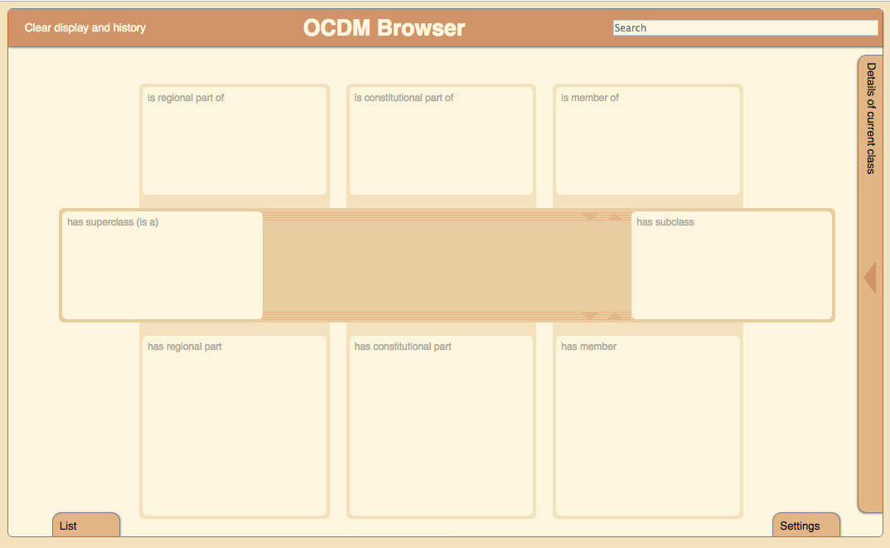
OCDM Browser 1
SparQL Endpoint
OCDM Browser

Slide 32
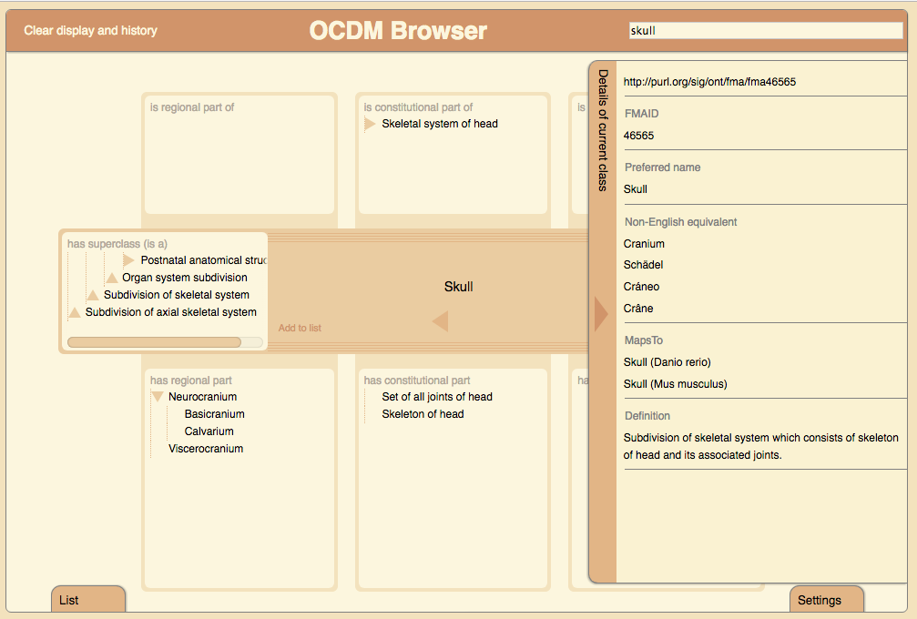

Slide 33
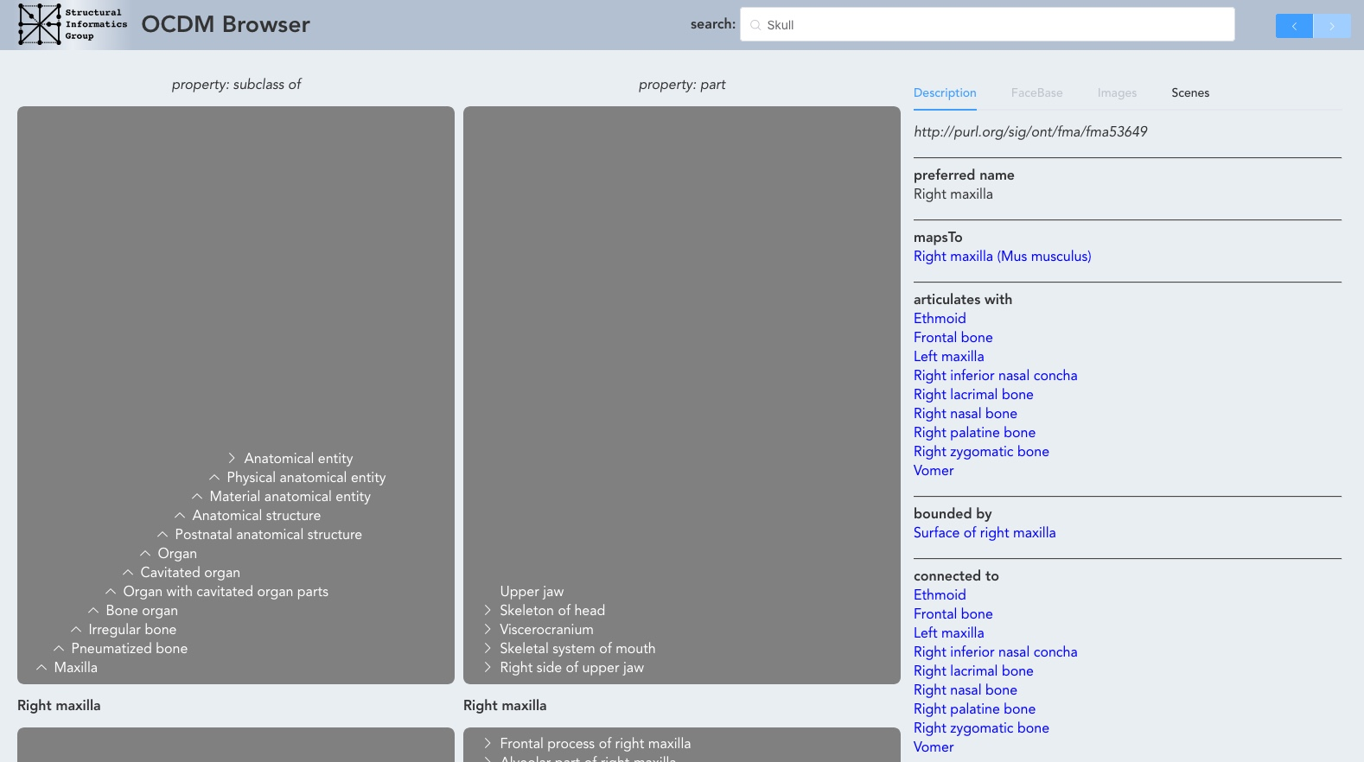
OCDM Browser 2
RDF Store
SparQL Endpoint
Other resources

Slide 34
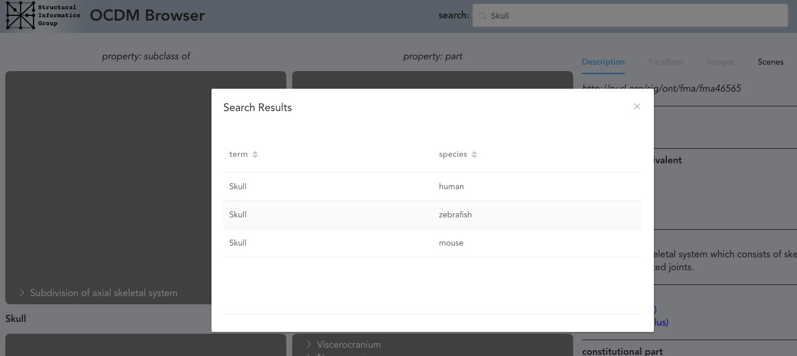

Slide 35
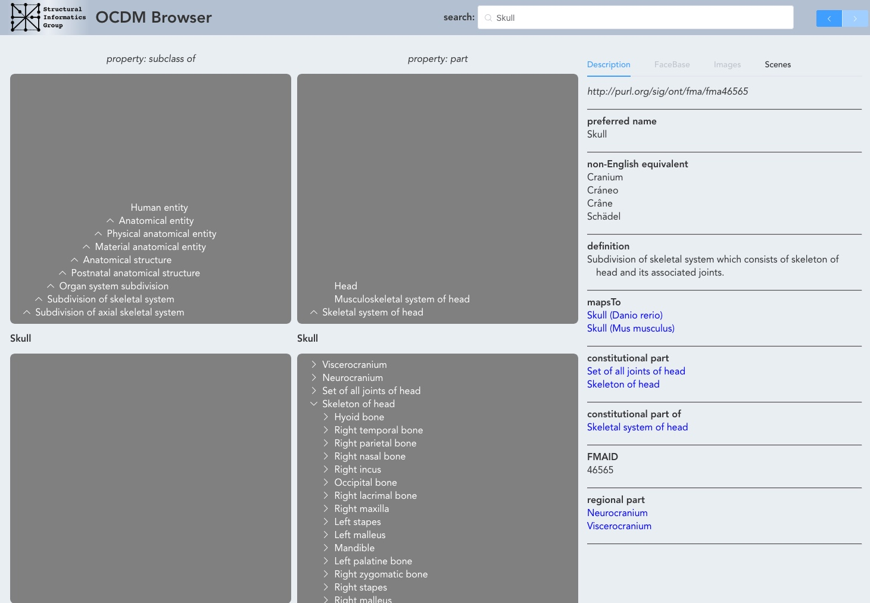

Slide 36


Slide 37
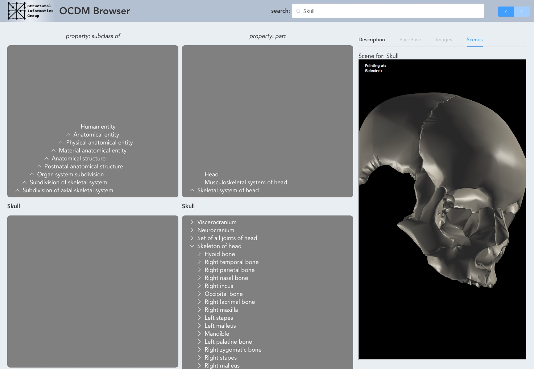

Slide 38
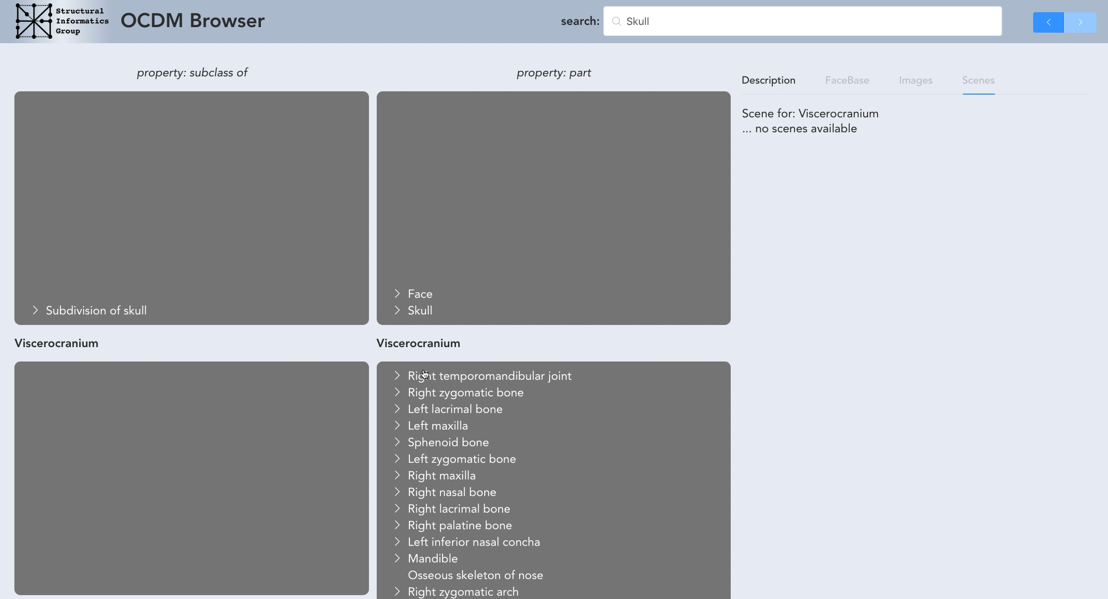

Slide 39
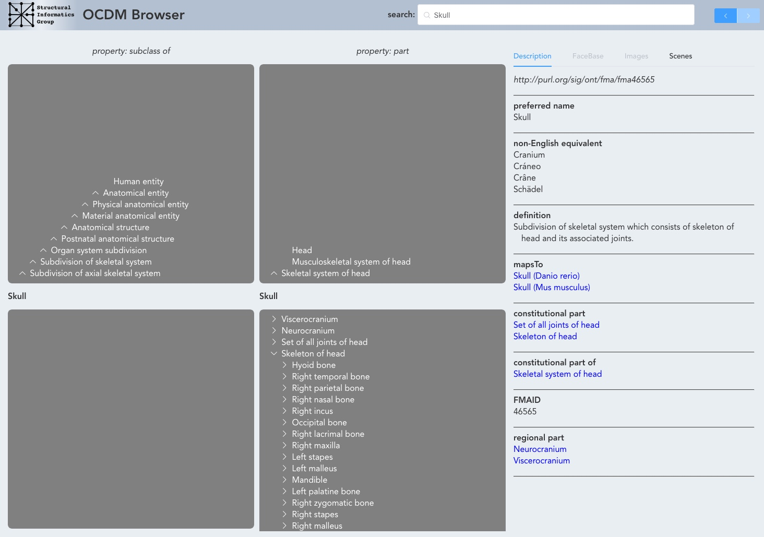

Slide 40
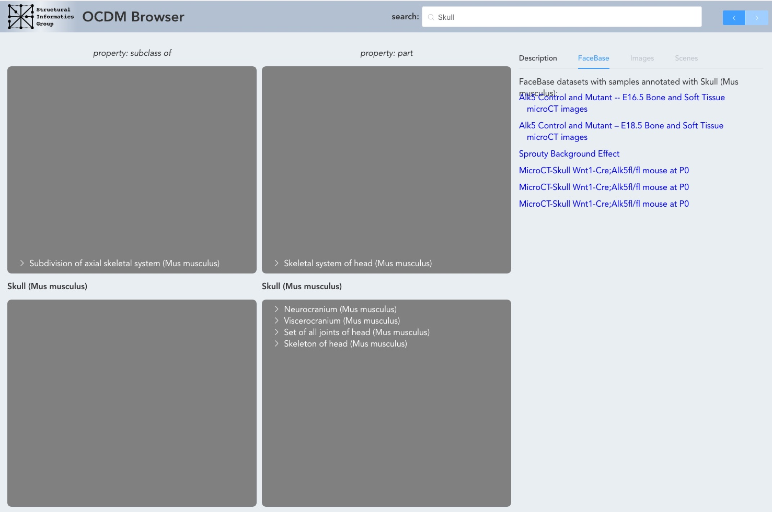

Slide 41
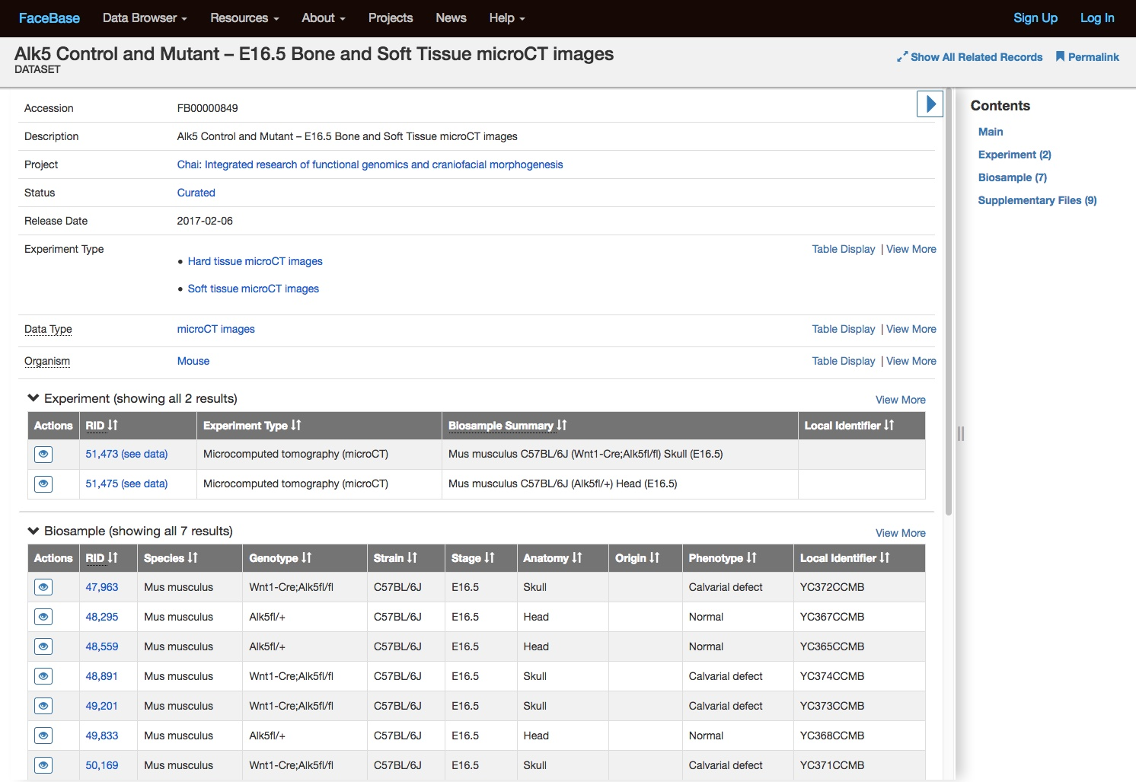

Slide 42
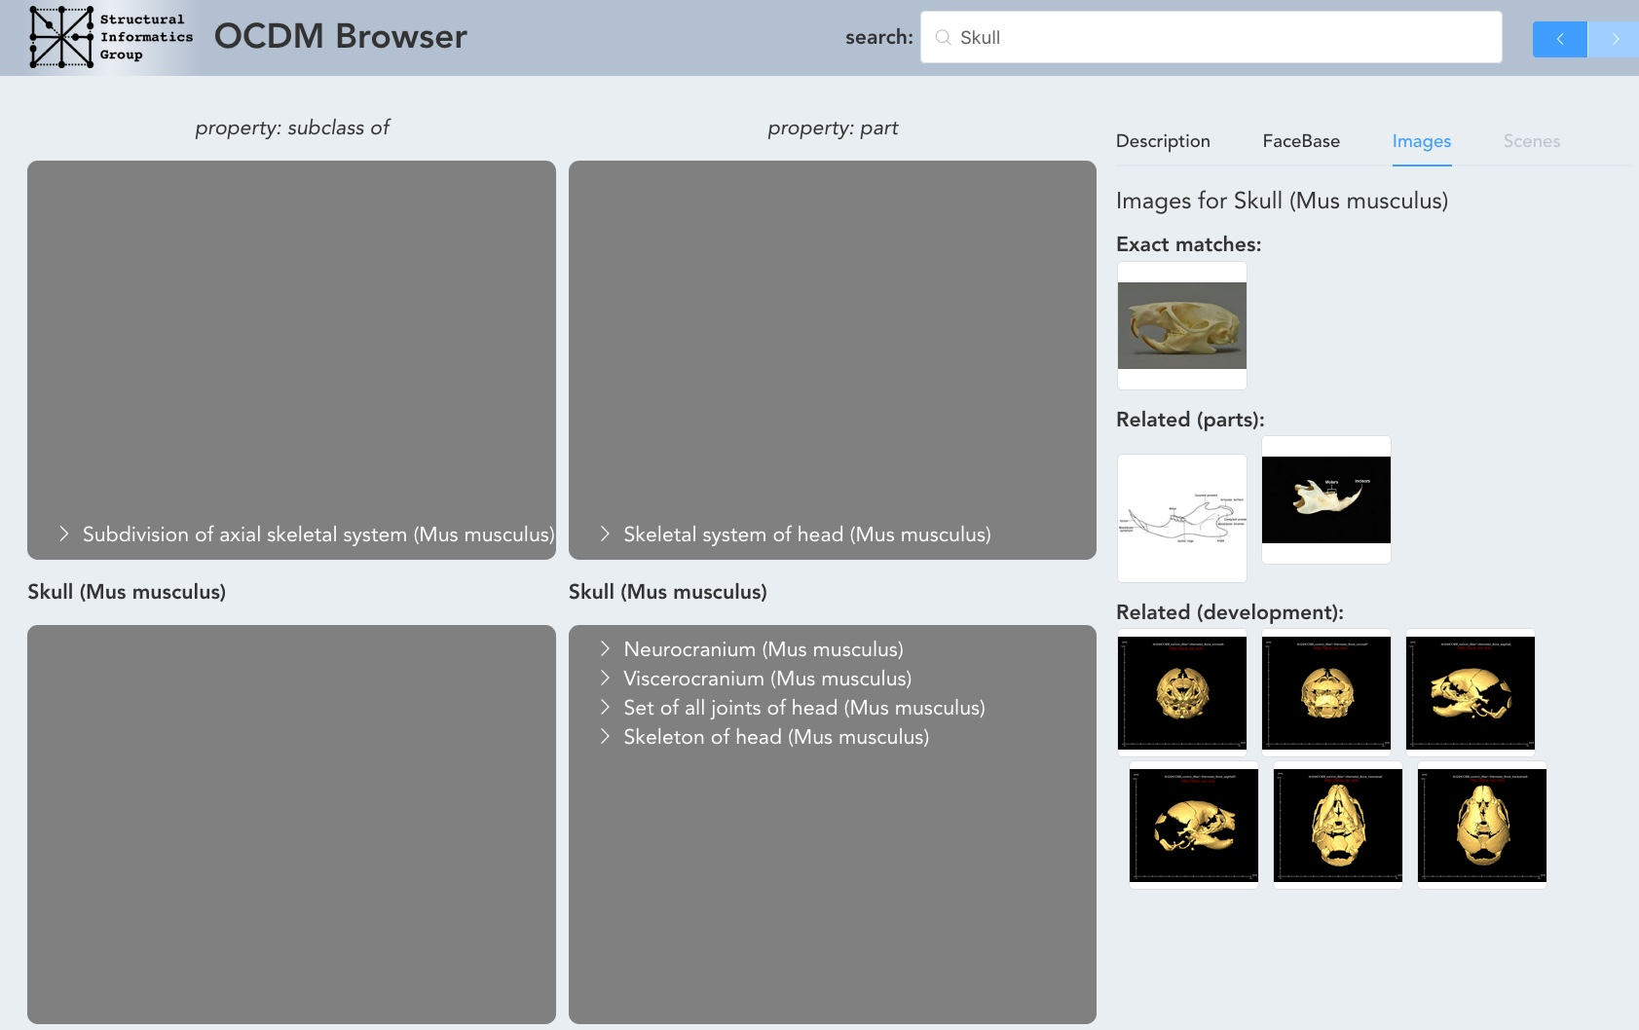

Slide 43
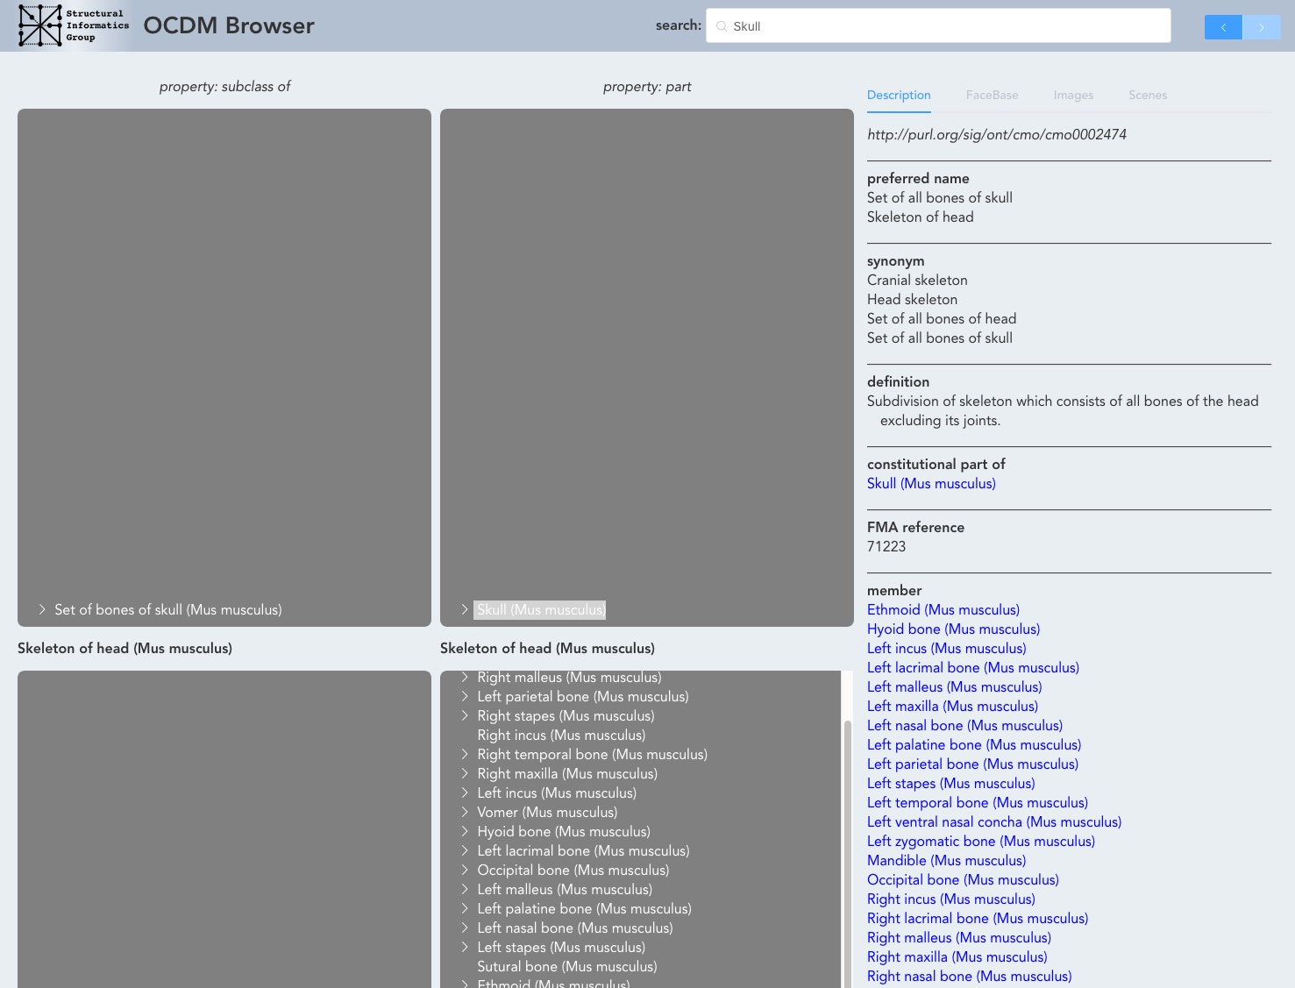

Slide 44
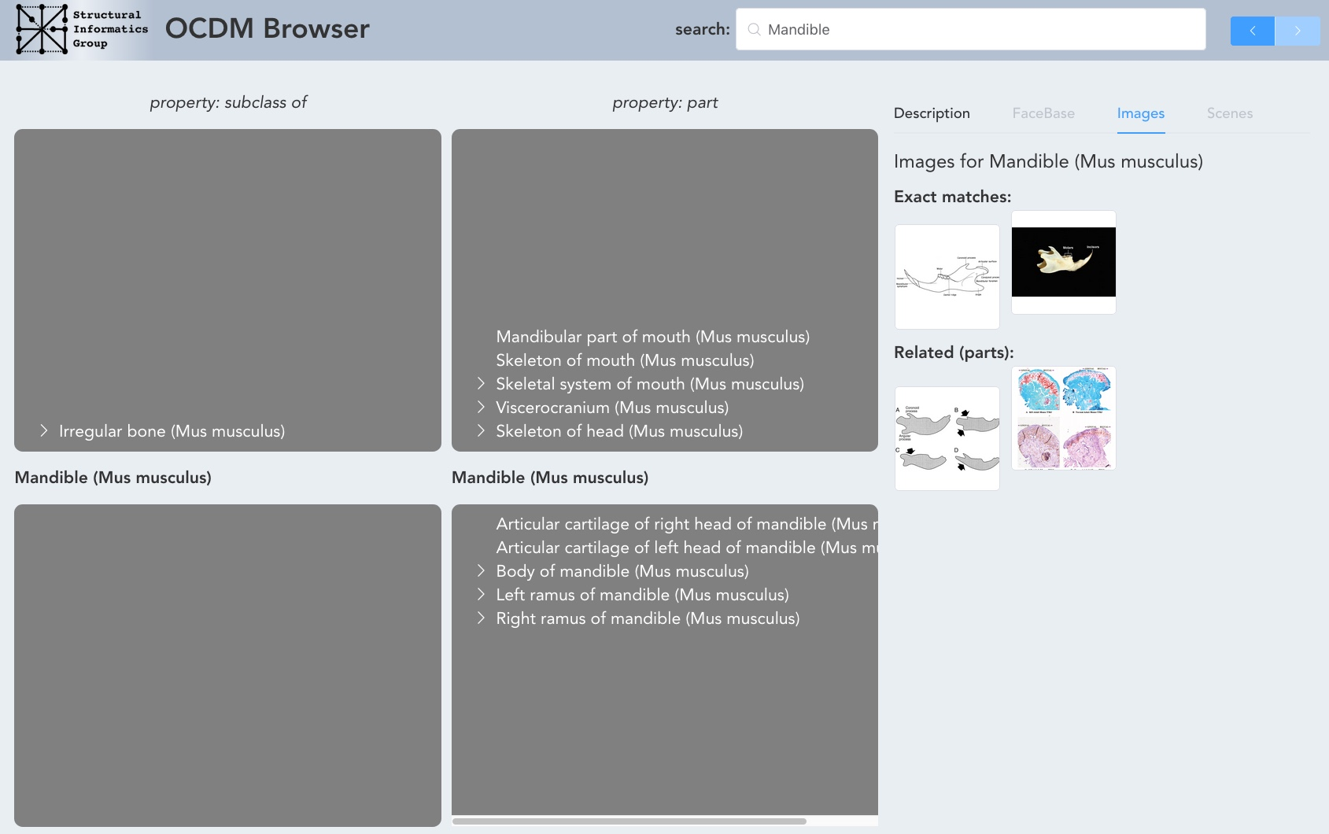

Slide 45
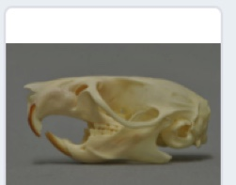
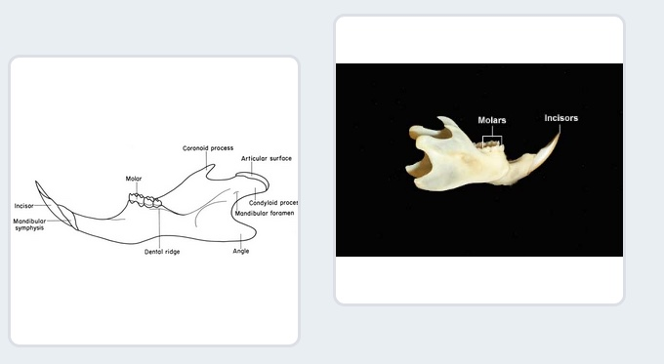
Exact Matches:
Skull (Mus musculus)
Related:
Mandible (Mus musculus)

Slide 46
Exact Matches:
Skull (Mus musculus)
constitutional part
Skeleton of Head (Mus musculus)
Related:
member
Mandible (Mus musculus)

Slide 47
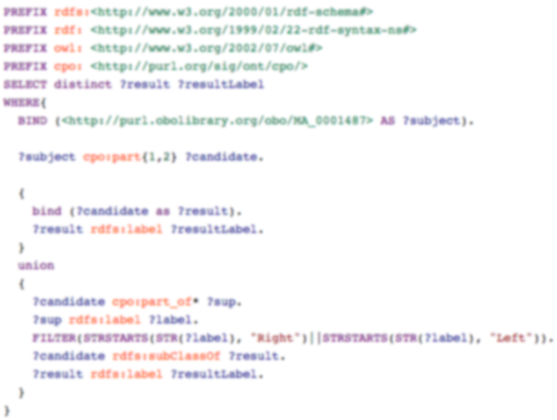
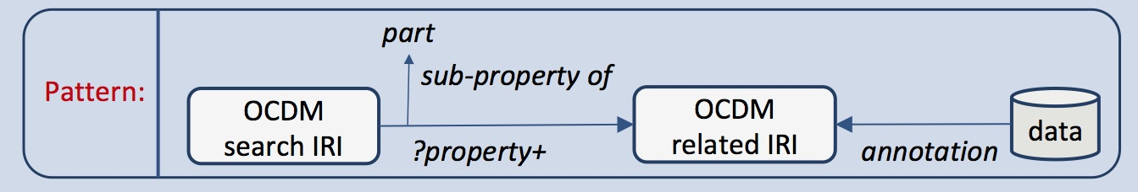
Knowledge Patterns

Slide 48
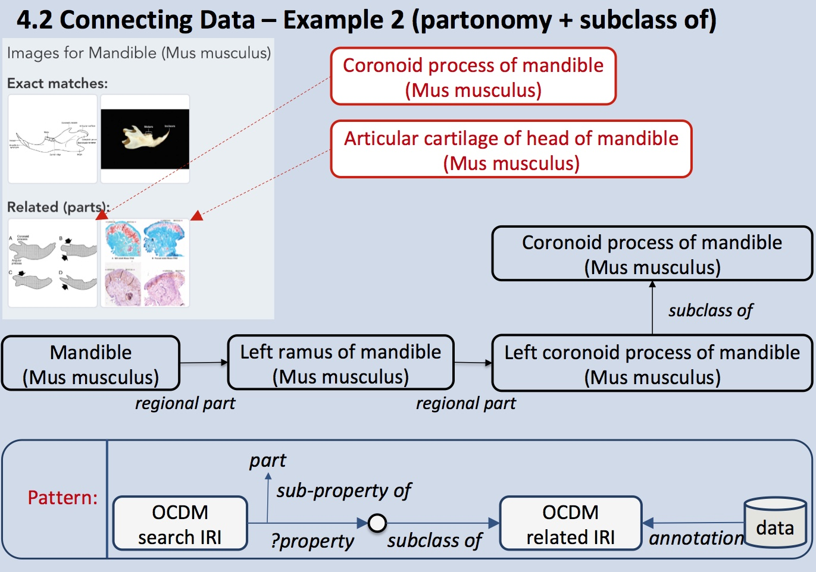

Slide 49
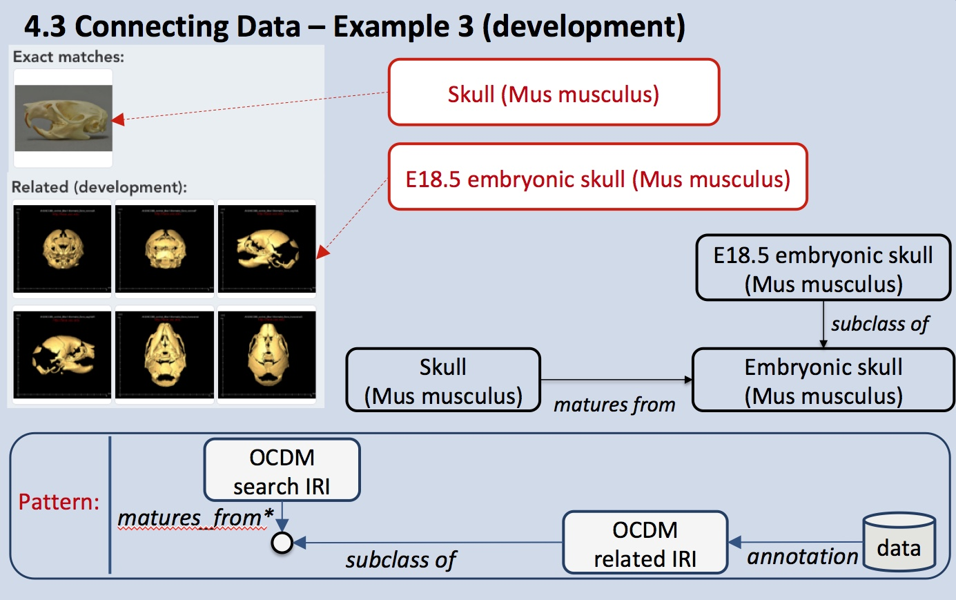

Slide 50
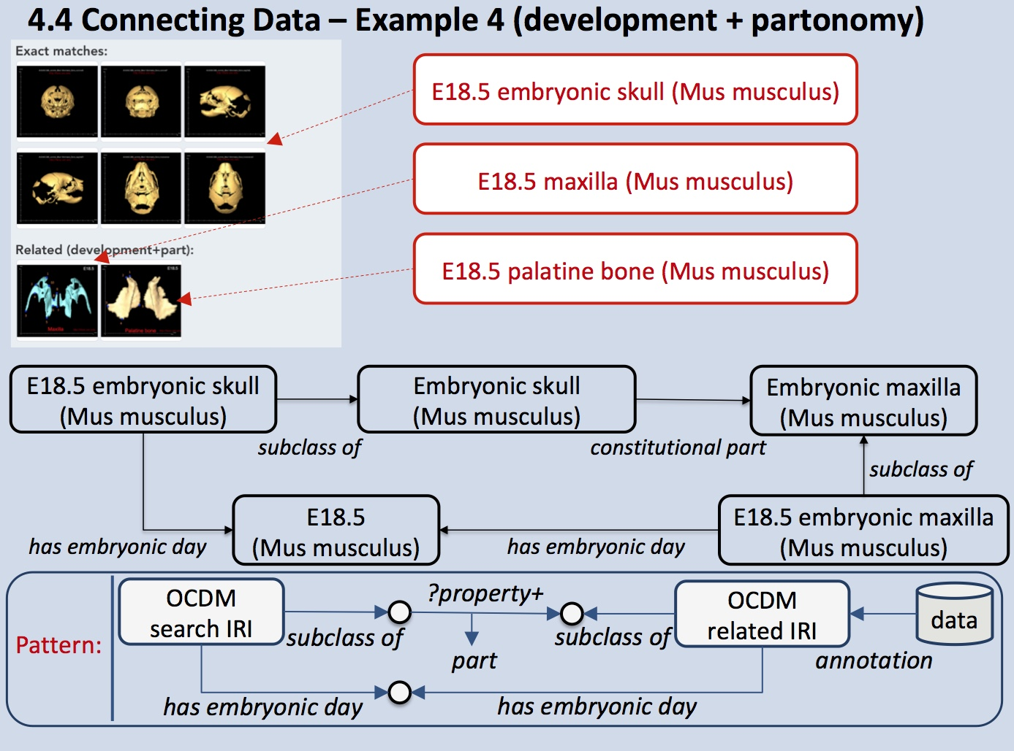

Slide 52
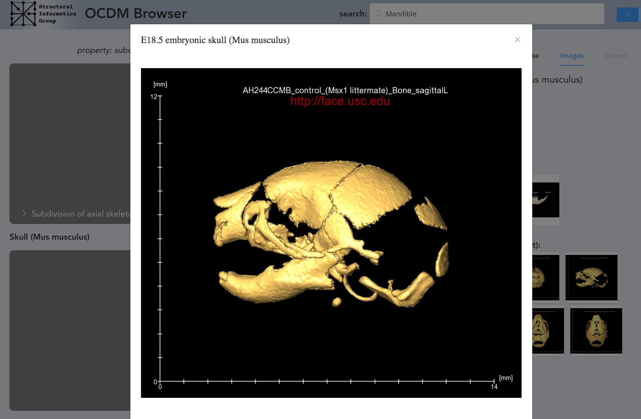

Slide 53
Topics
Multi-species malformation ontologies
Termlists for Hub
Ongoing methodology
Year 5 plans

Slide 54
Year 5 Plans
Year
Task Date
5. Craniofacial malformation (facial and cranial vault dysmorphology)
a. CHMO (Human) July 1, 2017 – Nov 30, 2017
b. CMMO (Mouse) Dec 1, 2017 – March 31, 2018
c. CZMO (Zebrafish) April 1, 2018 – Aug 31, 2018
6. Malformation mappings
a. CHMO with CMMO Sept 1, 2018 – Dec 31, 2018
b. CHMO with CZMO Jan 1, 2019 – April 30, 2019
4
5
Continue development of prototypes showing potential usefulness of OCDM

Slide 55
FaceBase interaction
Content development
  Human-mouse mapping (CMMO)
    Mimi Jabs
  Human-zebrafish mapping (CHZMO)
    Matthew Harris
    Shannon Fisher
  Zebrafish malformation (CZMO)
  Matthew Harris
  HUB term list
    Alejandro Bugacov

Slide 56
Links
Overview of OCDM
  http://www.ncbi.nlm.nih.gov/pmc/articles/PMC4041627/
OCDM Browser 2
  http://sigprod.si.washington.edu/ocdm/
Obtaining the OCDM
  https://www.facebase.org/ocdm/

