Slide 1
Anatomical atlas and transgenic toolkit
for late skull development in zebrafish
Fisher group
Michelle Kanther
Alexandra Scalici
Azman Rashid
Kelly Miao
Ella Van Deventer
Harris group
Katrin Henke
Brent Hawkins
Joana Lopes
Notes:
This project is a collaboration between myself and Matthew Harris. Before I start, I’d like to acknowledge the people in our two labs who have worked to generate the data I’m going to talk about today.

Slide 2
Notes:
A primary goal of our project is to provide anatomical information on normal skull development in zebrafish. We are employing two primary methods; in my lab, we use expression of fluorophores in transgenic fish, visualized by confocal microscopy. In the Harris lab, they use high resolution micro-computed tomography. The two methods are nicely complementary, and as our labs accumulate more data, we’ve been focusing on making it most useful to the broader community, and on improved methods for data collection and processing.

Slide 3
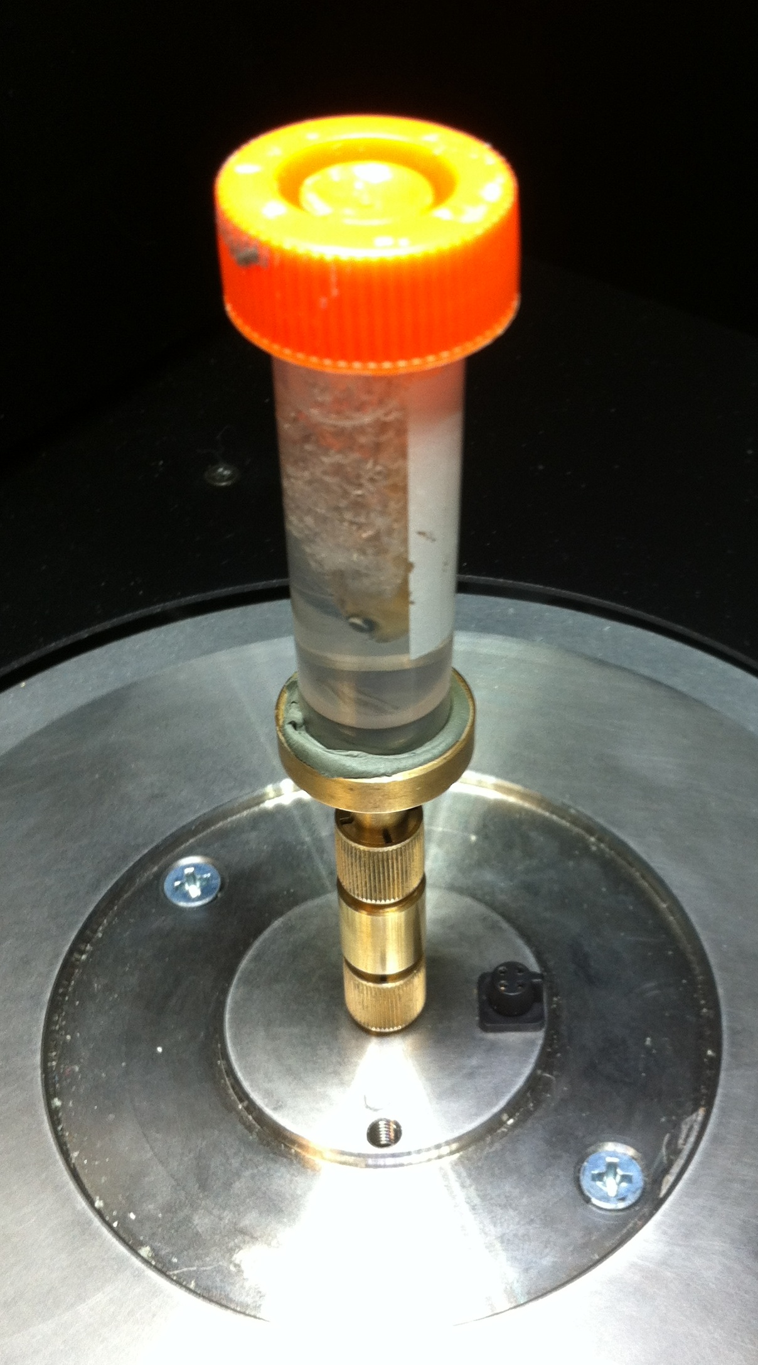
Notes:
The Harris lab relies on micro-CT to generate images of fixed specimens. This captures data with equally high resolution in all axes, which lends itself well to 3D reconstructions. However, imaging is performed on fixed samples, so dynamic processes cannot be observed. Additionally, because µCT traditionally relies on the contrast from tissue mineralization, imaging of poorly mineralized younger fish is difficult.

Slide 4
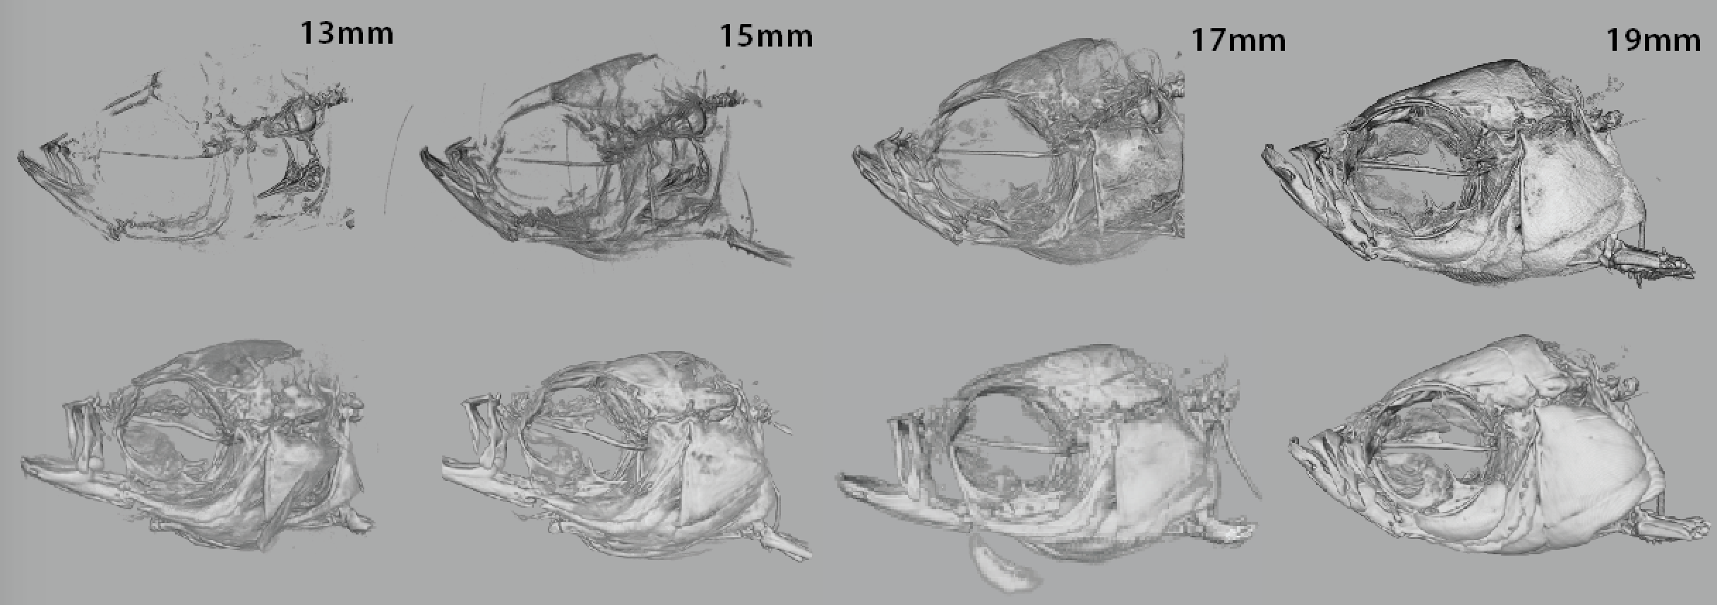
13 mm
15 mm
17 mm
19 mm
With AgNO₃ contrast
Notes:
The enhanced contrast makes it possible to see all cranial bones in much smaller fish, increasing the overlap between stages good for confocal and good for µCT. Even at later stages, where unenhanced µCT is feasible, the silver staining enhances detection.

Slide 5
col1a1:egfp
sp7:mcherry
Notes:
For our confocal imaging, the most broadly useful transgenic lines have been these two, that express GFP in chondrocytes and mCherry in osteoblasts. They are quite bright and very specific, with little background, and both maintain expression into adults. Our primary instrument for imaging is a Leica TCS-LSI, a macro confocal, which is basically the laser and detection guts of a confocal using the optics of a high-end zoom macroscope. Please visit Alexandra Scalici’s poster later today, where she will show you many additional beautiful images, and share some of the challenges of imaging on live fish.

Slide 6
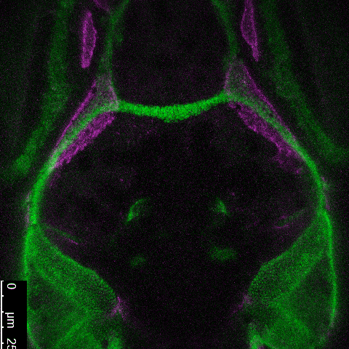
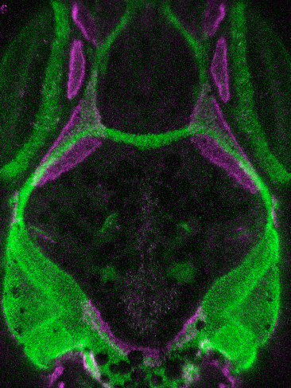
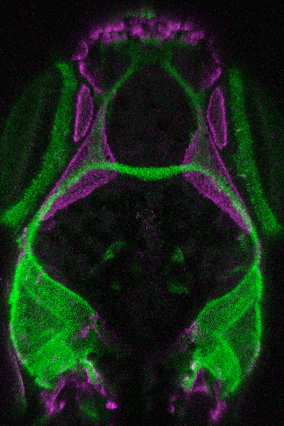
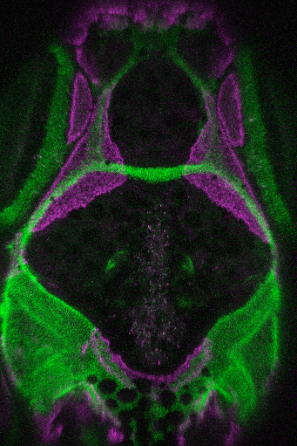
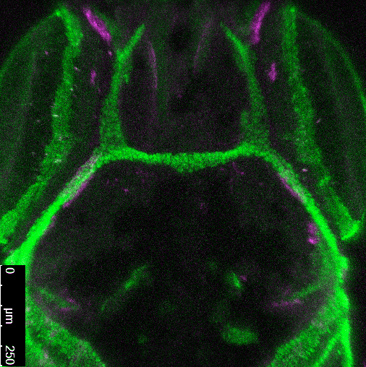
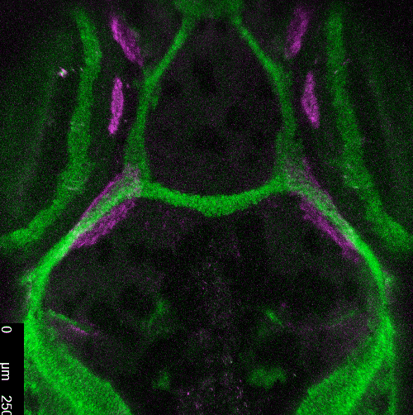
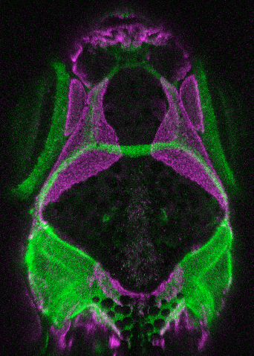
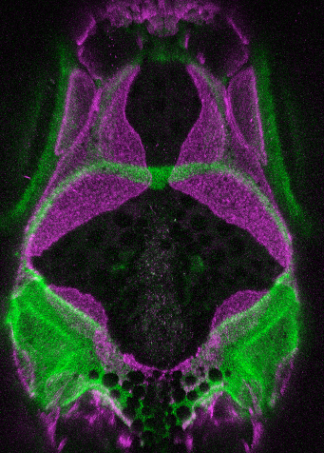
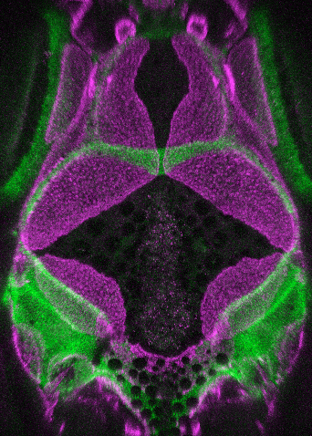
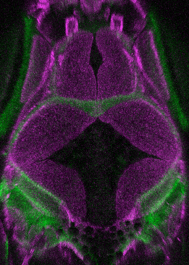
cartilage bone
18-32 dpf
Michelle Kanther
Notes:
We do a lot of what I call pseudo-time-lapses, where we successively image the same fish over a period of days or weeks. These are images of cartilage and bone in an individual fish over a period of two weeks. Each panel represents a projection of a Z-stack taken on a single day, starting just after the first appearance of the frontal bones and going up to the point where the interfrontal suture is largely established.

Slide 7
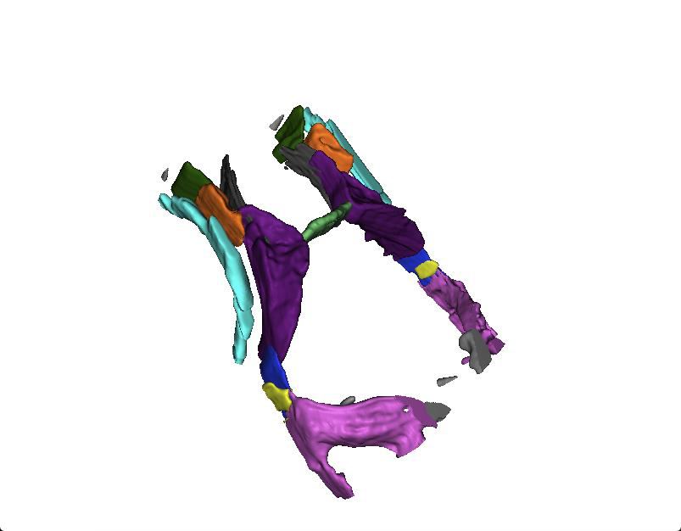
Azman Rashid
Notes:
Azman Rashid in my lab has been generating 3D PDFs from some of our confocal data – I will refer you to his poster for the details of the processing. The end result is a PDF file in which all the individual cartilage and bone elements have been annotated and color coded. The image can be freely rotated…

Slide 8
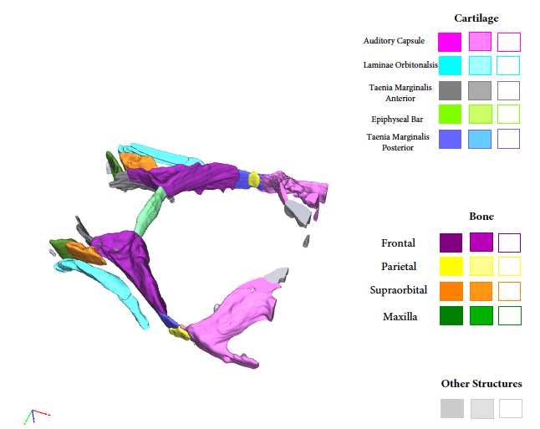
Notes:
and has interactive buttons…

Slide 9
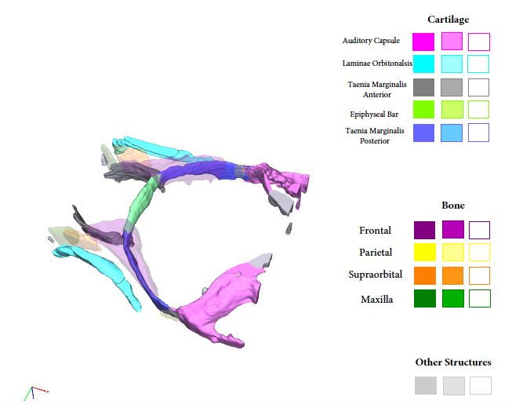
Notes:
that allow each element to be made translucent…

Slide 10
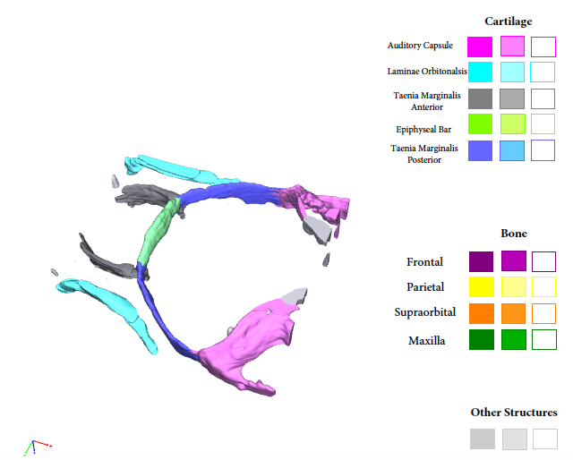
Notes:
or removed entirely. The PDFs will be available for download from FaceBase; they are files of fairly modest size, which can be viewed with the free program Adobe Acrobat Reader. The 3-D viewer that is integrated into FaceBase is not compatible with the PDFs, but we’ve found a workaround, where the files for the segmented structures are sent to the Hub in a different format.

Slide 11
Frontal bone initiation
5.79 mm (19 dpf)
5.99 mm (20 dpf)
6.15 mm (21 dpf)
6.30 mm (22 dpf)
Notes:
When we began these studies, the biggest surprise to me was how early we could see the beginning of frontal bone formation. We see the first cells of the frontal bone consistently at about 5.8 mm, associated with the taenia marginalis posterior near it’s junction with the epiphyseal bar. In this fish, we were lucky enough to start imaging just as the first couple cells appeared in the left frontal bone. Over the next couple days, there is a gradual increase in cells, which accelerates at about 6.3 mm.

Slide 12
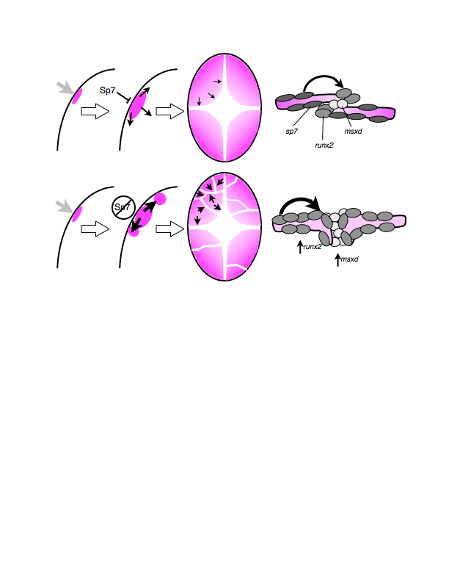
Phase 1
Initiation
Phase 2
Planar growth
Phase 3
Suture formation
Notes:
These observations have contributed to a model that we use as a framework for thinking about the events of normal skull formation, and the abnormalities we find in mutants.

Slide 13
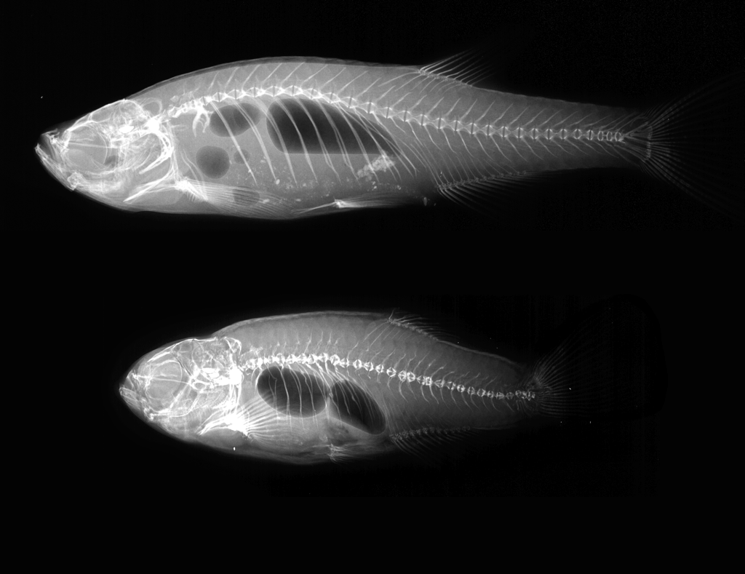
col1a1a mutation: Osteogenesis Imperfecta
Chi^{+/–}
Notes:
As a first step towards generating integrated data, we performed confocal imaging on several Chihuahua mutants and siblings. Chi is a mutant in one of the type I collagen genes, an accurate model for human OI, We started with Chi because it’s a model for a human disease, but also one of several mutants we have between our two labs that affect bone matrix and mineralization. Once we finished with the live fish, they were fixed and given to the Harris lab for scanning.

Slide 14
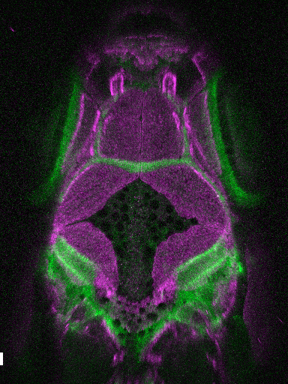
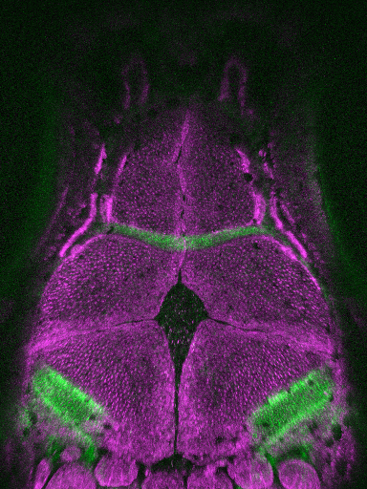
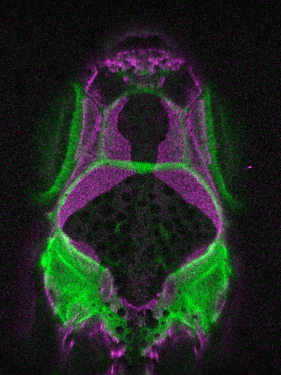
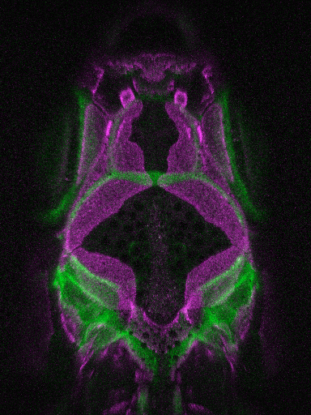
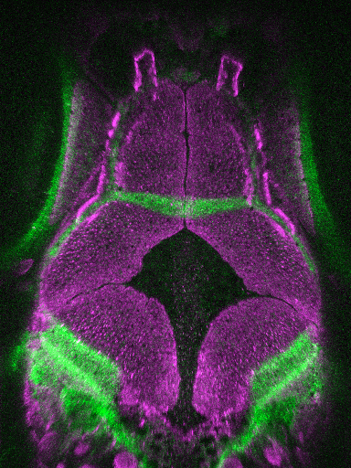
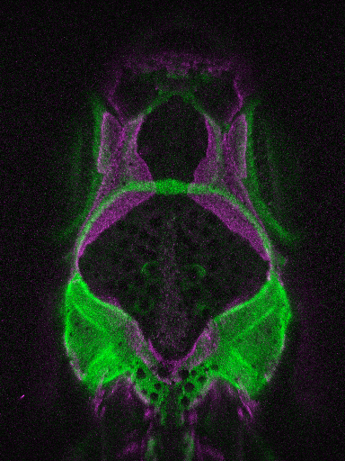
Skull growth lags in Chi mutants
24 dpf
30 dpf
36 dpf
Chi^{+/–}
Notes:
However, by observing skull growth in live fish, it became apparent that the mutants displayed a very specific and quantitative defect during planar growth of the skull bones. These fish are matched not just for age, but also for standard length, yet there is a growing lag in growth of the frontal and parietal bones.

Slide 15
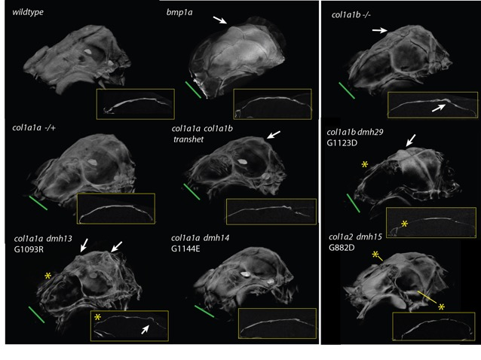
Zebrafish type I collagenopathies
Gistelinck, Willaert, et al.

Slide 16
toth–/–
WT
7.98 mm (45 dpf)
11.83 mm (41 dpf)
Alexandra Scalici
Ella Van Deventer
Notes:
We were limited initially in our live imaging studies on the mutants; not only are they difficult to pick out morphologically until fairly late juveniles stages, but they turn out to be only semi-viable. So we could see the phenotype fairly late, but were not able to see how it evolved. Through sheer perseverance, and many hours of staring in the microscope at transgenic larvae, Ali managed to pick out the mutants earlier, so that we could follow this process in younger fish.

Slide 17
toth–/–
WT
5.91 mm (20 dpf)
6.15 mm (21 dpf)
6.06 mm (22 dpf)
6.58 mm (23 dpf)
6.17 mm (25 dpf)
7.13 mm (26 dpf)
6.35 mm (28 dpf)
7.80 mm (28 dpf)
Notes:
As I said, the mutants as live fish are indistinguishable morphologically from their siblings until about a month of development, so we were surprised to see how severely affected the early growth of the frontal bone is. We believe the frontal bone initiates at the same stage as in WT, although we have only looked a small number of mutants at this point. So at first they look similar, but over the next few days the WT bone expands dramatically, while the mutant barely changes. Also, during this time period, the overall growth of the mutants seem to start lagging, as you can see by the increasing difference in standard length.

Slide 18
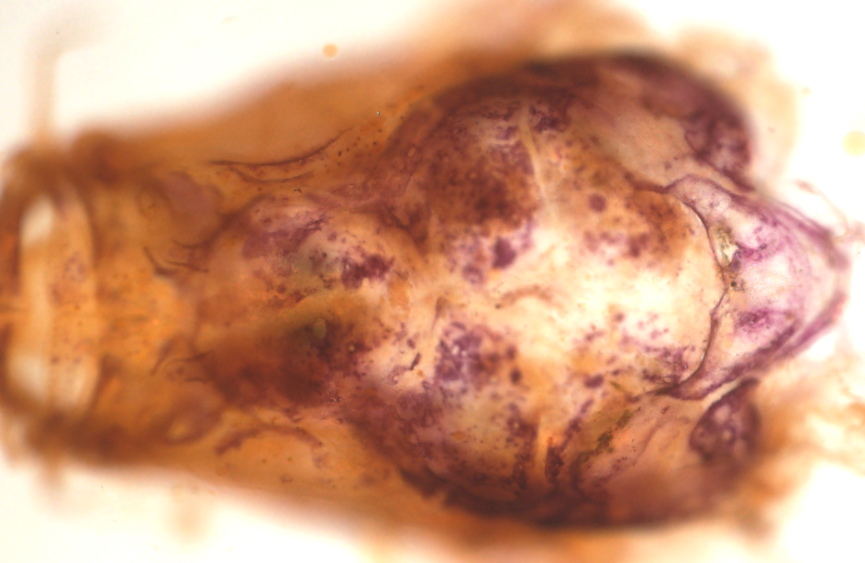
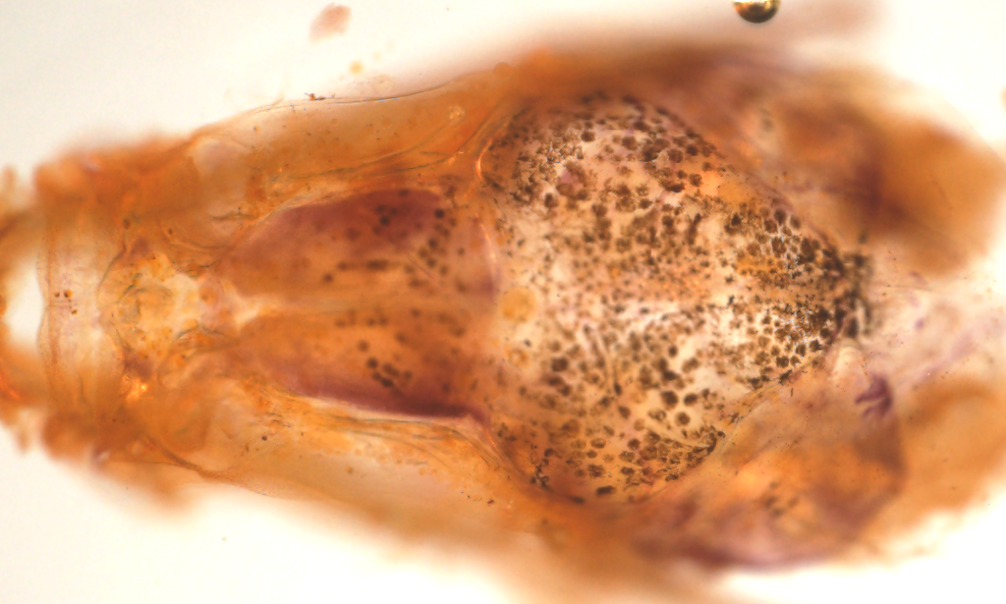
toth–/–
WT
12.6 mm (74 dpf)
14.6 mm (74 dpf)
Notes:
However, in fish at 2 ½ months, when we can pick out the mutants easily, we observe a dramatic difference in TRAP staining between mutant and WT. In the WT, there is almost no staining, which is a little bit obscured by the pigment cells; this arrow points to the only concentration of osteoclasts in the WT skull at this stage. In the mutant, the entire inner surface of the skull bones is covered with clusters of osteoclasts. We also see increased staining in other parts of the skeleton, for example in the ribs, which show almost no staining in the WT. However, not every part of the skeleton has TRAP staining, even in the mutant.
I can’t tell you quite yet what toth is, although I can tell you what it isn’t. In collaboration with Matthew Harris and Katrin Henke, we localized the mutation by exome sequencing, and followed up with mapping to further narrow the region to about 20 genes. Out of these, about half are pretty implausible as candidates, and none have nonsense mutations in the coding sequence. The other half are either uncharacterized, or have not been previously associated with either skeletal growth or osteoclasts. So whatever the gene is, it will reveal a new aspect of osteoclast regulation and its role in skeletal growth.

Slide 19
calcein
Joana Lopes
Kelly Miao
ctsk:dsred

Slide 20
22 dpf
34 dpf
27 dpf
34 dpf

Slide 21
Composite osteoclast distribution
9 mm
12 mm
Notes:
One of the datasets we are working to get on FaceBase in the next few months is a developmental atlas of osteoclast distribution in normal skull development. Between our two groups, we already have more than one mutant phenotype that will clearly be informed by a better understanding of osteoclast behavior in normal development. Our hope is that the availibilty of such data will similarly help others investigators, not just in zebrafish but in other organisms as well.
In summary, I’ve given you a very quick overview of the data that we have made available already on FaceBase. Even more importantly, I’ve tried to give you a sense of the research directions and collaborations that have been inspired both for us, by the acquisition of the data, and for others by its availability.

