Slide 1
Transcriptome Atlases of the Craniofacial Sutures
Greg Holmes
Icahn School of Medicine at Mount Sinai, New York
www.facebase.org
Notes:
Hello All, I’d like to present our update of the Transcriptome Atlases project, with a brief introduction for those not familiar with craniofacial sutures or the project.

Slide 2
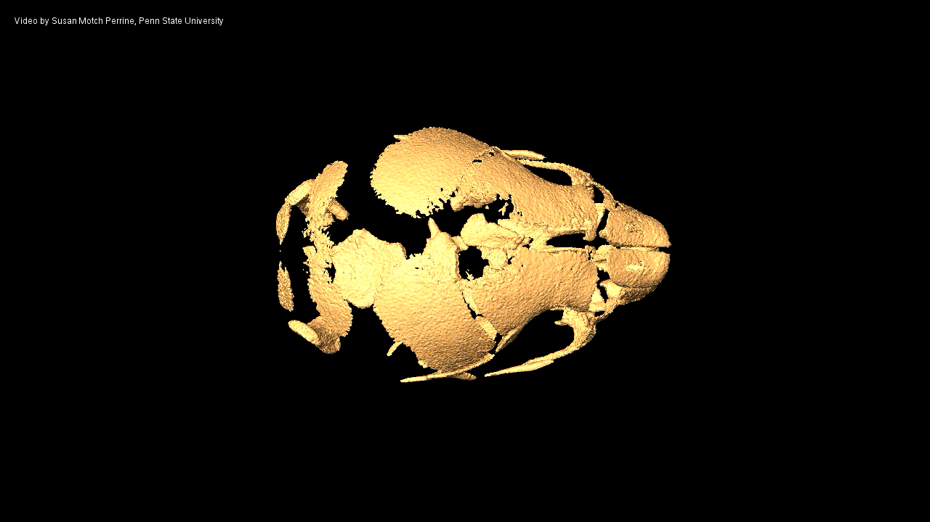
Sutures
Notes:
The bones of the vertebrate skull, as shown here in a uCT image of the P0 mouse skull, are separated by fibrous joints called sutures.

Slide 3
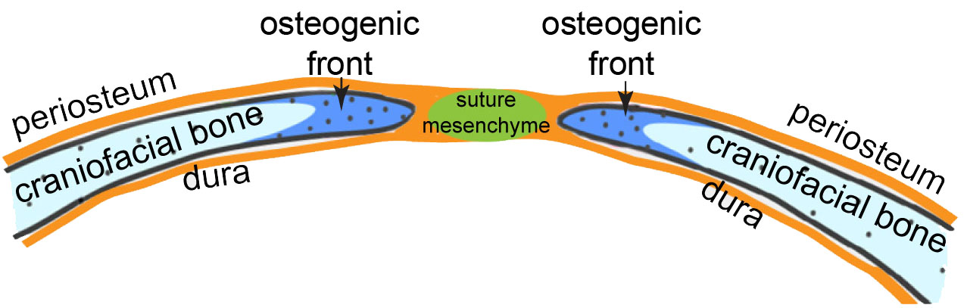
Sutures
Zhao et al., 2015
Subregions:
Osteogenic fronts- proliferation and differentiation of preosteoblasts
Suture mesenchyme- separates osteogenic fronts; later a niche for osteoblast stem cells
Notes:
In the simplest definition sutures consist of two subregions. One is the edges of the bones, or osteogenic fronts, which are sites of bone growth, as preosteoblasts proliferate and differentiate to osteoblasts. The fronts are separated by suture mesenchyme, which during postnatal life become a niche for stem cells, as shown by Yang Chai’s and Wei Hsu’s groups. The relationship between fronts and mesenchyme is less well defined during embryonic growth. This suture shape is typical of calvarial sutures, which form in a narrow tissue plane over the brain.

Slide 4
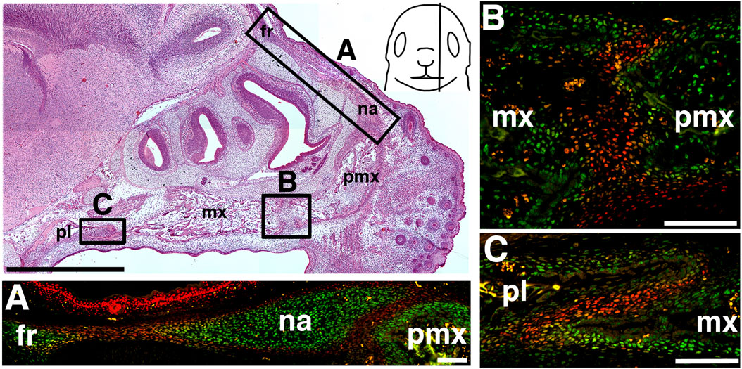
Suture Morphology Varies
Premaxillary/maxillary
Frontonasal
Nasopremaxillary
Maxillary/palatine
E16.5 Mouse
Immunohistochemistry: RUNX2, BCL11B
Holmes et al., 2015
Notes:
However, suture morphology varies widely, particularly in the face. This is a sagittal section of the E16.5 mouse face, antibody-stained green for Runx2 in osteoblasts, and red for Bcl11b in suture mesenchyme. The frontonasal suture has the arrangement I just showed you, where the osteogenic fronts are separated by mesenchyme in a narrow plane. But other sutures may have a much broader end to end interface, like the nasopremaxillary or the premaxillary/maxillary, and others like the maxillary/palatine can have an overlapping structure, where what may be considered the osteogenic fronts are a small component of the bone interface. But in all cases the suture mesenchyme is an identifiable compartment, for example by Bcl11b expression and other gene expression patterns we find in the transcriptome atlases we’ve generated.

Slide 5
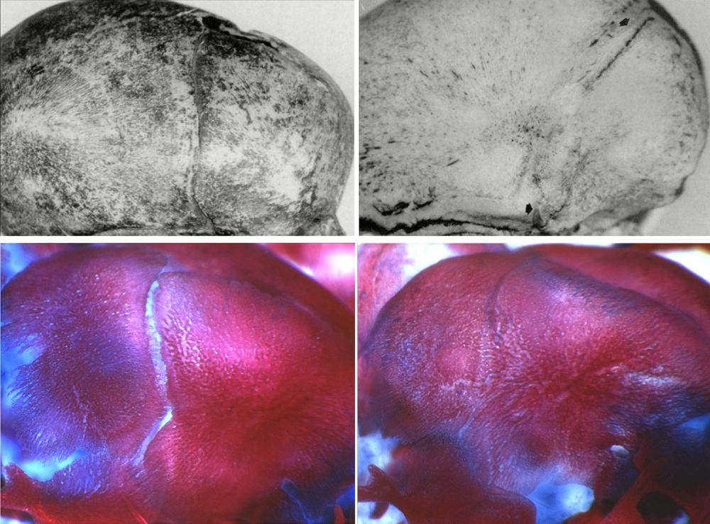
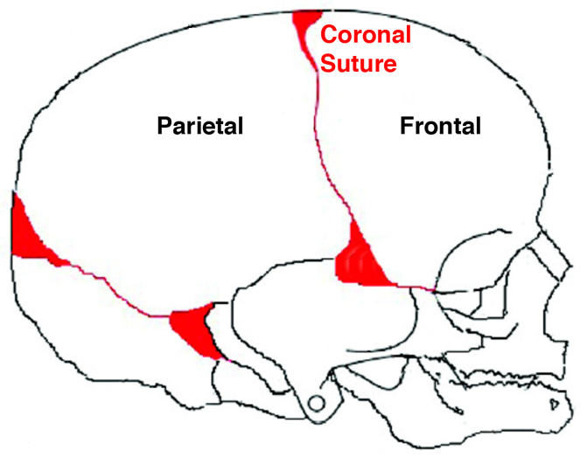
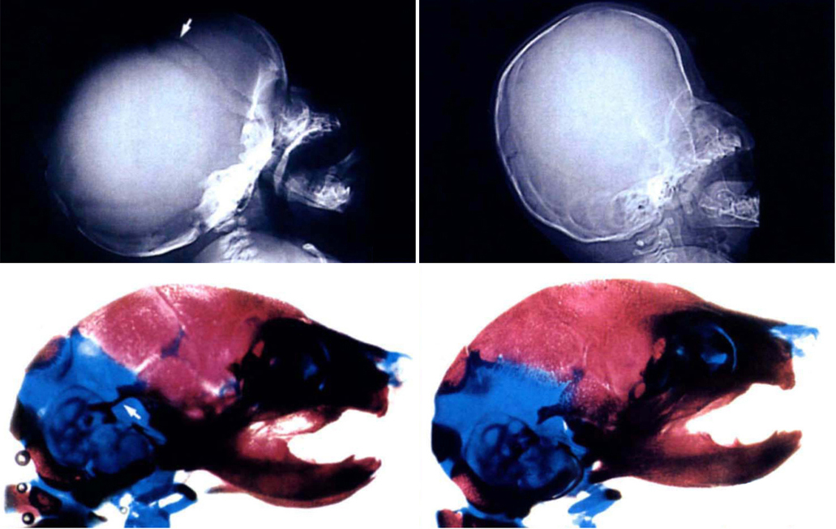
Differential Gene Expression Underlies
Suture Development and Disease
Coronal Suture
p
f
Apert syndrome
Fgfr2^{+/S252W}
Mathijssen et al., 1996
P0
Mouse Human Mouse Human
Holmes et al., 2009
9 months
P0
p
f
Saethre-Chotzen
syndrome
Twist1^{+/-}
1
Johnson et al., 2000
El Ghouzzi et al., 1997
Comprehensive suture subregion gene expression profiles are needed
Notes:
Formation and function of the sutures is underpinned by differential gene expression, and perturbation of gene function or expression results in craniofacial dysostoses such as craniosynostosis, midface hypoplasia, and frontonasal dysplasia.
This is exemplified by the expression of Fgfr2 and Twist1, shown here in the mouse coronal suture at E16. Fgfr2 is expressed in the osteogenic fronts, and activating mutations of Fgfr2 lead to ossification of the mesenchyme and fusion of the coronal suture such as in human Apert syndrome, and in mouse models of this condition.
Conversely, Twist1 is expressed in the suture mesenchyme and fronts, and depending on interactions with protein partners, represses Fgfr2 in the mesenchyme or promotes its expression in the fronts. Loss of Twist1 also leads to ossification of the mesenchyme and fusion of the coronal suture in human Saethre-Chotzen syndrome, and again in mouse models of Twist1 haploinsufficiency. The genes responsible for most cases of CS and other craniofacial dysplasias aren't known, and we lack a comprehensive knowledge of gene expression in sutures to understand how they function normally, let alone in disease. The transcriptome atlas project aims to rectify this.

Slide 6
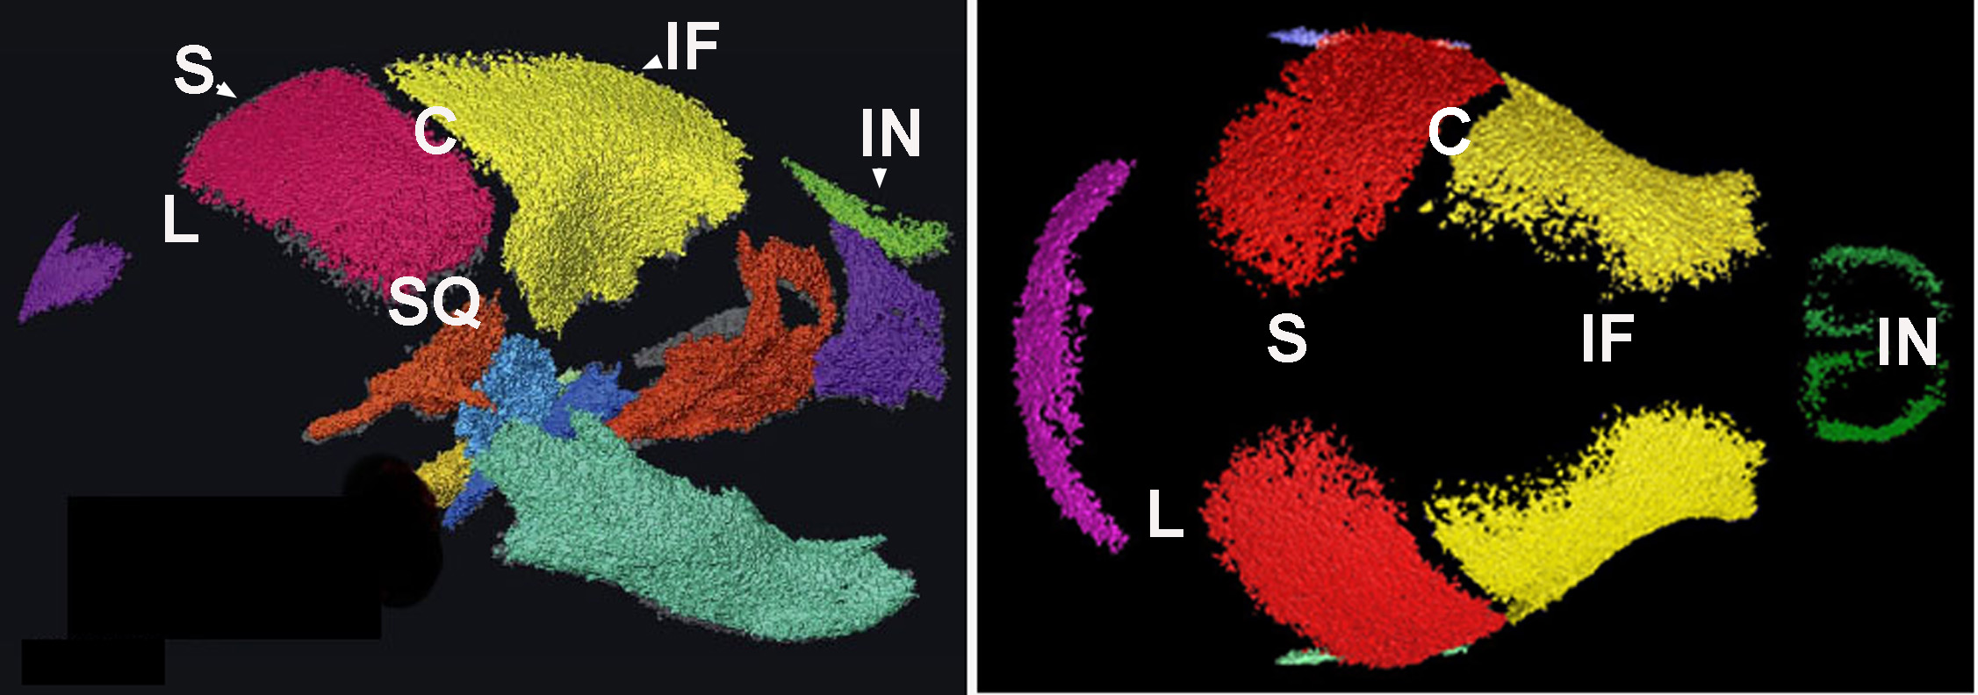
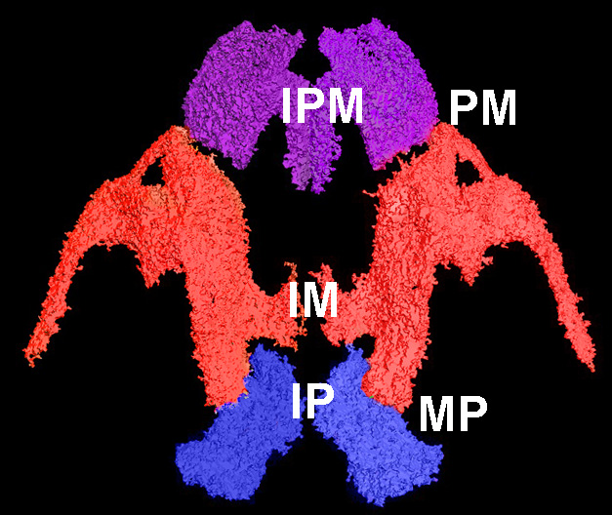
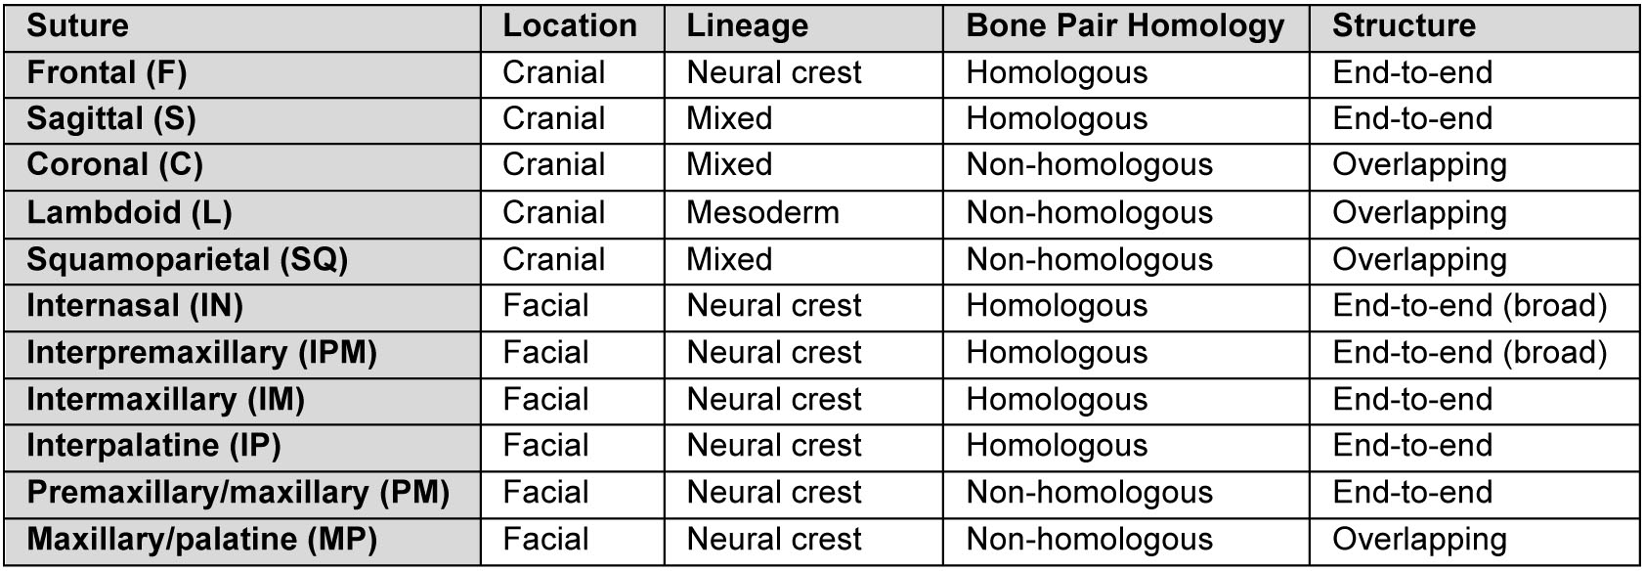
Atlases from 11 Sutures - Multiple Ages, WT and Craniosynostosis Genotypes
Chris Percival
Notes:
We are creating transcriptome atlases for 11 craniofacial sutures, including at multiple ages, and WT and craniosynostosis genotypes. The sutures themselves vary in a number of ways that may have a basis in gene expression differences, such as location and lineage, bone identity, or structure.
6

Slide 7
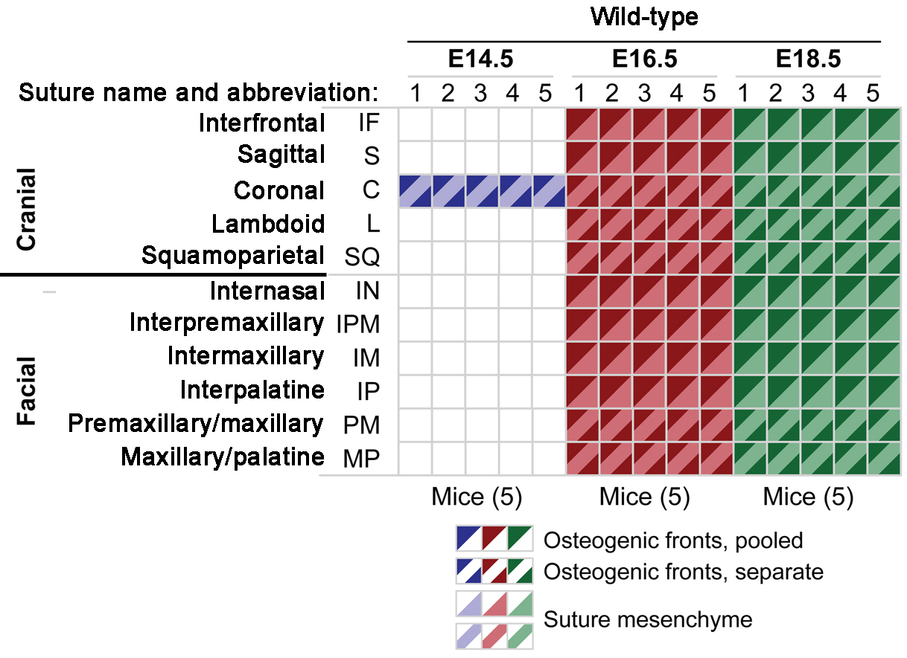
WT Suture
Expression Profiles
Frontal
285 WT profiles
285 WT profiles
Notes:
This table illustrates the number of samples in the final dataset for WT sutures. Each of the 11 sutures is a row, there are two ages for most sutures, E16.5 and E18.5, and 5 replicates for each, totaling 285 individual RNA-Seq libraries. For the coronal suture we are also including the E14.5 suture.

Slide 8
Craniosynostosis Mouse Models
Apert syndrome
Fgfr2^{+/S252W}
p
f
Mathijssen et al., 1996
P0
Mouse Human Mouse Human
Holmes et al., 2009
9 months
P0
Saethre-Chotzen
syndrome
Twist1^{+/-}
f
p
El Ghouzzi et al., 1997
Notes:
We are also generating libraries from CS mouse models to allow discovery of what happens in fusing or non-fusing mutant sutures, using the Fgfr2 and Twist1 mutant models I’ve mentioned.

Slide 9
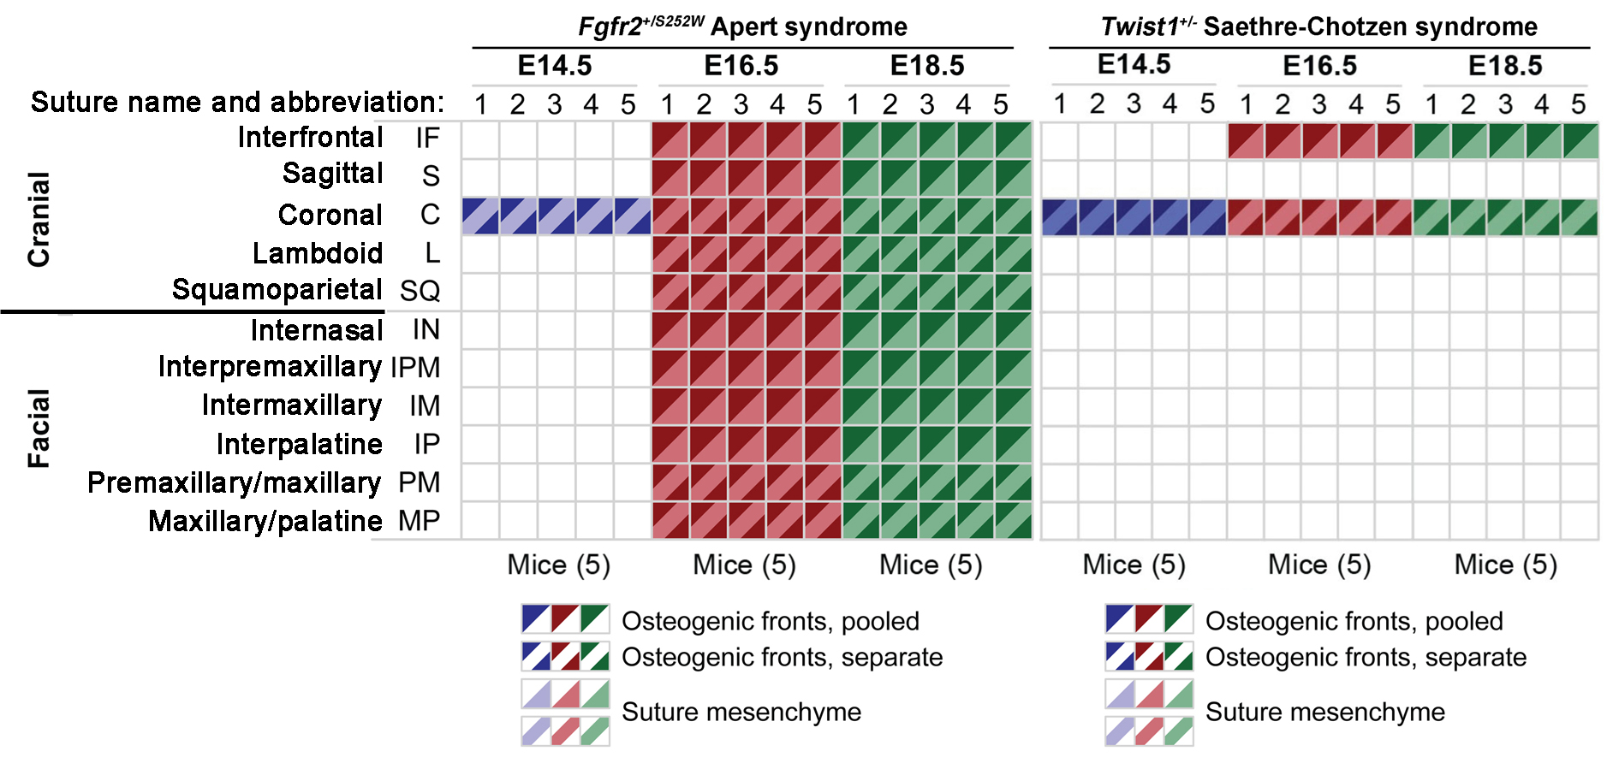
Fgfr2^{+/S252W} and Twist1^{+/-} Suture Expression Profiles
Frontal
350 mutant profiles → 635 total
Notes:
And we are doing all the same sutures for the Fgfr2 model that we did for the WT, and the two affected sutures in the Twist1 model, for a total of 350 RNA-Seq libraries, or 635 including the WT.

Slide 10
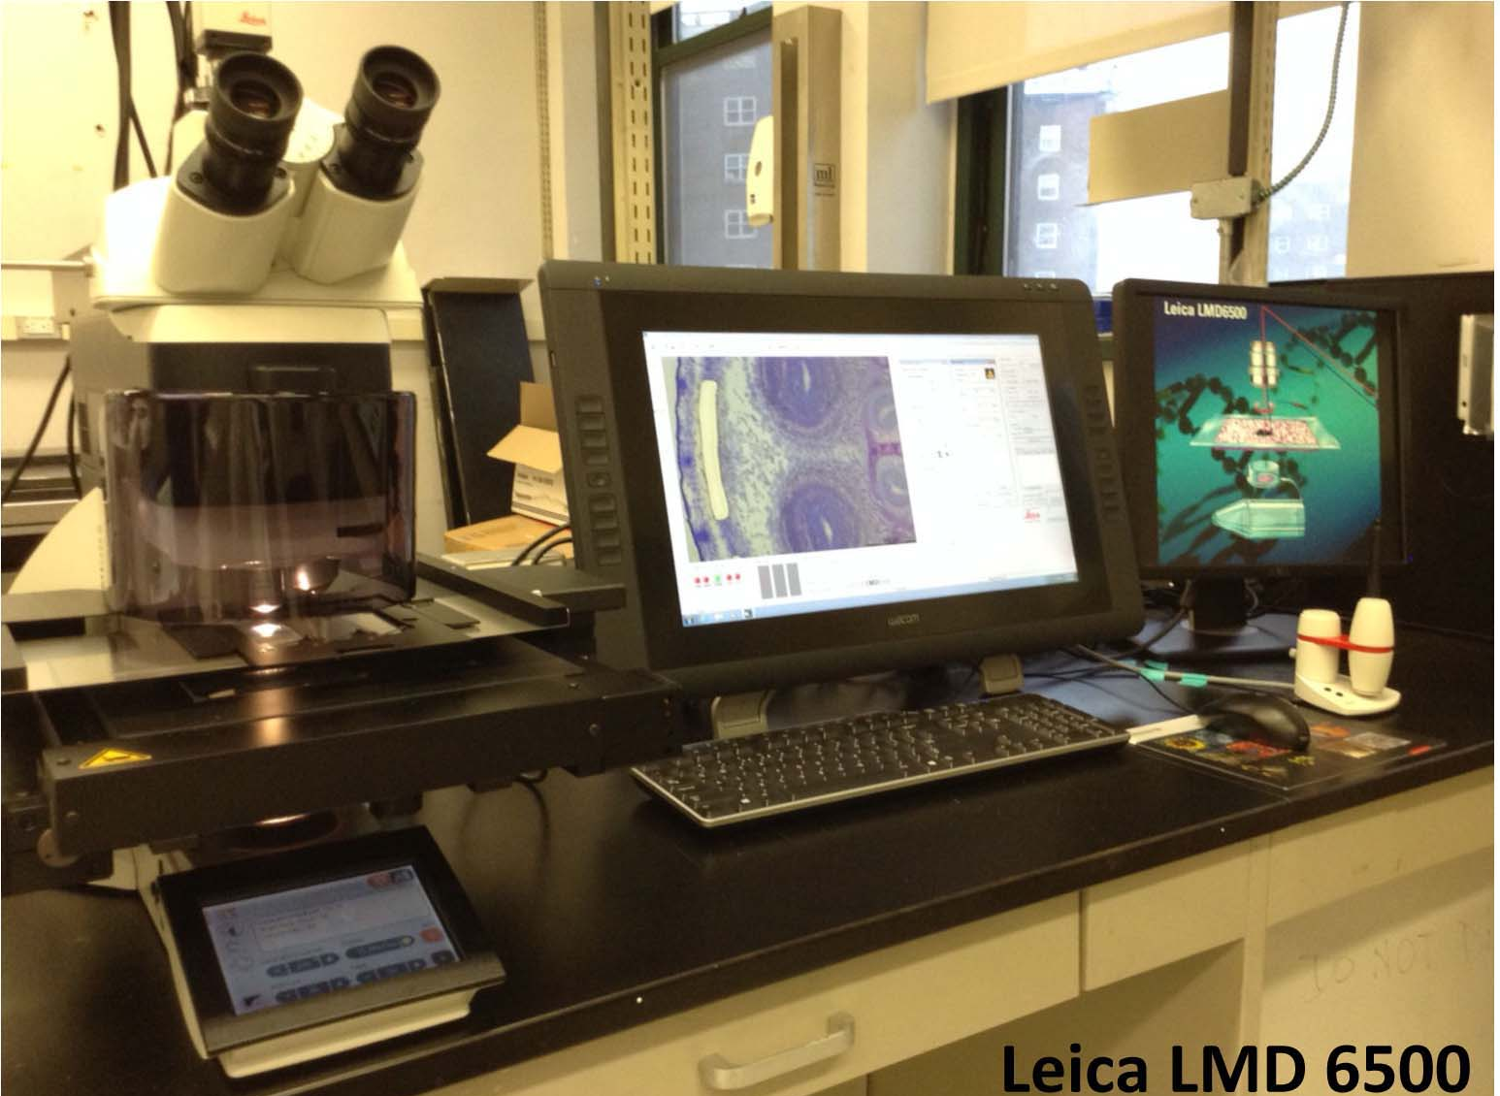

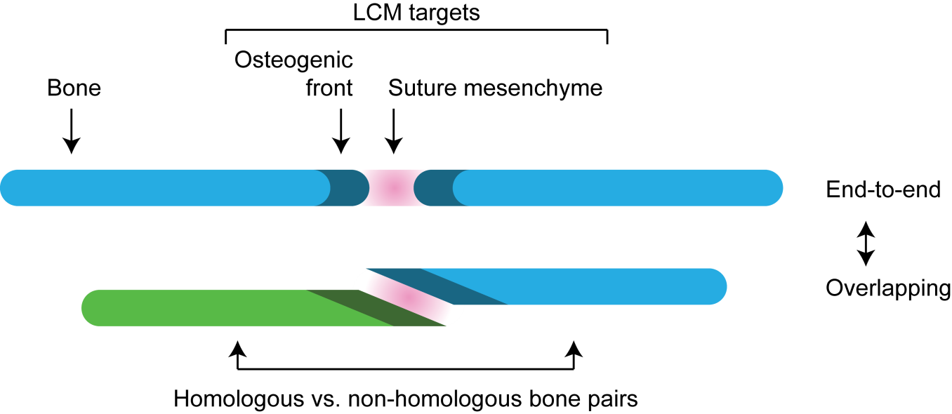
Laser Capture Microdissection of
Murine Suture Subregions for RNA-Seq Libraries
Frontal Suture
Notes:
To make our atlases we isolate suture subregions from frozen sections using laser capture microdissection to generate RNA-Seq libraries. The osteogenic fronts of homologous bones are treated as one sample, while those from non-homologous bones are treated as two individual samples.

Slide 11
Data Generation for Each Suture
Suture
→ LCM
Mesenchyme
Osteogenic fronts
→ 5 replicates (mice)
RNA extraction
→ 1-10 ng
SPI amplification
→ rRNAs suppressed
Total RNA-Seq
Illumina HiSeq 2500
Paired-end 100 nt reads (capture alternate splicing)
Depth: ~40M read pairs (comprehensive gene detection)
Notes:
For each suture subregion there are there are 5 biological replicates, and libraries are generated from total 1-10 ng RNA after rRNA suppression. The libraries are sequenced on a HiSeq 2500, and are paired-end sequenced to allow alternate splice capture, and at a sufficient depth to provide comprehensive gene expression coverage.

Slide 12
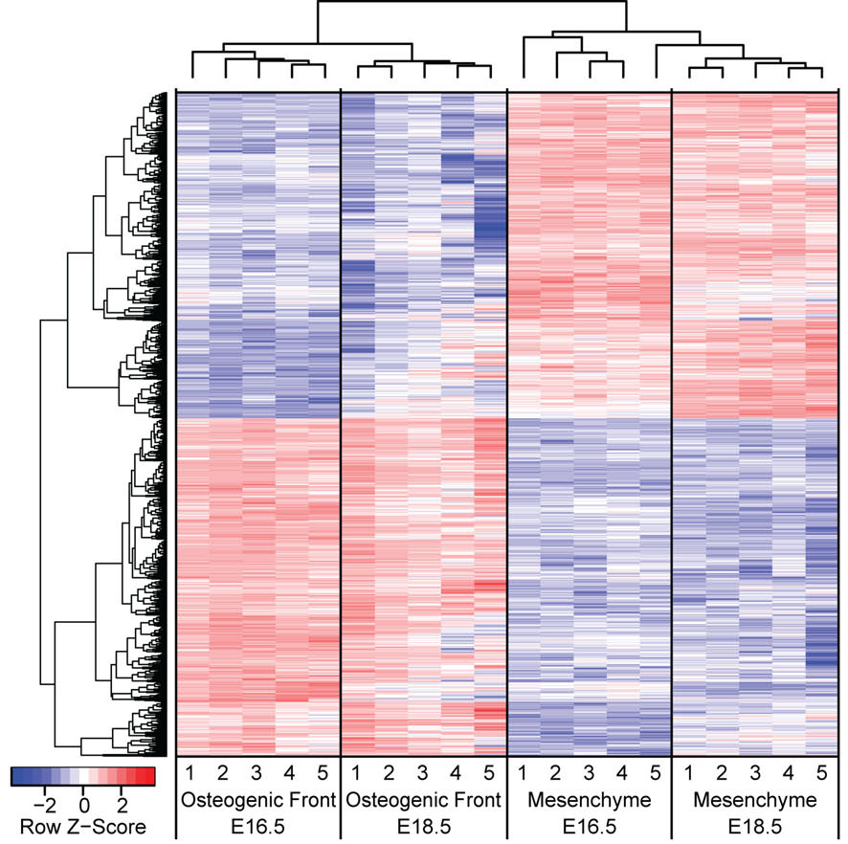
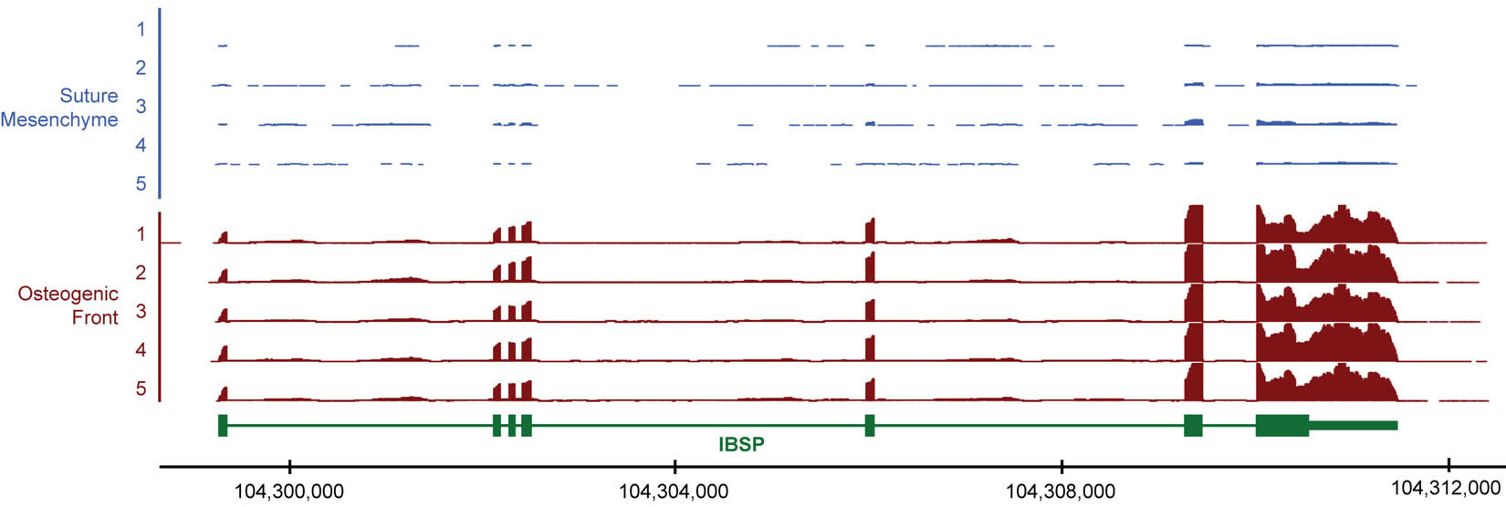
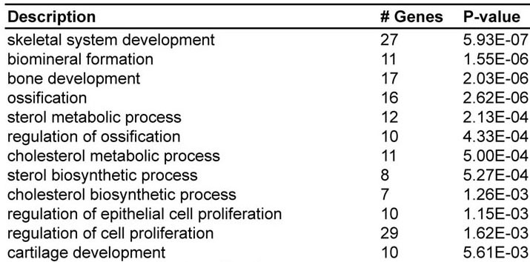
Differential Gene Expression:
WT Frontal Suture
Hierarchical Clustering (1,272 genes)
Browser track: Integrin-binding sialoprotein
Gene Ontology Categories (Osteogenic Fronts)
Poster: “Transcriptome Analysis of the Frontal Suture in Craniosynostosis Mouse Models”, Na Lu et al.
Notes:
This is an example of results for the WT frontal suture. This is a clustered heat map of for almost 1300 genes differentially expressed between the osteogenic fronts and suture mesenchyme. Red shows higher expression, blue shows lower expression. Clustering clearly separates the two subregions, but it also clearly separates each subregion by age. On the upper right is an example browser track showing Ibsp detected in OF samples but not in SM samples. And a gene ontology analysis of osteogenic front-specific genes shows expected categories of ossification and proliferation, but also of interest is sterol-related categories, which suggests an connection to HH signaling which requires cholesterol modification of the ligand, while may of the pathway components are found upregulated in the osteogenic fronts. We’ve also validated differential expression of a number of novel genes by in situ hybridization, and I’d refer you to this poster for more details.

Slide 13
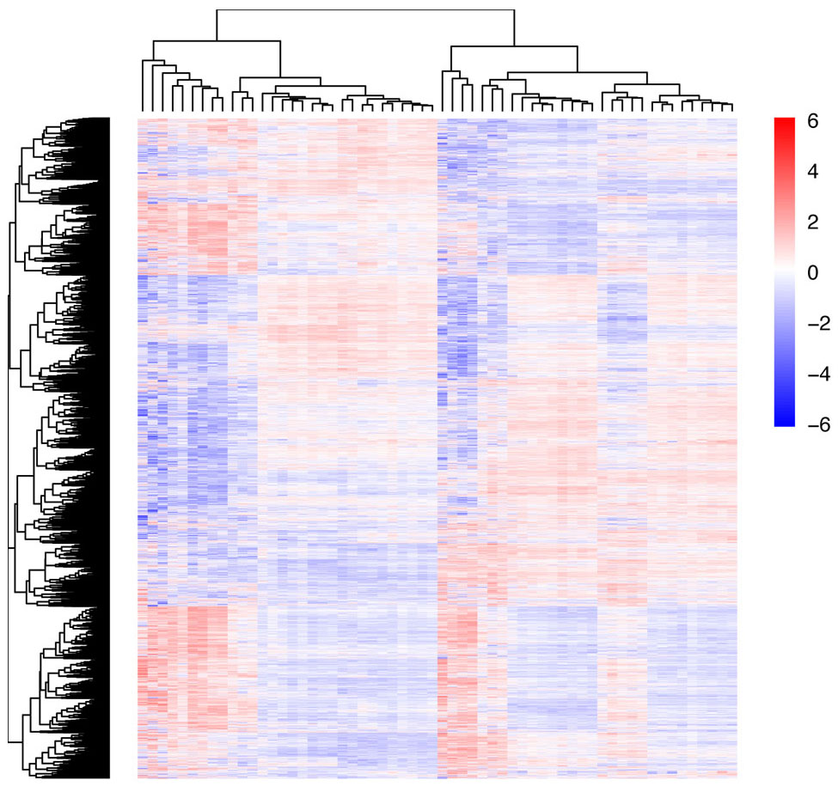
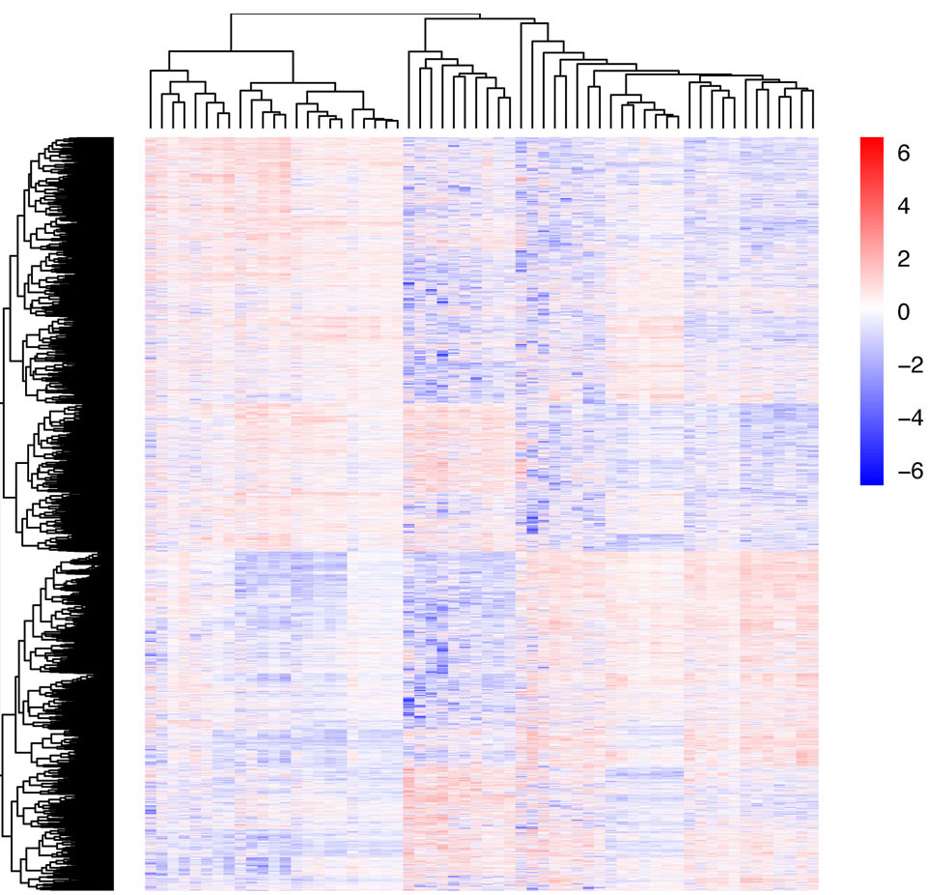
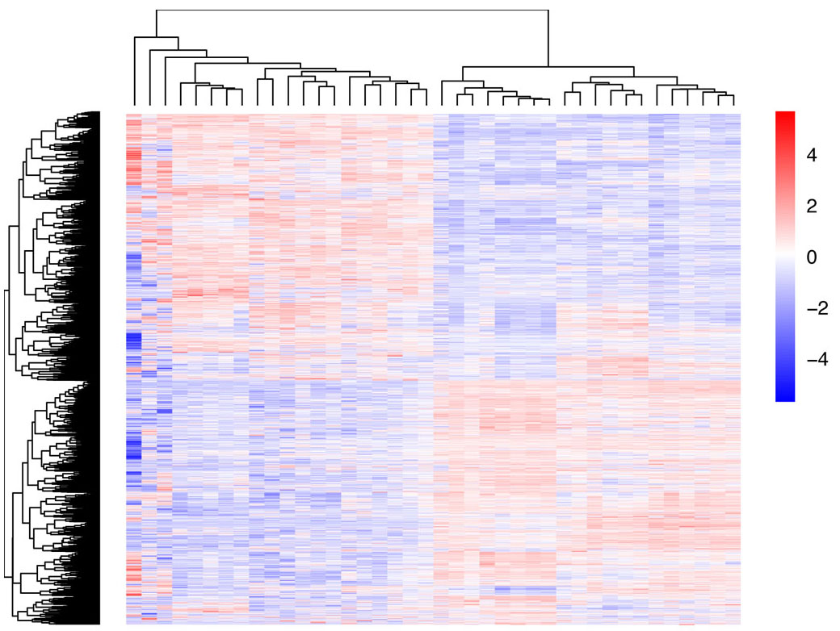
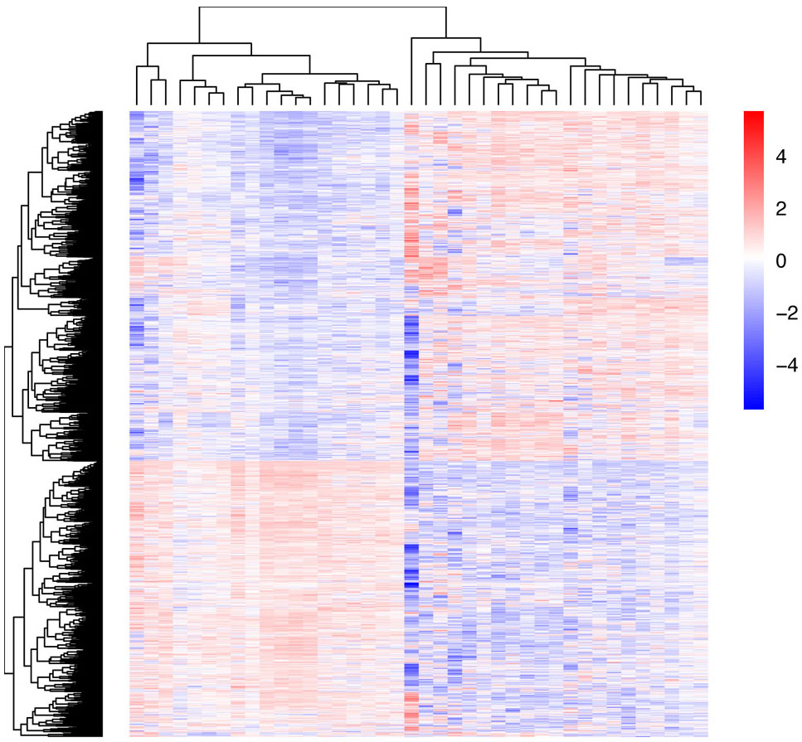
FaceBase Dataset Heatmaps
Frontal Suture (60)
Coronal Suture (60)
WT/Fgfr2^{+/S252W}/Twist1^{+/-} at E16.5/E18.5
WT/Twist1^{+/-} at E16.5/E18.5
Internasal Suture (40)
Interpremaxillary Suture (40)
WT/Fgfr2^{+/S252W} at E16.5/E18.5
WT/Fgfr2^{+/S252W} at E16.5/E18.5
4 suture types, 18 individual sutures, 200 RNA-Seq profiles
Notes:
At the moment we have data from 4 suture types in the Facebase repository: the frontal, coronal, internasal and interpremaxillary. They total 18 individual sutures, at E16.5 and E18.5 for WT, Fgfr2 or Twist1 mutant genotypes, for a total of 200 individual RNA-Seq libraries. The heatmaps clearly show the basic division between osteogenic fronts and mesenchyme, and further segregation by age and genotype can be found in each set.

Slide 14
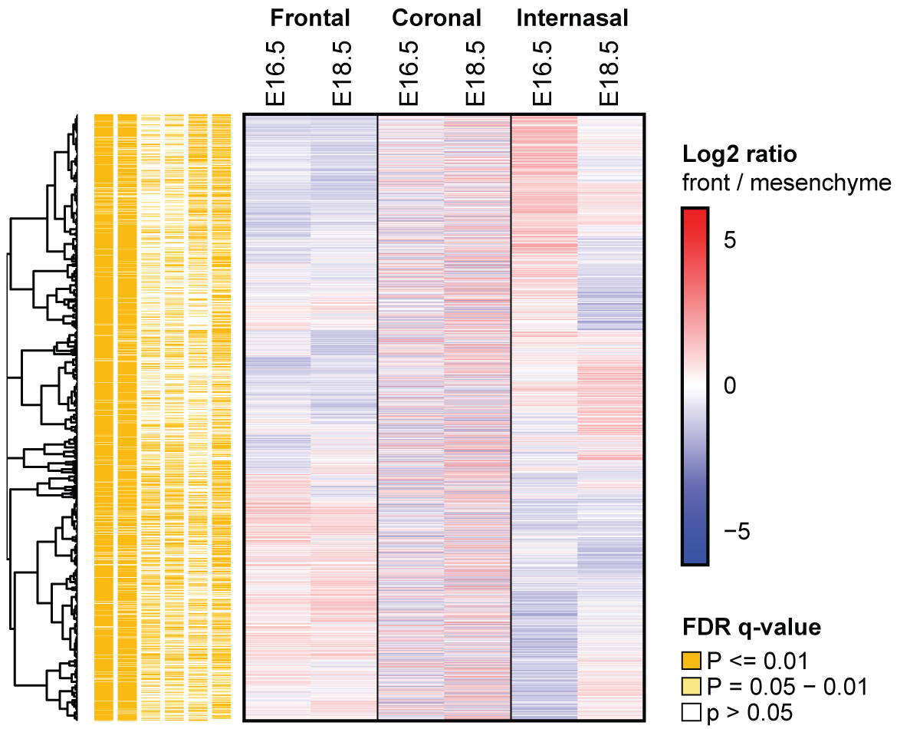
Comparisons Across Ages and Sutures
1,756
genes
Poster: “A Compendium of Expression Profiles of the Craniofacial Sutures”, Divya Kriti et al.
Notes:
As an example of further analysis, This figure demonstrates how differential expression varies across WT sutures. It takes the total number of differentially expressed genes in any of these 6 conditions, and then shows how this expression varies, and its probability, in any of the other conditions. It shows that differential expression of a given gene can vary between ages in a suture and between different sutures. I will refer you to this poster for more details of comparisons of these datasets.

Slide 15
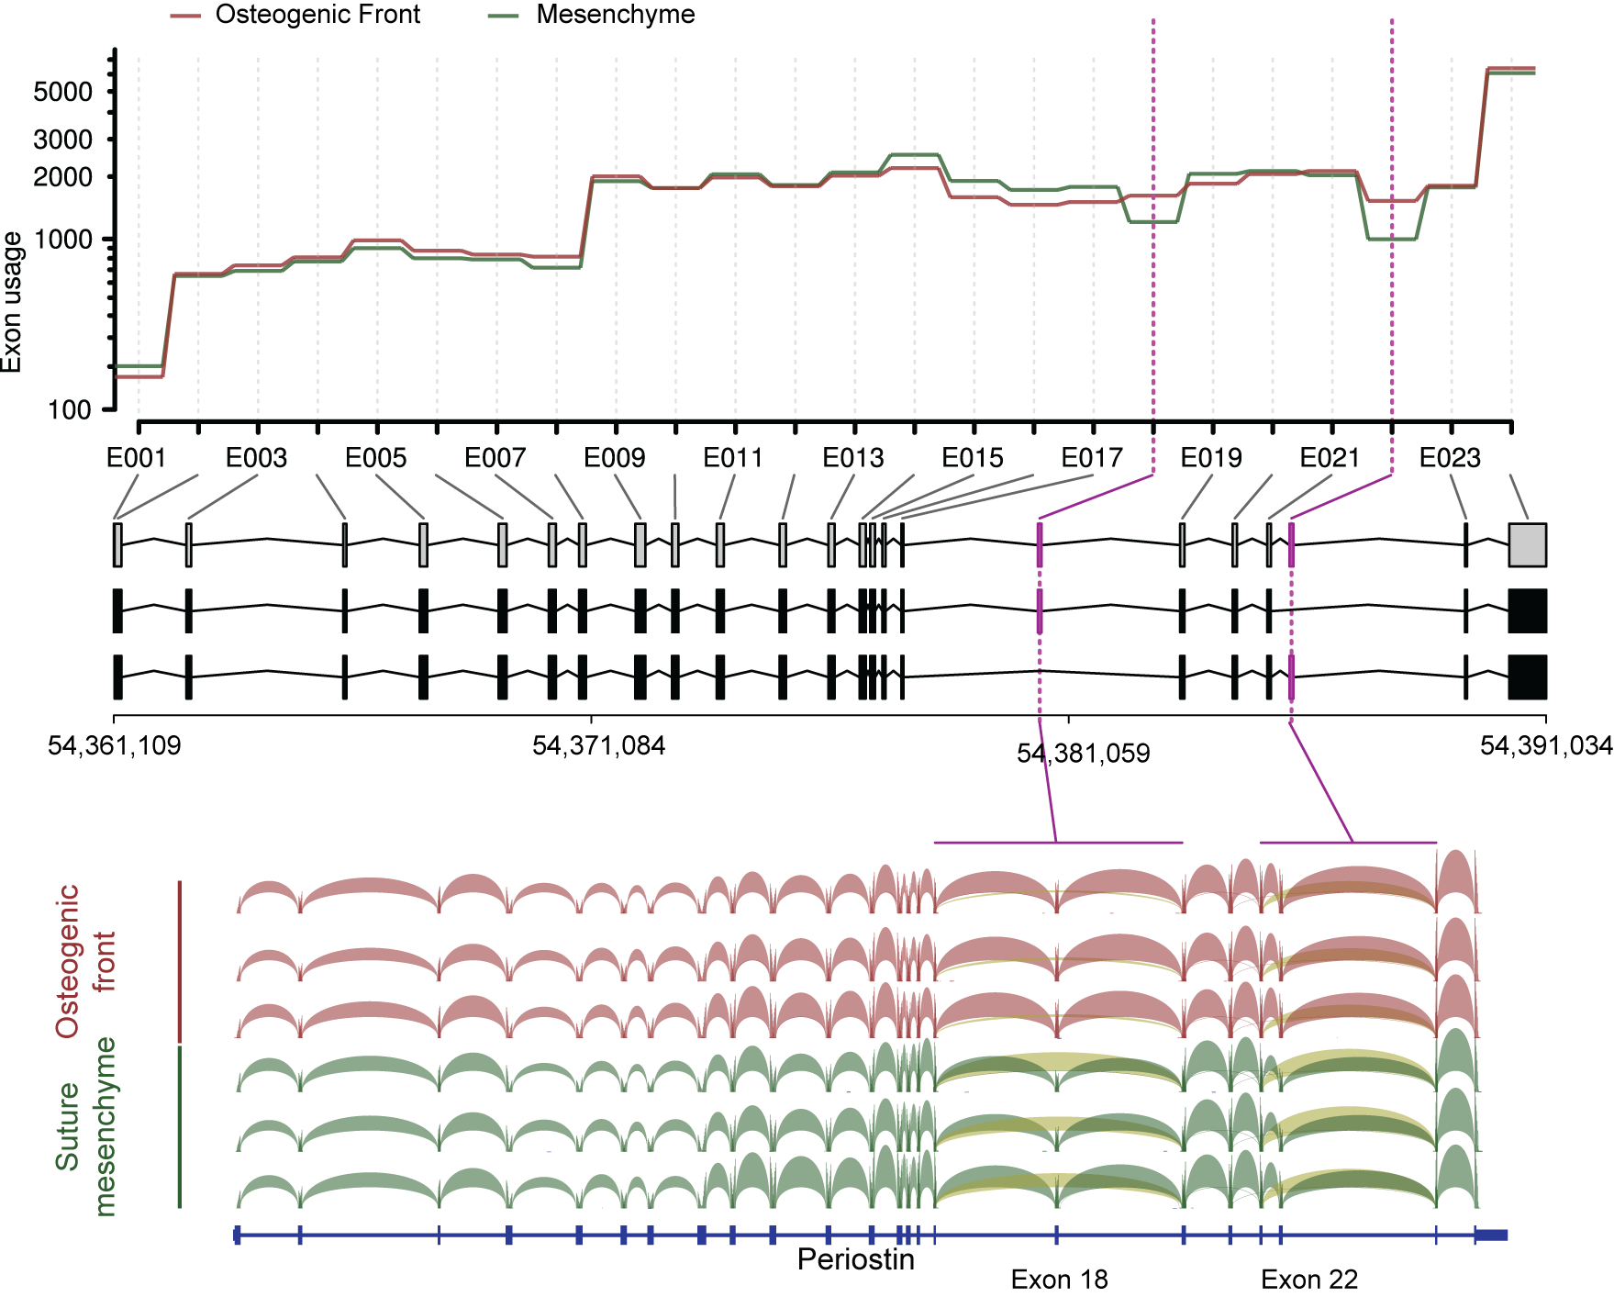
Alternate Splicing Analysis: Periostin
Poster: “A Compendium of Expression Profiles of the Craniofacial Sutures”, Divya Kriti et al.
Notes:
This Sashimi plot highlights an example of differential splicing in Periostin of exons 18 and 22 between the mesenchyme and osteogenic front. In the osteogenic front there is an increase in transcript isoforms lacking exons 18 and 22, as evidenced by an increase in the number of reads connecting neighboring exons. I will refer you again to this poster for more details of global isform expression in these datasets.

Slide 16
Network Analysis:
WT Frontal Suture Mesenchyme
Notes:
Our atlas also contains enough samples for network analysis, where one tries to identify groups of genes whose expression changes are correlated. This shows a network module hierarchy for the suture mesenchyme of the frontal suture. Each node corresponds to a network module and is annotated according to the top-ranking Gene Ontology Biological Process term.

Slide 17
Transcriptome Atlases of the
Craniofacial Sutures:
Single Cell Sequencing of Sutures
Competitive Revision: 3U01DE024448-04S1
Notes:
To further characterize suture structure we’ve recently been awarded a competitive revision for single cell sequencing of sutures. This is to identify the population substructure within suture subregions defined by gene expression differences.

Slide 18
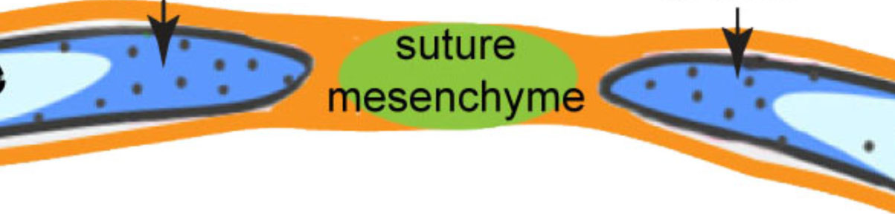
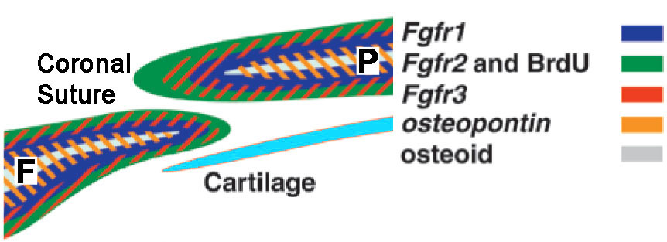
Suture Subpopulations:
Osteogenic Fronts
osteogenic
front
osteogenic
front
Zhao et al., 2015
Iseki et al., 1991
Notes:
Even within subregions, there are different populations. This was shown long ago in the osteogenic fronts and these subpopulations reflect increasing levels of osteoblast differentiation, as defined by the differential expression of Fgfrs within the coronal suture osteogenic fronts.

Slide 19
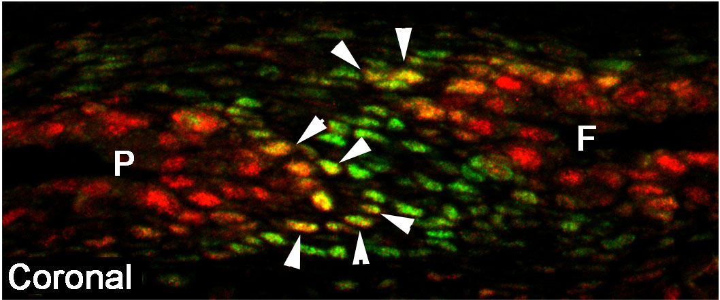
Suture Subpopulations:
Osteogenic Fronts
osteogenic
front
osteogenic
front
Zhao et al., 2015
WT E18.5
Immunohistochemistry: RUNX2, BCL11B
Holmes et al., 2015
Notes:
This can also be seen when looking at co-expression of other genes such as Bcl11b in green in the mesenchyme, and Runx2 in red in the bone, and we see a co-expressing population at the border between the subregions.

Slide 20
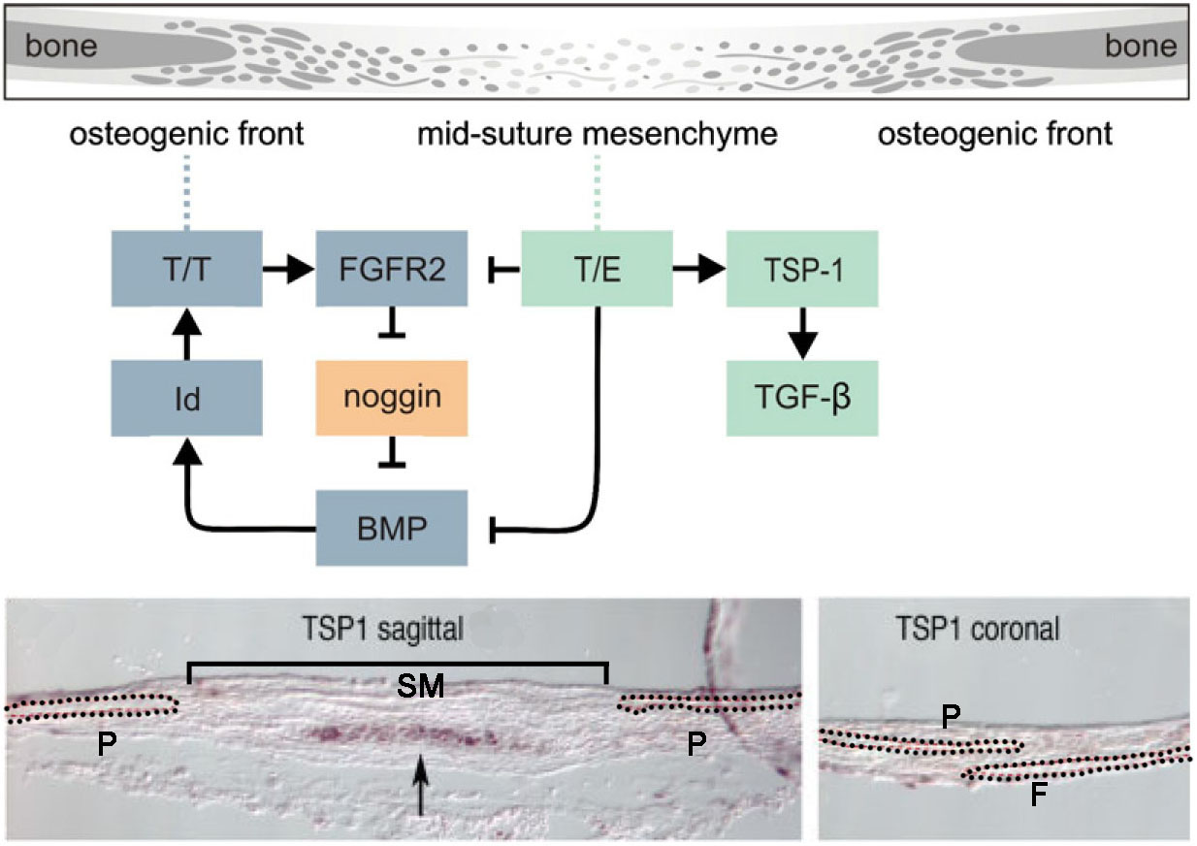
Suture Subpopulations:
Suture Mesenchyme
osteogenic
front
osteogenic
front
Zhao et al., 2015
Connerney et al., 2006
Notes:
Much less is known about the suture mesenchyme, but there is also evidence of subpopulation structure. For example, at P0 thrombospondin 1 is expressed in frontal and sagittal sutures, but only in a subset of the mesenchyme, and is also suture specific, not being expressed in the coronal suture. And postnatally, Yang Chai’s lab has shown that there are axin2 and gli1 subpopulations within suture mesenchyme that contain stem cells for suture maintenance.

Slide 21
Single Cell Sequencing of Sutures
Heterogeneity of gene expression within osteogenic fronts and suture mesenchyme is apparent, but subpopulations not defined
Significance of subpopulations for progenitor to osteoblast progression, or suture-specific functions, is unclear or unknown
Current “Transcriptome Atlases” provide deep sequencing of osteogenic fronts and mesenchyme, but homogenizes subpopulations within a suture subregion
Single cell sequencing goal is to distinguish these subpopulations: target of ~1,000 cells at 100,000 reads per cell.

Slide 22
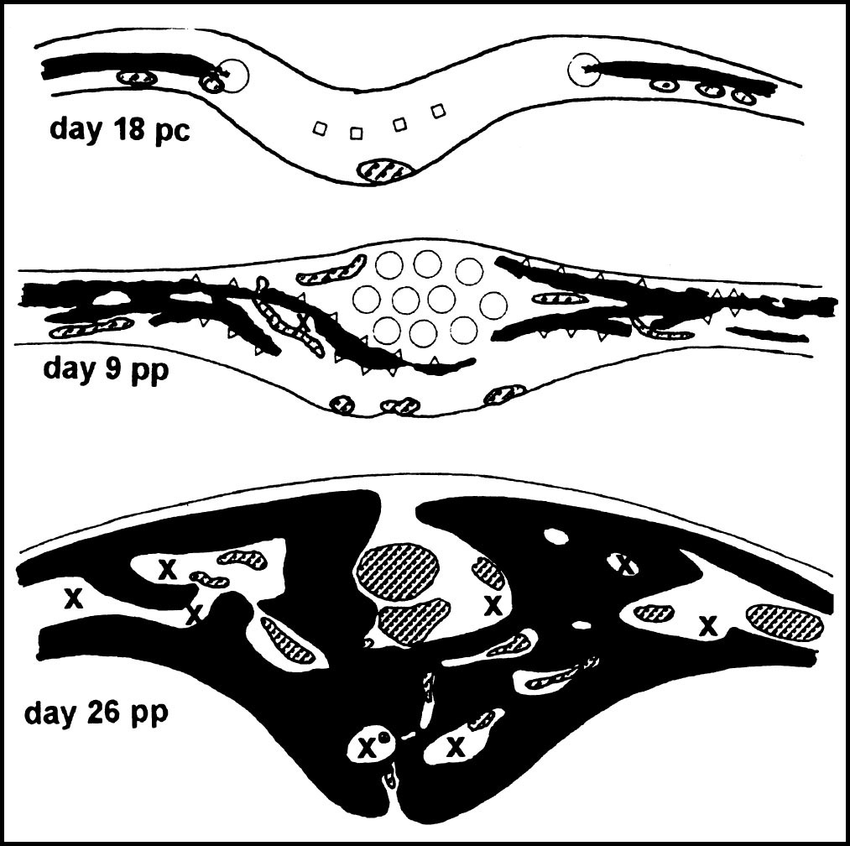
Single Cell Sequencing of Sutures:
4 Sutures, 3 Ages
WT Sutures: Frontal, Sagittal, Coronal, Lambdoid
Sagittal Suture
E18.5 (as in Atlases, active formation)
P10 (skull expansion, frontal suture fusion imminent)
P28 (post-expansion, mature suture maintenance)
Validation of expression by e.g., ISH or IHC
Zimmerman et al., 1998
Notes:
We will conduct this for 4 WT sutures, at 3 ages, to both complement and extend the Transcriptome Atlas data. The 4 sutures are the calvarial sutures most importance to human disease via craniosynostosis. The 3 ages reflect distinct phases of suture formation and function. (list on slide).

Slide 23
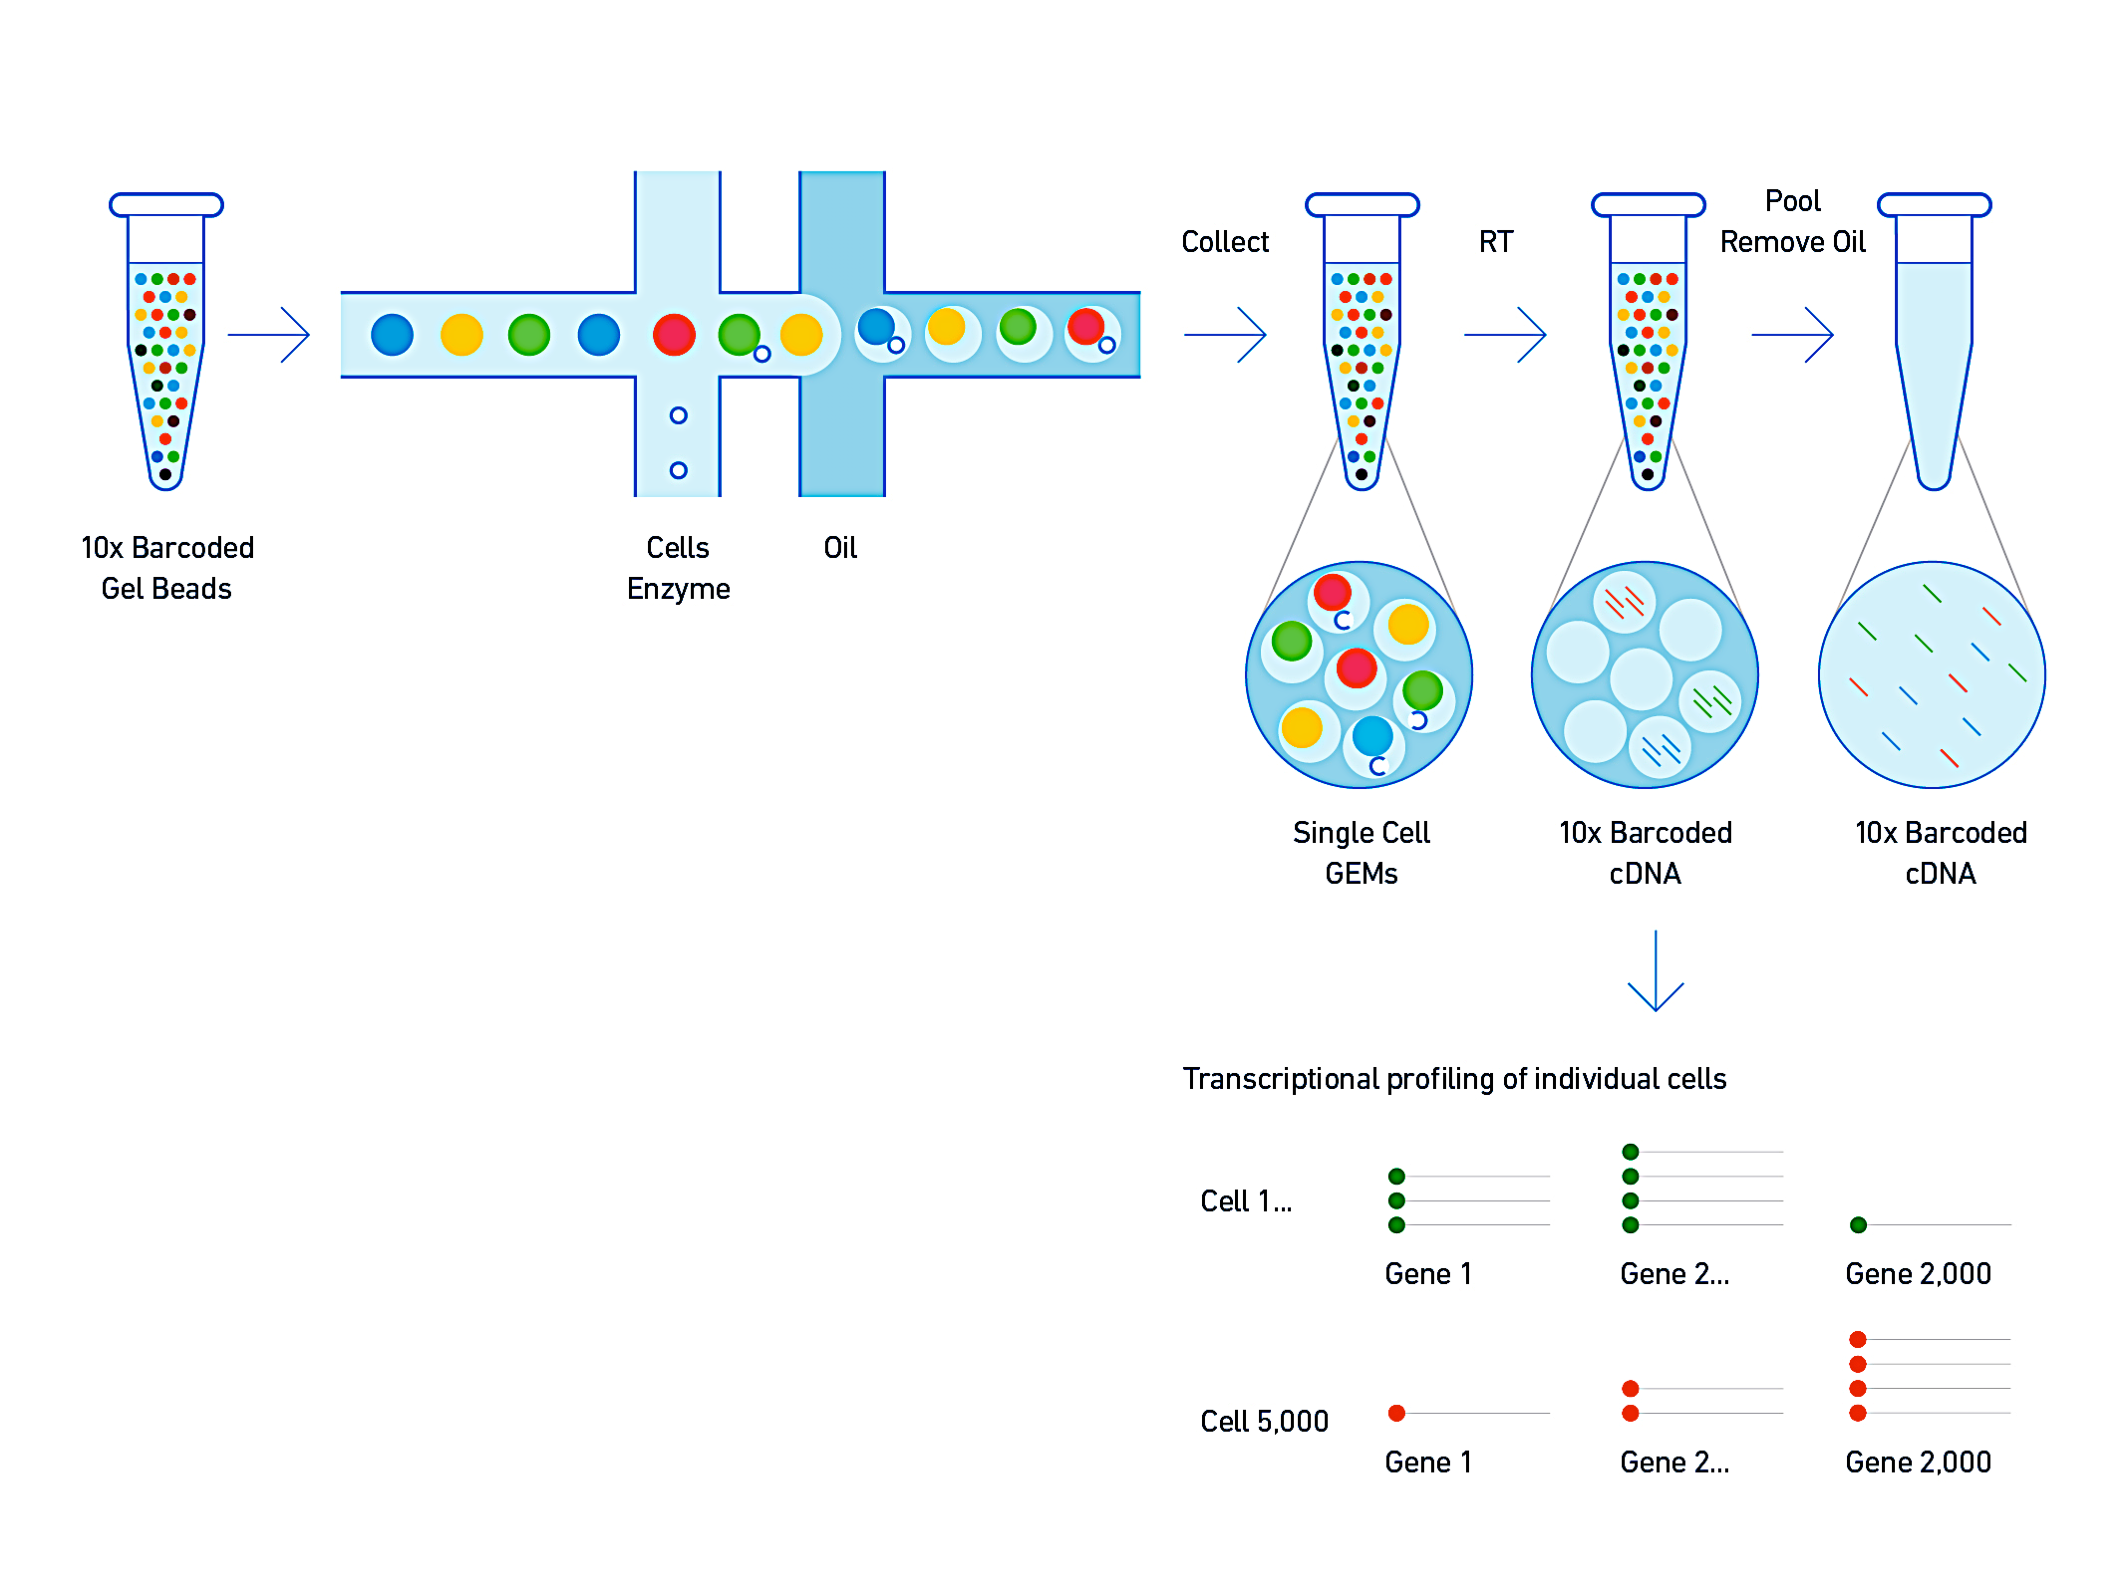
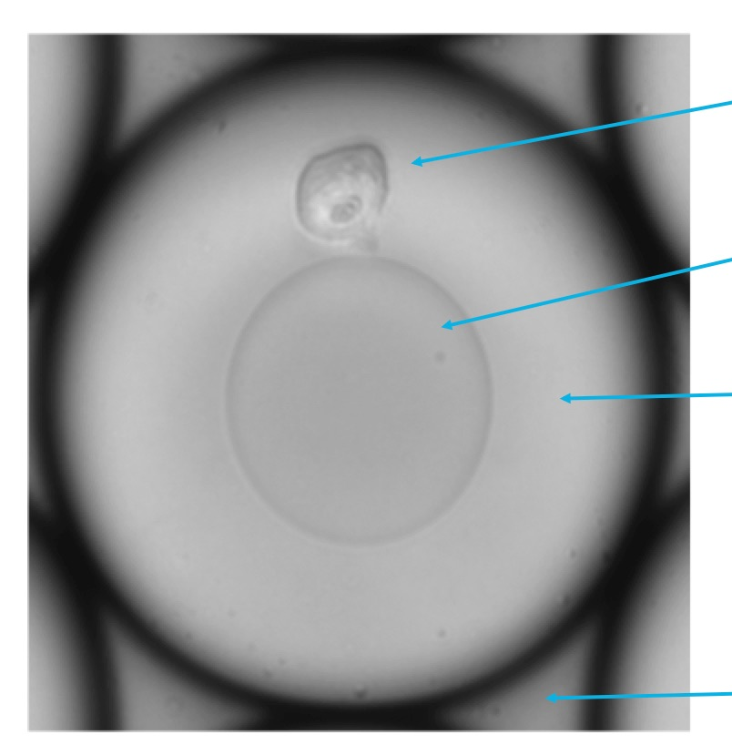
10X Genomics Chromium:
Nanofluidics and Emulsion PCR for Single Cell RNA-Seq
Cells + reagents + oil Library synthesis
Single cell
Functionalized
gel bead
RT reagents
in solution
Partitioning oil
(Courtesy of Robert Sebra, Icahn School of Medicine at Mount Sinai)
Notes:
To perform single cell sequencing we are using one of the latest droplet-based technologies from 10X Genomics called Chromium. (1) Basically, single cells are combined with oligo-coated beads and reaction solution within individual oil droplets, (2) within which bar-coded libraries are then created, after which all cell libraries can be combined for sequencing. (3) Cells can then be differentiated and/or clustered by their gene expression profiles

Slide 24
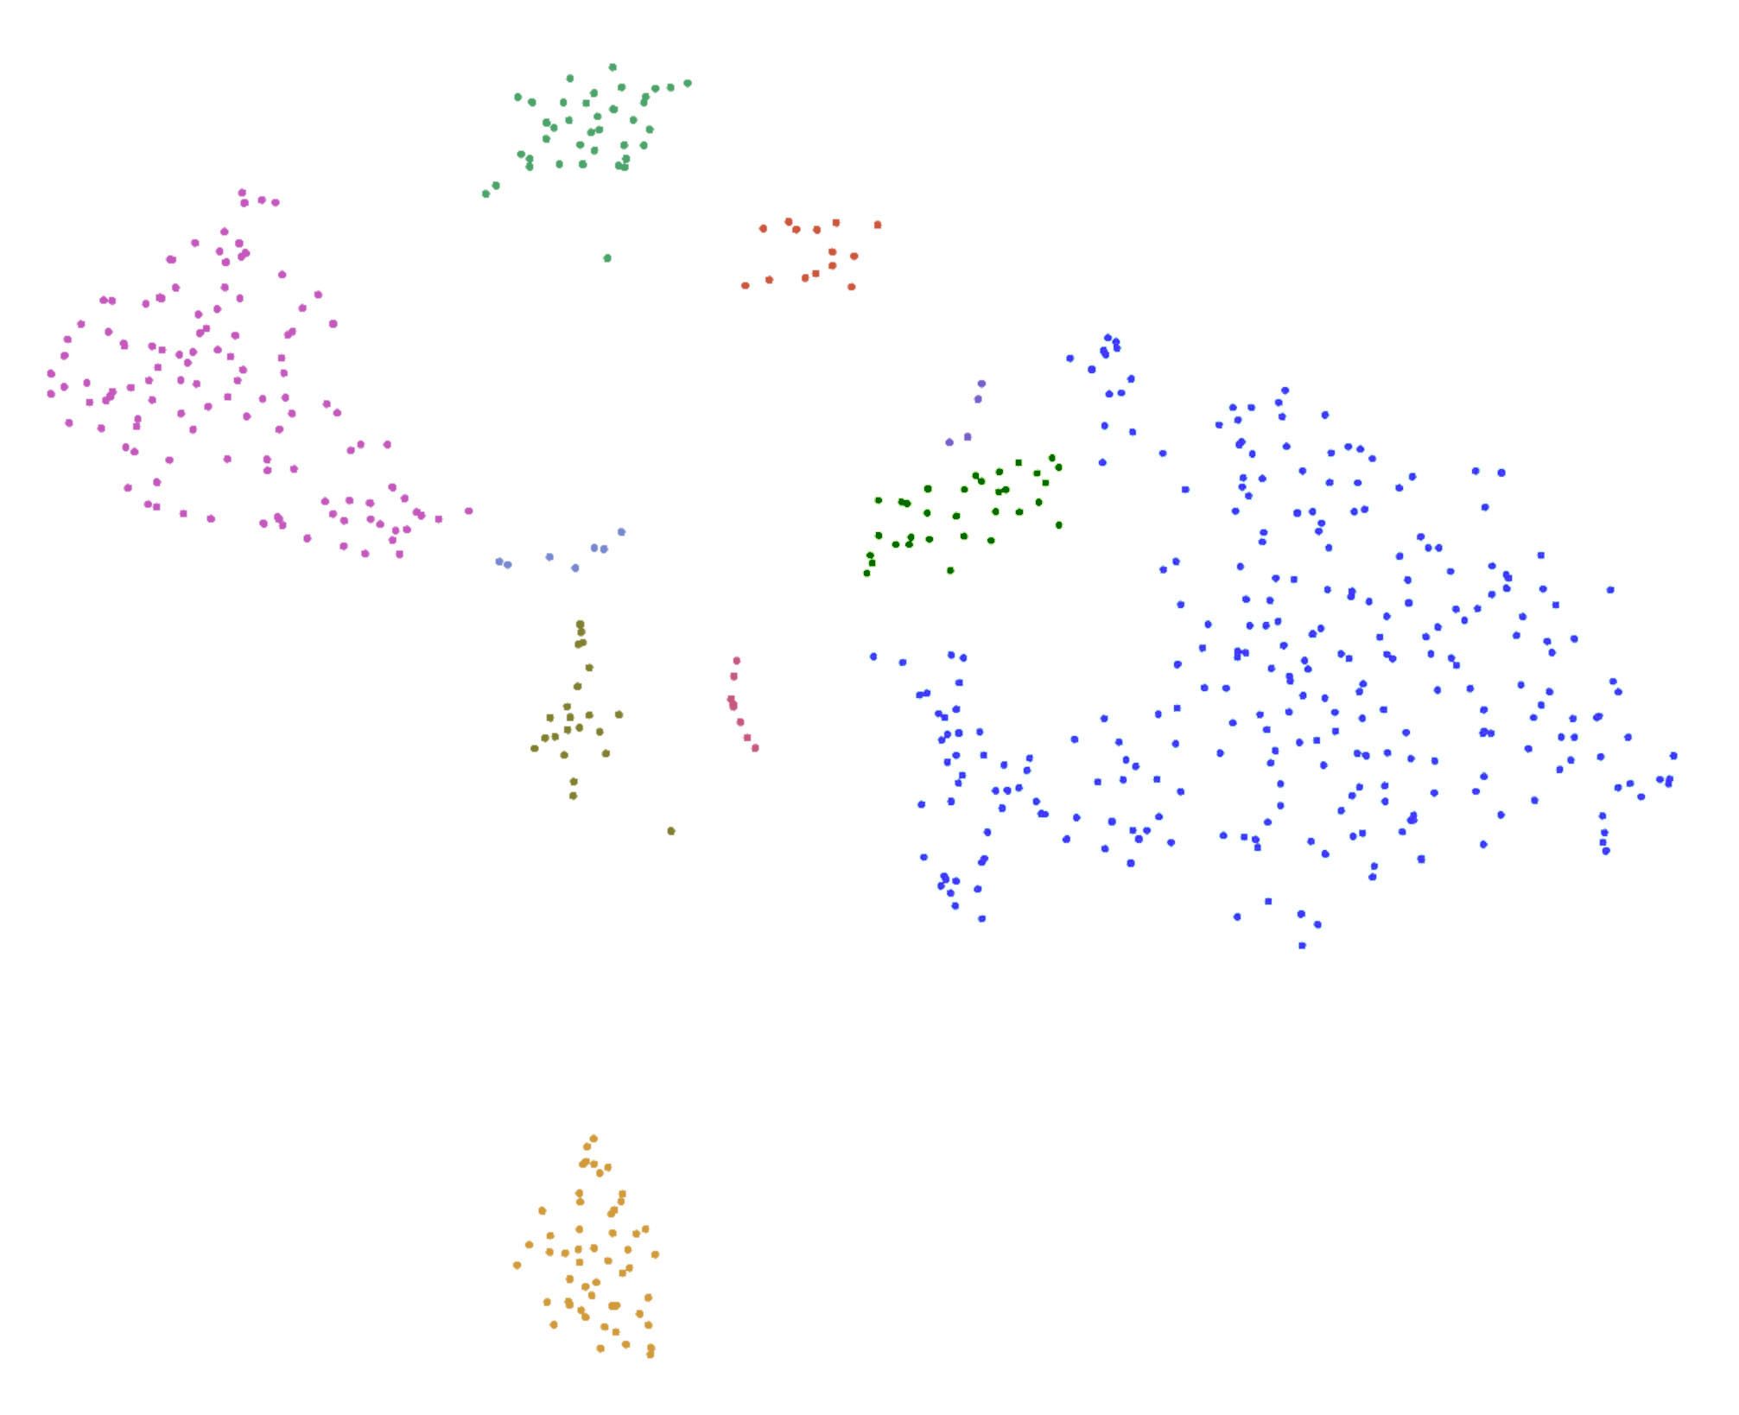
Preliminary Example:
E18.5 Frontal Suture (~500 cells)
Osteoblasts
Mesenchyme
PC2
PC1
Notes:
This shows a preliminary result of single cell sequencing of the E18.5 frontal suture with about 500 cells in the library set. You can see that the osteoblast population in green and the suture mesenchyme population in blue are readily identifiable from other populations, which are largely hematopoitic lineages.

Slide 25
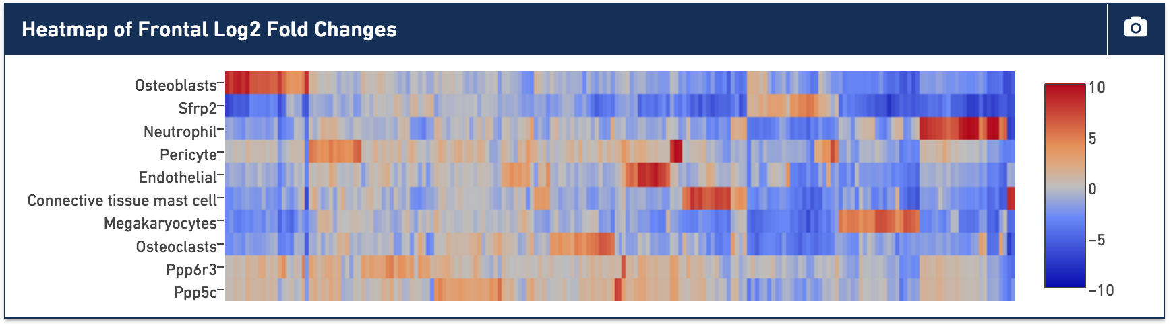
Preliminary Example:
E18.5 Frontal Suture (~500 cells)
Osteoblasts
Mesenchyme
PC2
PC1
Mesenchyme
Notes:
Looking at the highly expressed genes in red in a heatmap of this analysis, you can see how these populations are distinct at the gene expression level, and the next step would be to identify any subpopulations within these groups.

Slide 26



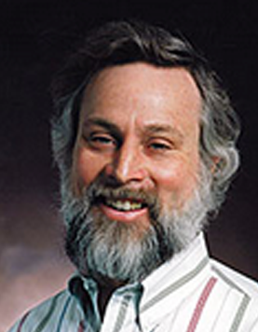
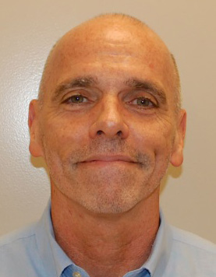
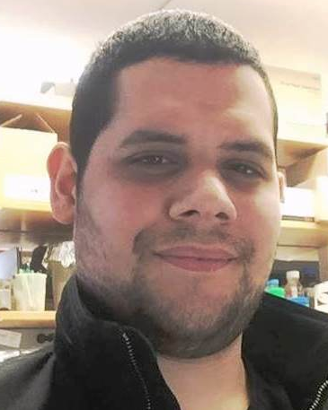
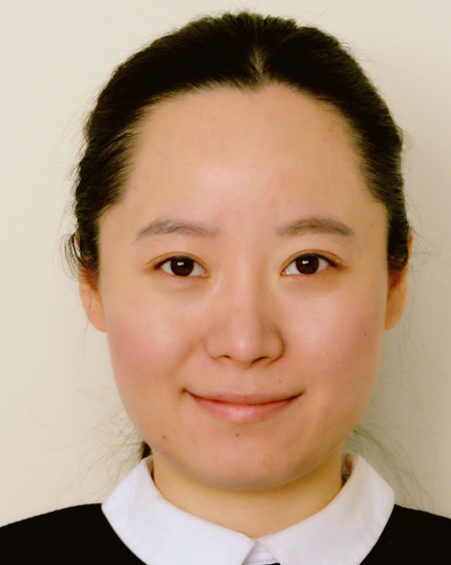
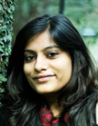
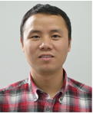
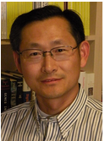

Acknowledgements
Icahn School of Medicine at Mount Sinai
Ethylin Wang Jabs Harm van Bakel
Greg Holmes Divya Kriti
Joshua Rivera
Na Lu
Bin Zhang
Xianxiao Zhou
Michael Donovan
Cincinnati Children’s Medical Center
Steven Potter
NIH/NIDCR 5U01 DE024448
Notes:
I'd like to acknowledge the other Facebase team members and others contributing to this project, which is funded by the NIDCR. Thank you.

