Slide 1
Hub Updates for Year 3
Carl Kesselman

Slide 2
Intro/Overview
What we’ve been up to:
Pushing out more FB2 data than ever
High resolution data model
Cross-cutting integrations and visualizations
Integrations between datasets and linkages with Phenogrid and other useful entities

Slide 3
statistics

Slide 4
Dataset Updates
Species | Curated | Released | Pending
Mouse | 26 | 43 | 0 | 69
Human | 5 | 1 | 0 | 8
Zebrafish | 34 | 0 | 0 | 34
 | 64 | 45 | 0 | 111
Notes:
Curated: Dataset has been fully curated to the current FB2 model
Released: Dataset appears in our catalog with minimal metadata information and is in the process of being curated
Pending: Dataset appears in our catalog but some data and/or metadata needs to be completed before it can be curated

Slide 5
Dataset Summaries
Data Type | Counts
Datasets | 708
Samples (curated) | 1,121
Assays (curated) | 4,670
Files | 2,306
Notes:
Curated: Dataset has been fully curated to the current FB2 model
Released: Dataset appears in our catalog with minimal metadata information and is in the process of being curated
Pending: Dataset appears in our catalog but some data and/or metadata needs to be completed before it can be curated

Slide 6
Traffic statistics for www.facebase.org
Analytics Metric | 7/2015 - 4/2017 | 7/2015 – 5/2016 | 5/2016 – 4/2017
Pageviews | 71,076 | 28,771 | 42,373
Avg Session Duration | 6:17 | 6:34 | 6:07
Users | 12,395 | 4,699 | 7,905
Sessions | 19,371 | 7,171 | 12,227
Returning visitors | 60.56% | 60.58% | 60.53%
Notes:
When you think about how many craniofacial researchers there are in the world - 1,000? 5,000? And you have 66% of site visitors returning and spending an average of over 6 minutes on the page - it could indicate a fair amount of interest in the community.

Slide 7
Data Browser Usage Statistics
Number of registered FaceBase2 Accounts: 305
User activity within the Data Browser:
200+ whole dataset downloads (>1000+ files roughly) per month
1,750+ image views per month(*)
Usage of our Track Hub for the UCSC Genome Browser:
2,000+ track file accesses(**) per month
100+ GB track file downloads per month
* Filtering out for generic placeholder thumbnails
** The Genome Browser reads byte ranges of the part of the file the user is actually looking at
Notes:
(Beyond Downloads) So these are the number of times files of datasets have been downloaded. But there’s more to measuring the impact of this site. If you’re researching a phenotype, once you’ve seen a good jpg on the webpage, do you really need to download the source file? So here’s usage stats for images as well as track hub, etc.. And note that the number of track file accesses is actually a quite accurate measure of usage because it specifically captures only what the user actually looked at.

Slide 8
Data Browser and Site Features

Slide 9
New Features Summary
    New data model
    Phenotype rollups (Monarch)
    Gene summaries (integrated)
    Surface viewers
    JBrowse/UCSC Genome Browser
    New linkages/data navigation
    Dashboard – revised pipeline (Released vs Curated)
    New project pages

Slide 10
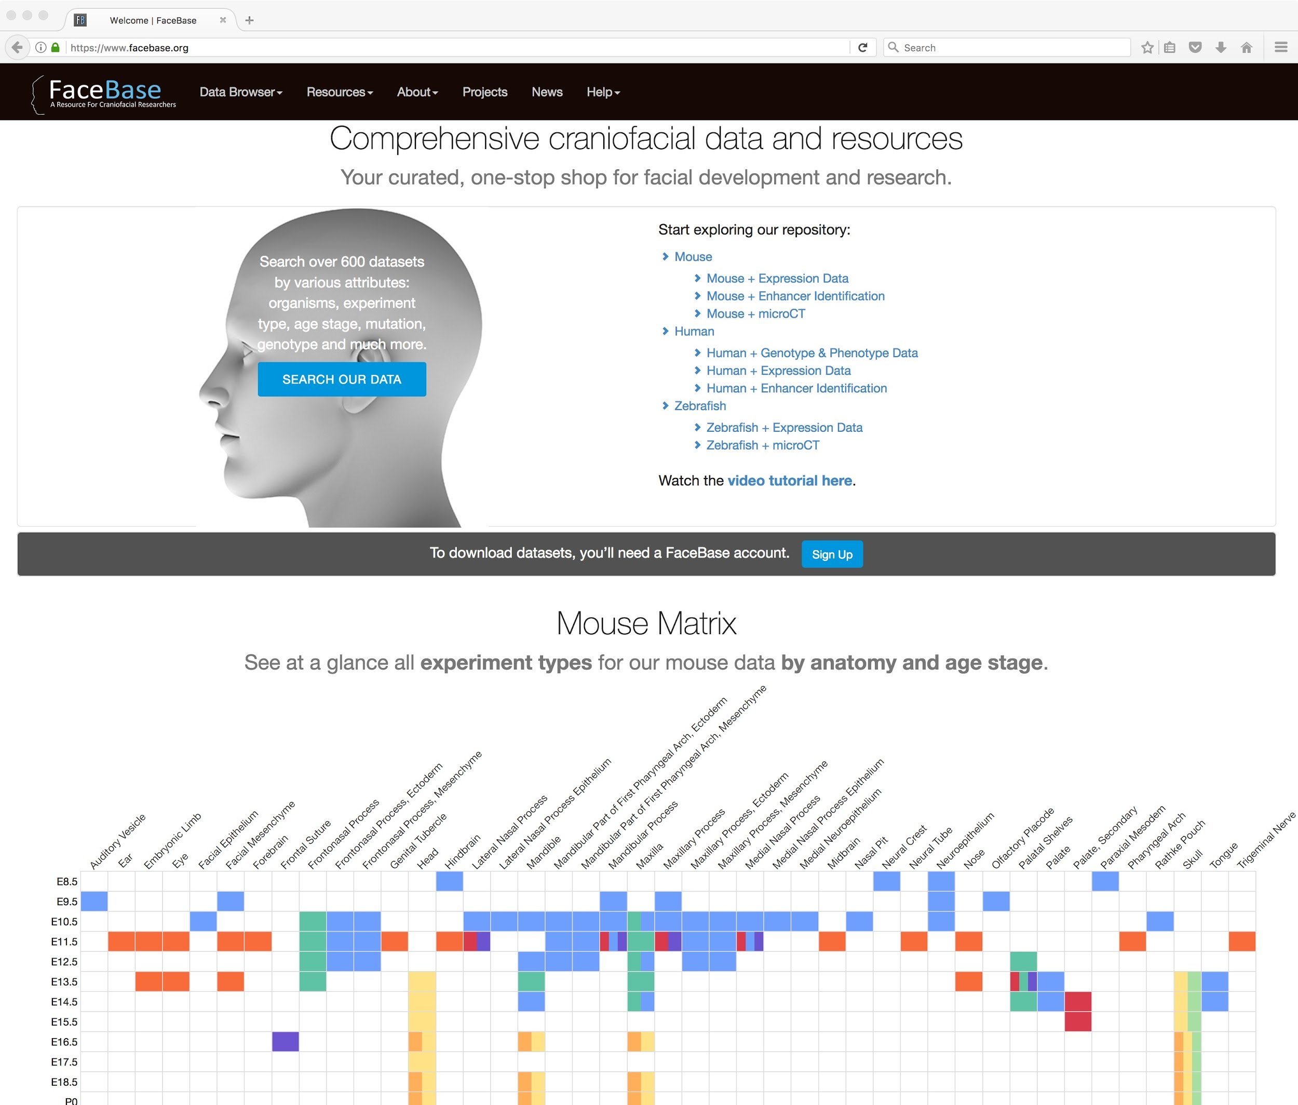
Homepage Improvements
Reorganized w/ shortcuts to search the datasets
Dynamic matrix of mouse data integrated on home page
Links to highlighted resources (e.g., Human Genome Analysis Interface, Mouse Flythrough)

Slide 11
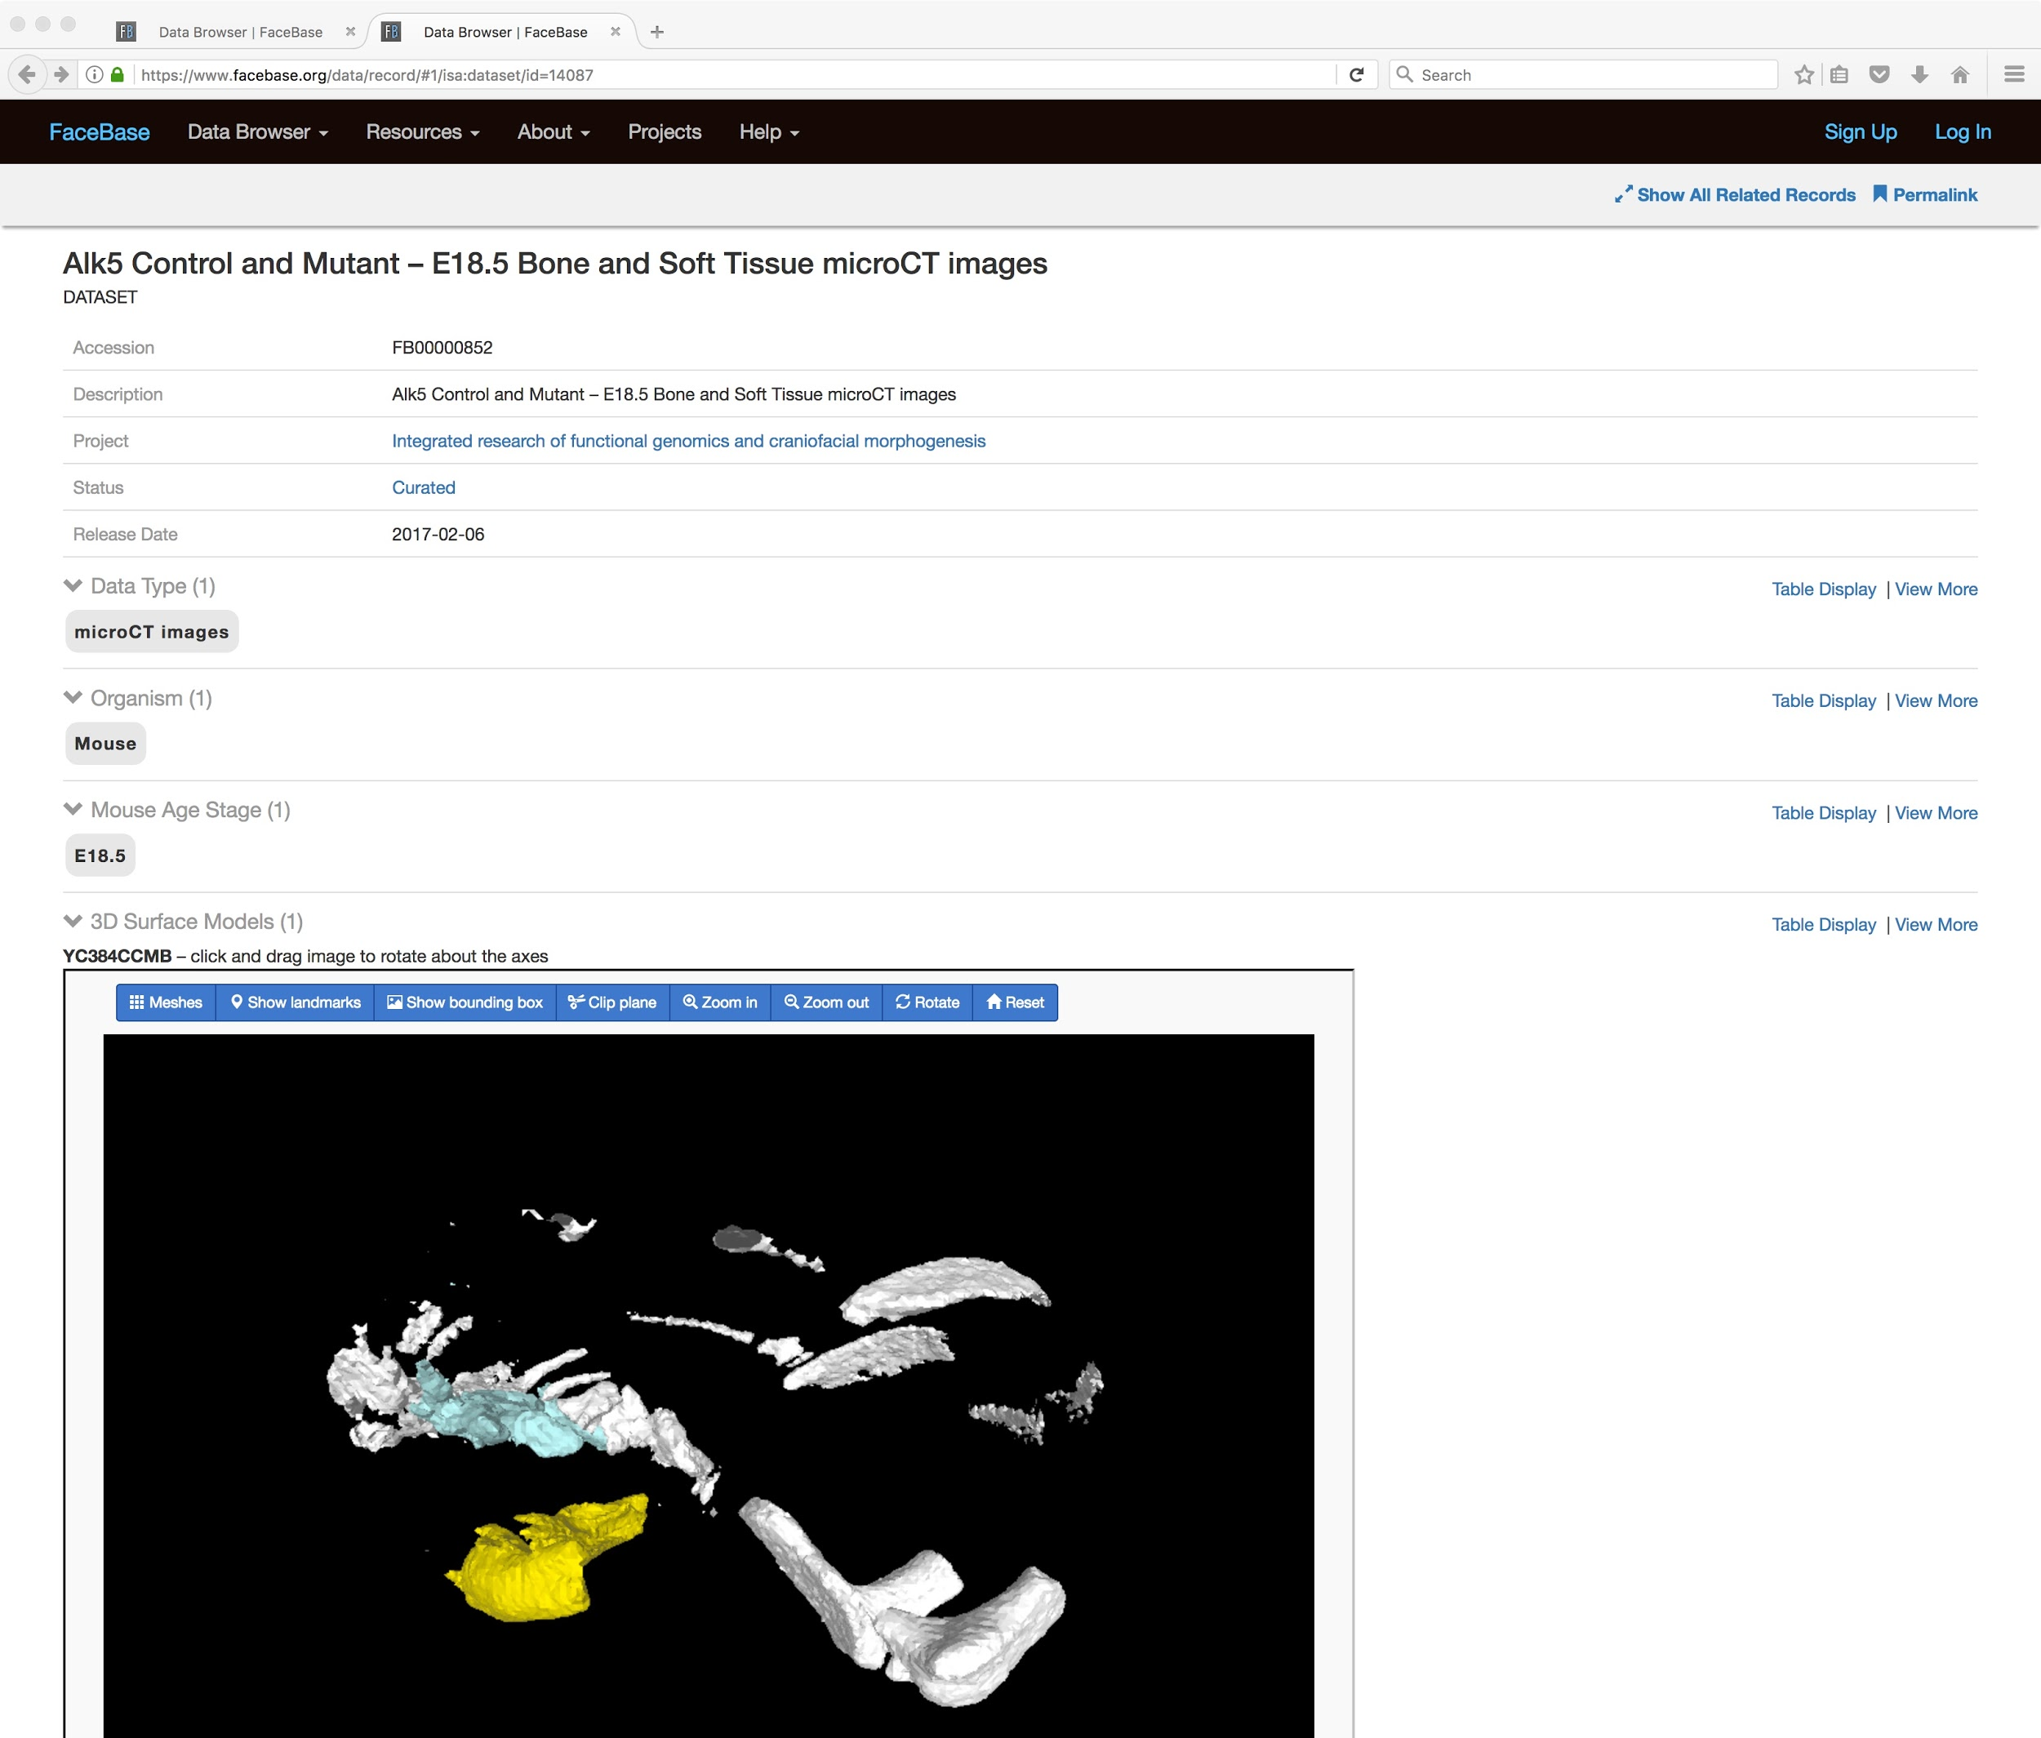
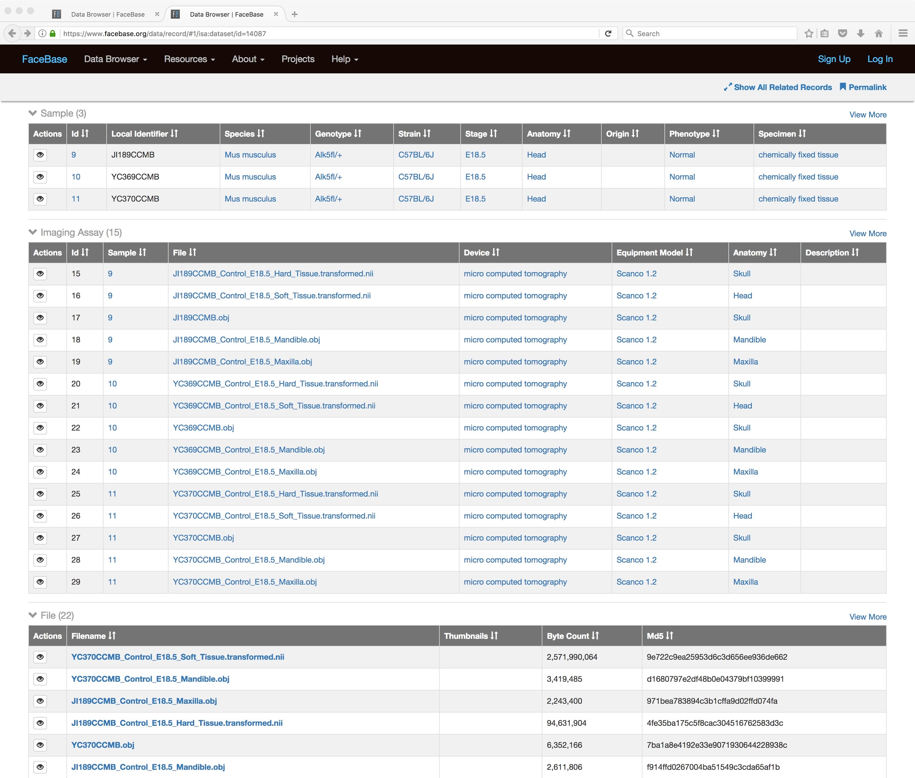
Highly detailed, new data model
New datasets curated with detailed metadata describing:
Samples (species, stage, anatomy, etc)
Assays (details of images, -omics, enhancers)
Files (individually accessible and linked with above metadata)
Significantly more detailed records for each datasets as seen in the screenshots here

Slide 12
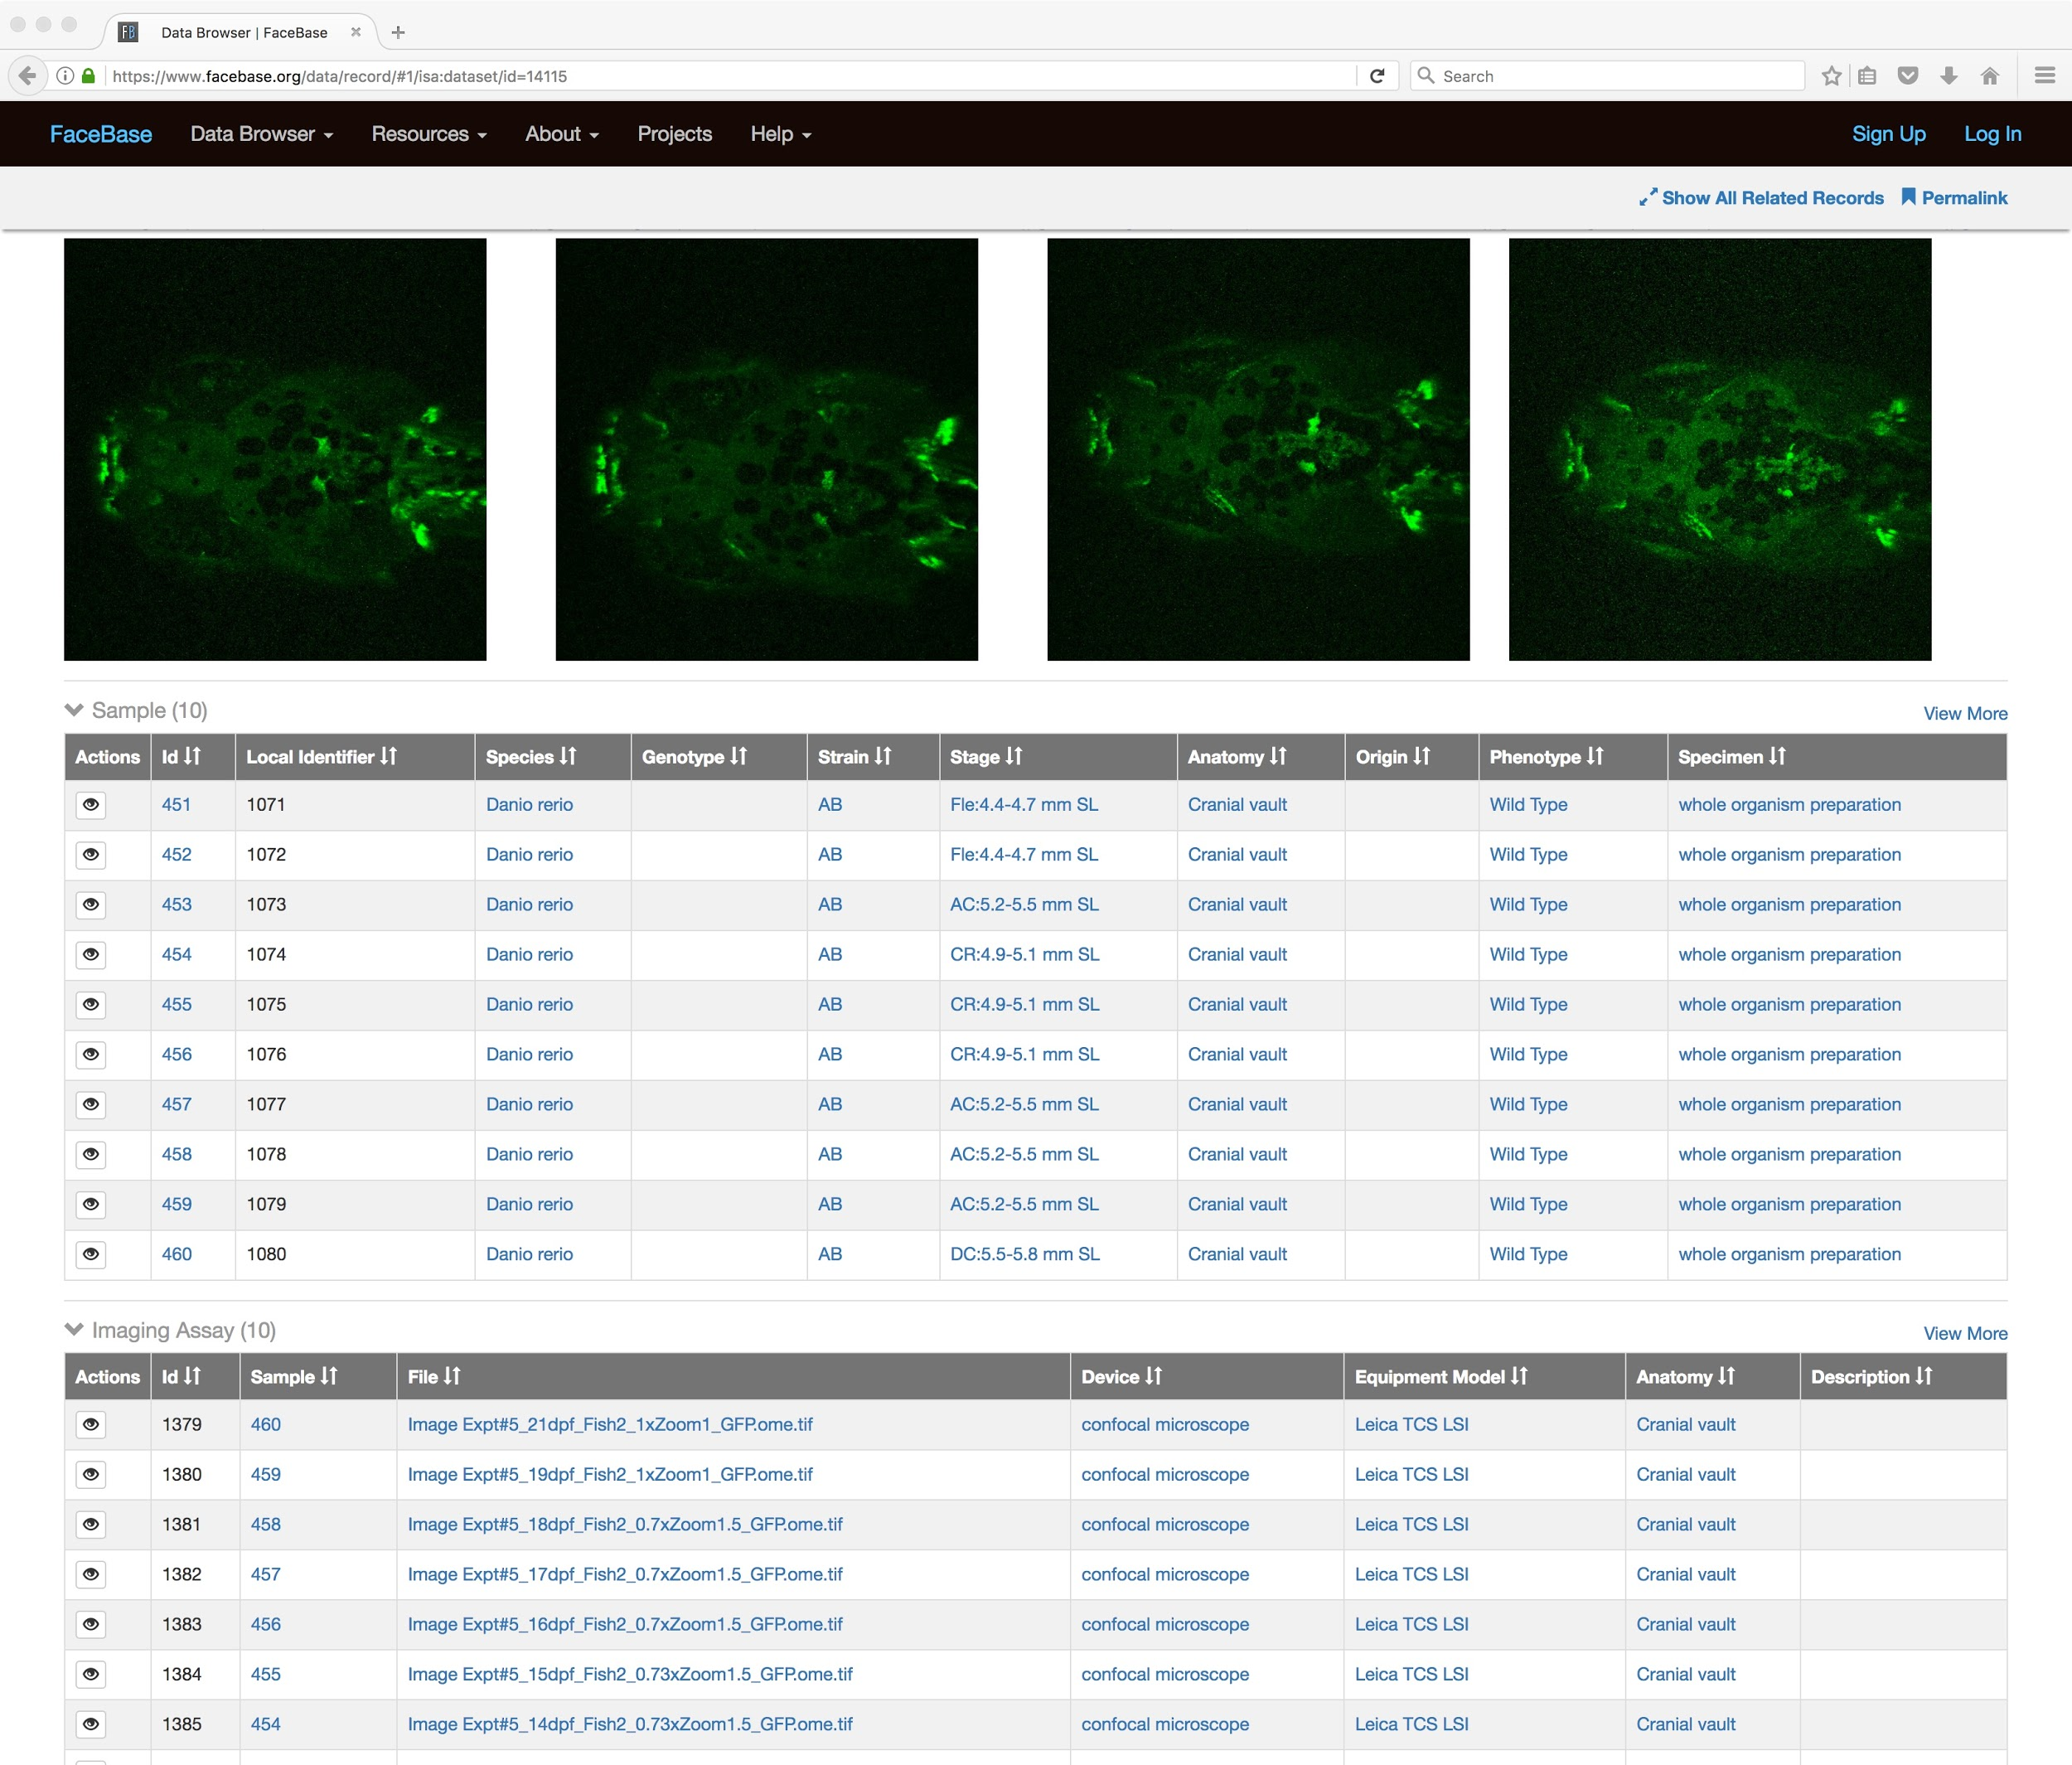
Extensive Data Linkages and Navigation
Dynamically generated navigation hyperlinks between linked data elements in a database
Navigate from projects → datasets → samples → assays
Link from vocabulary terms (anatomy, phenotype, age stages, etc.) to annotated entities (datasets, samples, assays)

Slide 13
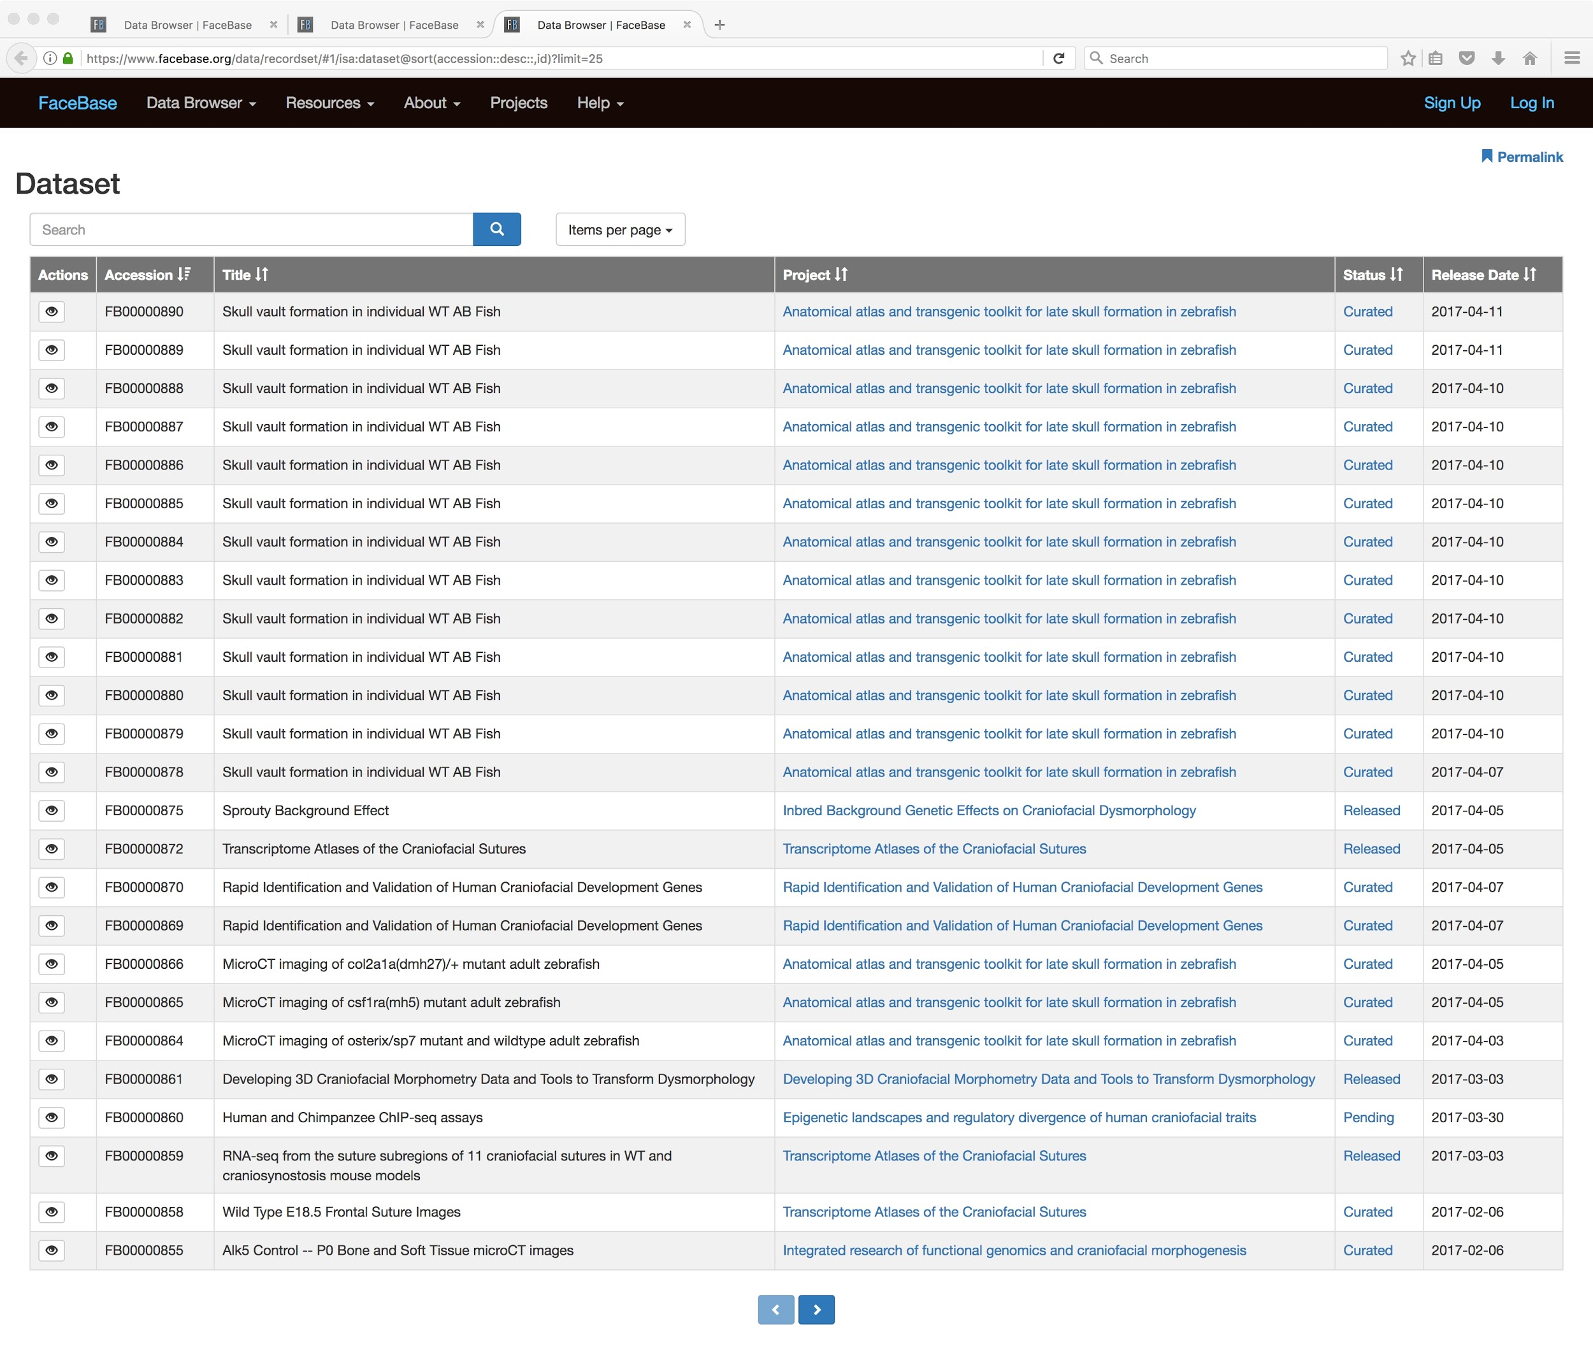
Dataset Dashboard
Concise, searchable, high-level listing of all datasets across FaceBase
Ordered by most recently submitted so you can see what is new and upcoming from the FaceBase Consortium

Slide 14
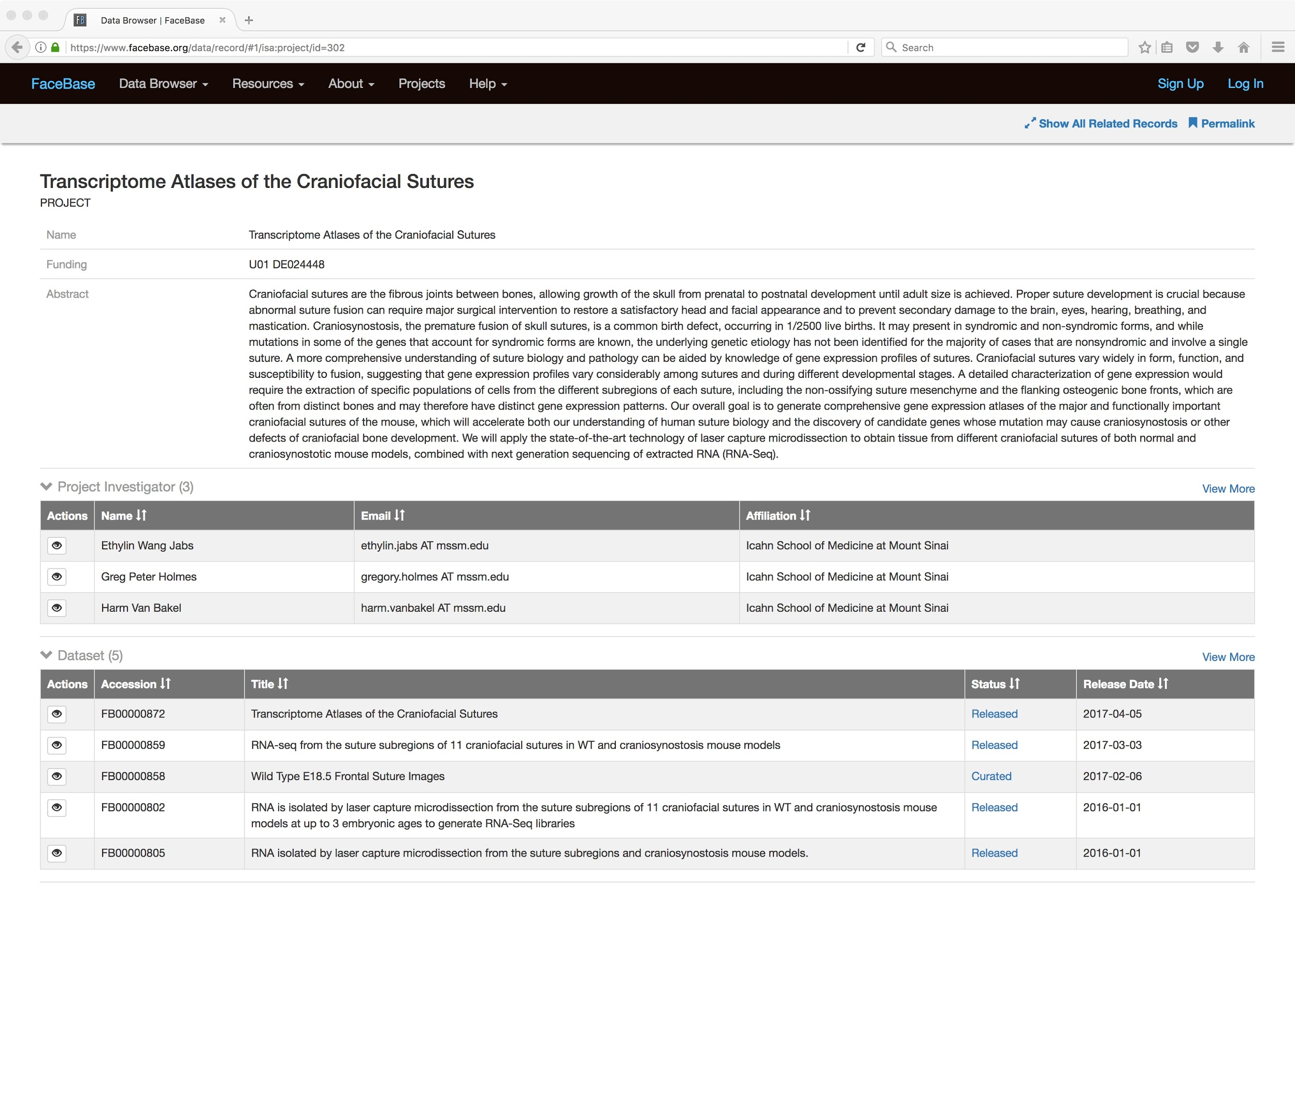
Projects integrated in database
Project pages now driven by the database
Up-to-date listing of all datasets produced by each spoke project
Easy way to follow the data produced by a project

Slide 15
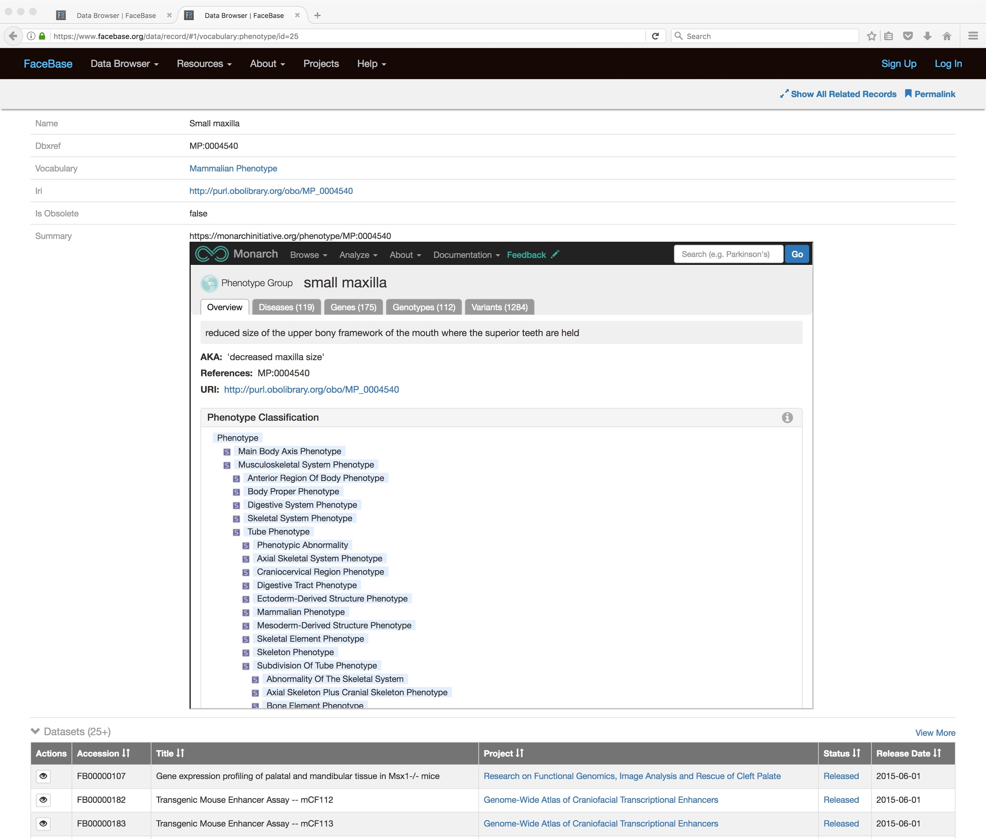
Phenotype Summaries
Listing of craniofacial phenotypes targeted by the FaceBase Consortium
Linkages to phenotype descriptions published through NCBO
Integration of phenotype resources provided by the Monarch Initiative (related diseases, genes, phenotypes, and more)
Listings of all datasets and samples in the FaceBase database for any given phenotype

Slide 16
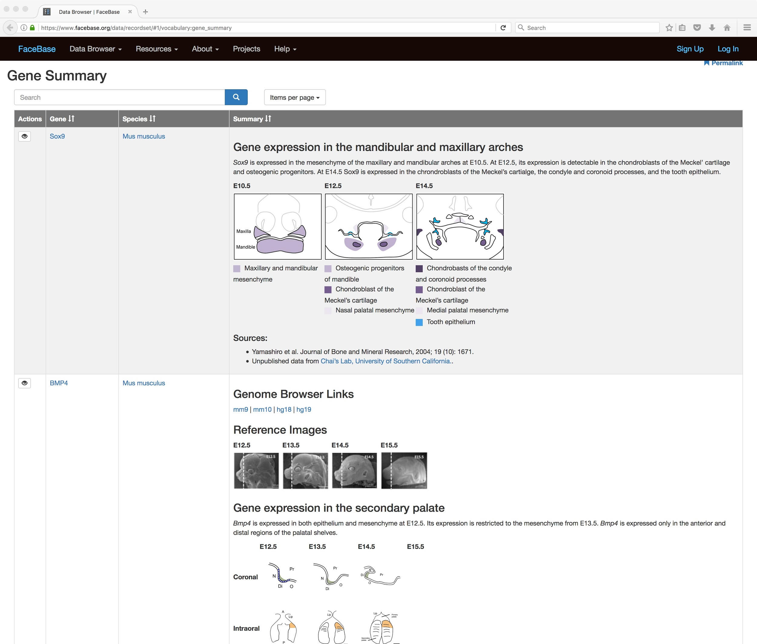
Gene Summaries
New and existing gene summaries produced by the FaceBase Consortium now integrated in the database
Easy to search and navigate across all gene summaries
(Upcoming linkages from gene summary pages to annotated datasets and samples in the database -- coming soon)

Slide 17
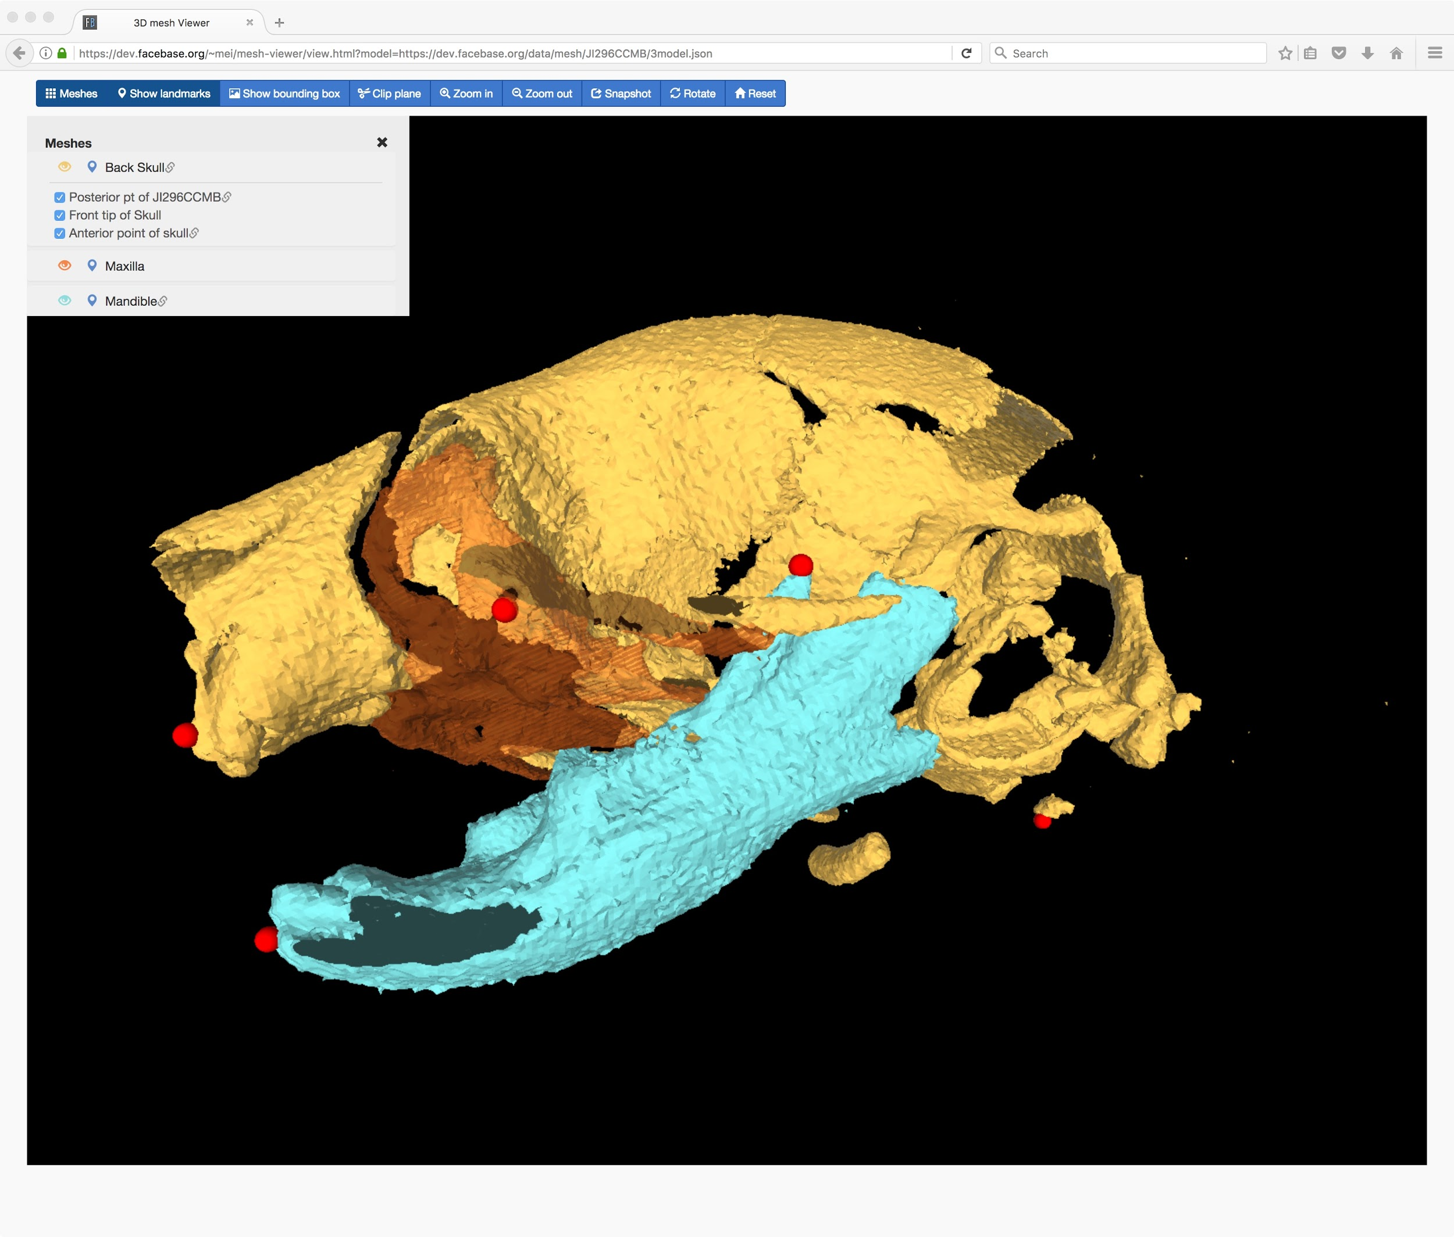
Surface Models
All new surface model viewer integrated into the database
Supports multi-mesh surface models and “landmark” annotations
(Upcoming integration with image volumes to view soft tissue images integrated with surfaces)
Example 1 (mouse): https://www.facebase.org/data/record/#1/isa:dataset/id=14087
Example 2 (zebrafish): https://www.facebase.org/data/record/#1/isa:dataset/id=14123

Slide 18
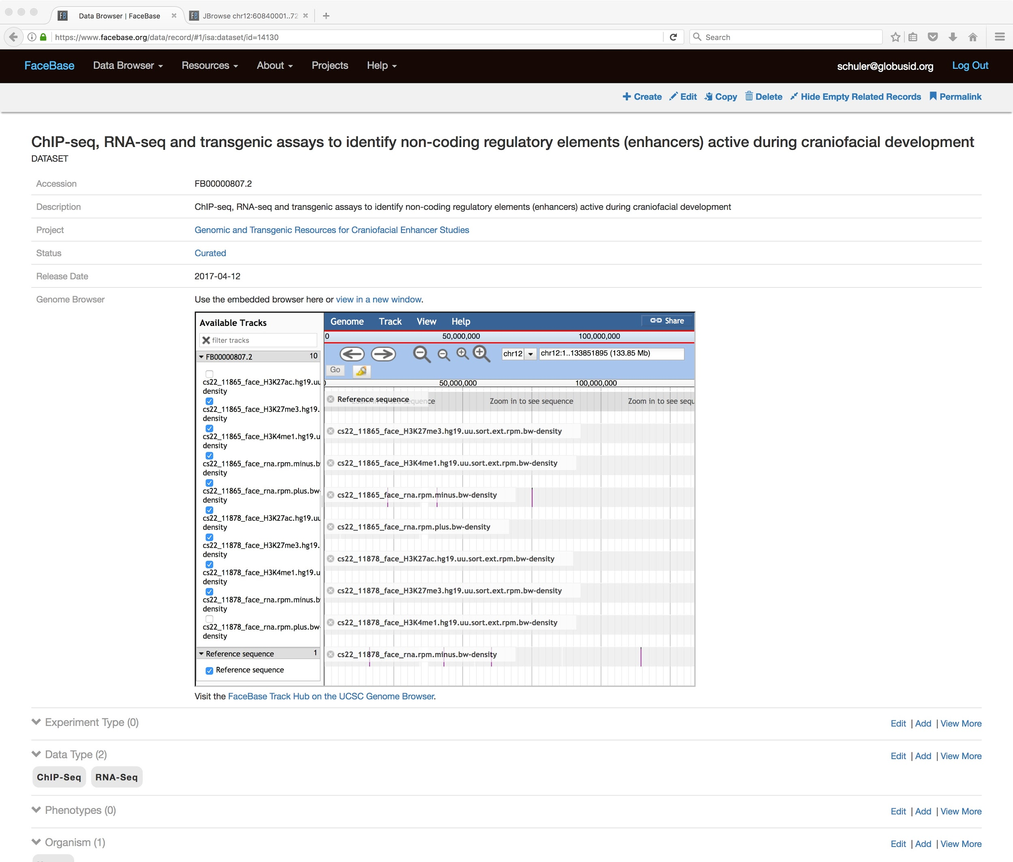
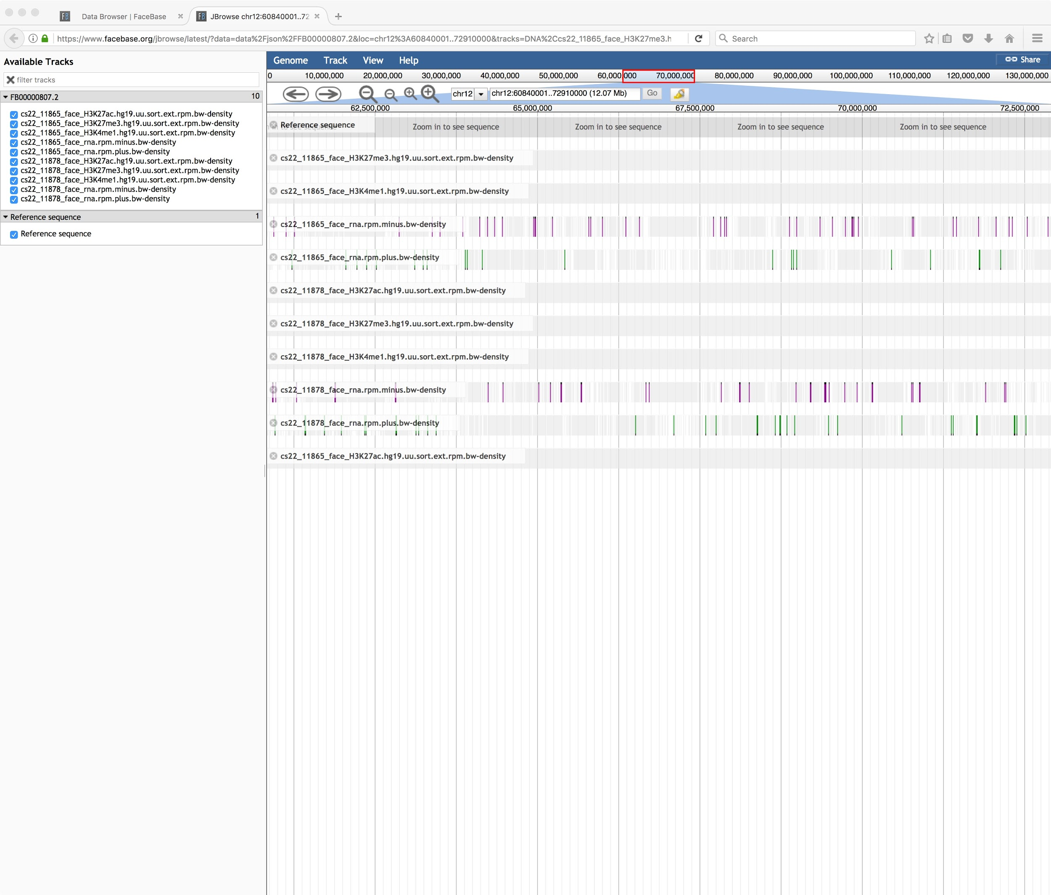
Genome Browser
All new Javascript Genome Browser integrated with the database (*)
View tracks for all FaceBase or per-dataset
Integrated with the dataset page so you can see track details inline with each dataset
* Continued support for UCSC Genome Browser via the FaceBase track hub server
Embedded Viewer
Open in New Window

Slide 19
“Behind the scenes” updates
Revised curation pipeline
Streamlined release of datasets
Stages:
  Pending: an announced dataset available in the new future
  Released: files and images released for public download (basic metadata)
  Curated: fully curated metadata to the new more detailed database
New online data curation tools for data submitters (spoke projects)
Major infrastructure upgrades
Scalable “cloud” style enterprise storage
Choice of FaceBase or campus or other user ids to login

Slide 20
For Year 4…
Curation Pipeline
  Self-curation tools
Mesh Surface Viewer
  Adding landmarks, measures between landmarks
Heatmaps
  Progress made, demoing, lots of work, BUT still need the use case
JBrowse - integrating with the data

Slide 21
For Year 4… (continued)
Improving presentation/usability of data.
  Tailoring data interfaces per spoke.
  Choosing database views and tailoring the data interface.
  Improving the integration of cross-dataset and specific presentation about a dataset.
Collaborations
  with Monarch (better linkages with community ontologies)
  DMDD (more complementary data
Better curation of spokes, better integration, better interactions with the data we have.

Slide 22
Demo
https://www.facebase.org
Notes:
General tour of browser to show the good things we have that users may not even know - including previews - as well as drilling down into the new features we just described - should take about 15 min

Slide 23
Q & A
Any questions?

