Slide 1
Anatomical atlas and transgenic toolkit
for late skull development in zebrafish
Fisher group
Michelle Kanther
Alexandra Scalici
Azman Rashid
Kelly Miao
Ella Van Deventer
Harris group
Katrin Henke
Brent Hawkins
Joana Lopes
Katherine Woronowicz
Notes:
Before I start, I want to acknowledge all of the talented people in both of our groups who have actually done the work – I will mention their specific contributions as I go along.

Slide 2
Notes:
As you can appreciate from this picture of a zebrafish skull, the overall structure in the adult is largely similar to humans and other model organisms such as mouse and chick. However, many of the structures that are most relevant to human defects, including the bones of the top of the skull, develop well past early stages of development that have been most intensively studied in zebrafish.

Slide 3
Zebrafish
Larval development
Early genetic screens
Human
Craniofacial disorders
Genetics, GWAS
Mouse, chick
Anatomical descriptions
Genomic engineering
Notes:
When we conceived this project, we were building on important foundations in the zebrafish related to early craniofacial development. These include many detailed descriptions of structures and gene expression in the larva, and many genetic screens that yielded mutants affecting larval development. Much of this knowledge, however, was of limited usefulness in explaining mechanisms of human craniofacial disorders. By the very fact that they occur in live births, these human disorders manifest later in development. Partly for this reason, mouse and chick have historically been used more widely as models for human development. Both systems have a rich and detailed body of descriptions of developmental and adult anatomy, and in the mouse sophisticated tools for genomic engineering.

Slide 4
• Data from fixed samples
• Limited time points, up to 21 dpf
Notes:
When we began our work, the Kimmel lab had created FishFace, a community resource describing early aspects of zebrafish craniofacial development. This data set, still available on the FaceBase site, is made up of beautiful, detailed images, mostly from confocal microscopy, and has served as a valuable resource for many groups. We were inspired by this example in the planning stages of our own work, and wanted to create something equally useful for later stages of zebrafish craniofacial development.

Slide 5
Zebrafish
Larval development
Early genetic screens
Human
Craniofacial disorders
Genetics, GWAS
Mouse, chick
Genomic engineering
Anatomical descriptions
Notes:
We saw, in the gap between these bases of knowledge, an opportunity to connect them and capitalize on the strength of all the approaches.

Slide 6
Zebrafish
Larval development
Early genetic screens
Human
Craniofacial disorders
Genetics, GWAS
Zebrafish models for human disease
• Visualize and describe later skull development and anatomy
• Enable quantitative mutant analysis
• Facilitate comparisons with human, other model systems
• Create an anatomical atlas
Mouse, chick
Genomic engineering
Anatomical descriptions
Notes:
We set out to make zebrafish an even more powerful model system for human disease, in particular congenital craniofacial disorders. We have developed tools to better visualize and describe later skull development and anatomy, bridging the gap between larva and adult. This has enabled us to describe mutant phenotypes quantitatively, and facilitated comparisons with humans and other model systems. Finally, we have worked create an anatomical atlas that will be accessible to the community and help other groups analyze mutant phenotypes and draw parallels with other systems.

Slide 7
col1a1:egfp
sp7:mcherry
Notes:
In my lab, we have exploited some of the primary strengths of the zebrafish as a model system – its accessibility for imaging throughout development, and the existence of many fluorescent trangenic lines marking specific cell types. Our imaging has relied on low magnification confocal microscopy, largely using these two transgenic lines that mark cartilage and bone throughout growth and into the adult.

Slide 8
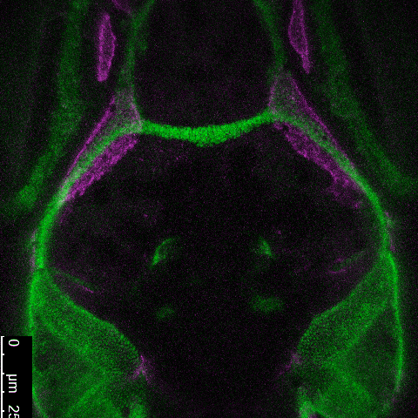
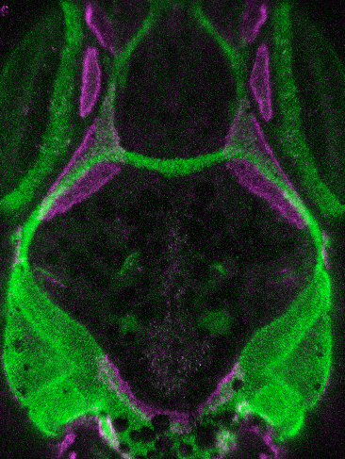
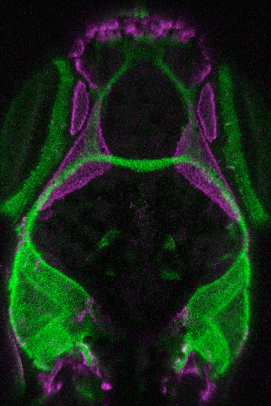
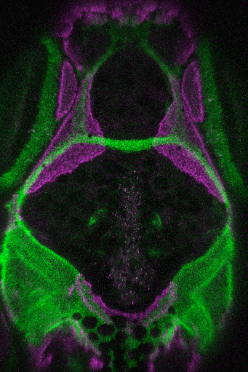
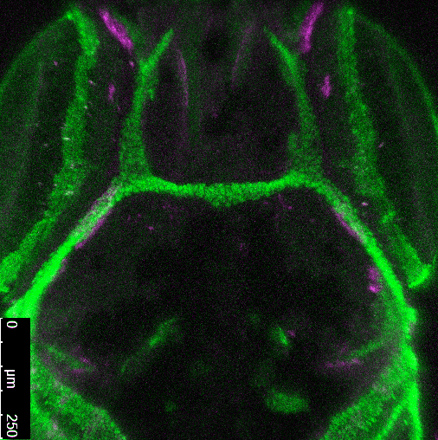
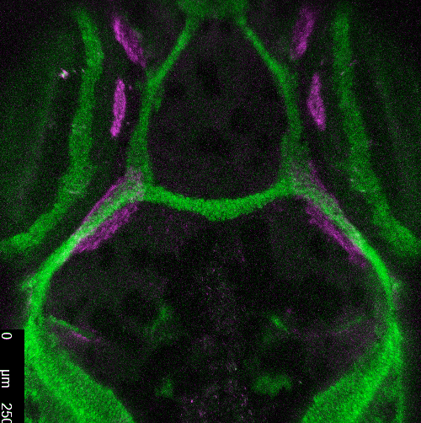
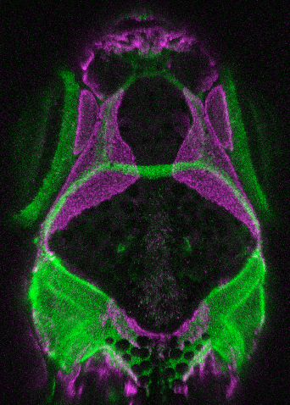
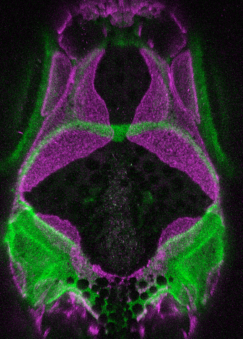
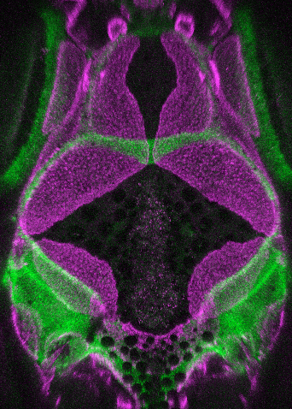
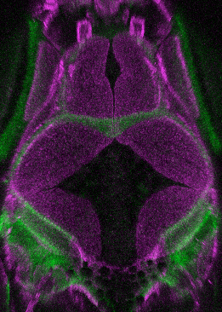
cartilage bone
18-32 dpf
Michelle Kanther
Notes:
Because we are imaging live fish, we can watch the dynamic processes of skull formation, as illustrated here. At this point, I want to make a comment about developmental staging. Early larval development not extremely variable, and can be described fairly precisely by days post fertilization. However, at later stages, growth and the achievement of developmental milestones is much more dependent on rearing conditions. Therefore, we use standard length to calibrate all of our imaging data. I will largely only refer to standard lengths from now on, although I usually have the days also on the slide as a reference point.
These are images of cartilage and bone in one individual fish over a period of two weeks. This ability to image skull formation in live animals, during a time when other model organisms are largely inaccessible, has provided important insights into the process.

Slide 9
Frontal bone initiation
5.79 mm (19 dpf)
5.99 mm (20 dpf)
6.15 mm (21 dpf)
6.30 mm (22 dpf)
Notes:
One important example is the way in which we have been able to observe the earliest stages of frontal bone initiation, seen here in an individual fish starting with only a handful of cells. These cells first appear in close association with the peripheral cartilage; over a period of several days, the cells increase in number but remain tightly associated.

Slide 10
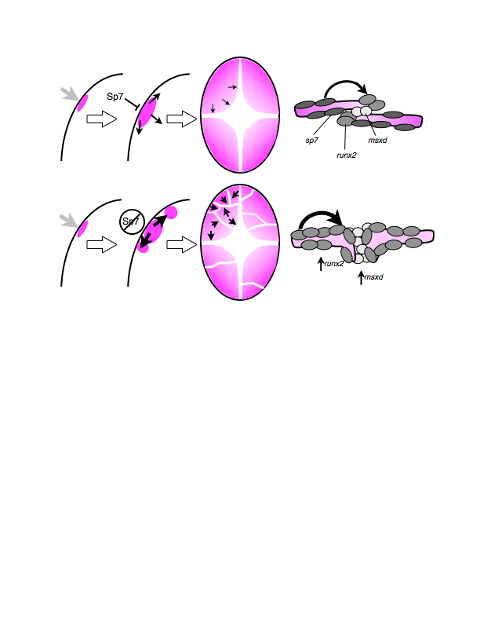
Notes:
Through similar observations on a large number of fish, we have developed a model of important stages in growth of the frontal bones.

Slide 11
Phase 1
Initiation
0.014
Notes:
In the first phase, when the cells remain closely associated with the cartilage, the area of the frontal bones does not change much as a function of standard length.

Slide 12
Phase 1
Initiation
Phase 2
Planar growth
0.109
0.014
Notes:
In the second phase, the bones enter a stage of rapid planar growth, when the two frontal bones and, with a slight lag, the two parietal bones, grow towards the apex of the skull to cover the surface of the brain.

Slide 13
Phase 1
Initiation
Phase 2
Planar growth
0.093
0.109
Phase 3
Suture formation
0.014
Notes:
In the third phase, the bones make contact and begin to form sutures, at which point their growth is measurably slower.

Slide 14
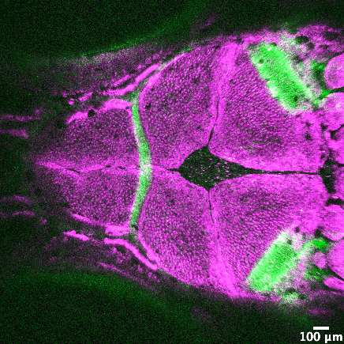
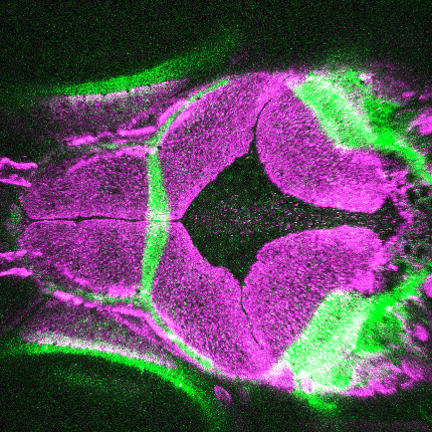
Chi^{+/–}
WT
col1a1a
~10.2 mm (36 dpf)
Alexandra Scalici
Michelle Kanther
Notes:
To illustrate part of the utility of our measurements, I want to briefly show comparable data on two mutants. The first of these is Chihuahua, a dominant mutation in a type one collagen gene and a model for osteogenesis imperfecta.

Slide 15
WT
toth–/–
11.83 mm (41 dpf)
7.98 mm (45 dpf)
Alexandra Scalici
Ella Van Deventer
Notes:
The second of these is the mutant toth, in an unidentified gene, that also broadly effects growth of the skull and skeleton. Superficially, the mutants look similar, and both display delays in growth of the skull bones relative to their siblings.

Slide 16
Notes:
However, when we plot the growth data, it is apparent that the two mutants show a very different pattern. While the Chihuahua mutants show a delay in frontal bone growth relative to standard length, the toth mutants actually show the opposite pattern of growth, with faster frontal bone growth relative to standard length.

Slide 17
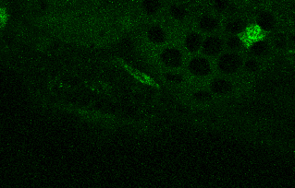
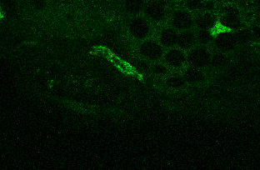
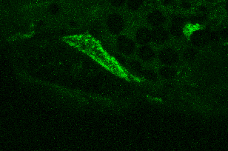
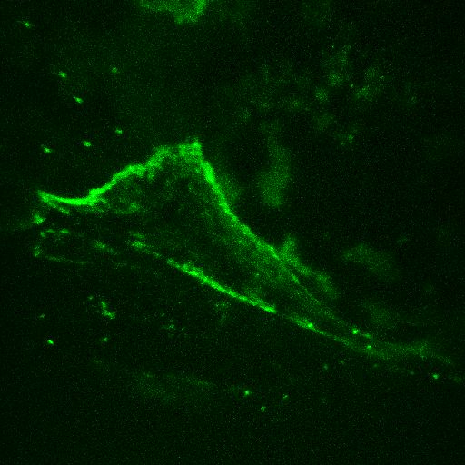
RUNX2:egfp during growth of frontal bone
sp7:mcherry
BMPER:egfp marks cells of osteogenic front
Notes:
In addition to standard markers we have used for most of our imaging, we have been documenting the expression of other transgenes of potential utility to the community. Shown here are two examples of transgenes based on enhancer sequences associated with human disease genes; in this example, both enhancers are active in precursor cells at the edges of the growing skull bones.

Slide 18
Dynamic and variable osteoclast distribution
calcein
Joana Lopes
Kelly Miao
ctsk:dsred
Notes:
Another important example is this transgene, based on regulatory sequences from the CTSK gene, generated by Joana Lopes in the Harris lab. The transgene serves as a marker for active osteoclasts, and Kelly Miao in my group has been working to generate an atlas of that activity during craniofacial development. As you can see here, the cells are sparse and scattered, and their positions vary from one fish to another…

Slide 19
22 dpf
34 dpf
27 dpf
34 dpf
Notes:
And across time within individuals.

Slide 20
Composite osteoclast distribution
9 mm
12 mm
Notes:
To effectively represent this data, we have overlaid the data from several fish, shown here in dorsal view at two stages. We are making the data from all of these constructs, and the transgenic lines themselves, available through FaceBase as resources for the community.

Slide 21
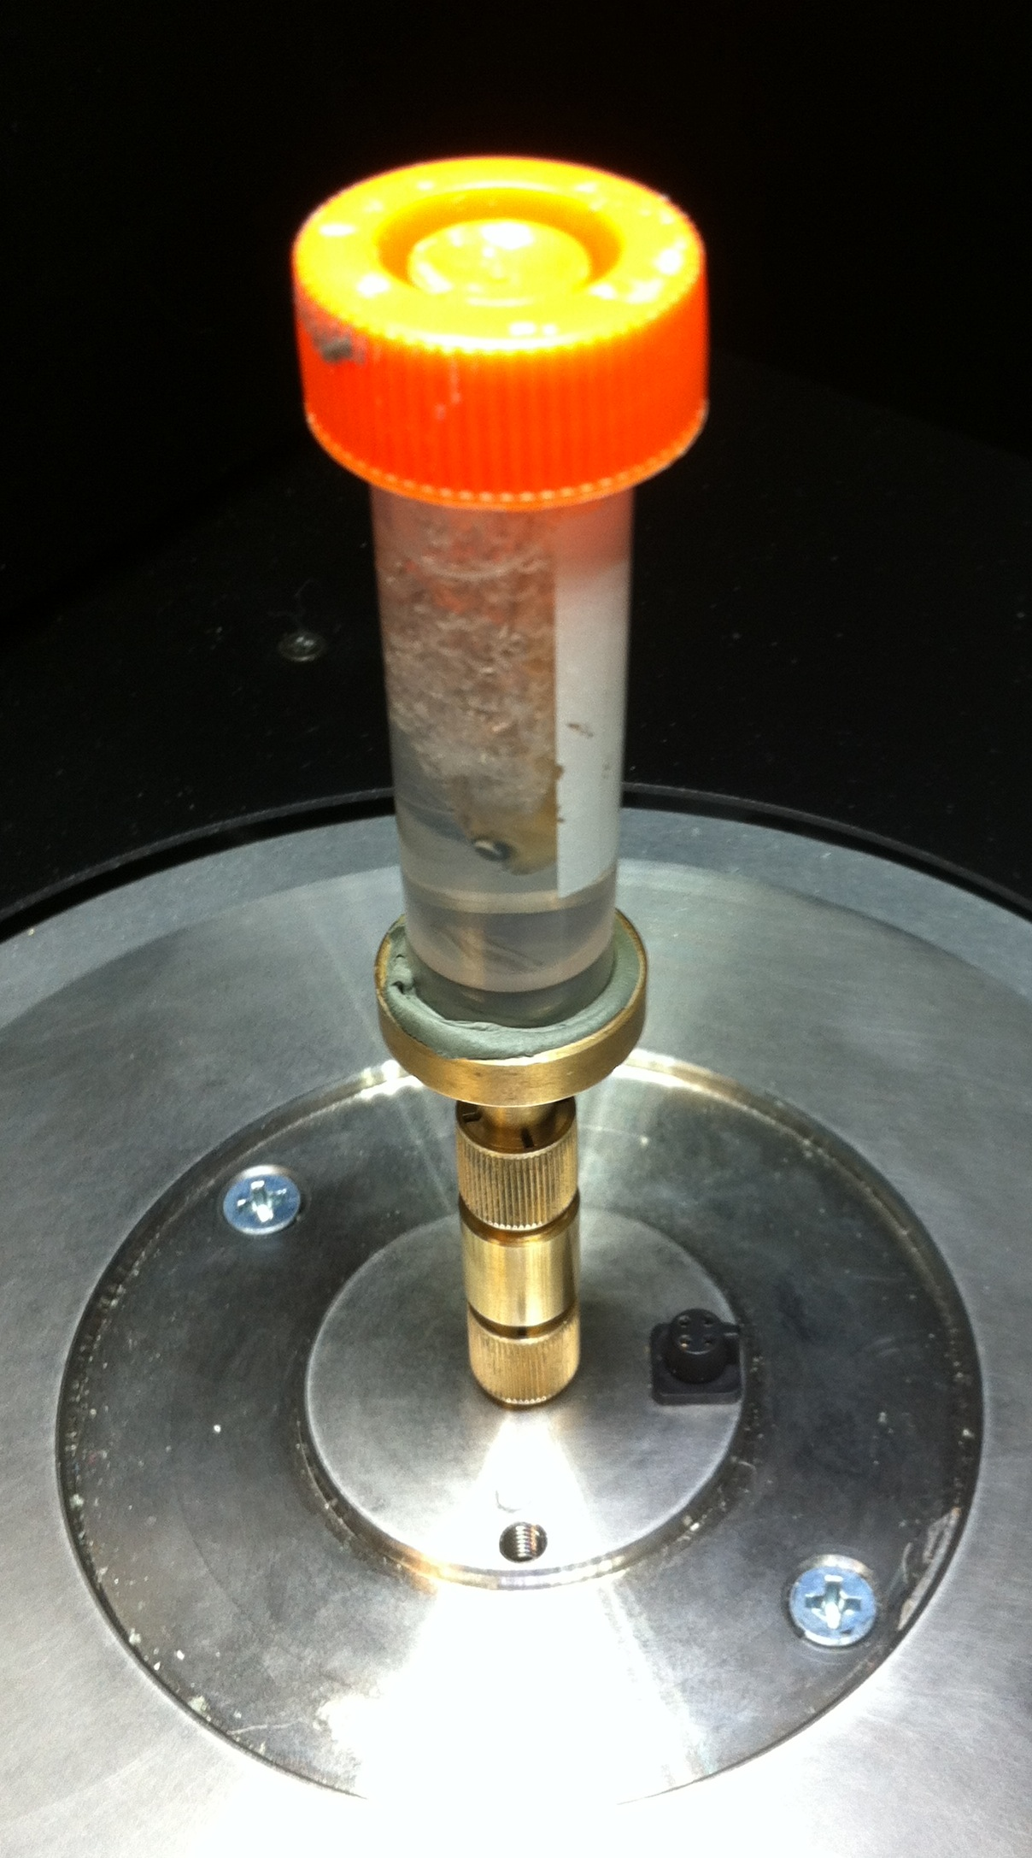
Notes:
As important as the live imaging has proven, it has important technical limitations. First, because it relies on confocal imaging of transgenic lines, it is limited to earlier developmental stages. It is also more time-consuming, and repeated imaging is stressful to the fish, limiting the number of individuals and the amount of data we can collect. The Harris lab has relied on high resolution micro-computed tomography to generate images of wild-type anatomy in later juveniles and adults. This captures data with equally high resolution in all axes, which lends itself to 3 dimensional reconstructions. Additionally, the ease of microCT imaging, with no requirement for transgenes or for special tissue preparation, makes it an ideal screening tool for subtle abnormalities that might otherwise go unnoticed.

Slide 22
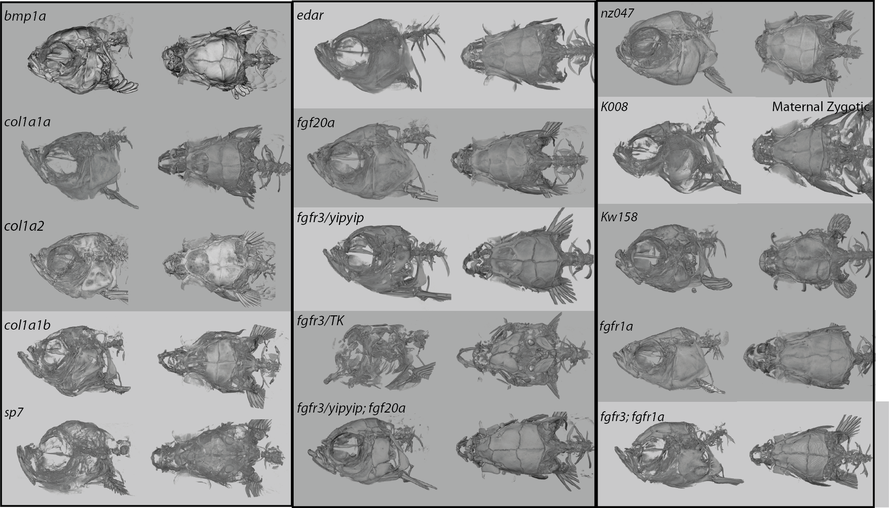
Notes:
This slide is a beautiful illustration of that, showing many of the mutants that have been scanned and the data made available on FaceBase. Importantly, many of these mutants are in genes or pathways affected in human craniofacial disorders, reflected in many cases by similar anatomical defects.
I’m sure you can appreciate from the above images the complexity of the anatomy in the adult zebrafish skull. There are some excellent published descriptions of the formation of the dozens of bones, but we wanted to create a more accessible resource to aid in visualization of the complex 3-dimensional relationships.

Slide 23
Ho, Iwata, et al.
Dev. Biol. 2015
Notes:
We were inspired by the reconstructions published Yang Chai’s group, based on microCTs of mouse skulls during development. Using their approach as a starting point, we have created similar reconstructions for earlier development, based on confocal imaging, and of the adult skull, based on microCTs.

Slide 24
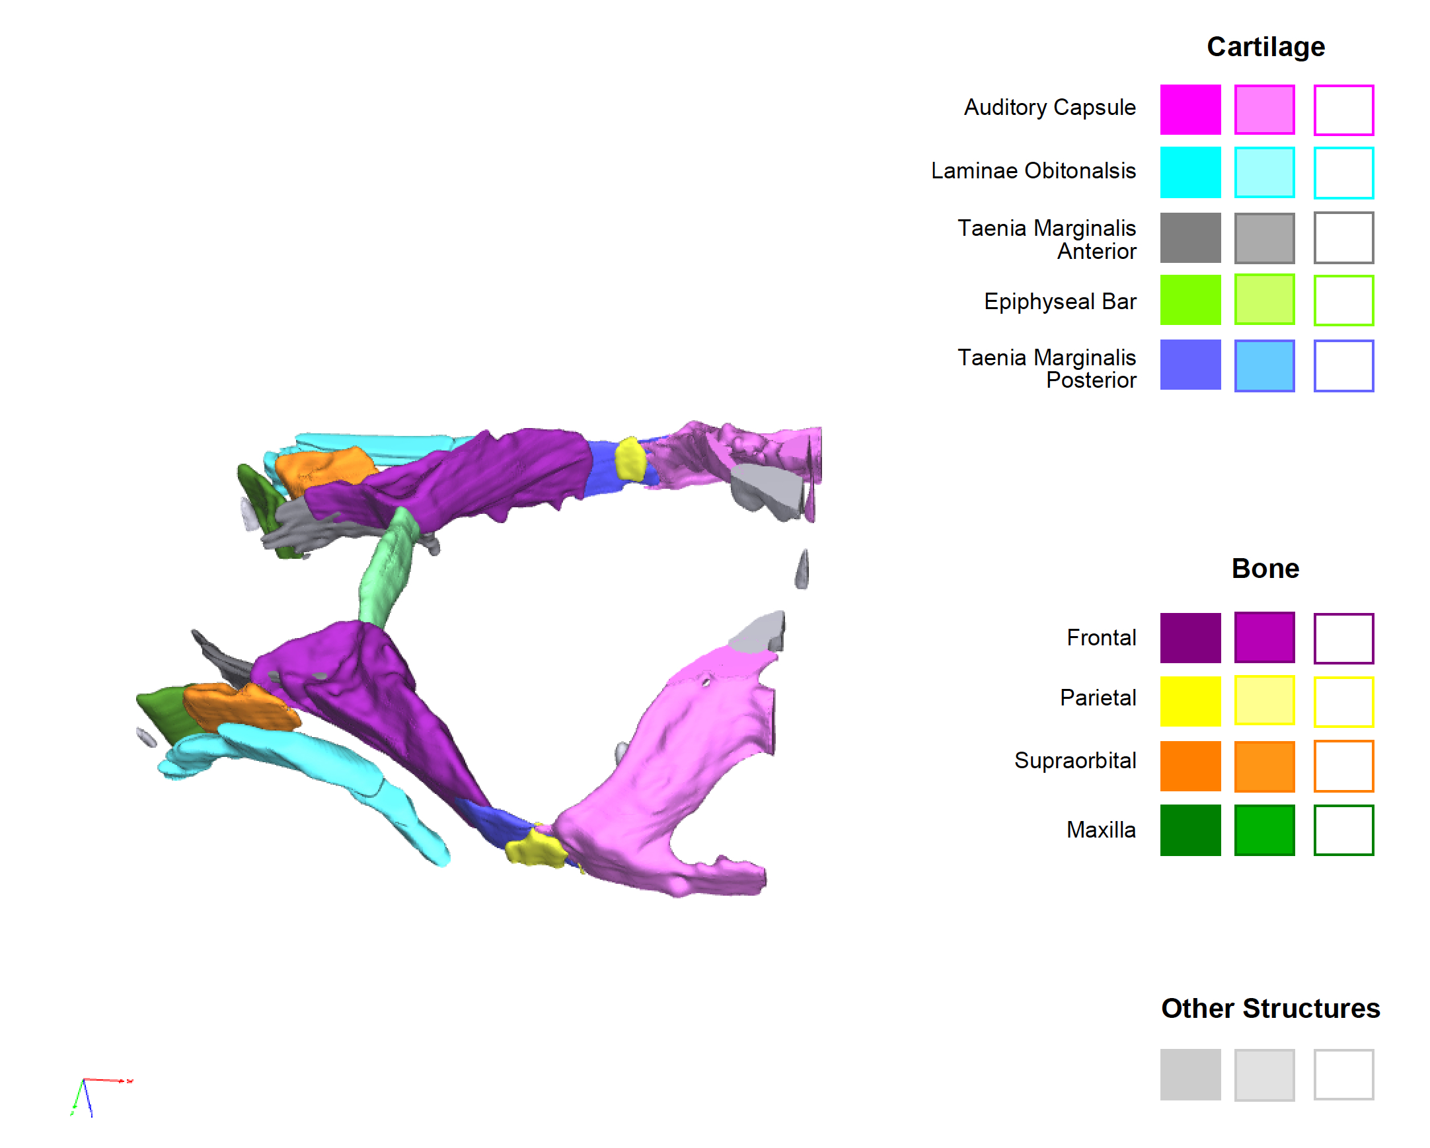
WT fish at 25 dpf
8.1 mm
Azman Rashid
Notes:
These first models were created by Azman Rashid in my lab, based on confocal Z-stacks of cartilage and bone. He first segmented all of the structures from the confocal data, then assigned colors and annotated them manually. He then exported them into Adobe Acrobat to create interactive 3-D PDFs. Each annotated structure is associated with a color and label…

Slide 25
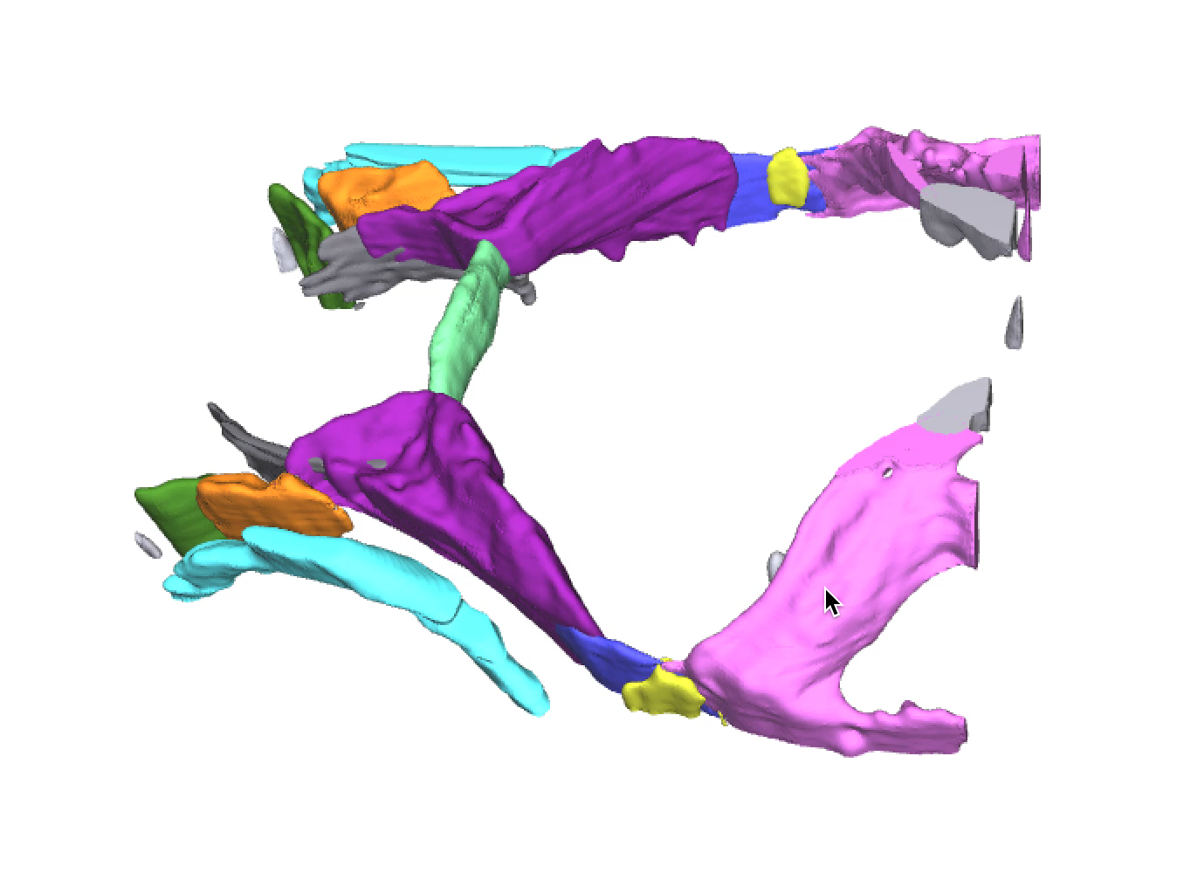
Notes:
And as you can see here, the entire image can be freely rotated, and the interactive buttons allow each element to be made translucent or removed entirely. The PDFs are files of modest size, that can be easily downloaded and viewed with the free program Adobe Acrobat Reader.
This is all well and good, when the fish is small and the anatomy relatively simple. The real challenge for us was to create a similar atlas of the adult anatomy.

Slide 26
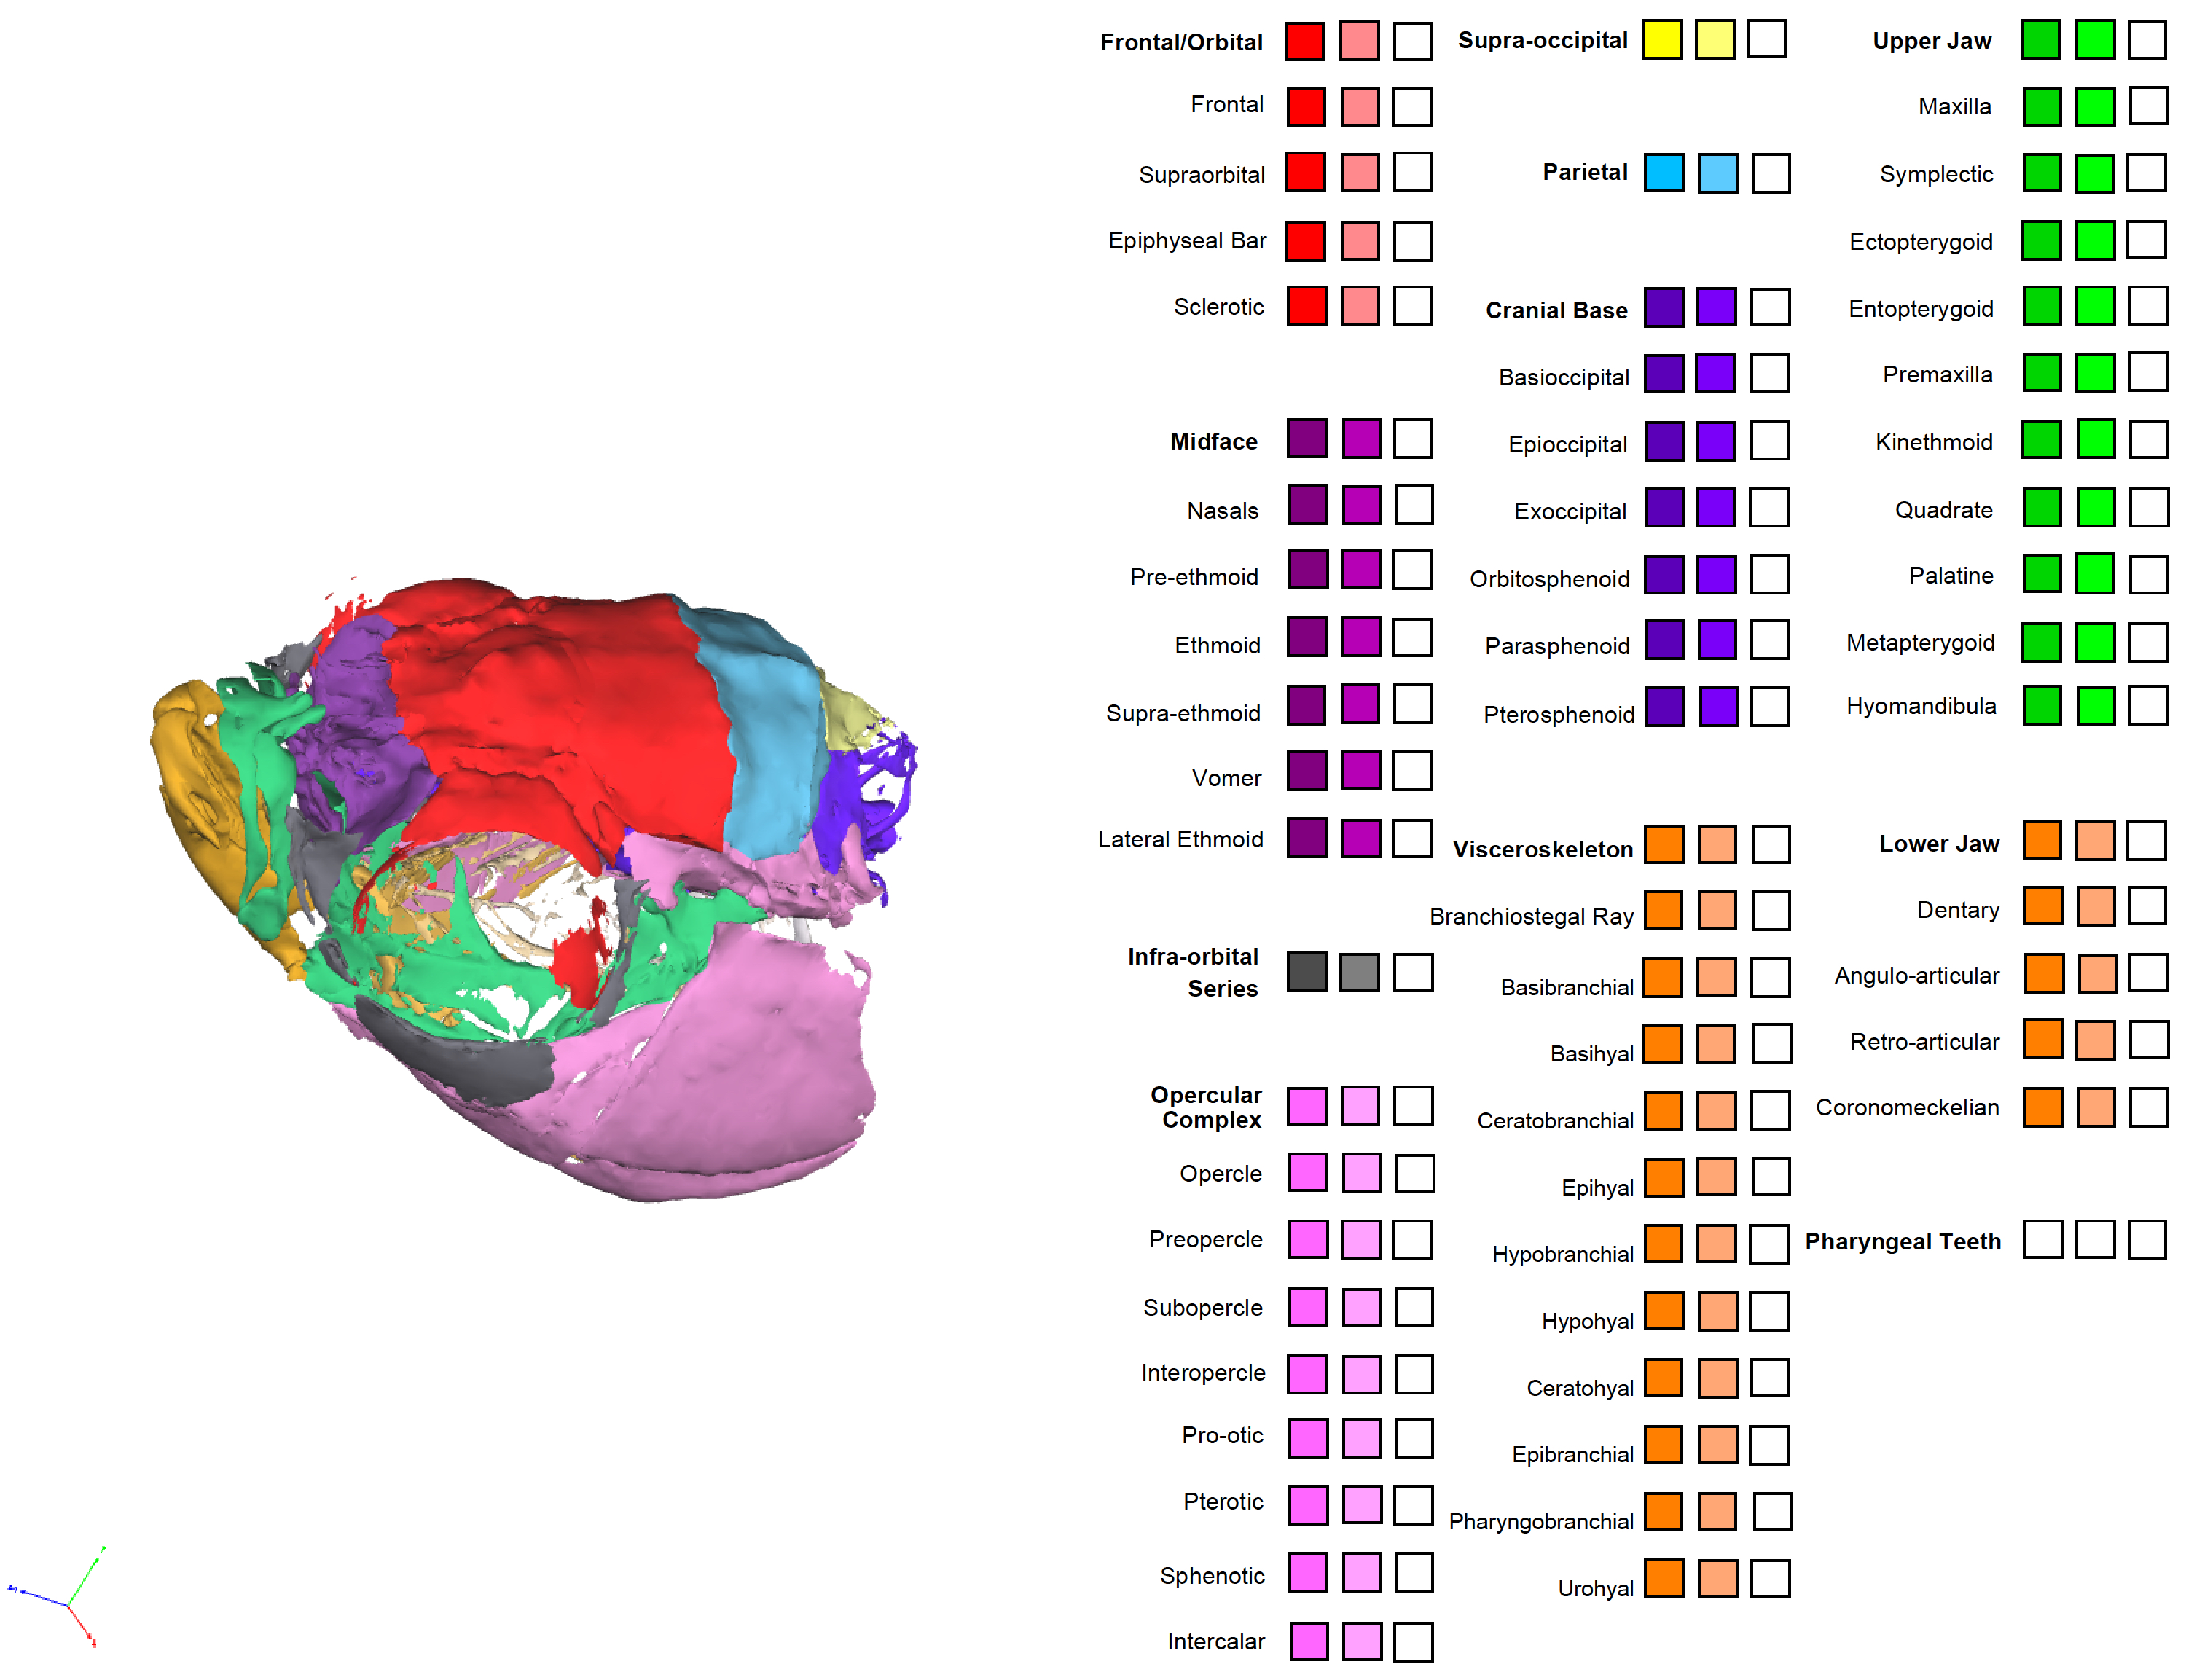
Katherine Woronowicz
Azman Rashid
Notes:
Starting with microCT data from a wild-type adult fish, Katherine Woronowicz in the Harris lab has similarly segmented the data, and Azman has generated corresponding PDFs.

Slide 27
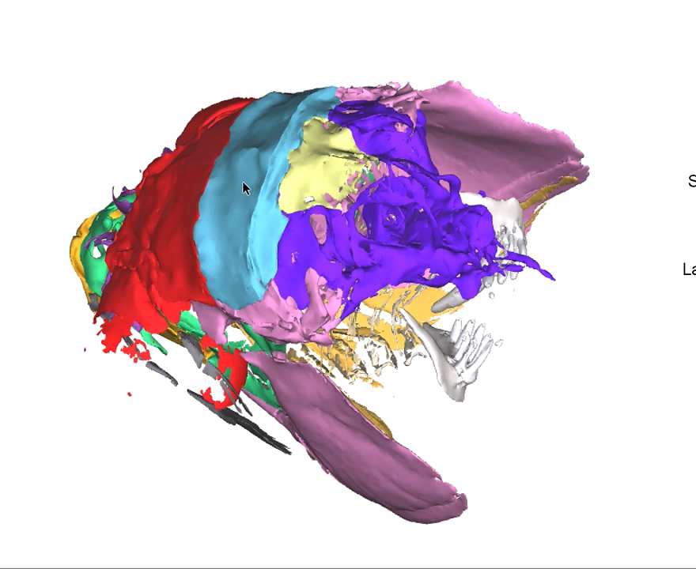
Notes:
As with the confocal models, the image can be freely rotated. Because of the complexity of the anatomy, we have grouped related bones together; the entire group can be controlled with a single button, or individual bones can be controlled separately. As with the earlier models, these models of the adult anatomy will be available on FaceBase, for viewing or for download.

Slide 28
Zebrafish as models for human craniofacial disorders
• Developed tools and approaches to visualize later development
• Enable quantitative analyses, of both normal development and mutant phenotypes
• Facilitate comparisons with human, other model systems
• Create an anatomical atlas of later craniofacial development and adult anatomy

