Slide 1

FaceBase Hub
Years 1 through 5
Carl Kesselman

Slide 2
FaceBase Hub Goals
Create an integrated, linked data resource, not just a repository of individual data sets
  Links to internal and external sources
Promote self-curation to enable rapid turn around of data submission
Promote data pipelines to support both raw data and derived data such as bioinformatics pipelines
Promote FAIR principles, including focus on citable data
Adapt rapidly to emerging data types, such as single cell gene expression
Enhanced the end-user experience of data through online visualization

Slide 3
Years 1: Migration and improved data standards
Transition from U Pitt to ISI
Gathering of project requirements via short-term teams
Initial new data model
Updated request process and handling for human data
Communications
  New wiki and mailing lists
  Monthly Steering Committee calls
New FaceBase website

Slide 4
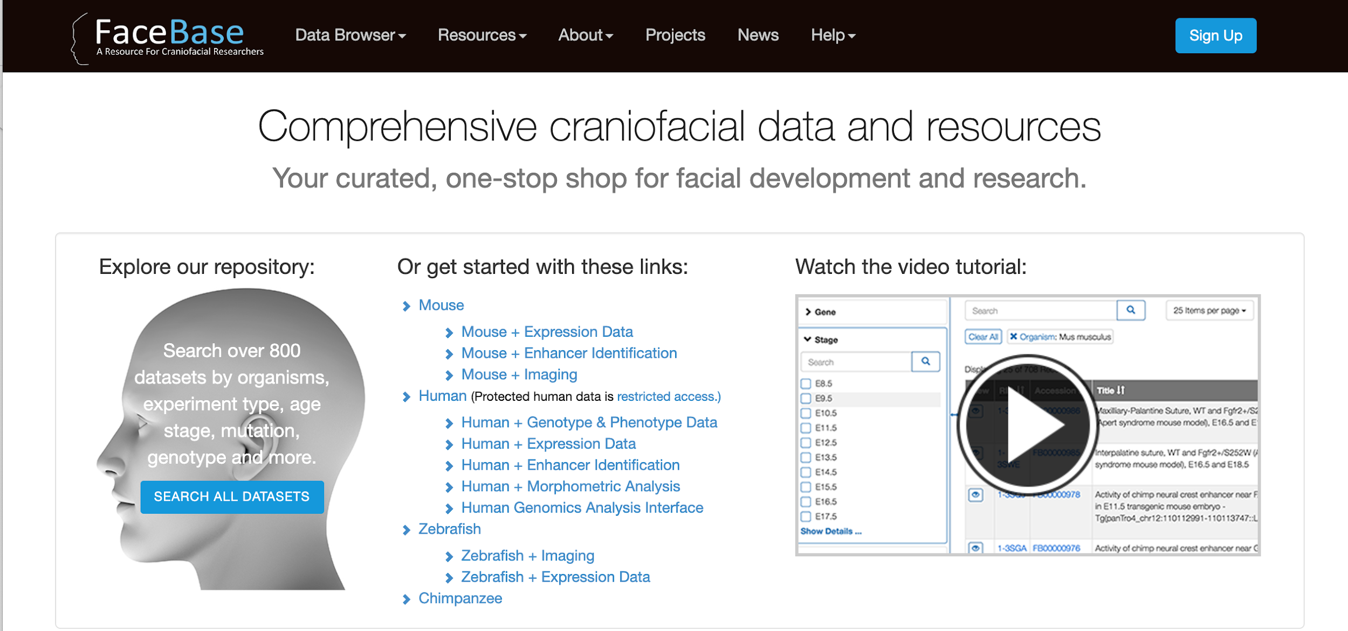
FaceBase 2 website

Slide 5
Years 2: Improving data standards
Improved classification of data - ie, more accurate experiment types, adding phenotypes, support for transgenic enhancer data
Clean up of existing data: consistent anatomical terms from OCDM, genotypes,
Mouse Matrix page - rich visualization of all mouse control data
Secure and flexible user and group management, support for fine-grained authorization
User testing and usability enhancements

Slide 6
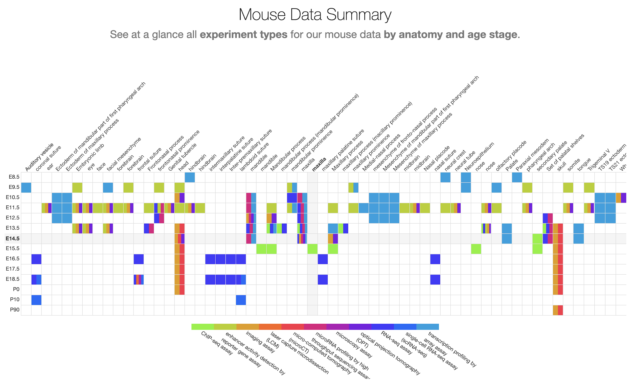
Mouse Matrix
Notes:
Link should be to main homepage

Slide 7
Year 3: Increase sophistication of repository
Cross-cutting integrations and visualizations
  3D Surface Model viewers - multi-mesh surface models and “landmark” annotations
Higher resolution data model leads to more intensive inter-linkages:
  Dynamically generated navigation hyperlinks between linked data elements of the database
  Link from vocabulary terms (anatomy, phenotype, age stages, etc.) to annotated entities (datasets, samples, assays)
  Phenotype summaries (with integration Monarch Initiative)
  Gene Summaries (integration from Chai resource)
Genome Browser - integrated custom browser within datasets
Self-curation data submission tools

Slide 8
Year 4: Optimizing for collaboration and sharing
Establishment of Bioinformatics Pipeline based on ENCODE
More improvements on data model to represent diverse research data using FAIR principles
Improved search and filtering interface
Image Navigation via surface model viewer
Improved integration with TrackHub and the internal JBrowse plugin for viewing genomic data internally and being able to compare with other datasets
Data Submissions:
  Continued to streamline browser-based data submissions
  Added desktop & command-line data upload tools

Slide 9
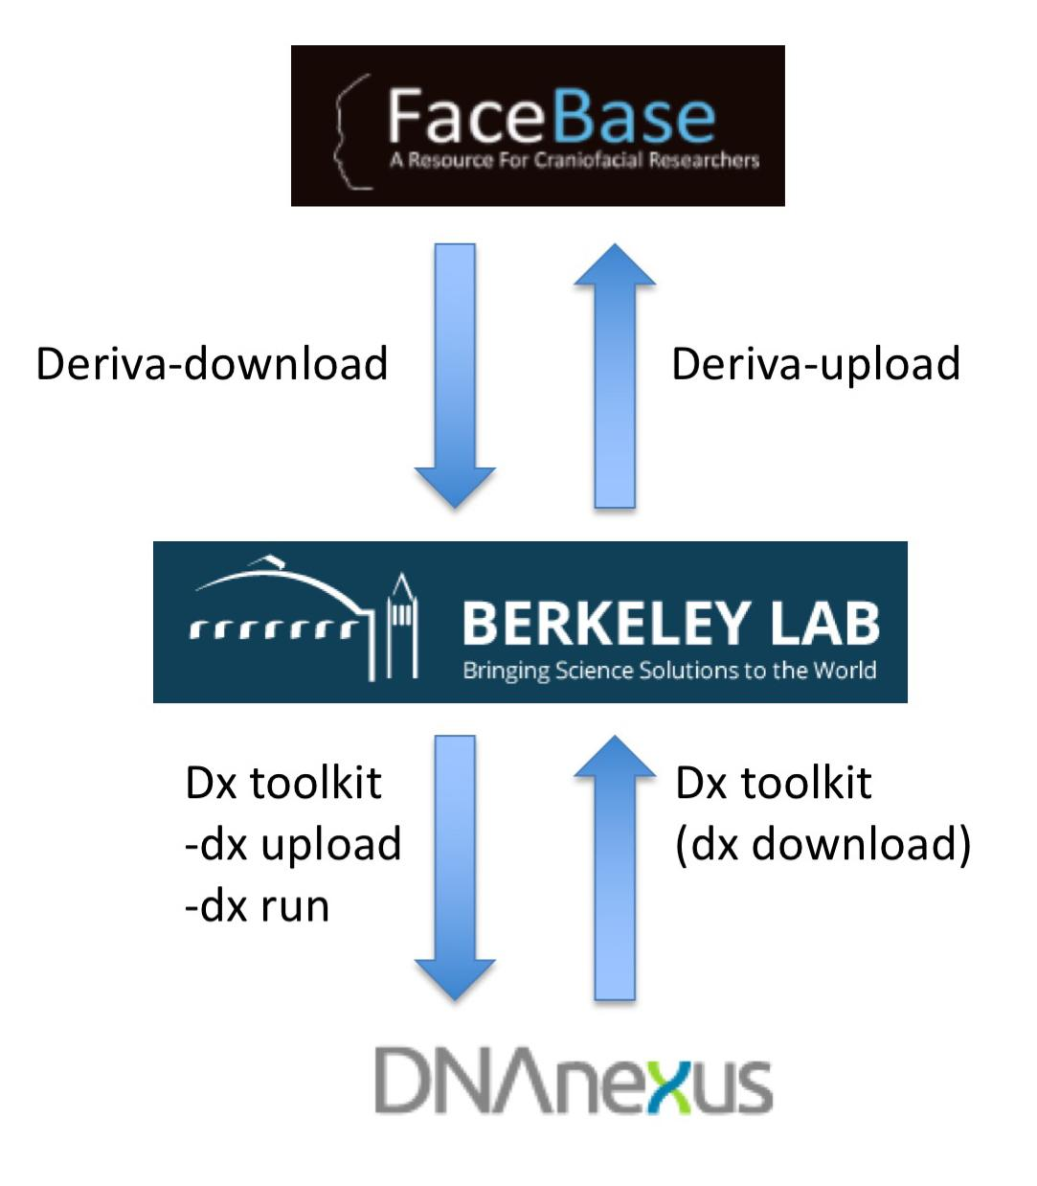
Bioinformatics Pipeline
Rationale - ensure that sequencing data between spokes can be compared.
Solution - establish a common sequencing pipeline, (based on ENCODE) and operate on a cloud-based genome informatics service (DNAnexus).
Process - Visel’s lab in Berkeley administers the routing of sequencing data from FaceBase to DNAnexus and back.

Slide 10
Highlights of Year 5:
Bioinformatics Pipeline: coordinate curation of data and operation of pipeline, full automation.
Vocabulary enhancements: finish integration with Uberon, improve semantic search
Data curation: total data review, coordination with spokes, new curation tracking tools
Image visualization and display: 3D mesh, imaging results across datasets, control vs mutant
Usability enhancements: Bulk download capability
Genome Browser/JBrowse integration and enhancements: ie, cross-dataset browsing of data

Slide 11
Highlights of Year 5 (cont.):
FAIR Identifiers and Resolver
Historical information tracking (versioning/provenance)
Final push receiving and curating data from the spokes
Migrating the HGAI website.

Slide 12
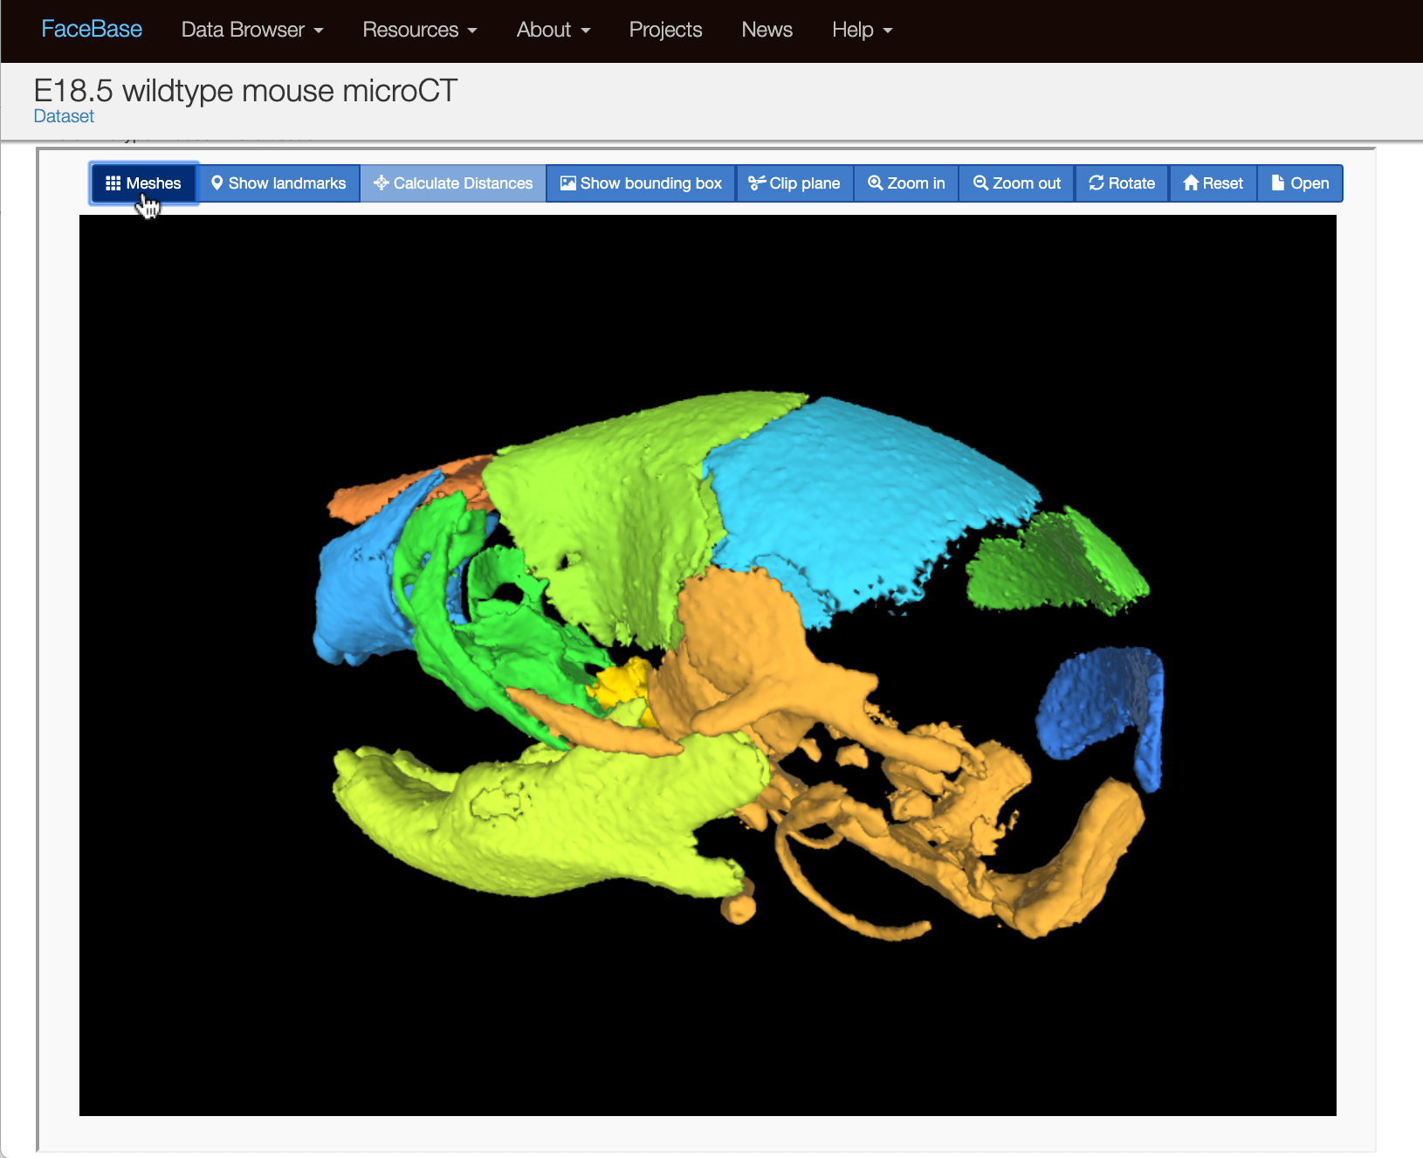
3D Mesh Viewer
Building on the surface model viewer
Connecting anatomical regions to the database.
Clicking an image of an anatomical region pulls up the list of all datasets with data related to that region.
Available on ALL FaceBase dataset pages
Notes:
https://www.facebase.org/chaise/record/#1/isa:dataset/RID=3V4A

Slide 13
Usage Statistics (past year)
Database Statistics
832 datasets and growing
141 publications
As of April 2019: over 4,300 individual data files - over 6 terabytes of data
18 different assay/experiment types
Website Statistics
Pageviews: 52,867
Sessions*: 19,560
Avg Session Duration: 3:40
Users**: 13,832
Notes:
* Sessions: Total number of sessions within the data range. A Session is the period of time a users is actively engaged with the website.
** Users - as defined by Google = Unique Visitors = The number of unduplicated (counted only once) visitors to your website over the course of a specified time period. (Depending on cookies, so it’s not a foolproof number ie, user deletes cookies, visits from a different device.)

Slide 14
Data Download Statistics
User activity within the Data Browser for the past year:
523 data file downloads
5,452 thumbnails*
Usage of our Track Hub for the UCSC Genome Browser:
183,254 track downloads**
* Filtering out for generic placeholder thumbnails
** The Genome Browser reads byte ranges of the part of the file the user is actually looking at

Slide 15
Possible Future Directions
Continued alignment with FAIR guidelines and NIH COMMONS
Enhancements planned for improving usability of self-curation, including curation task worklists and dashboards
Codified curation quality metrics
Next generation anatomical/visual search
Advanced display of imaging data
Enhanced genome browser configuration and integration
Further integration and alignment with vocabularies
Advanced semantic search capabilities
Annotation tools for facilitating analysis of anatomy and phenotypes in datasets

Slide 16
Demos
https://facebase.org/id/3V4A
https://facebase.org/id/TMJ
https://facebase.org/id/VXA
Notes:
Image navigation demo, revised JBrowse interface,

Slide 17
Let Us Know What You Think!
Let us know your questions, comments, feedback at:
help@facebase.org

