Slide 1

Human Genomics Analysis Interface
(U01-DE024425)
Mary L. Marazita
Eleanor Feingold, Harry Hochheiser, Elizabeth J. Leslie,
University of Pittsburgh
Center for Craniofacial and Dental Genetics
FaceBase Annual Meeting/Webinar
May 20, 2019

Slide 2
ACKNOWLEDGEMENTS
Current Staff :
Nandita Mukhopadhyay
Myoungkeun Lee
Annette Krag-Jensen
Lance Kennelty
Tamra Mitchell
Jim Gallagher
Former Staff/Students :
Tom Maher
Justin Stickel
Jenna Carlson
Funding NIDCR
U01-DE024425
Faculty:
Mary L. Marazita
Elizabeth Leslie
Eleanor Feingold
Harry Hochheiser

Slide 3
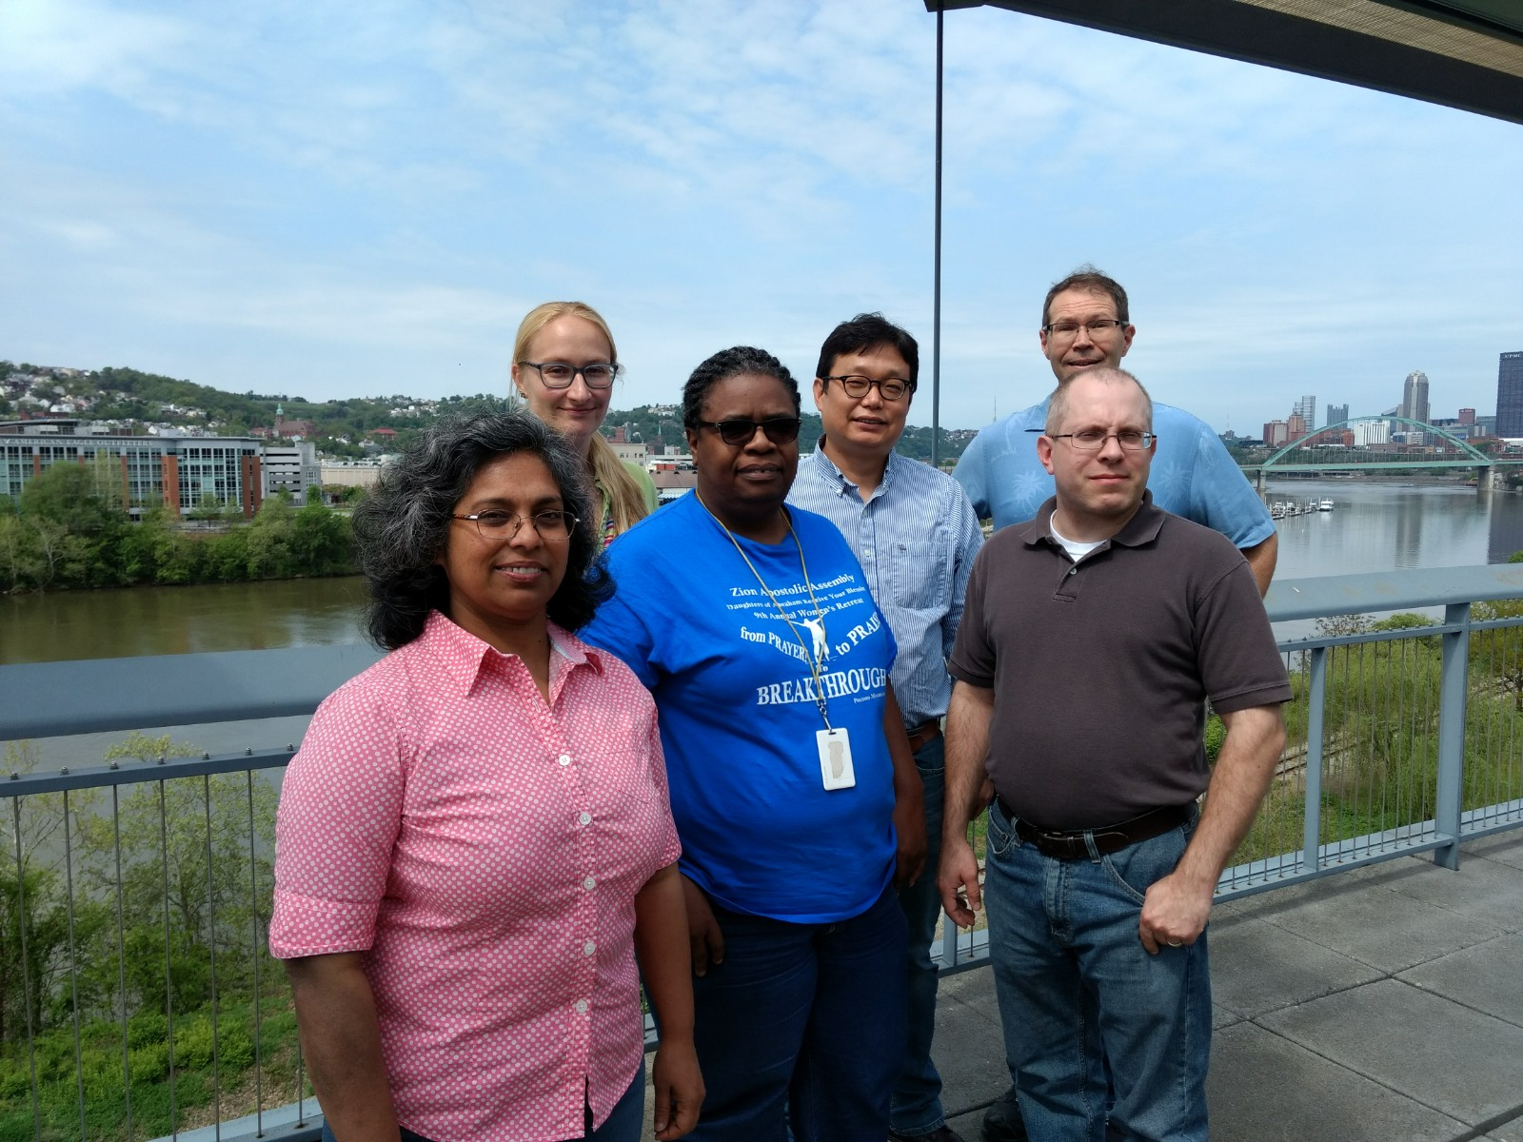






Slide 4

GOALS
Develop software interface for Human Genomics Results
  No access to individual level data
  Secure hardware
Identify appropriate craniofacial and oral genomics projects
  From research community, dbGaP, publications
Create and display results from genomics projects
  E.g. Manhattan plots, LocusZoom
Move to FaceBase Hub for ongoing management

Slide 5
UNDERLYING APPROACH
User friendly, save user time
Pre-calculate results databases (e.g. p-values at SNPs)
  For all relevant subsets: by ethnicity, by genotyped versus imputed panels, by phenotype, by environmental factors
  Customized: with input from PIs (e.g. published results)
Manhattan plots
LocusZoom interface for specific SNP/gene/region requests

Slide 6
YEAR 5 UPDATES
Finished creation of projects for display
  9 total projects: 5 OFC, 1 facial variation, 3 dental disorders
  119 total results datasets available for visualization
Revamped website for easier transition to Hub
  i.e. Static Manhattan plots; interactive LocusZoom plots
Transition to Hub done (still working on search terms etc)

Slide 7

LINK
https://www.facebase.org/hgai/

Slide 8
DEMONSTRATION

Slide 9

Remaining Issues with Transfer to Hub
Enhance search terms at the Hub to be able to “find” the HGAI project for use cases such as:
  Animal model researchers looking for human results for genes of interest
  Human genetic researchers looking for results for genes of interest, e.g. to compare to their results
  Prepare figures for papers, e.g. LocusZoom, Manhattan, from projects
Documentation on how to add new data

Slide 11
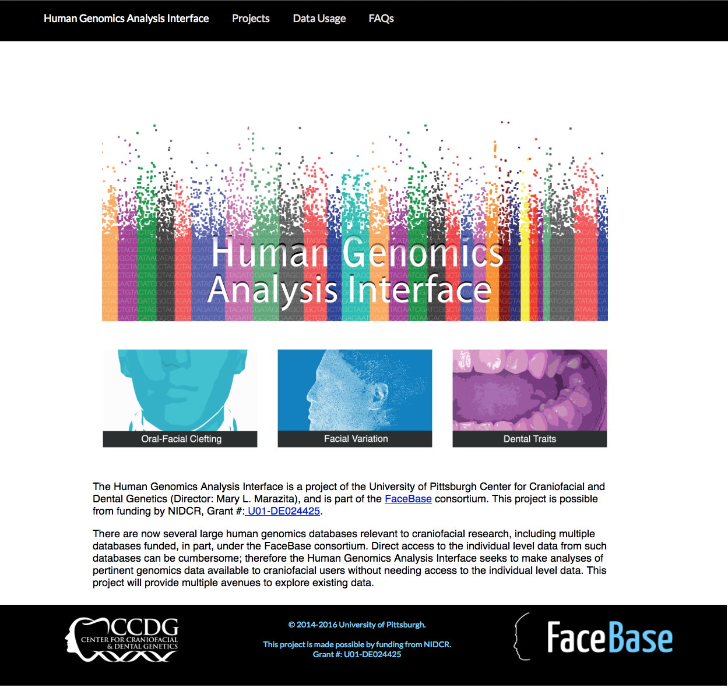

Slide 12
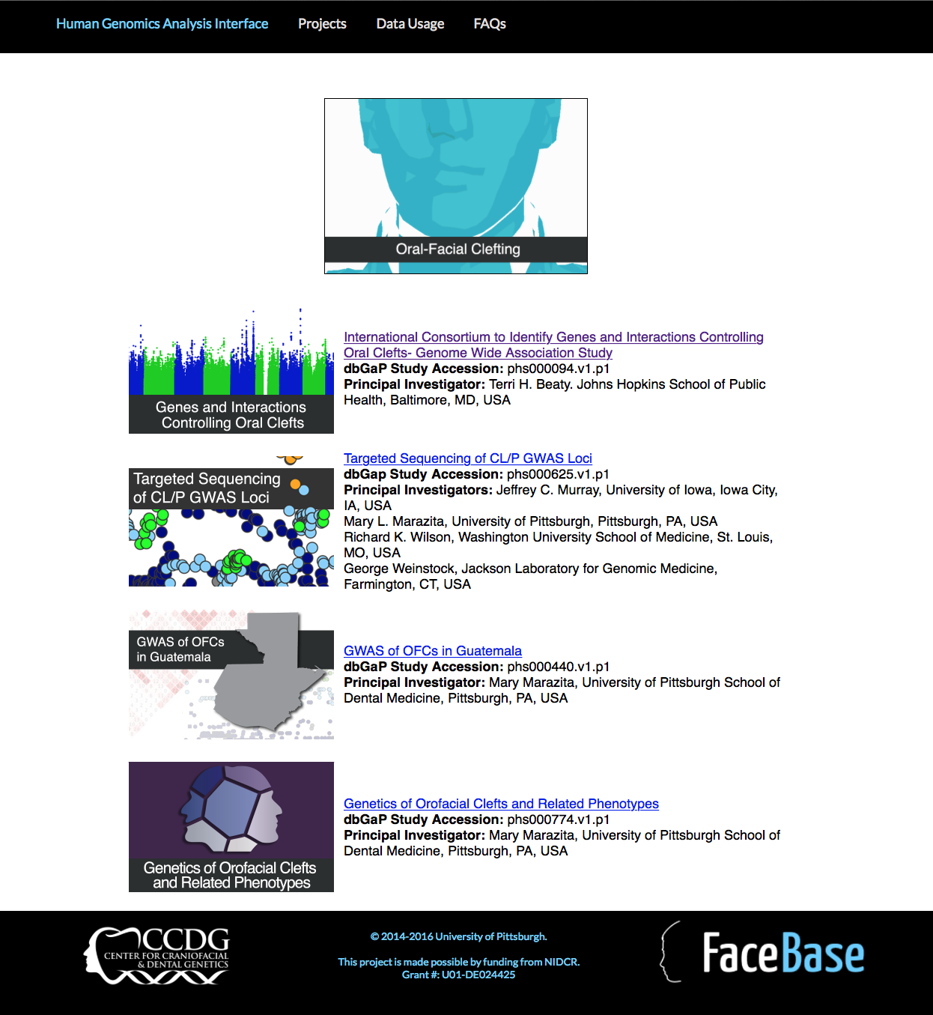

Slide 14
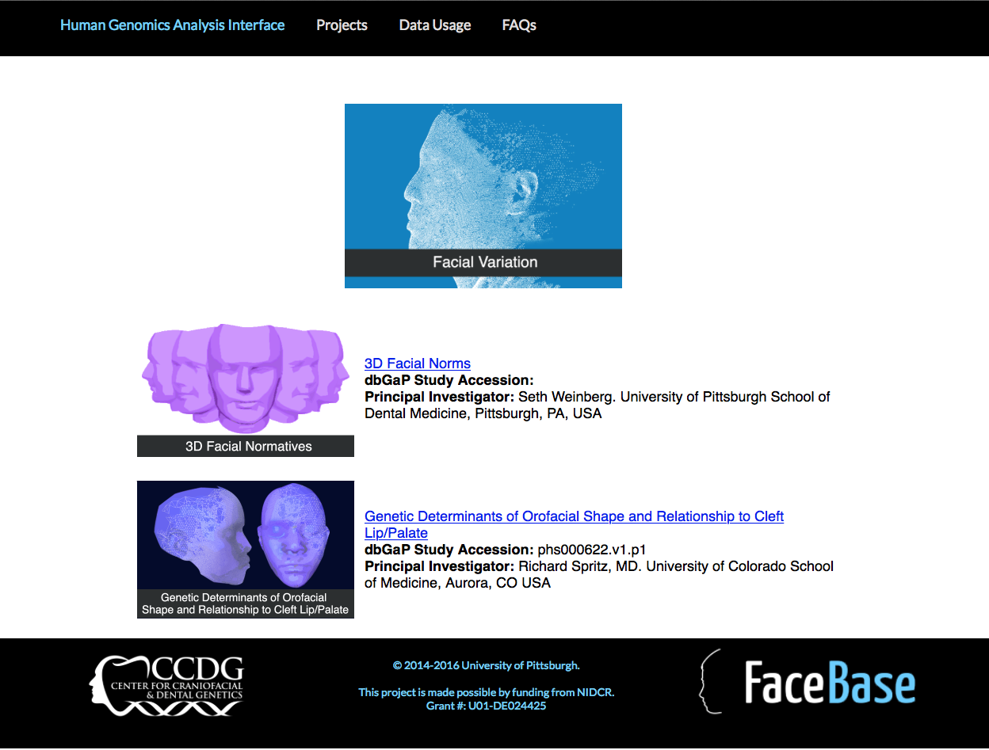

Slide 16
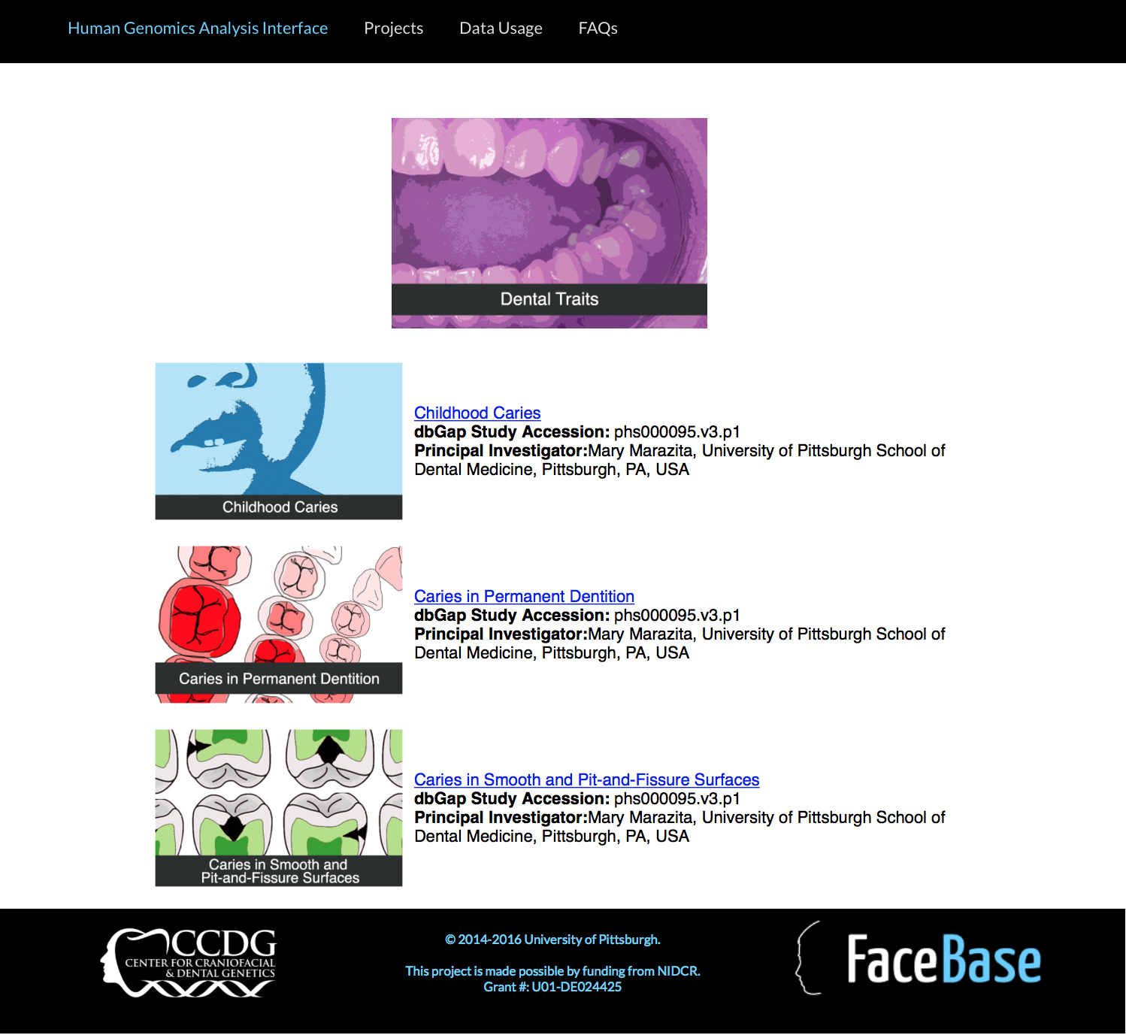

Slide 18
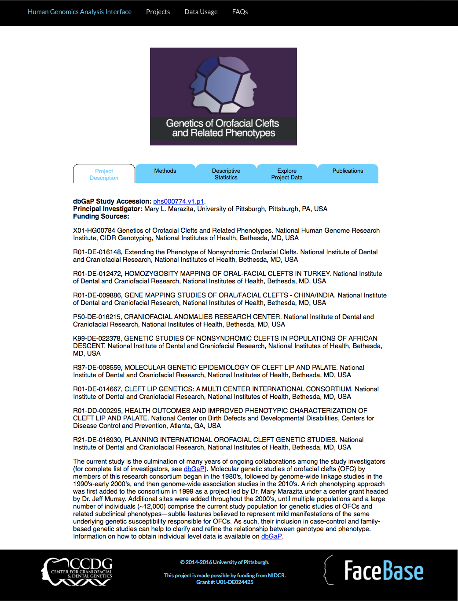

Slide 19
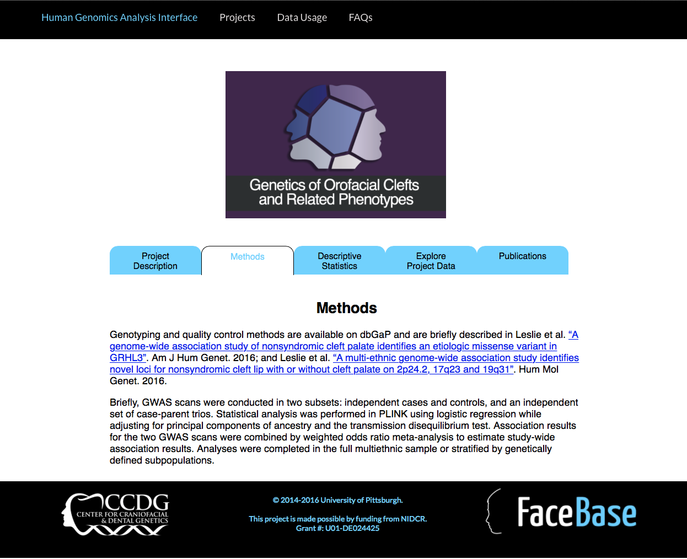

Slide 20
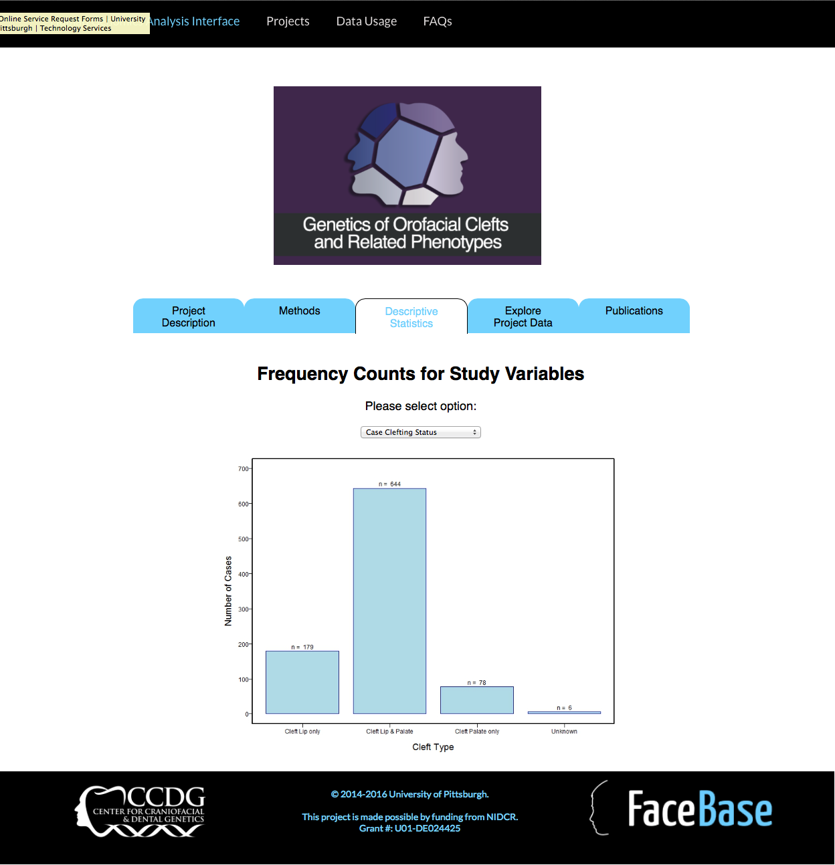

Slide 21
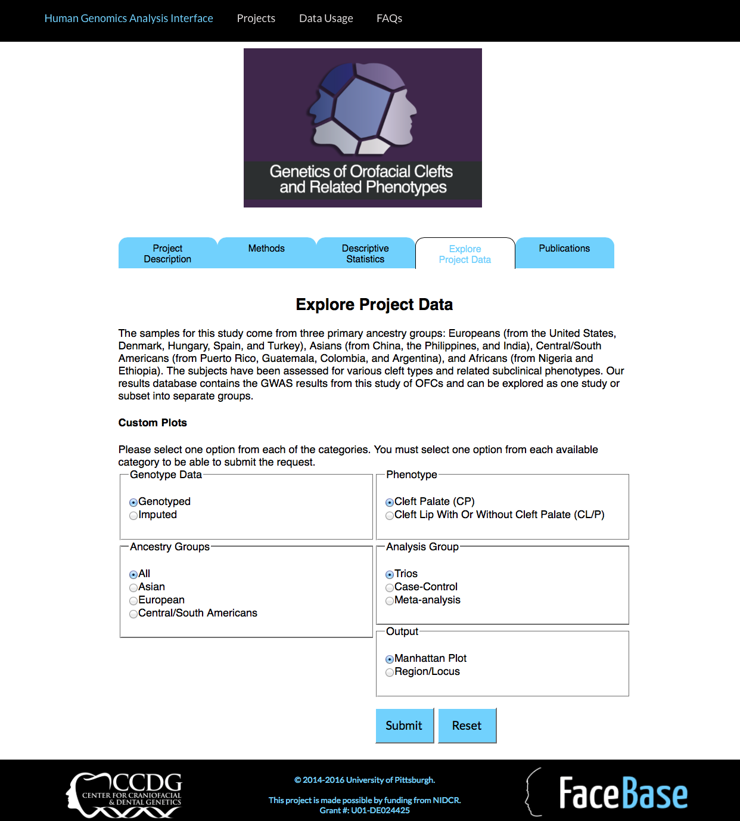

Slide 22
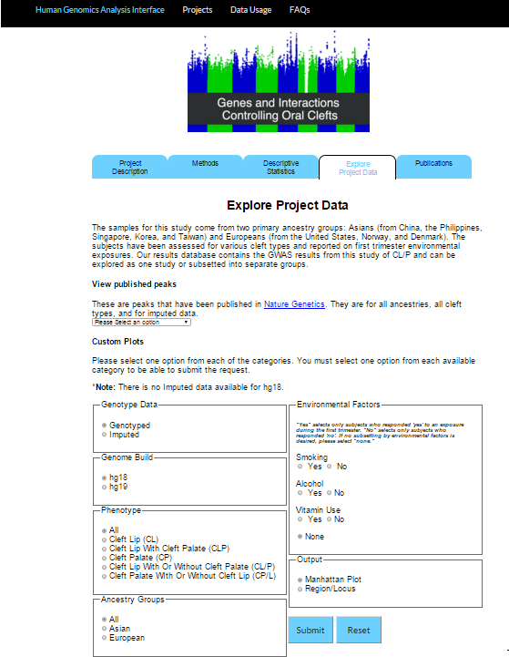

Slide 23
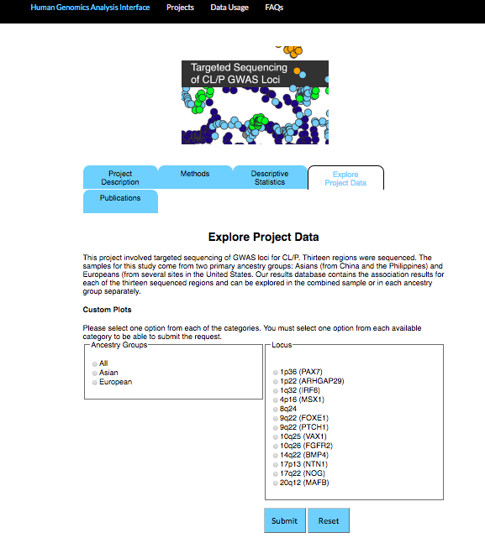

Slide 25
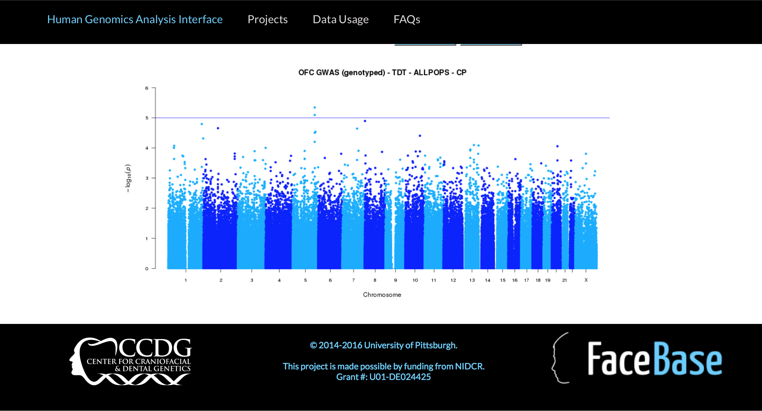

Slide 26
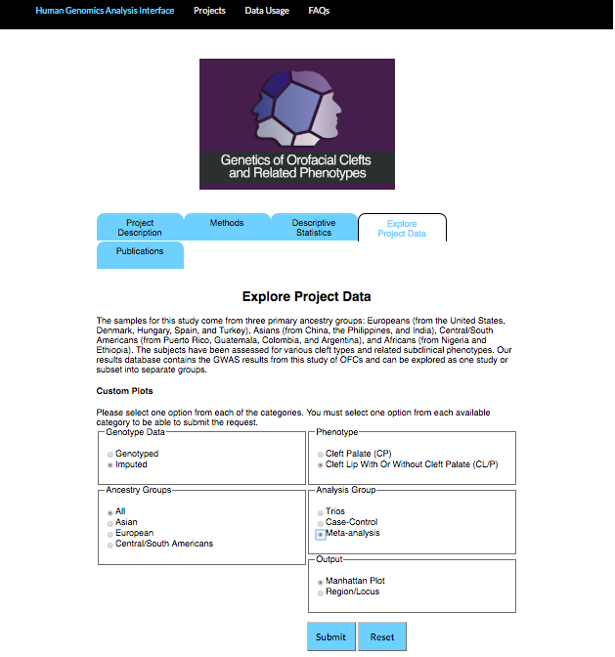

Slide 27
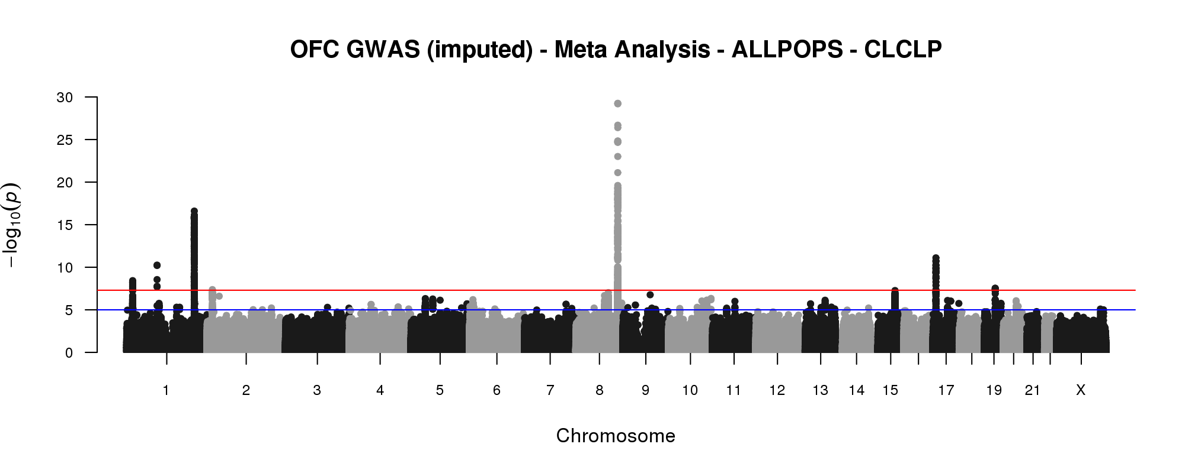

Slide 28
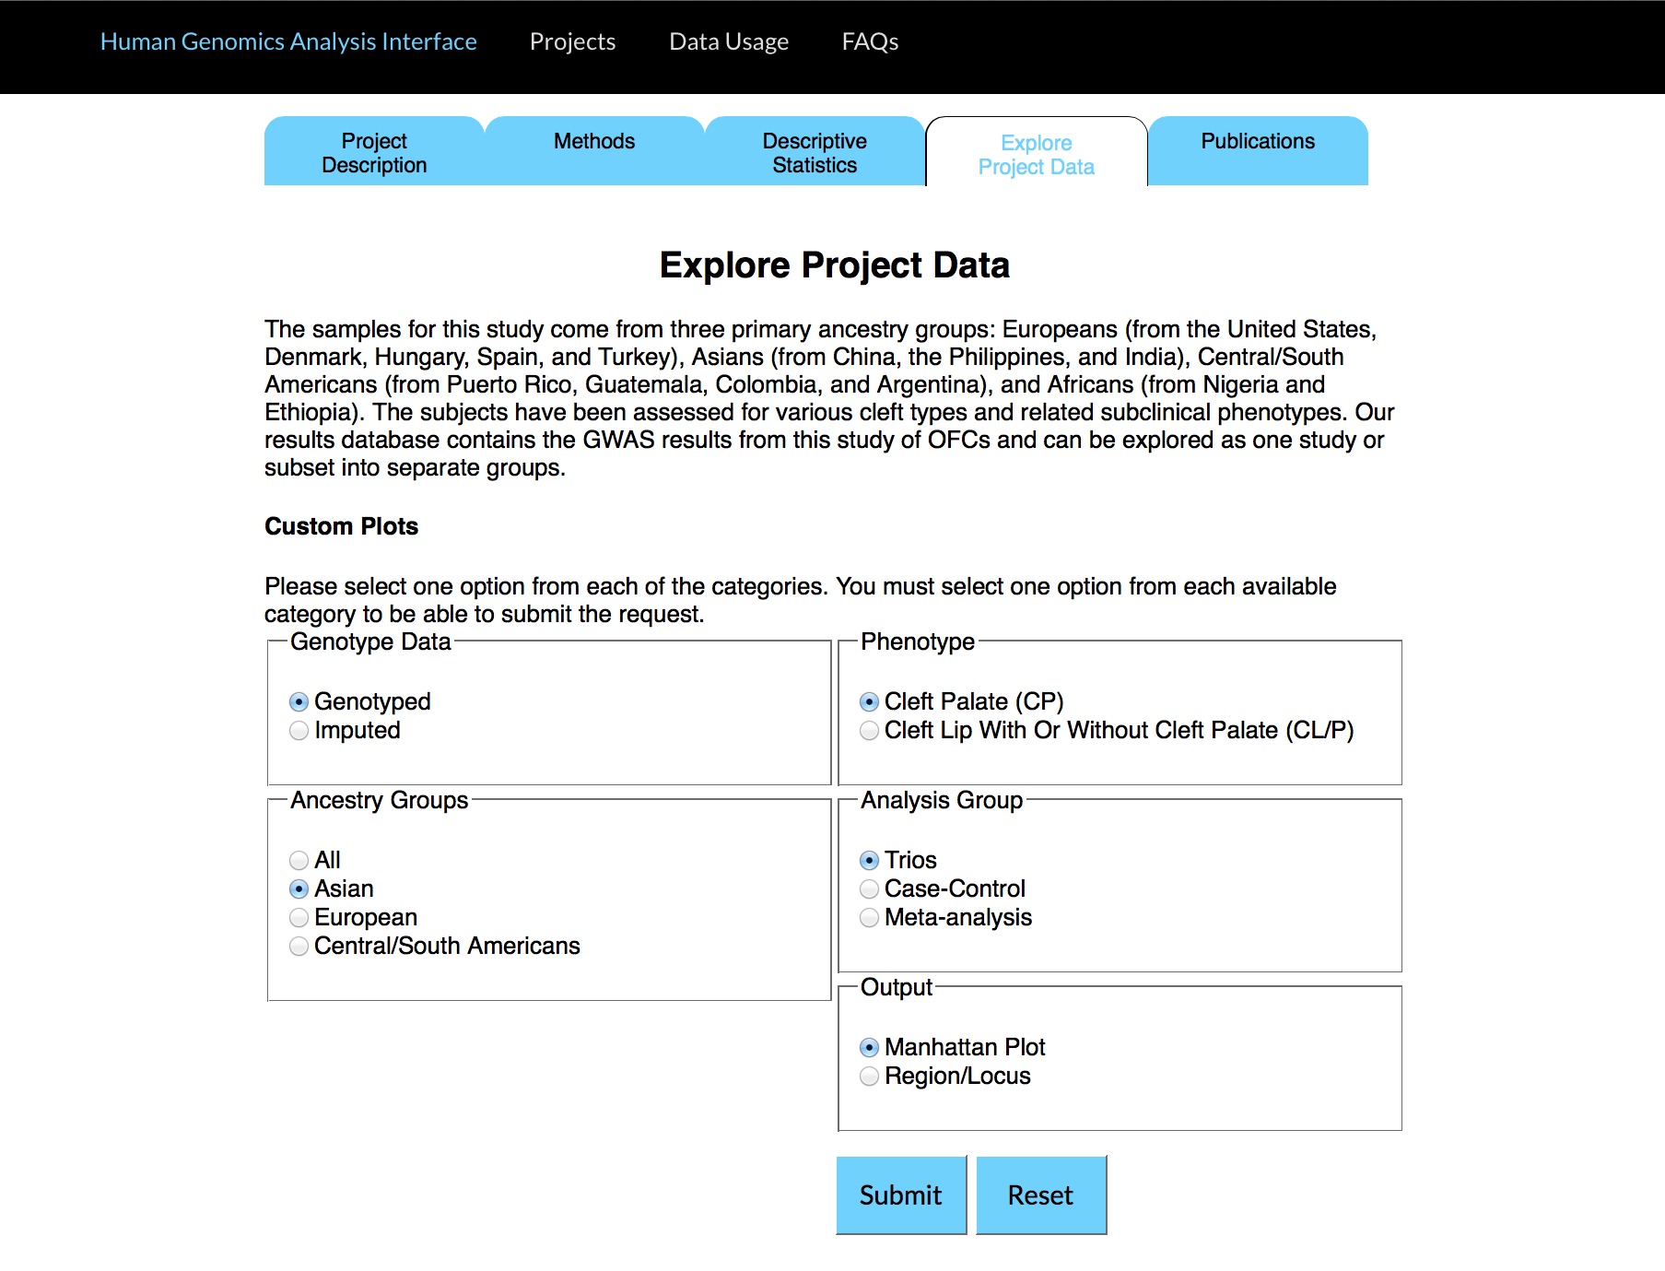

Slide 29
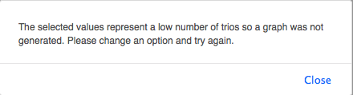

Slide 30
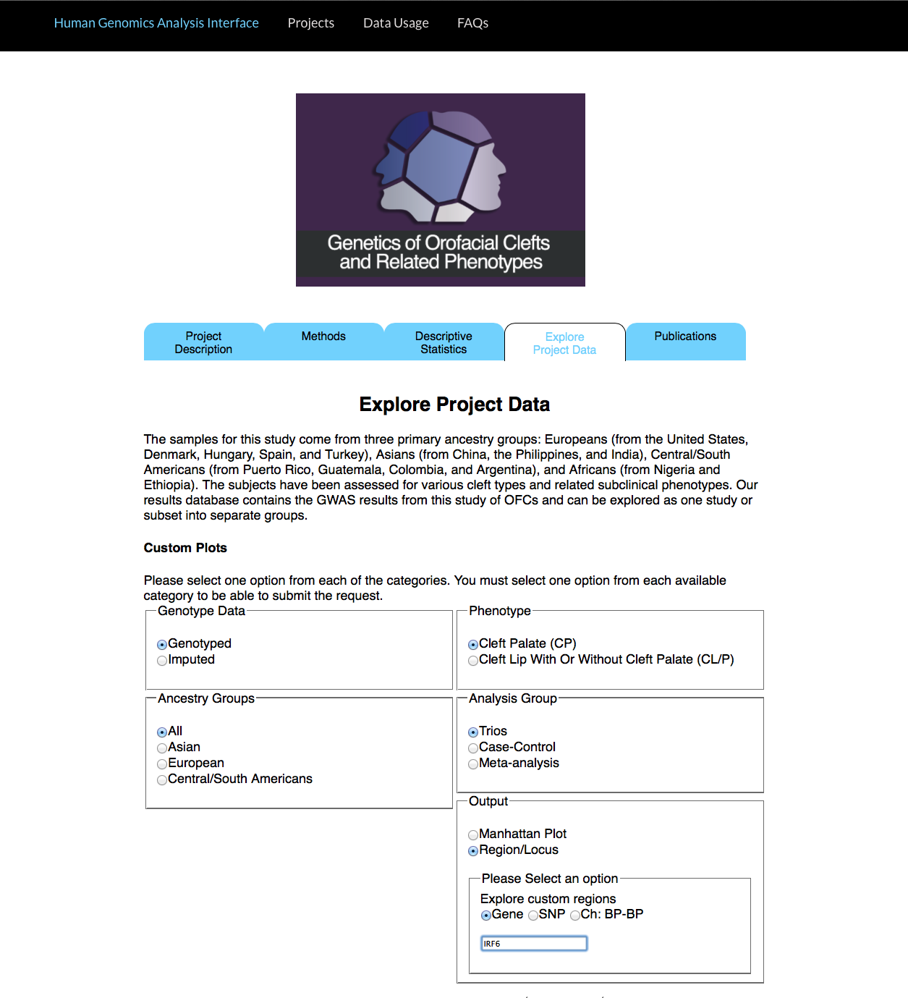

Slide 31


Slide 32
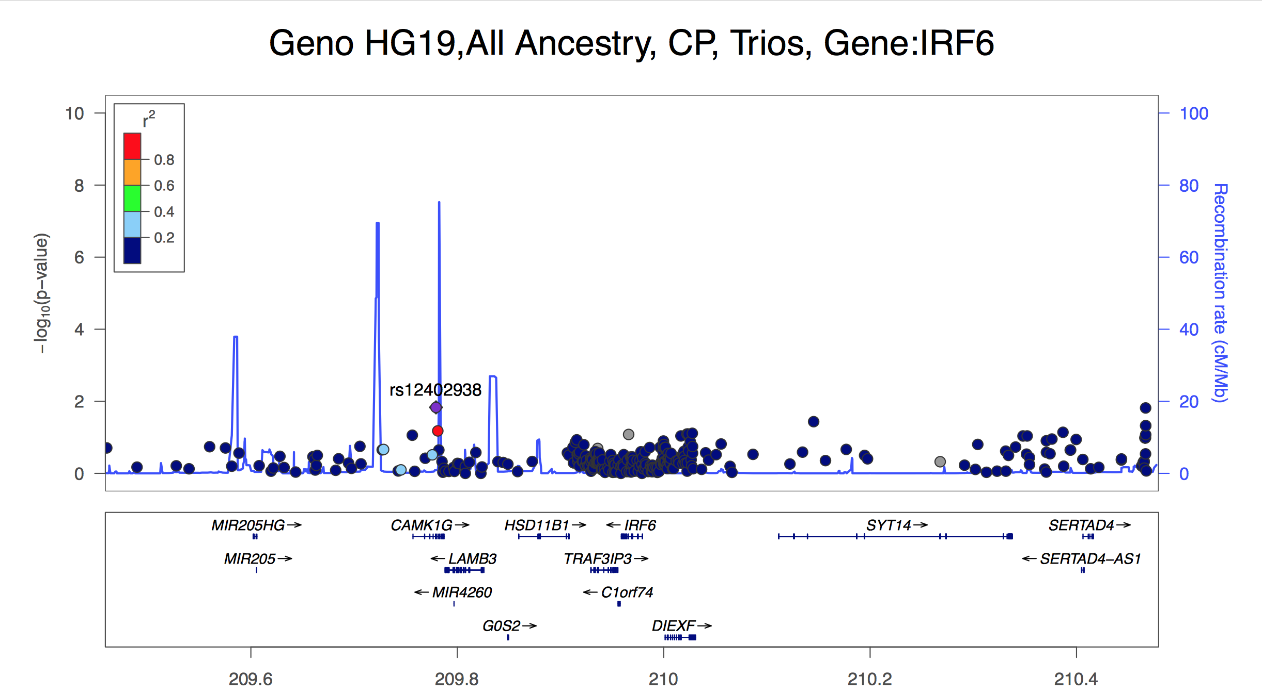

Slide 33
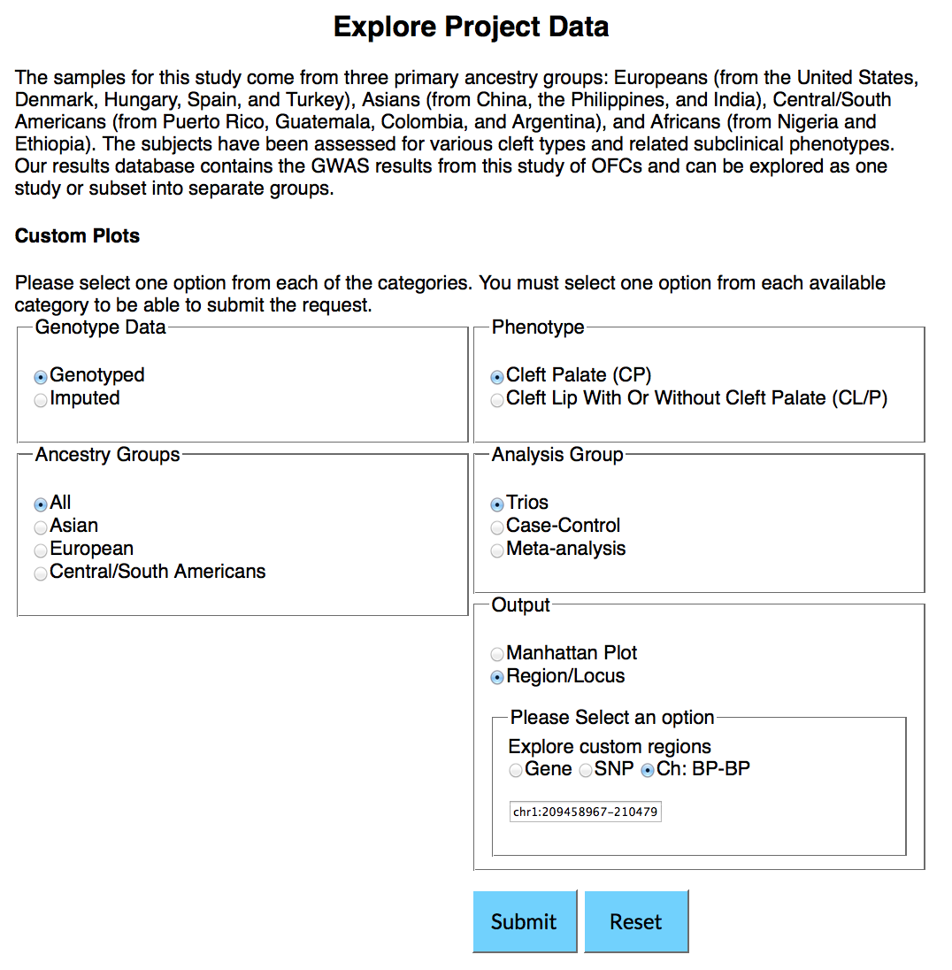

Slide 34
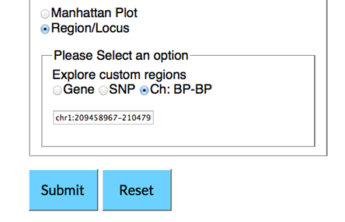

Slide 35
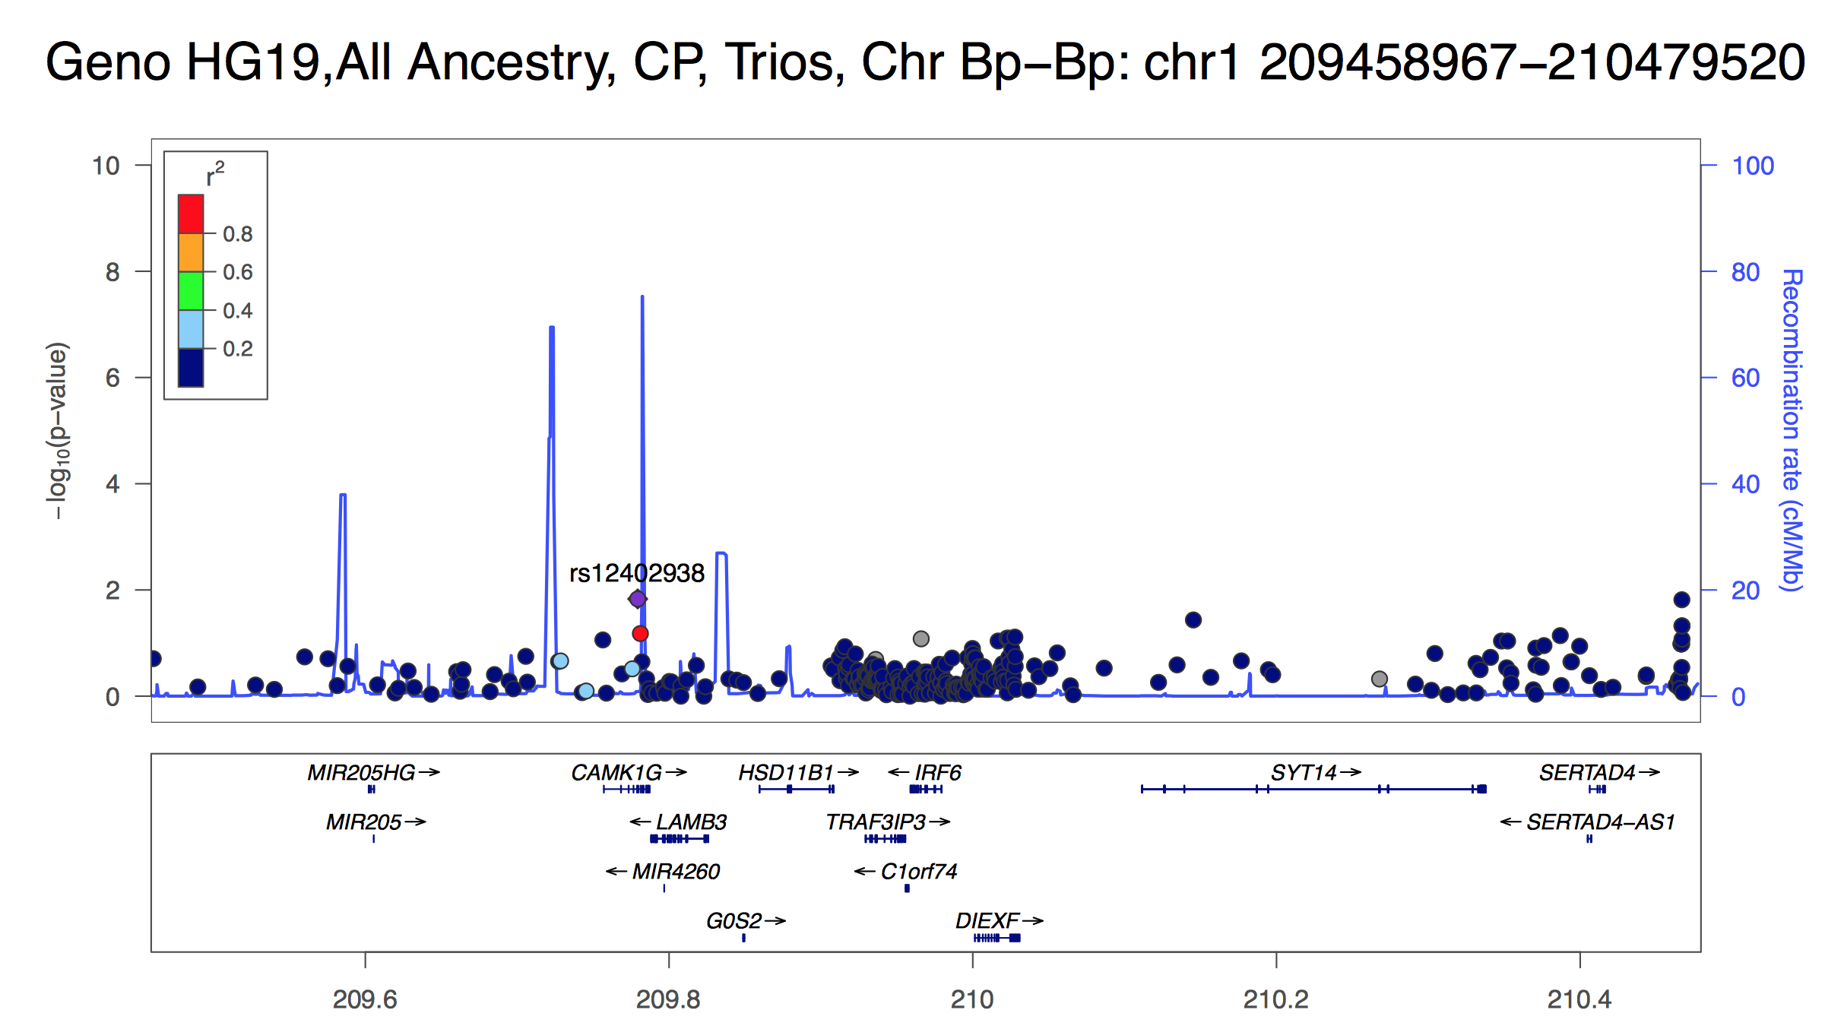

Slide 37


Slide 38
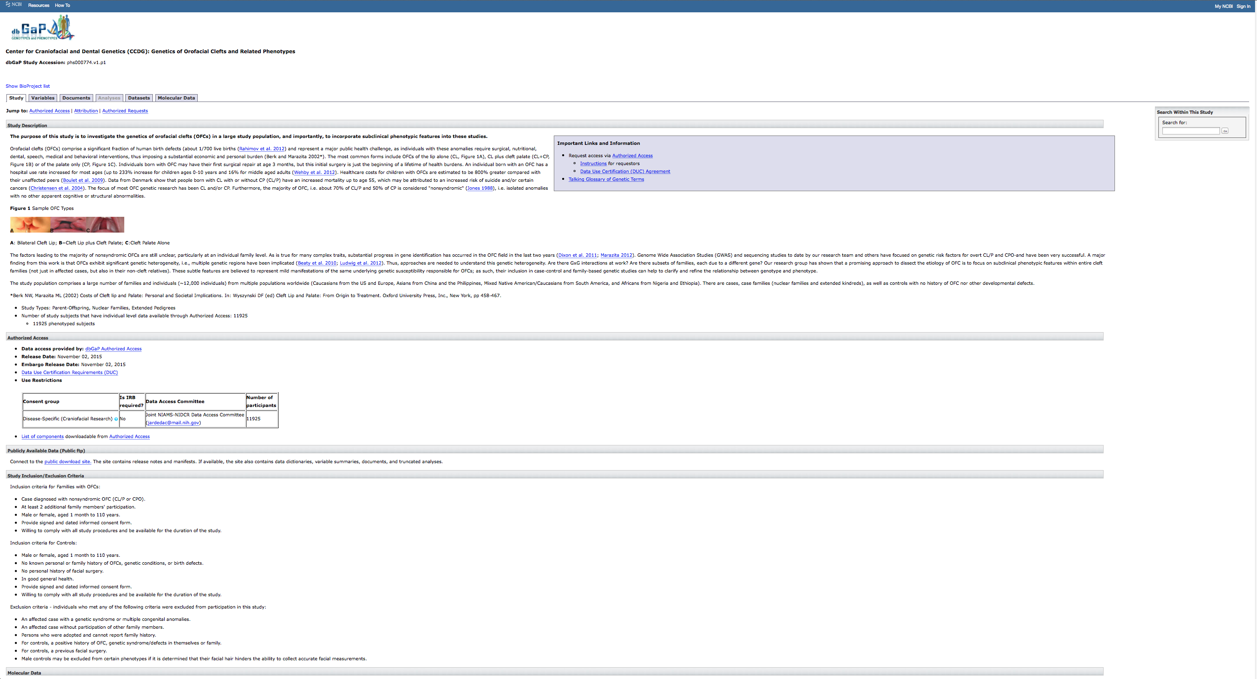

Slide 40
