Slide 1
RNA dynamics in the developing mouse face
University of Colorado Anschutz Medical Campus
Hong Li, Sonia Leach, Irene Choi, Phil O’Neill, Joan Hooper, Ken Jones, Trevor Williams
Aim 1. Describe the transcriptional dynamics of mouse facial development.
What genes are expressed in the different prominences and different tissue layer over time during critical early events in mouse face formation and fusion?
Aim 2. Experimental and bioinformatics analysis of differential splicing.
What isoform differences distinguish the various tissues and prominences over time?
Aim 3. Describe the post-transcriptional RNA dynamics of mouse facial development.
Concerns about reproducibility and bias for relevant techniques to study RNA:protein interactions were raised throughout the funding period and so these studies were not completed.

Slide 2
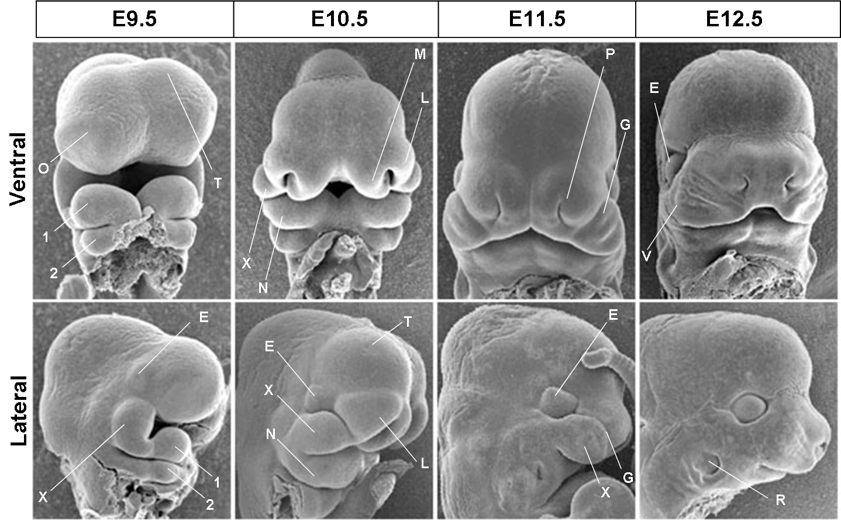
Normal Craniofacial Development (mouse)
FNP
MxP
Man
FNP = Frontonasal
MxP = Maxillary
Man = Mandibular
Matt Kaufman
Notes:
Face formation involves growth morphogenesis and fusion of distinct prominences that will form different components of the face. Defects in these processes result in facial defects such as clefting, one of the most common human birth defects.

Slide 3
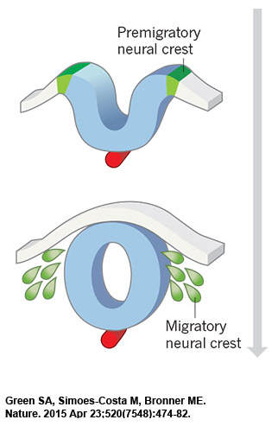
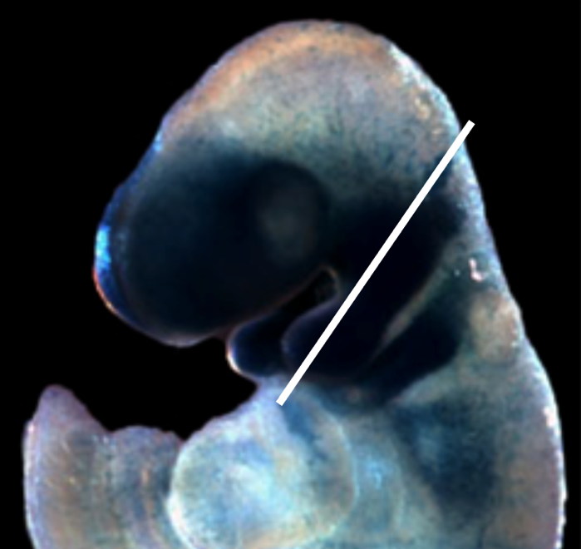
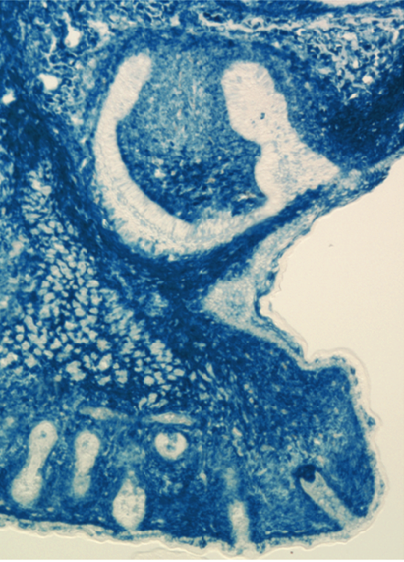
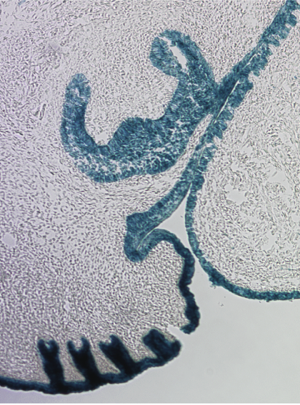
Tissue Interactions During Face Formation
Neural crest
Neural Crest and Mesoderm Form the Mesenchymal
Cell Populations that are the building blocks of the face –
they will form e.g. skeleton and muscles.
Surrounding tissues, especially ectoderm, provide critical signals for growth, patterning and morphogenesis, as well as contributing to teeth, glands, eye and hair.
Note: much less ectoderm!
Ectoderm

Slide 4

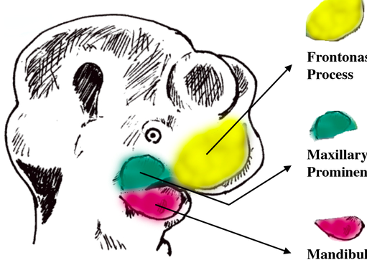
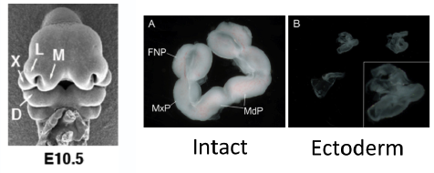
APPROACH
E10.5
Ect + Mes
FnP
E11.5
dispase
MxP
E12.5
MnP
RNA
e.g. mRNA
For RNAseq
Notes:
So – we know these tissue have distinct and important functions – how do we analyze?
Methods : "in my memory, we did not have draft for the ectoderm story. As for the
material and methods, you can just refence our previous plos one paper,
because Everything (staging and rna preparation) is the same, except we
added the ectoderm isolation step. I sent the isolation protocol to Irene
long time ago. I do not have detailed protocol on my laptop anymore right
now. If you can not find it in the lab, I can dig it out from my external
hard drives at home.
Simply, after seperation of individual facial prominences, I incubated them
in dispase (concentration?) for 15 min at 37 degree, then peel the ectoderm
off and collected ectoderm and mesenchyme seperately for RNA extraction."

Slide 5
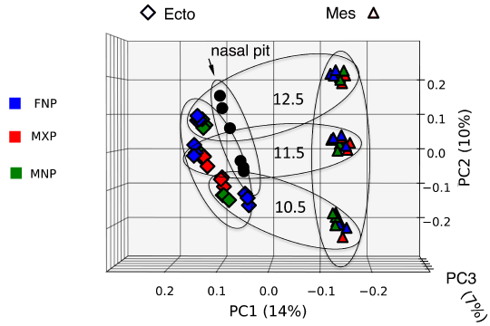
Aim 1. Mouse RNA-Seq Datasets are complete.
Principal component analysis indicates replicates are tight.
Samples separate mainly by tissue layer and time, and to a lesser extent prominence.
Time
Tissue Layer
Notes:
Replicates are tight
Most of the variance is due to tissue type: ECTO, MESEN, NASAL_EPI
second most variance is development time…with a tissue x time difference…that is MESEN is more differentiated, or less diverse…your choice
Lastly, there is variance explainable by substructure (FNP, MXP, MNP), but you have to analyze them separately to see it. You could show the individual PCAs to illustrate.

Slide 6
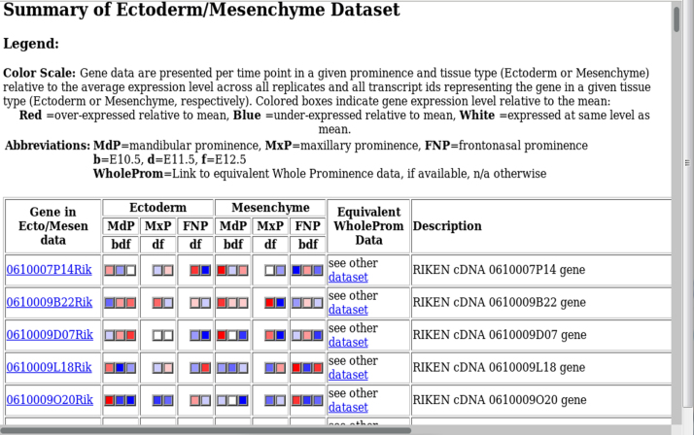
Data obtained from Microarray Analysis are available as a searchable alphabetical gene list
i.e. Investigators can rapidly assess if, when, and where a specific gene is expressed …..

Slide 7
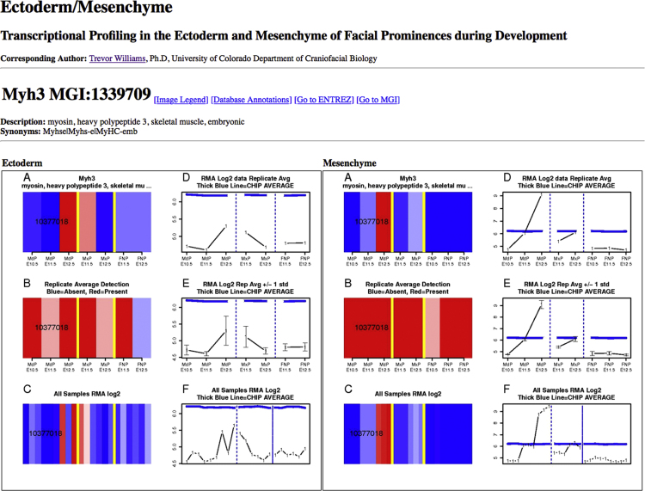
….. And then visualize the data in greater detail
This gene shows increasing expression over time specifically in the mesenchyme of the mandible,
presumably correlating with tongue muscle development

Slide 8
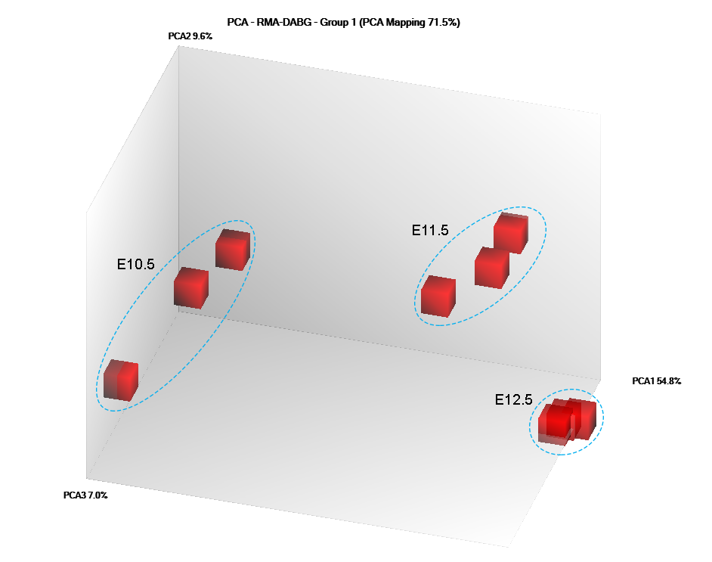
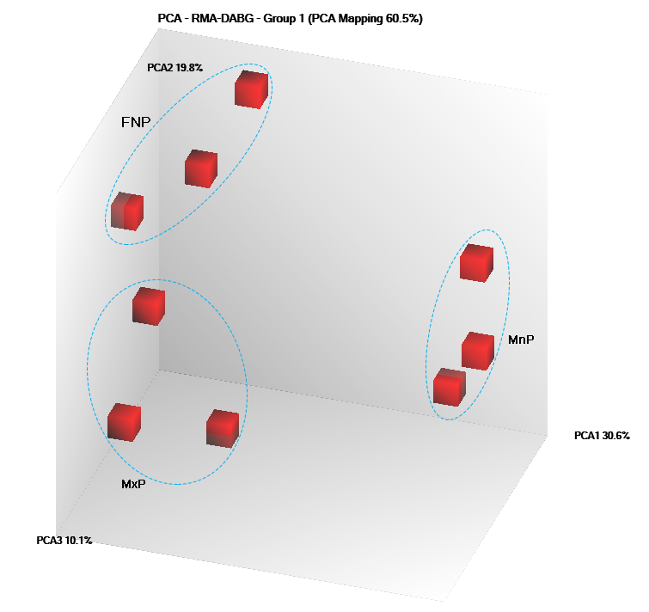
miRNAs and other small RNAs
In association with Affymetrix, we designed a custom mouse small RNA array
RNA type | # loci | detected* | DiffExp** | FC >=2 | # unique seq
miRNA | 1915 | 985 | 597 | 481 | 481
miRNA hairpin | 1277 | 337 | 172 | 43 | 43
sno & scaRNA | 1470 | 307 | 158 | 30 | 19
snRNA | 1385 | 942 | 483 | 86 | 29
tRNA | 504 | 355 | 224 | 171 | 36
rRNA | 422 | 305 | 194 | 0
total | 6973 | 3231 | 1828 | 811 | 608
Principal component analysis:
replicates group by age (Mx Mesenchyme) and by prominence (E10.5 Ectoderm)
FNP
E10.5
E11.5
MnP
MxP
E12.5
Notes:
p <= 0.05 for DABG in at least 3 samples
** fdr <= 0.05

Slide 9
Small RNA differential Expression
snoRNAs
miRNAs
snRNAs
(U6 & U1)
tRNAs
Ect
Mes
10.5
11.5
12.5
10.5
11.5
12.5
Ect
Mes
10.5
11.5
12.5
10.5
11.5
12.5
Notes:
also a subset of splicosomal U6 with preference for later Mes, etc and U1 with preference for

Slide 10
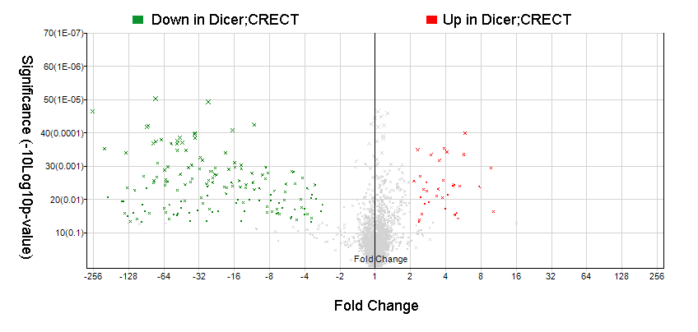
miRNAs and other small RNAs
Small RNA expression changes in an ectodermal dicer conditional knockout

Slide 11
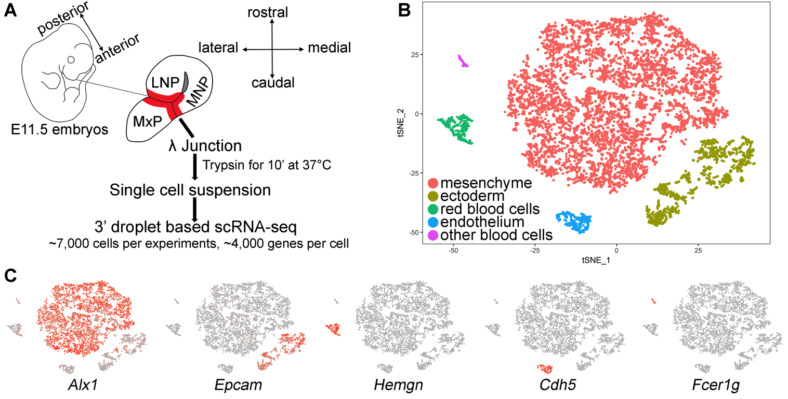
Single-Cell RNA-seq Analysis of Lambdoid Junction and Nasolacrimal Groove

Slide 12
Verification of Assignments by RNA in situ hybridization

Slide 13
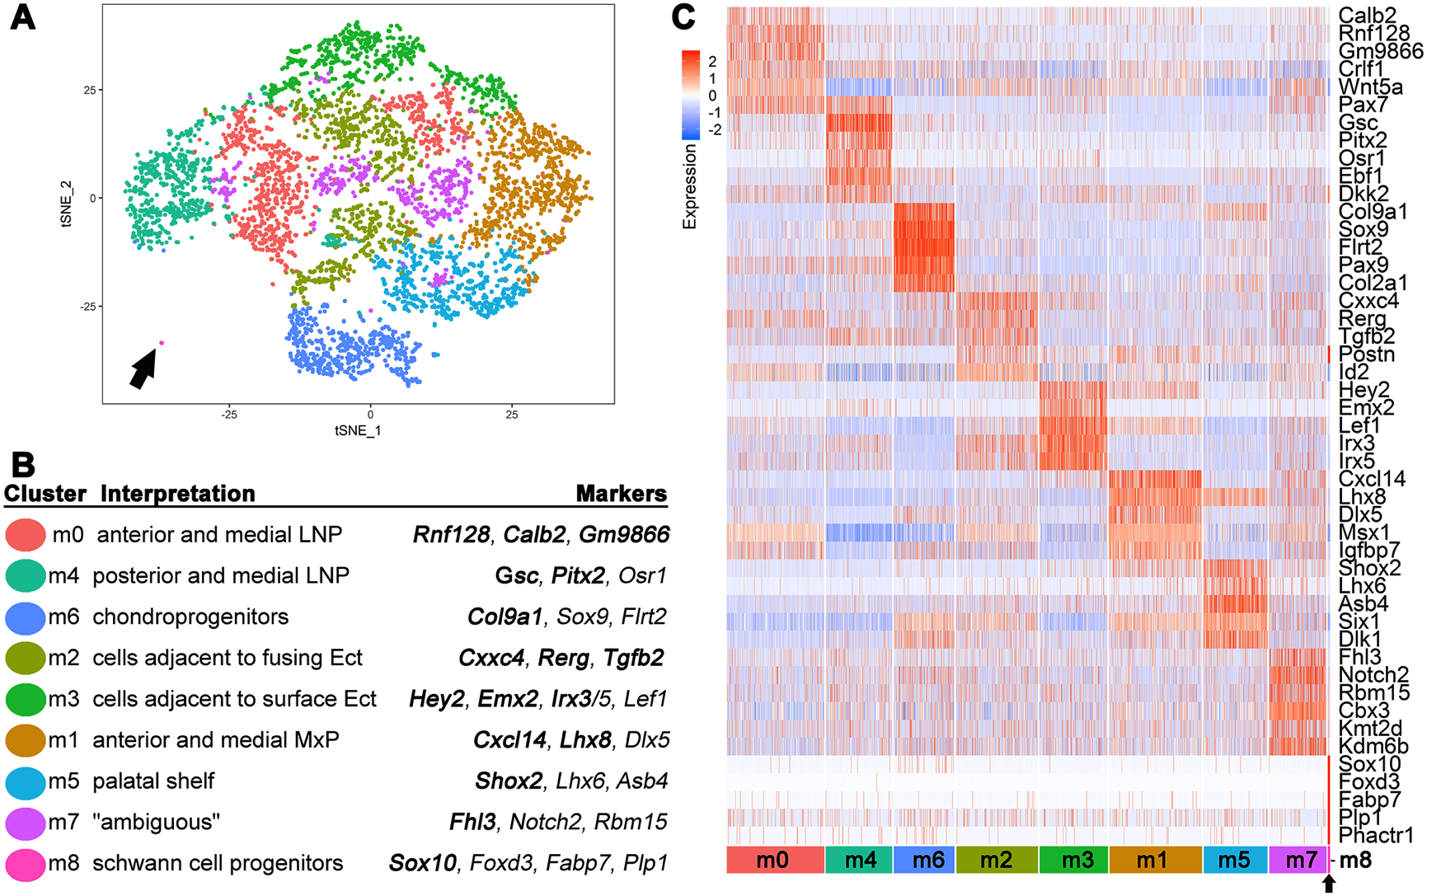
Reclustering the Mesenchyme Identifies Multiple Cell Populations that Correlate
With Discrete anatomical positions

Slide 14
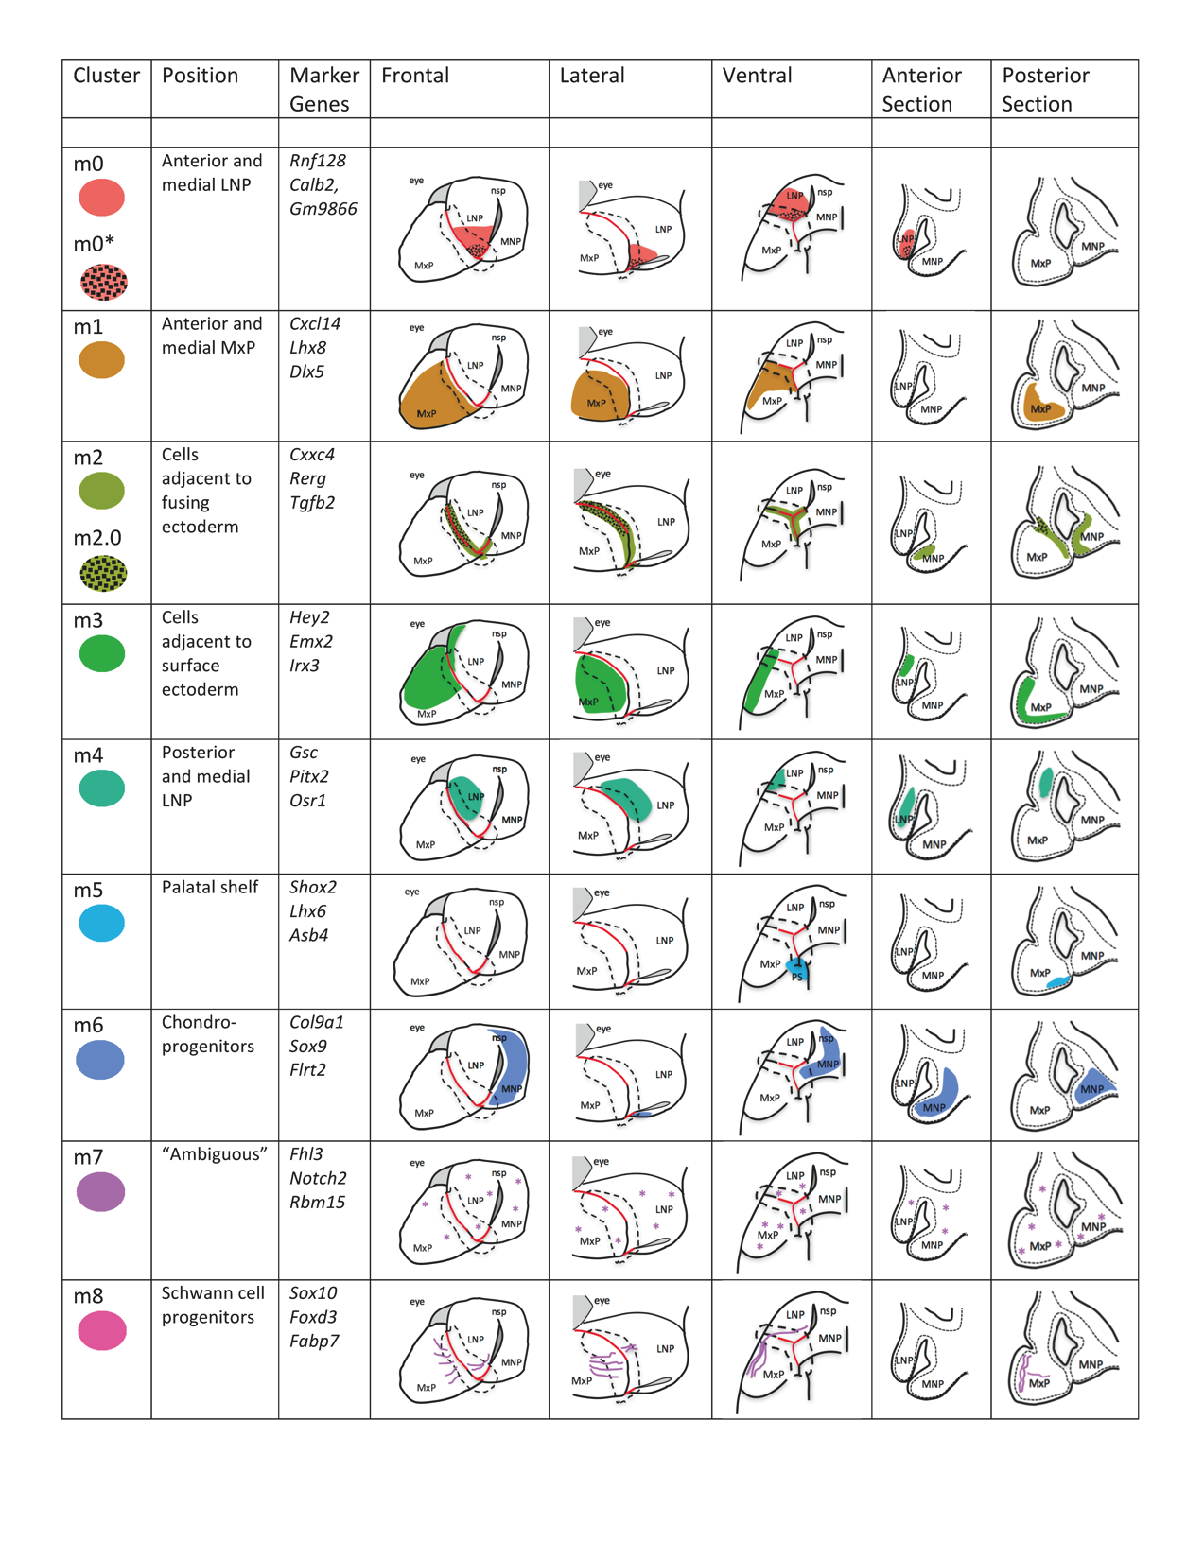
Graphic Representation of Mesenchymal Clusters

Slide 15
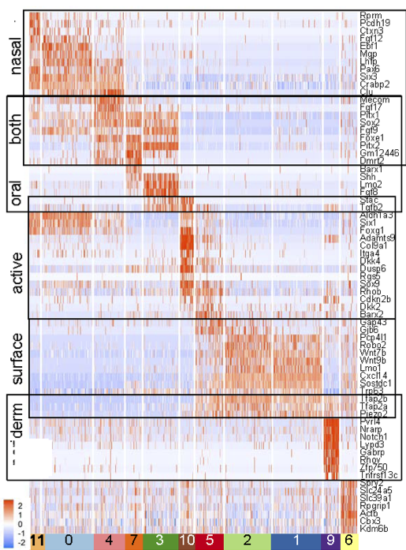
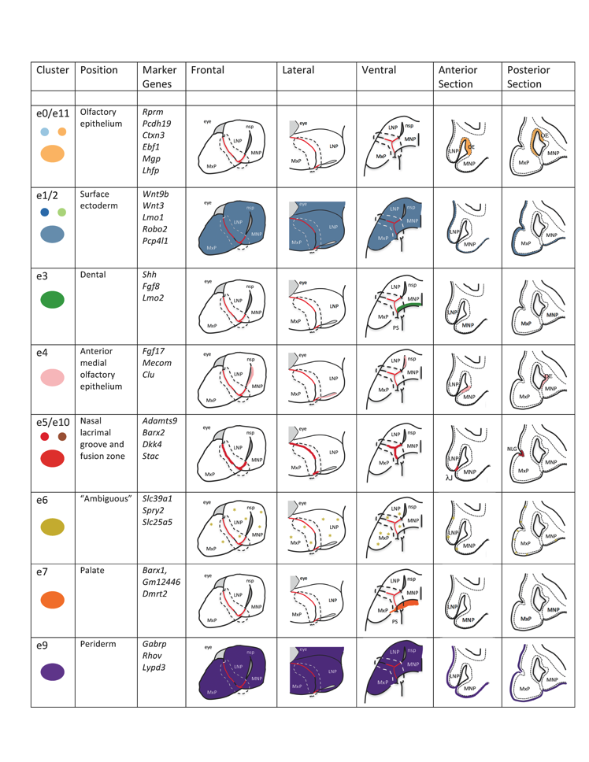
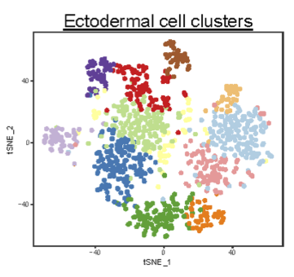
Reclustering the Ectoderm also Identifies Multiple Cell Populations that Correlate
With Discrete anatomical positions
Together, the RNAseq, small RNA microarrays, and scRNAseq provide resources to
Mine gene expression by time, tissue layer and anatomical location

Slide 16
Aim 2: The RNAseq data was mined for differential isoform expression…
Most differential isoform usage occurs between the different tissue layers.
Many of the genes that are differentially spliced are associated with EMT in other biological contexts.
Isoform expression in the maxilla, mandible and nasal prominences is very similar.
Only a few genes show alterations in exon usage over time in a specific tissue.

Slide 17
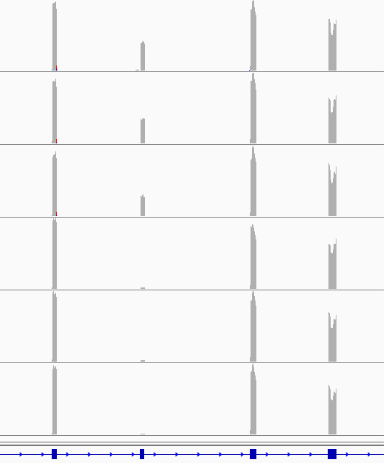
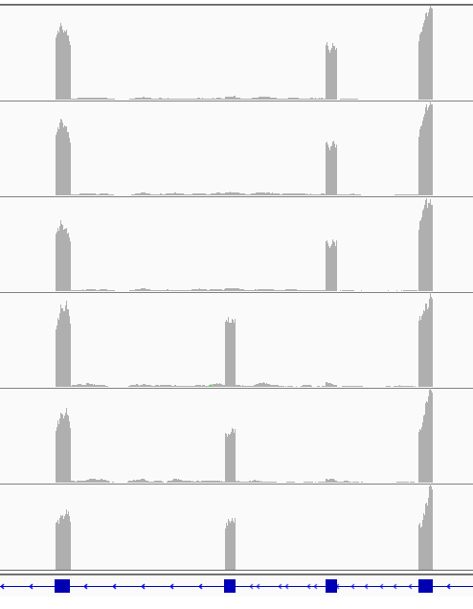
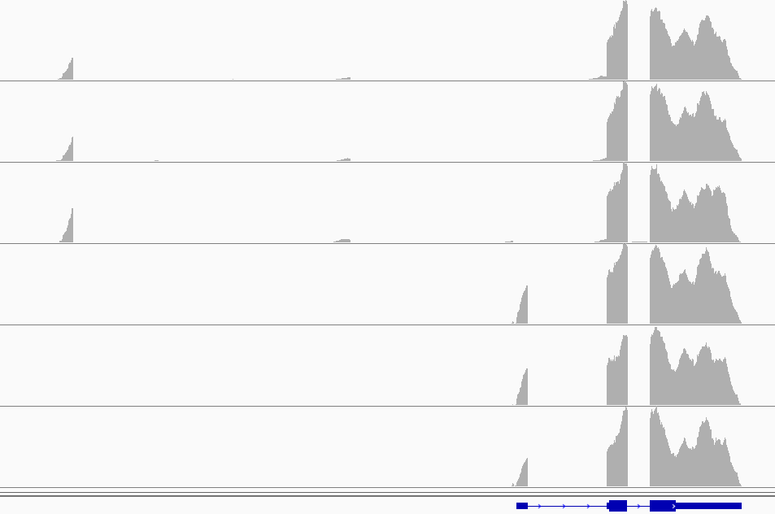
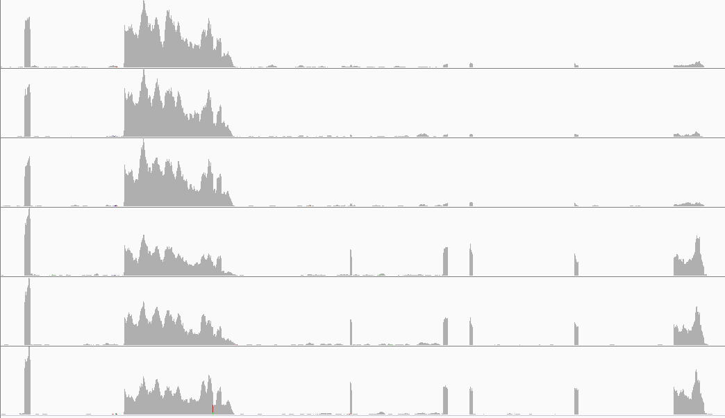
Examples of differential isoforms
Ecto
Differential
splicing
IGV browser
screenshots
…............
Mes
Lef1
Fgfr2
Differential
promoter
usage
S100a16
Differential
3’ end
usage
Lrrfip1
Ecto
…...........
Mes
Verification by RT-PCR, in situ hybridization, Basescope analysis
Notes:
what does that data actually look like – how to derive estimates of where the transcpts start and end, their UTRs, their alternative splicing?
How to actually measure/calculate the prevelance of specific isoform features?

Slide 18
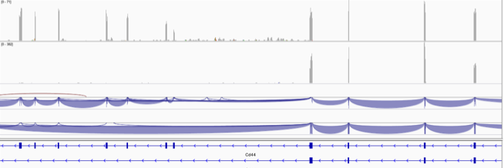
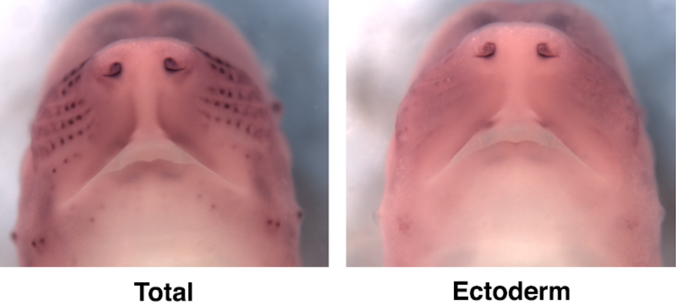
WMISH analysis of Cd44 differential splicing
Ecto
Mes
However, most internal splicing differences are <80nts, not suitable for WMISH

Slide 19
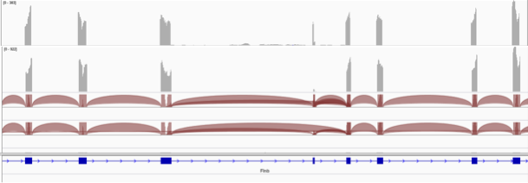
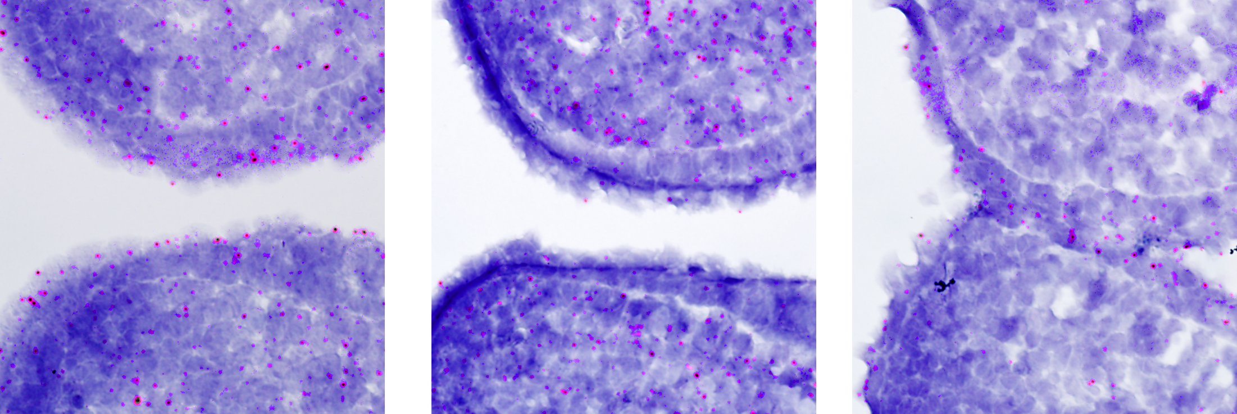
Basescope analysis of Flnb differential splicing
Ecto
Mes
Signal
= red dot
Common Exon
Probe ECTO + MES
Probe for
Skipping = MES
Probe for
Inclusion = ECTO

Slide 20
Conclusions:
Aim 1. Describe the transcriptional dynamics of mouse facial development.
Complete
Aim 2. Experimental and bioinformatics analysis of differential splicing.
Complete
Aim 3. Describe the post-transcriptional RNA dynamics of mouse facial development.
Replaced by scRNAseq analysis - Complete
Deliverables
Raw data files (.bam, .cel); Metadata; Gene Summaries; Expression Summaries all available at the Facebase hub and/or in publications.
Publication of the datasets, the verification analyses, and the summaries is still ongoing but we expect all pertinent manuscripts will be submitted in 2019 to bring further attention to the resources available at Facebase.

