Slide 1
Genome wide study of oral clefts using an international consortium of case-parent trios
T.H. Beaty
FaceBase Meeting
June 5, 2010
Pittsburgh PA

Slide 2
A bit of background
Both cleft lip with/without cleft palate (CL/P) & cleft palate (CP) show strong familial aggregation
  Twin & family studies show clear evidence of genetic control
  Population level risk ratios (risk to 1º relatives compared to general population) are 32 for CL/P & 56 for CP
Clearly genes play a role in the etiology, but there may be several causal genes

Slide 3
Genetic basis of oral clefts has yet to be clearly defined
Genome wide linkage studies show several chromosomal regions may harbor causal genes, but linkage heterogeneity is very common
Candidate gene studies also show multiple genes are associated with risk but they are plagued by inconsistency which may reflect allelic heterogeneity
Genome wide association studies show some signals are in gene deserts or well away from coding regions

Slide 4
International Cleft Consortium
Supported by U01-DE-01889
Part of the Gene & Environment Initiative (GENEVA)
3 FaceBase groups (Hopkins, Pittsburgh & Iowa), plus Utah & several international collaborators
Study design: cleft cases and their parents
  This design minimizes effects of confounding due to population stratification

Slide 5
CL & CLP trios from each recruitment site
Number of trios by recruitment site noting complete and incomplete trios (those with 1 parent missing).
Recruitment Site | CL Trios Complete (Incomplete) | CLP Trios Complete (Incomplete) | Total Trios Complete (Incomplete)
Utah | 68(16) | 96(20) | 164(36)
Norway | 106(4) | 174(8) | 280(12)
Korea | 19(0) | 40(2) | 59(2)
Maryland | 19(12) | 71(42) | 90(54)
Pittsburgh | 26(2) | 70(28) | 96(30)
Singapore | 15(1) | 45(7) | 60(8)
Taiwan | 42(4) | 176(11) | 218(15)
Iowa | 16(9) | 29(11) | 45(20)
Denmark | 6(15) | 15(12) | 21(27)
Philippines | 0(0) | 94(4) | 94(4)
Hubei Prov. | 39(3) | 136(9) | 175(12)
Shandong Prov. | 54(21) | 129(70) | 183(91)
Sichaun Prov. | 43(3) | 63(3) | 106(6)
Total | 453(90) | 1138(227) | 1591(317)
*total includes probands of indeterminate cleft type: 2 in WuHan; 3 in Shandong Prov.
Incomplete trios won’t contribute to TDT, but can help in other analyses

Slide 6
Isolated, non-syndromic cleft cases & their parents from 13 populations
Incomplete trios won’t contribute to TDT, but can help in other analyses
Table 1: Case-parent trios from 13 recruitment sites in the International Cleft Consortium
Recruitment Site | CL Trios Complete (Incomplete) | CLP Trios Complete (Incomplete) | CP Trios Complete (Incomplete) | Total Trios Complete (Incomplete)
Utah | 68(16) | 96(20) | 52(12) | 216 (48)
Norway | 106(4) | 174(8) | 107(3) | 387 (15)
Korea | 19(0) | 40(2) | 5(0) | 64 (2)
Maryland | 19(12) | 71(42) | 25(18) | 115 (72)
Pittsburgh | 26(2) | 70(28) | 11(4) | 107 (34)
Singapore | 15(1) | 45(7) | 53(4) | 113 (12)
Taiwan | 42(4) | 176(11) | 74(5) | 292 (20)
Iowa | 16(9) | 29(11) | 24(17) | 69 (37)
Denmark | 6(15) | 15(12) | 5(8) | 26 (35)
Philippines | 0(0) | 94(4) | 0(0) | 94 (4)
Hubei Prov. | 39(3) | 136(9) | 42(3) | 219 (15)*
Shandong Prov. | 54(21) | 129(70) | 30(8) | 215 (101)*
Sechuan Prov. | 43(3) | 63(3) | 38(2) | 144 (8)
Total | 453(90) | 1138(227) | 466(84) | 2060 (403)*
*total includes probands of indeterminate cleft type: 2 in WuHan; 3 in Shandong Prov.

Slide 7
Number of Founders
Code | Site | N | Reported Racial Mix
11 | Denmark | 87 | 100% EU
12 | Norway | 791 | 100% EU*
13 | Iowa | 183 | 97%EA;1.6%Hisp;0.6%NA;0.6Other
14 | Maryland | 315 | 90%EA;8%AfrAm;1.3%AsAm;0.6%NA;0.3%Other
15 | Pittsburgh | 254 | 89%EA,0.4%AfAm;9.2%Hisp;1.2%Other
16 | Utah | 512 | 91%EA;0.4%AfAm;1.2%AsAm;4.7%Hisp;0.2%NA;2.8%Other
17 | Phillipines | 194 | 100%SEAsian
18 | Singapore | 238 | 80%Asian;12.2%SEAsian;7%SoAsia;0.8%Afr
19 | Taiwan | 607 | 100%Asian
20 | Weifang | 531 | 100%Asian
21 | Wuhan | 456 | 100%Asian
22 | Chengdu | 300 | 100%Asian
23 | Korea | 131 | 100%Asian
 | Total | 4599

Slide 8
PCA on all 13 Sites + 4 HapMap Groups
African=YRI
1.57% of variation
European=CEU
Asian=CHB/JPT
PCA based on 38K independent SNPs
8.89% of variation

Slide 9
Principal Components Analysis on All 13 Sites
Korea & China
Europeans/US
Taiwan
0.32% of variation
Philippines
Admixed Persons
9.07% of variation

Slide 10
Genetic Distance: Estimated F_{st} for all 13 recruitment sites based on 38K SNPs
 | DN | NO | IA | MD | PA | UT | PH | SG | TW | WF | WH | CD
NO | 0.001
IA | 0.000 | 0.001
MD | 0.002 | 0.002 | 0.001
PA | 0.001 | 0.001 | 0.001 | 0.001
UT | 0.001 | 0.001 | 0.000 | 0.001 | 0.000
PH | 0.105 | 0.100 | 0.102 | 0.094 | 0.095 | 0.097
SG | 0.092 | 0.087 | 0.089 | 0.082 | 0.082 | 0.084 | 0.011
TW | 0.108 | 0.103 | 0.105 | 0.097 | 0.097 | 0.100 | 0.014 | 0.001
WF | 0.105 | 0.100 | 0.102 | 0.094 | 0.094 | 0.097 | 0.021 | 0.004 | 0.003
WH | 0.106 | 0.101 | 0.103 | 0.095 | 0.095 | 0.097 | 0.017 | 0.003 | 0.001 | 0.000
CD | 0.106 | 0.101 | 0.103 | 0.095 | 0.095 | 0.098 | 0.015 | 0.002 | 0.001 | 0.002 | 0.000
KR | 0.108 | 0.103 | 0.105 | 0.097 | 0.097 | 0.100 | 0.022 | 0.006 | 0.005 | 0.002 | 0.003 | 0.004

Slide 11
Family based tests are robust to population stratification
TDT compares observed alleles, genotypes or haplotypes to expected given parents
There is the opportunity to test for parent-of-origin effects (maternal vs. paternal)
  This could represent maternal genotype effects or genomic imprinting
We can’t test for effects of environmental risk factors (E) alone, but we can test for GxE interactions
We can test for GxG interactions

Slide 12
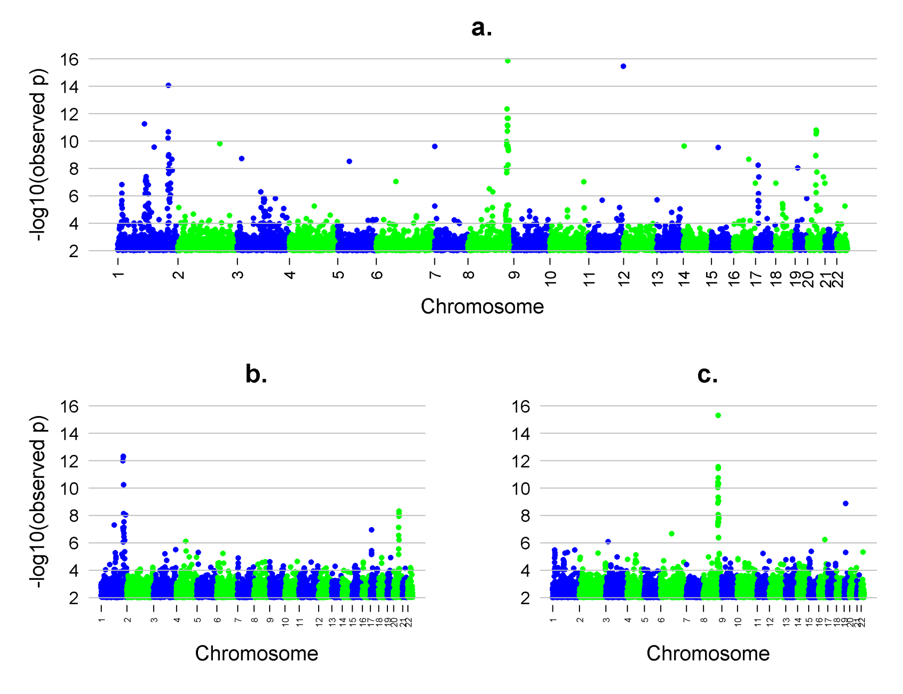
Several hits in genome wide TDT
ABCA4
Total sample
8q24
IRF6
MAFB
European trios
Asian trios
IRF6
8q24
MAFB

Slide 13
8q24
Supplementary Figure 3: Estimated OR(case) from a conditional logistic regression] and their 95%CI under an additive model for 78 SNPs in chr. 8q24. The minor allele among European parents was the target allele. The most significant SNP (rs987525) is noted by the star.

Slide 14
Supplementary Figure 4: Linkage disequilibrium (LD) patterns among parents of European and Asian ancestry (measured as r²) for markers in chr. 8q24 region showing evidence of linkage and association at the genome wide level of significance. The position of rs987525 is noted by the diamond.

Slide 15
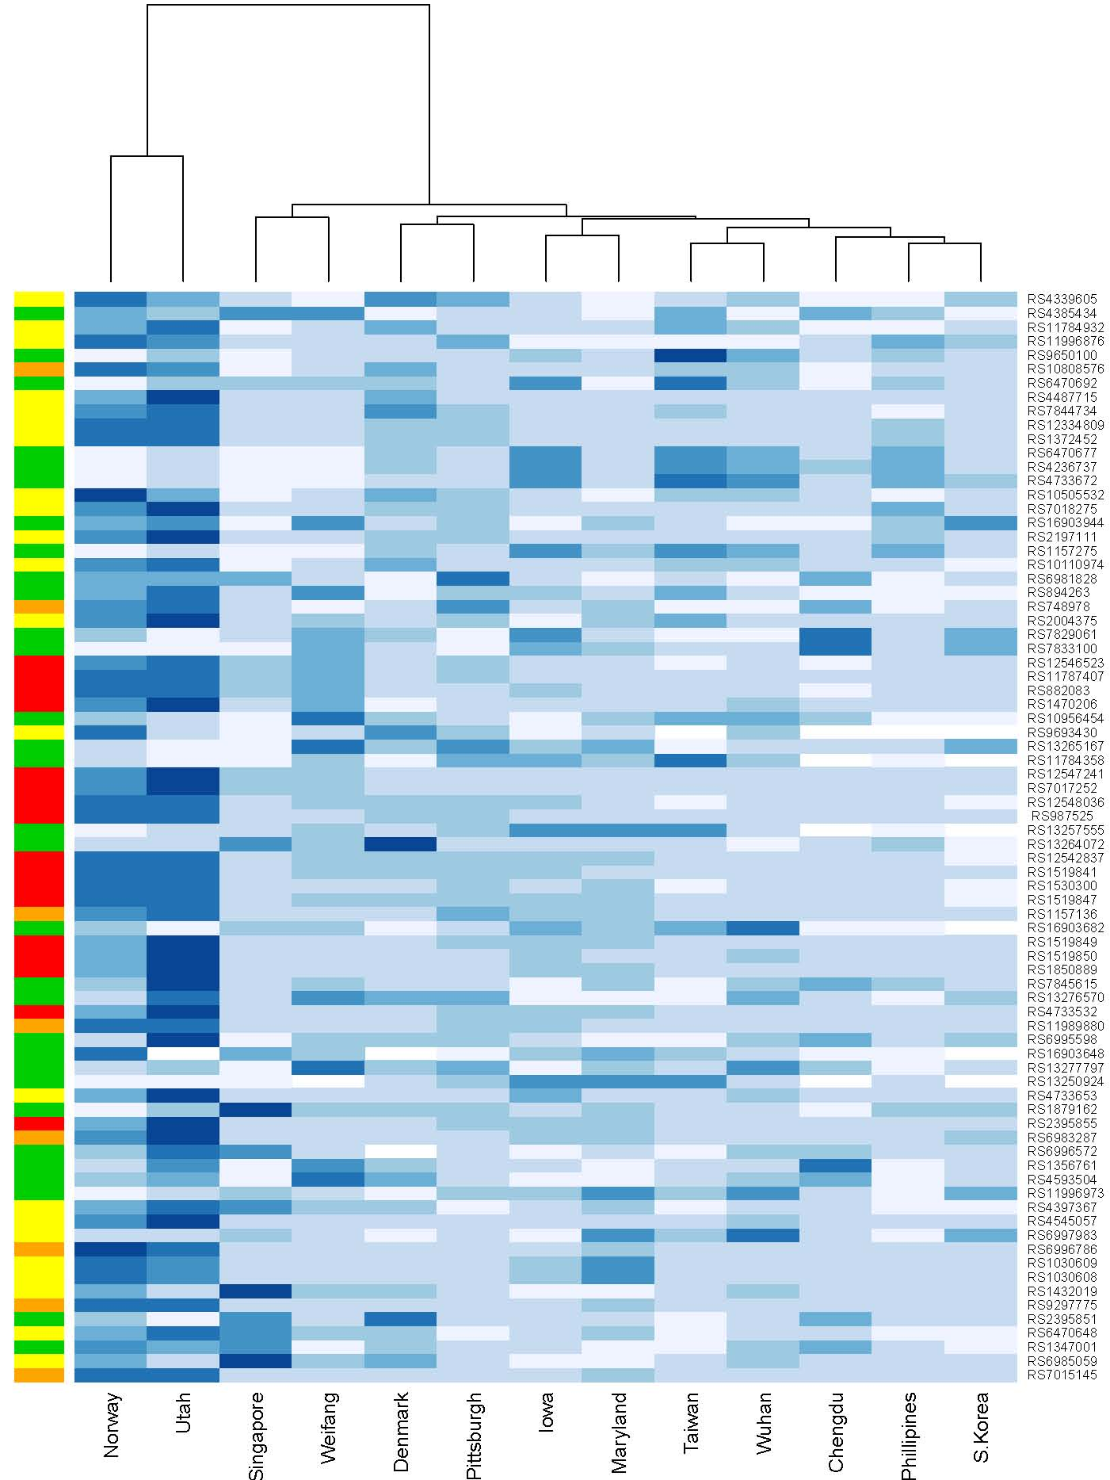
P-value from TDT in 8q24
P-value from TDT in total (red p<10⁻ ⁶ orange: 10⁻⁶<p<10⁻⁴; yellow: 10⁻⁴<p<10⁻²)
Allowing populations to be clustered by p-value
Norway & Utah gave strongest evidence

Slide 16
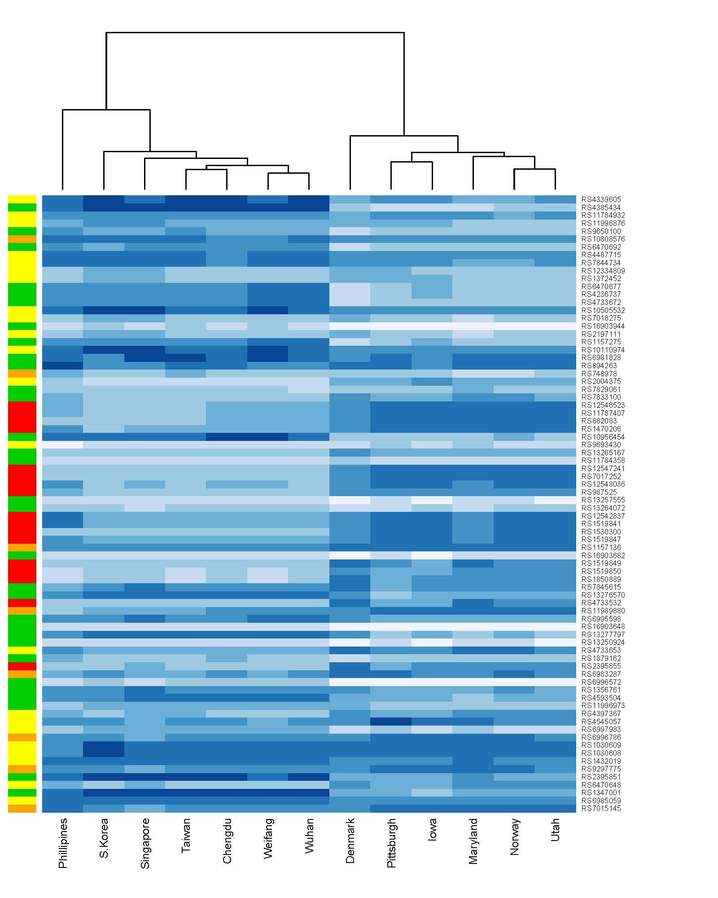
Heterozygosity among parents at 78 SNPs in 8q24
Low heterozygosity means no informative parents
P-value from TDT in total (red p<10⁻ ⁶ orange: 10⁻⁶<p<10⁻⁴; yellow: 10⁻⁴<p<10⁻²)
Asians
Europeans
Pvalue

Slide 17
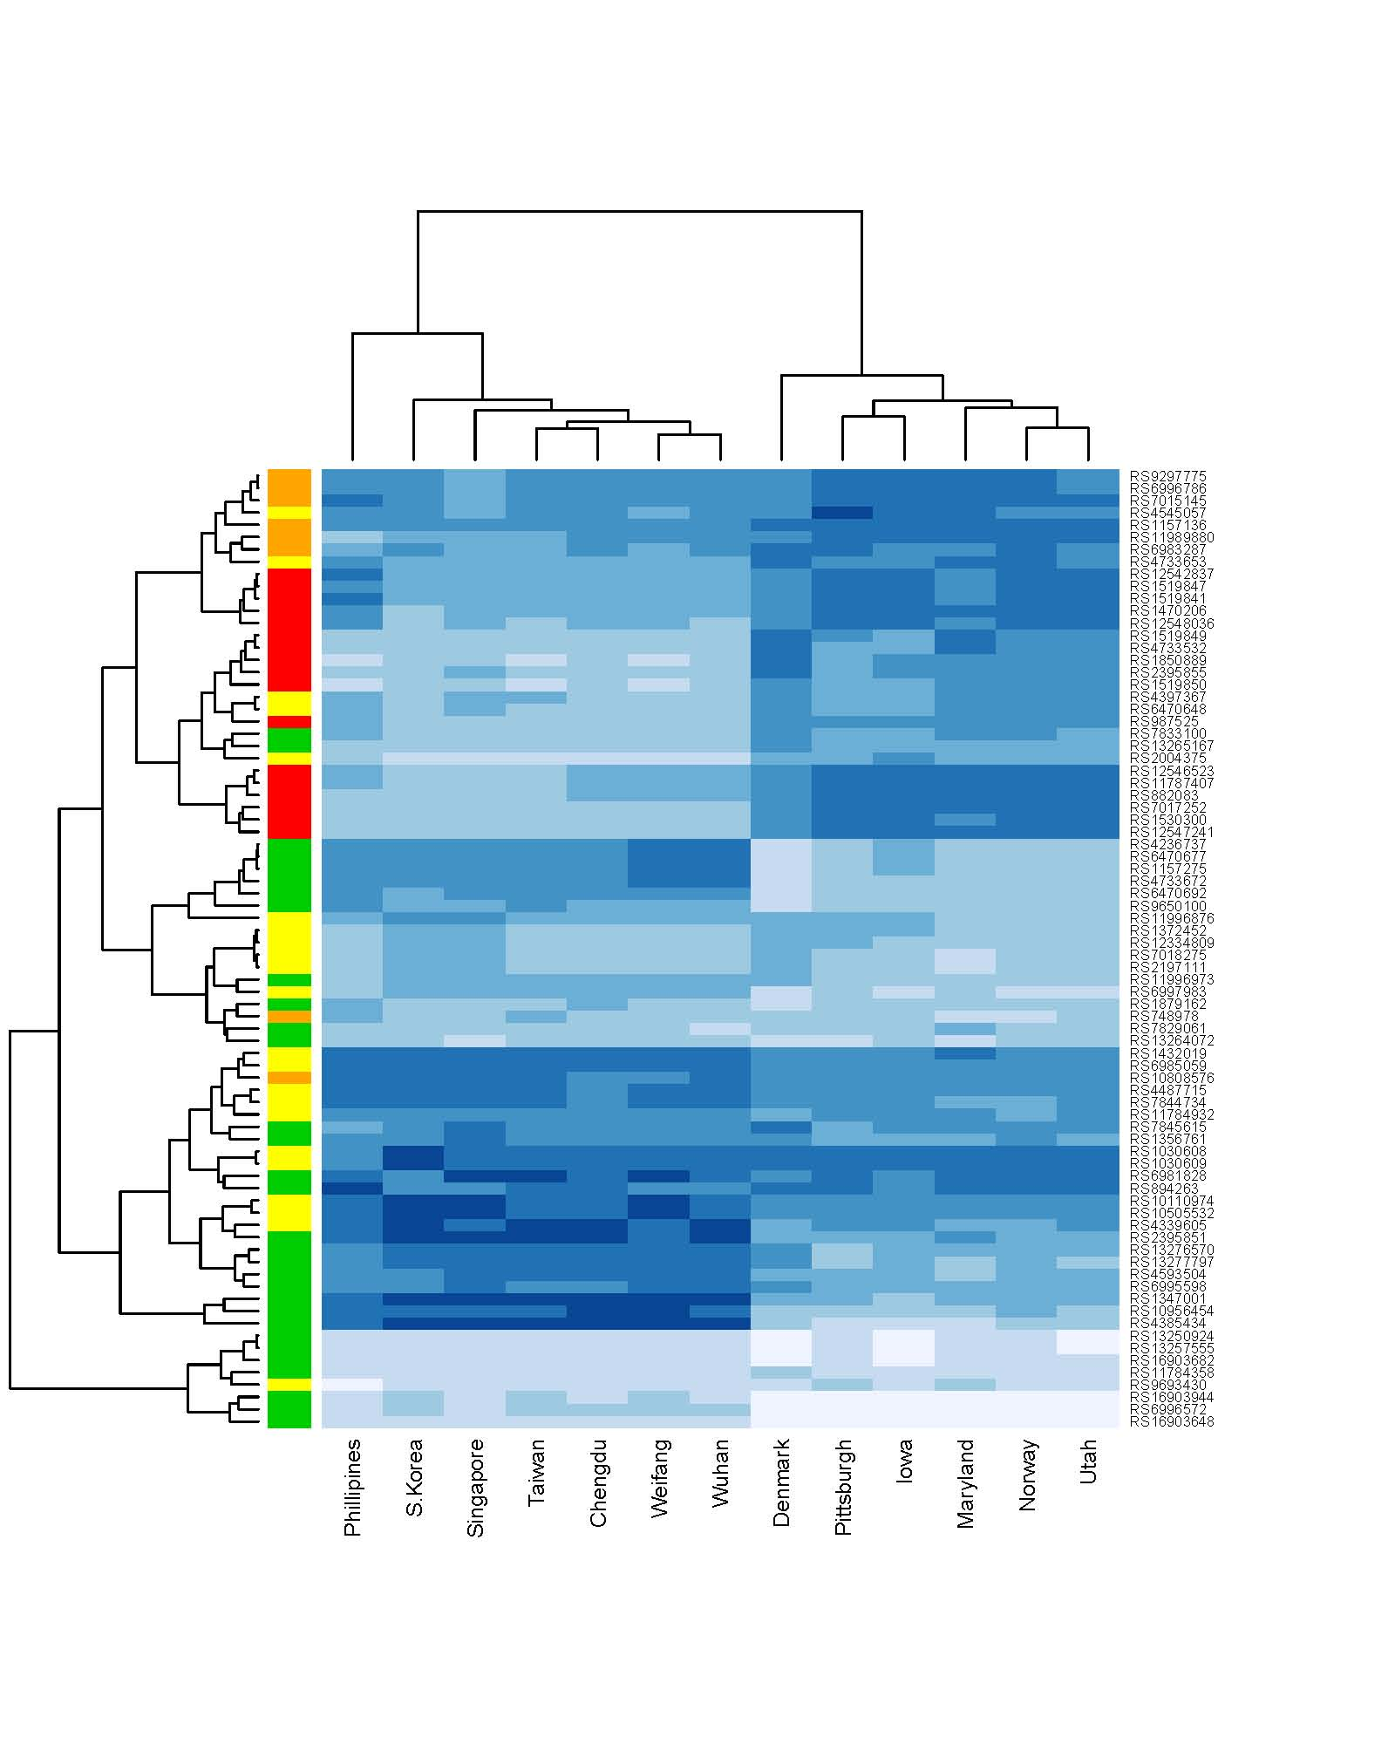
Heterozygosity at 78 SNPs in 8q24
Low heterozygosity means no informative parents
P-value from TDT in total (red p<10⁻ ⁶ orange: 10⁻⁶<p<10⁻⁴; yellow: 10⁻⁴<p<10⁻²)
Asians
Europeans
Allowing SNPs to be clustered by heterozygosity
Pvalue

Slide 18
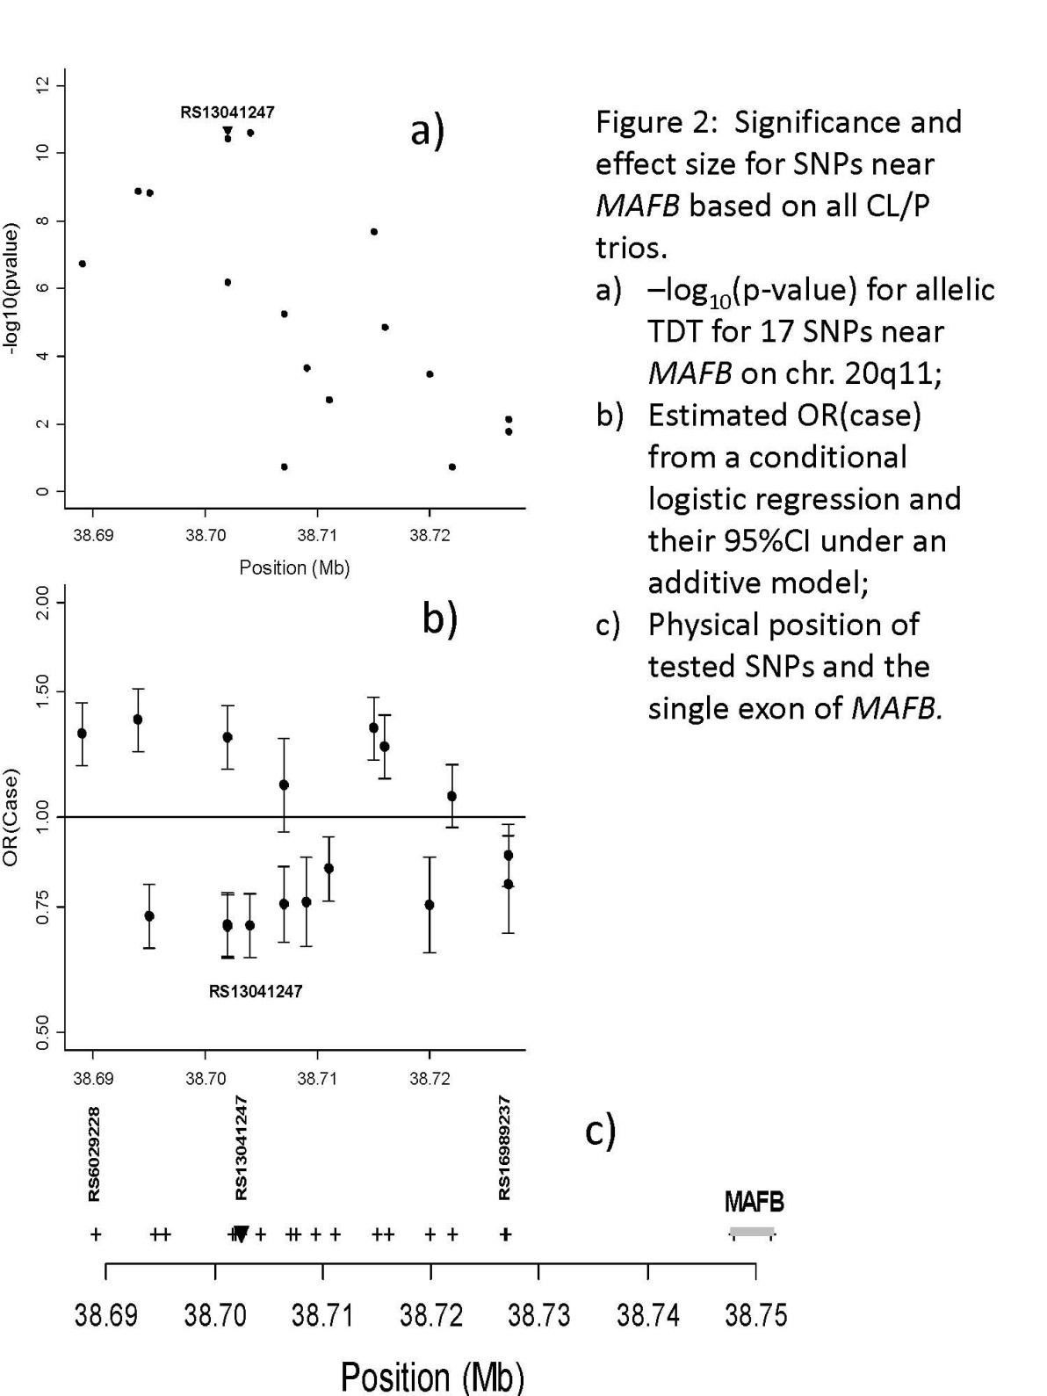
MAFB: Novel gene for CL/P
Most of statistical signal is well away from gene

Slide 19
Supplementary Figure 5: Linkage disequilibrium (LD) patterns among parents of European and Asian ancestry (measured as r²) for markers in MAFB showing evidence of linkage and association at the genome wide level of significance.

Slide 20
Figure 4: Mafb, and not Abca4, is expressed during the development of the secondary palate in the mouse. In situ hybridization for Mafb on whole mount e13.5 embryos (a, c) shows expression in craniofacial ectoderm, vibrissae, and neural-crest derived mesoderm in murine embryos. Signal was also detected in the elevated palatal shelves (b – view of the roof of the mouth). Immunofluorescence staining for Mafb (red) on e13.5 palatal sections shows Mafb localized in the epithelium of the palatal shelves (f) and in the medial edge epithelium during palatal fusion on e14.5 tissue sections (g, h). Expression is also detected in the epithelium at the base of the nasal septum and on the tongue epithelium (g). Note the absence of signal in the sense probe (b, d) and no primary antibody control (e). Immunofluorescence staining for Abca4 (green) on adult murine retina (i) and e14.5 palatal sections (j) show the presence of Abca4 in the rim of rods photoreceptor cells of the retina and its absence in orofacial structures. Nuclei were counterstained with DAPI (blue). v, vibrissae; p, palatal shelf; t, tongue, ns, nasal septum. (Scale bar = 100 µm panels e-h & j; = 50 µm panel i).

Slide 21
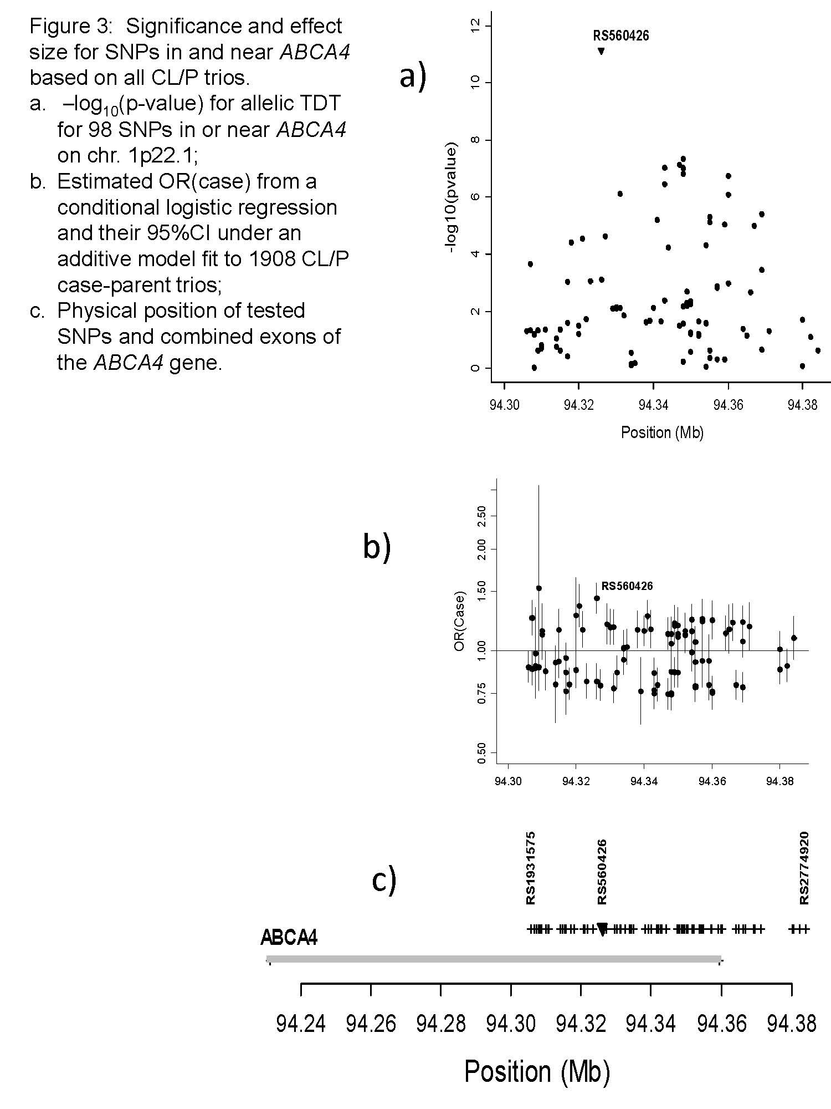
ABCA4: Some signal in the gene, some outside

Slide 23
Supplementary Figure 6: Linkage disequilibrium (LD) patterns among parents of European and Asian ancestry (measured as r²) for markers in ABCA4
showing evidence of linkage and association at genome wide level of significance.

Slide 24
Genes nearly genome wide significant need further investigation
Supplementary Table 2: SNPs showing at or near genome wide levels of significance in recognized or potential candidate genes from TDT analysis in 1908 CL/P case-parent trios.
SNP | Position | OR(case) | 95%CI | Asymptotic p-value | MA | overall MAF | Freq. Euro. | Freq. Asian
PAX7 on chr. 1
rs4920520 | 18802429 | 1.262 | (1.124,1.417) | 8.53E-05 | A | 0.312 | 0.491 | 0.142
rs4920522 | 18812967 | 0.774 | (0.694,0.864) | 4.90E-06 | C | 0.642 | 0.485 | 0.802
rs17352100 | 18824699 | 1.380 | (1.215,1.567) | 7.32E-07 | T | 0.240 | 0.397 | 0.090
rs766325 | 18829045 | 0.762 | (0.681,0.853) | 2.37E-06 | G | 0.644 | 0.465 | 0.823
rs6695765 | 18851907 | 0.783 | (0.708,0.867) | 2.57E-06 | T | 0.562 | 0.455 | 0.675
rs742071 | 18852461 | 1.449 | (1.261,1.666) | 1.84E-07 | T | 0.234 | 0.431 | 0.048
rs6659735 | 18856284 | 0.776 | (0.694,0.868) | 8.59E-06 | G | 0.656 | 0.485 | 0.816
rs4920338 | 18863380 | 1.277 | (1.140,1.430) | 2.47E-05 | T | 0.312 | 0.446 | 0.177
rs2236832 | 18872418 | 1.223 | (1.103,1.355) | 1.27E-04 | C | 0.395 | 0.485 | 0.301
VAX1 on chr. 10
rs7078160 | 118817550 | 1.342 | (1.204,1.495) | 1.07E-07 | A | 0.333 | 0.194 | 0.456
rs4752028 | 118824981 | 1.284 | (1.151,1.434) | 7.98E-06 | C | 0.285 | 0.195 | 0.361
NTN1 and LOC728685 on chr. 17
rs2872615 | 8855418 | 0.774 | (0.696,0.861) | 2.48E-06 | C | 0.369 | 0.237 | 0.482
rs9788972 | 8860355 | 1.398 | (1.248,1.565) | 7.05E-09 | A | 0.254 | 0.289 | 0.221
rs4791330 | 8861324 | 1.361 | (1.217,1.522) | 6.81E-08 | C | 0.307 | 0.324 | 0.292
rs1880646 | 8870570 | 0.795 | (0.716,0.883) | 1.90E-05 | C | 0.411 | 0.270 | 0.532
rs4791331 | 8872807 | 1.296 | (1.158,1.451) | 6.80E-06 | T | 0.318 | 0.459 | 0.190
rs8076457 | 8884654 | 1.345 | (1.157,1.563) | 1.14E-04 | T | 0.147 | 0.279 | 0.035
rs9915089 | 8893619 | 1.341 | (1.194,1.507) | 7.56E-07 | T | 0.240 | 0.300 | 0.183
rs8069536 | 8897010 | 1.644 | (1.373,1.968) | 6.04E-08 | T | 0.084 | 0.128 | 0.046
rs8081823 | 8906276 | 1.277 | (1.153,1.415) | 2.64E-06 | A | 0.384 | 0.323 | 0.436
*the target allele was defined as the minor allele (MA) among parents of European ancestry

Slide 25
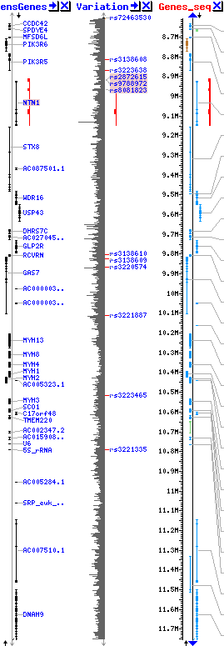
Region of signal on 17q

Slide 26
Replication study is underway
1000 case-parent trios
Custom panel of genes/regions identified in GWAS
Results pending….
What about CP case-parent trios?

Slide 27
550 CP case-parent trios
Gender of CP cases by recruitment site
Sites | Male |  | Female |  | Total
 | Counts | % | Counts | % | Counts | %
Denmark | 8 | 62% | 5 | 38% | 13 | 2%
Norway | 52 | 47% | 58 | 53% | 110 | 20%
Iowa | 19 | 46% | 22 | 54% | 41 | 7%
Maryland | 19 | 44% | 24 | 56% | 43 | 8%
Pittsburgh | 7 | 47% | 8 | 53% | 15 | 3%
Utah | 31 | 48% | 33 | 52% | 64 | 12%
Singapore | 22 | 39% | 35 | 61% | 57 | 10%
Taiwan | 29 | 37% | 50 | 63% | 79 | 14%
Shangdong Prov | 16 | 42% | 22 | 58% | 38 | 7%
Hubei Prov | 19 | 42% | 26 | 58% | 45 | 8%
Sechuan Prov | 18 | 45% | 22 | 55% | 40 | 7%
Korea | 4 | 80% | 1 | 20% | 5 | 1%
Total | 244 | 44% | 306 | 56% | 550 | 100%

Slide 28
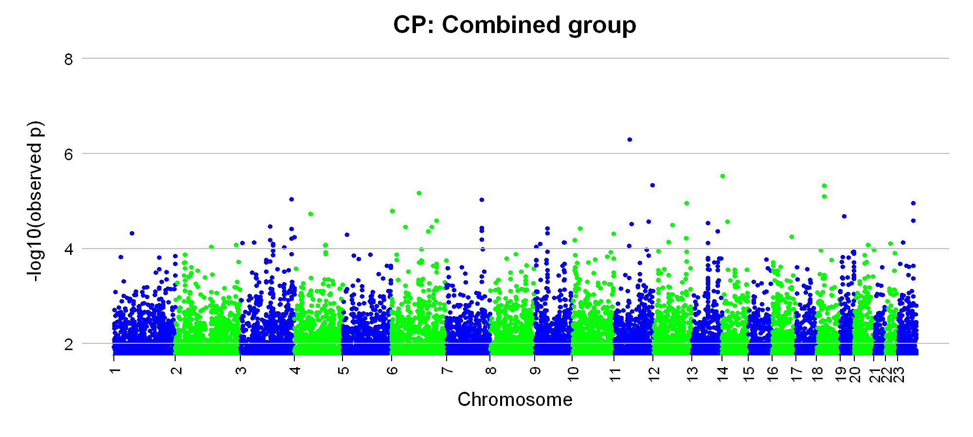
Nothing reaches genome-wide significance
X
Where do we go from here?

Slide 29
Consider GxE interactions with 3 maternal exposures
Maternal smoking, alcohol consumption & vitamin supplementation
We did three family based tests (effectively genotypic TDTs)
  Ignoring all exposures
  Model G and GxE interaction (2 df test)
  Model GxE interaction alone (1 df test)
Look for improvement in strength of signal (p-value) in either 1 df test or 2 df test after dropping really strong G only effects
  Double Manhattan plots

Slide 30
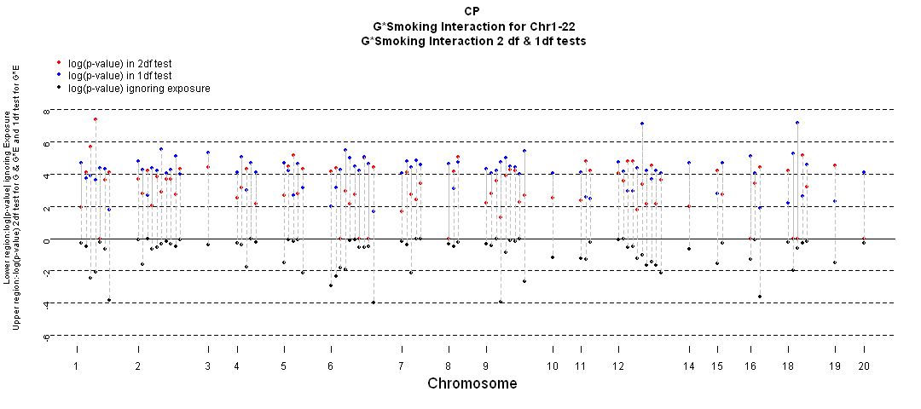
Test of gene effects (G) and gene-environment (GxE) for maternal smoking in 550 CP trios. a) –log₁₀(p-value) for autosomal SNPs yielding p<0.0001 in either 2df or 1df test from conditional logistic regression model with G and GxE included. b) log₁₀(p-value) from similar model ignoring maternal exposure.
OBSCN
TBK1
ZNF236
a)
b)
Pure interaction

Slide 31
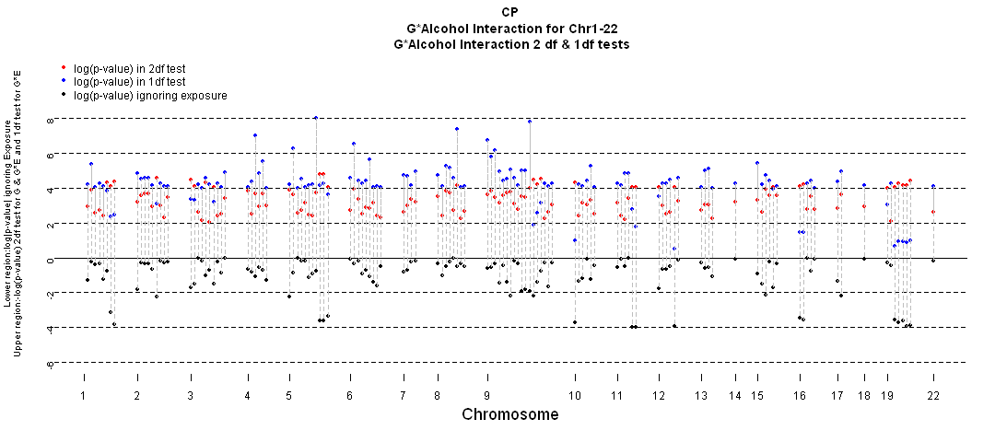
Figure 2: Test of gene effects (G) and gene-environment (GxE) for maternal alcohol consumption in 550 CP trios. a) –log₁₀(p-value) for autosomal SNPs yielding p<0.0001 in either 2df or 1df test from conditional logistic regression model with G and GxE included. b) log₁₀(p-value) from similar model ignoring maternal exposure.
AGXT2
c6orf105
MLLT3
HMP19
PRDM14
LOC645762
SMC2
a)
b)

Slide 32
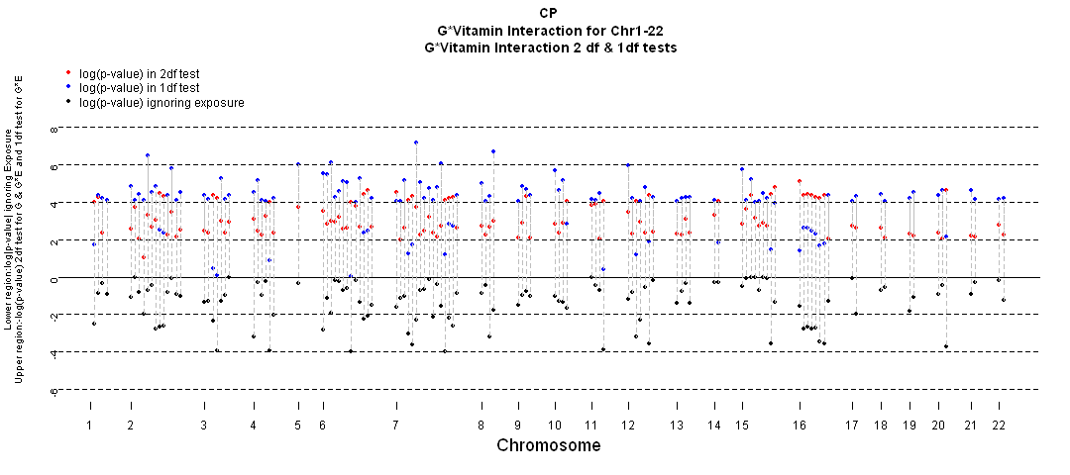
Figure 4: Test of gene effects (G) and gene-environment (GxE) for maternal vitamin supplementation in 550 CP trios. a) –log₁₀(p-value) for autosomal SNPs yielding p<0.0001 in either 2df or 1df test from conditional logistic regression model with G and GxE included. b) log₁₀(p-value) from similar model ignoring maternal exposure.
BTN2A1
LOC391828
CADPS2
a)
LOC729940
LOC392027
ACOXL
BAALC
ETV6
b)

Slide 33
Genes that became interesting when exposure was considered
Table 3: Genes yielding p-values <10⁻⁶ in either the 2 df test for G and GxE or the 1 df test for GxE with one or more maternal exposures in genome wide screen using PBAT on 550 CP trios
Gene (Chr) | # SNPs p<0.01 |  | s | . | Gene (chr) | # SNPs p<0.01 |  | s | Exp
 | in 2 df test | in 1 df test |  |  |  | in 2 df test | in 1 df test
LOC645762 (4) | 6 | 8 | 70 | Alc | TBK1 (12) | 6 | 4 | 18 | Smk
AGXT2 (5) | 1 | 1 | 34 | Alc | ZNF236 (18) | 3 | 8 | 39 | Smk
HMP19 (5) | 1 | 3 | 107 | Alc | ACOXL (2) | 8 | 10 | 82 | Vit
c6orf105 (6) | 11 | 18 | 126 | Alc | LOC391828 (5) | 3 | 4 | 52 | Vit
PRDM14 (8) | 2 | 1 | 42 | Alc | BTN2A1 (6) | 1 | 1 | 13 | Vit
MLLT3 (9) | 4 | 8 | 144 | Alc | LOC392027 (7) | 3 | 5 | 214 | Vit
SMC2 (9) | 5 | 5 | 141 | Alc | BAALC (8) | 3 | 7 | 61 | Vit
OBSCN (1) | 10 | 10 | 27 | Smk | ETV6 (12) | 2 | 2 | 149 | Vit

Slide 34
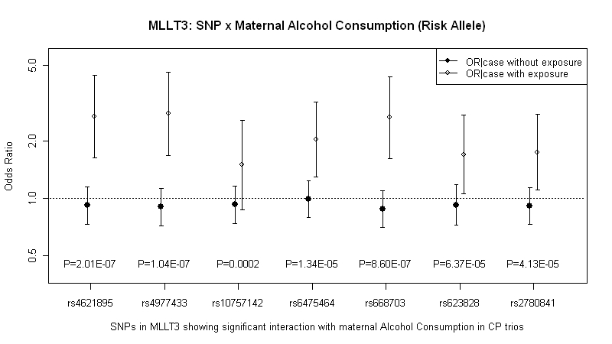
Estimated OR(case|G no E) & OR(case|G & E) and p-values from 1 df test for GxAlcohol interaction
No SNPs significant ignoring exposure, 6 of 7 showed higher risk for exposed offspring

Slide 35
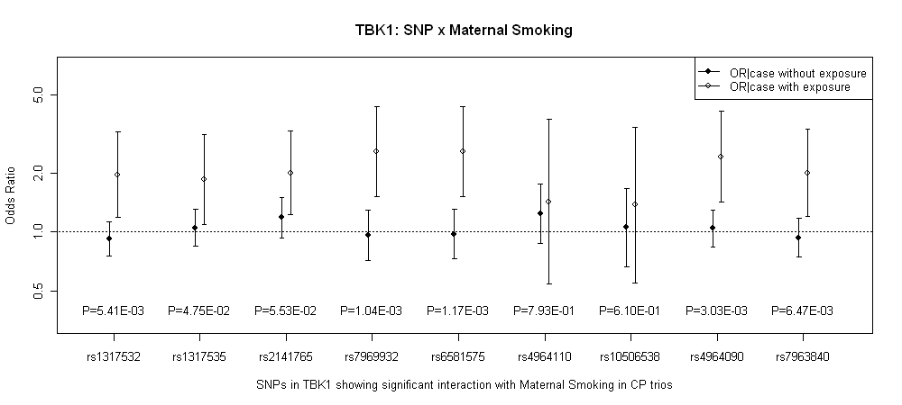
Estimated OR(case|G no E) & OR(case|G & E) and p-values from 1 df test for GxSmoking interaction for 9 SNPs in TBK1

Slide 36
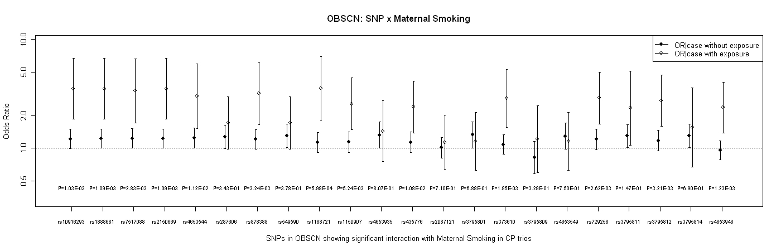
Estimated OR(case|G no E) & OR(case|G & E) and p-values from 1 df test for GxSmoking interaction for 22 SNPs in OBSCN
Quantitative interaction

Slide 37
There is much work yet to be done
GxE is underway
Replication of regions is underway
Min Shi of NIEHS is examining maternal genotype & parent of origin effects
Holger Schwender & Ingo Ruczinski are doing GxG interactions (beyond 2-way)
Rob Scharpf & Ingo Ruczinski are doing CNV from raw intensity data
Alan Scott is doing sequencing

