Slide 1
Gene Wiki Jamboree
FaceBase Spring Meeting
June 3-4, 2010
Benjamin Good, GNF

Slide 2
Outline
Why Gene Wiki ?
What is a Jamboree?
Get started!

Slide 3
The goal
“Create a continually-updated, collaboratively-written, and community-reviewed review article for every gene in the human genome” (Andrew Su).
Create a continually-updated, collaboratively-written, and community-reviewed review article for every concept of relevance to FaceBase

Slide 4
Because
Such review articles are valuable.
They provide:
  quick summaries of relevant knowledge
  compilations of references
  a unique opportunity (responsibility?..) to communicate your knowledge to each other and to a very large public audience

Slide 5
Something to shoot for
http://en.wikipedia.org/wiki/Reelin
About 18 pages of text
178 references
14 images, 1 movie
60+ editors
500+ edits
Now viewed > 2,000 times a month.

Slide 6
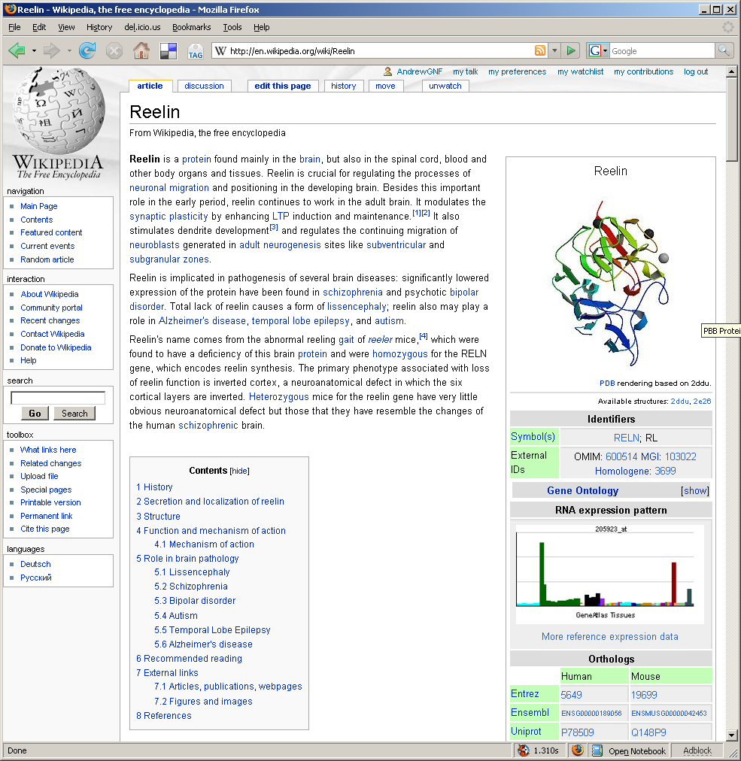
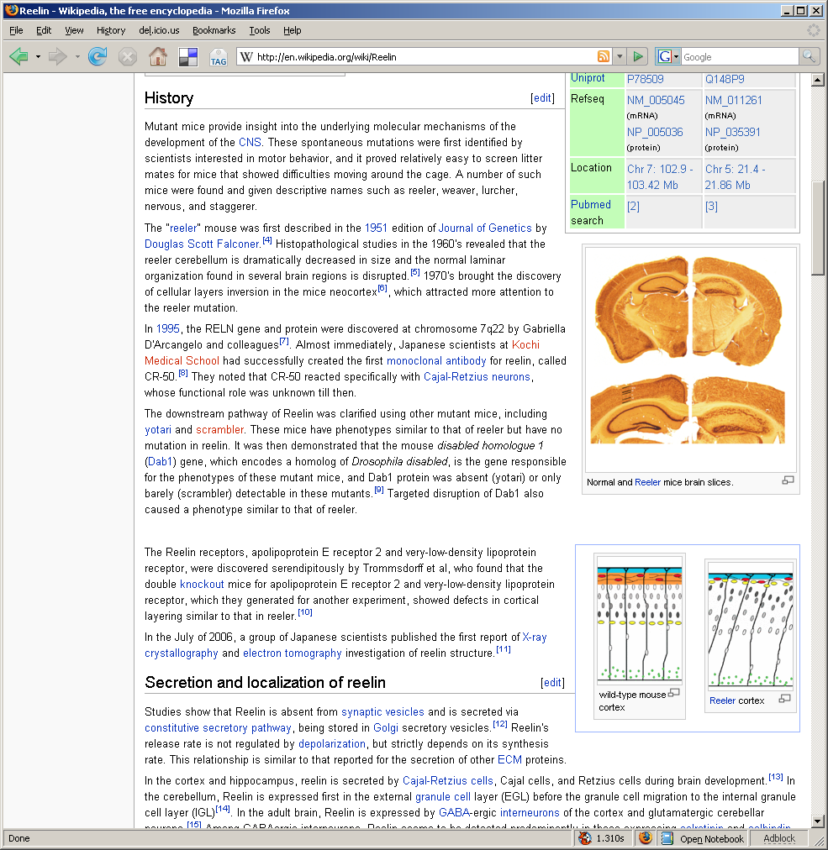
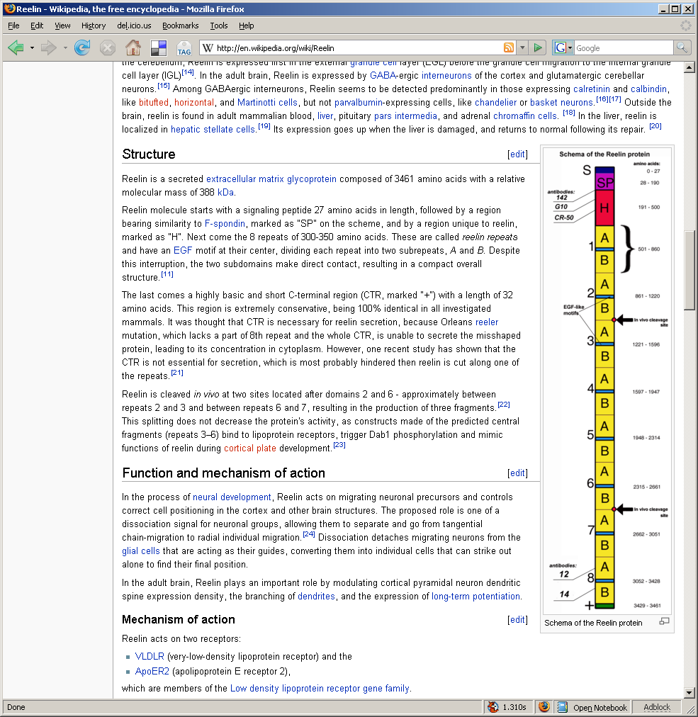
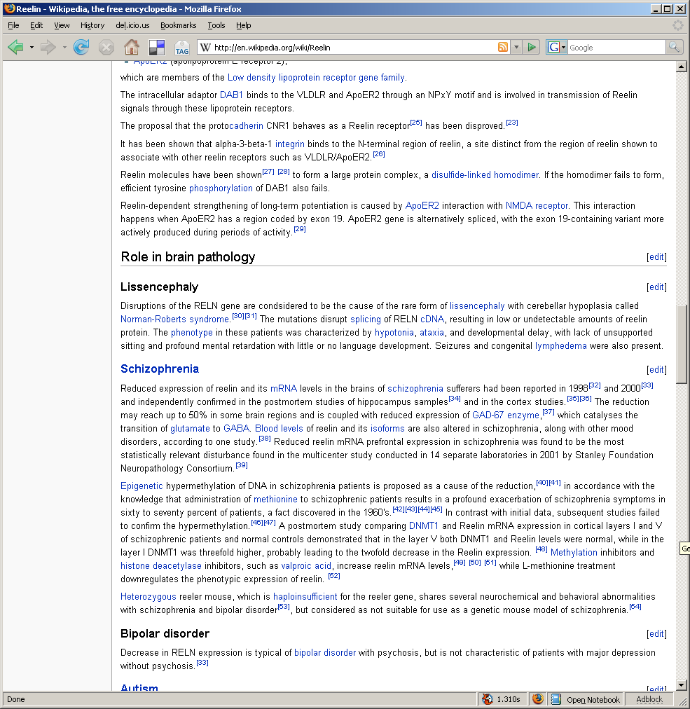
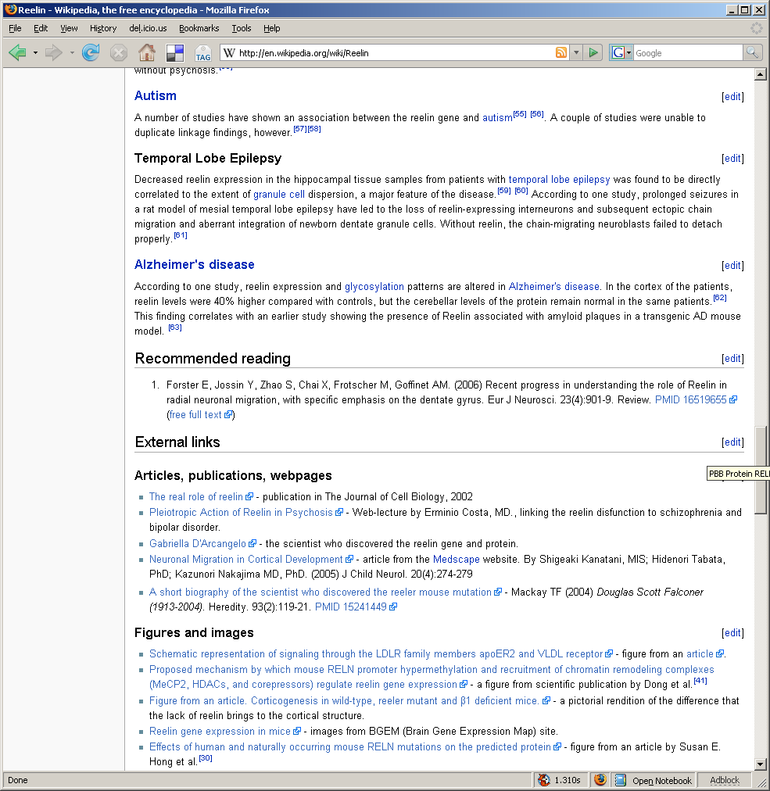
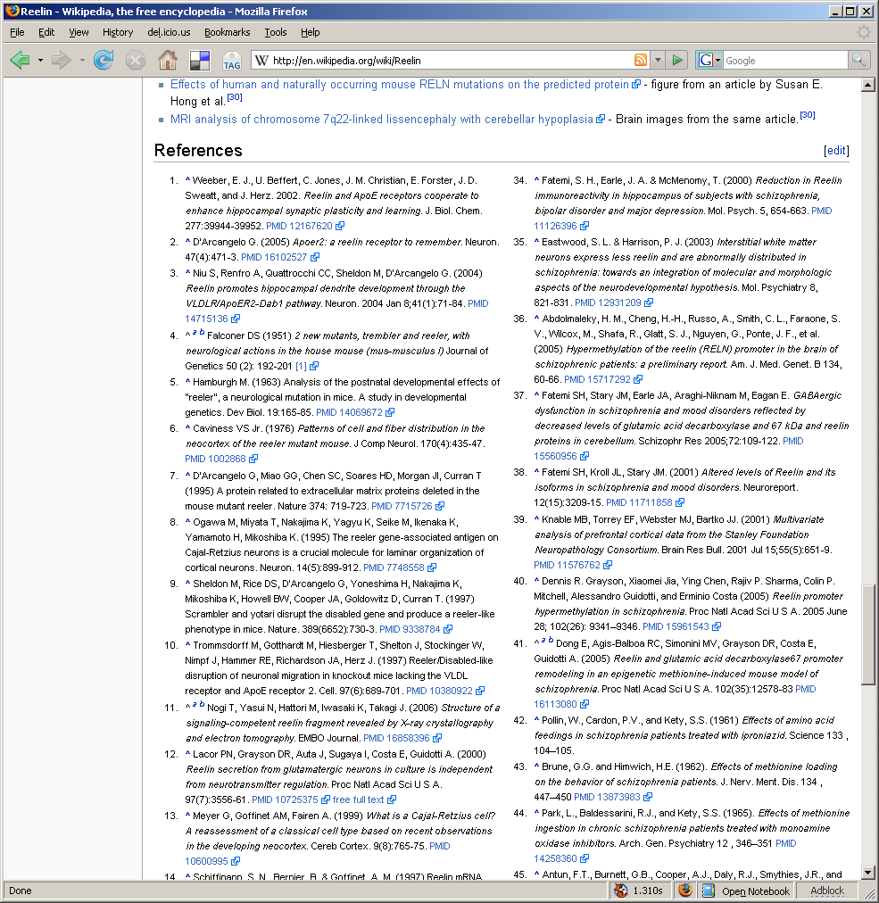
Reelin, a model example
Notes:
Goal: Create a continually-updated, collaboratively-written, and community-reviewed review article for every gene in the human genome.

Slide 7
In contrast…
Genes that matter to FaceBase
  IRF6
    1 page text, 10 references
  MSX1
    1 paragraph, 9 references
  FOXE1
    1 paragraph, 3 references
  Etc…

Slide 8
So…
_{Its time for a Jamboree!}

Slide 9
“Jamboree”
From the wiktionary
  “A lavish or boisterous celebration or party”
  “A large rally of scouts or guides”
For biologists…
  “A lavish rally of boisterous scientists sharing their knowledge”
  (First usage Drosophila Genome Annotation Jamboree at Celera in 1999?)
Notes:
From the Science paper about the Drosophila Genome (from Celera). Annotation
The initial annotation of the assembled genome concentrated on two tasks: prediction of transcript and protein sequence, and prediction of function for each predicted protein. Computational approaches can aid each task, but biologists with expertise in particular fields are required for the results to have the most consistency, reliability, and utility. Because the breadth of expertise necessary to annotate a complete genome does not exist in any single individual or organization, we hosted an "Annotation Jamboree" involving more than 40 scientists from around the world, primarily from the Drosophila research community. Each was responsible for organizing and interpreting the gene set for a given protein family or biological process. Over a 2-week period, jambo ree participants worked to define genes, to classify them according to predicted function, and to begin synthesizing information from a genome-wide perspective.

Slide 10
Goals
Learn basics of wiki editing
Start editing FaceBase-relevant pages
Achieve boisterousness..!

Slide 11
Organizational Notes
Text discussions can be joined at
  http://friendfeed.com/genewikijamboree
The main coordination page for this project is
  http://en.wikipedia.org/wiki/Portal:Gene_Wiki/Clefting
Suggest working with a partner
I will start by introducing the basics, if you already know them please skip ahead and get started on your own!

Slide 12
Let the Jamboree Begin!
Notes:
Please refer to your notes for the basic agenda. We are now at the ‘organization stage’

Slide 13
Wrap up
Please send comments and questions about this jamboree to me
  bgood@gnf.org
and Andrew Su
  asu@gnf.org

