Slide 1
Biomedical Informatics Research Network (BIRN): Enabling Collaboration on Someone Else’s Dime (mostly…)
Karl Helmer Ph.D.
Athinoula A. Martinos Center for Biomedical Imaging,
Massachusetts General Hospital
June 4, 2010
Notes:
Check for official title

Slide 2
BIRN Research Networks
The main goal of the BIRN is to enable collaborative bioscience/biomedicine
Use Cases:
- share data/tools
- provide security
- develop, add to, merge ontologies
- query across disparate data sources
- search for outside resources

Slide 3
BIRN Background
Funded by National Center for Research Resources in 2001.
Three neuroimaging testbeds initially provided use cases
for developed technology.
Reorganized in 2008 to provide software-based solutions for
data sharing in the biosciences. No longer focused on
neuroimaging (or even imaging).
One can no longer ‘log into BIRN’. New model of providing
modular capabilities that users can fit into existing toolset.

Slide 4
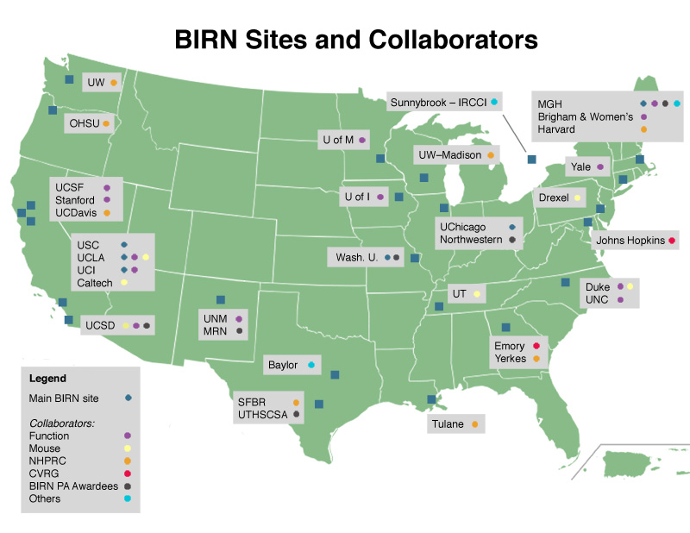

Slide 5
Technical Approach
Bottom up, not top down
Focus on user requirements - what they want to do
Create solutions - factor out common requirements
  Capability model includes software and process
  Avoid “Big Design up Front” (BDUF)
Notes:
Federated ex.

Slide 6
Capability Model
Software and services are only useful in bioinformatics if they do things that scientists need.
  What is the problem?
  How do the tools address the problem?
BIRN’s capabilities are defined in terms of problems and solutions, not in terms of software and services.
  This is true from beginning (definition and documentation) to end (quality assurance and assessment).

Slide 7
Dissemination Models
Different problems require different kinds of solutions.
  BIRN operates services for all users; e.g., user registration service
  BIRN provides kits for project teams to deploy services for their members; e.g., data sharing
  BIRN provides downloadable tools for individuals to use on their own; e.g., image manipulation tools
Understanding deployment needs is part of defining the problem to be solved.

Slide 8
Working With BIRN
New capabilities are defined, designed, and disseminated by BIRN Working Groups
  Data Management
  Information Integration
  Knowledge Engineering
  Workflow Tools
  Security
  Genomics

Slide 9
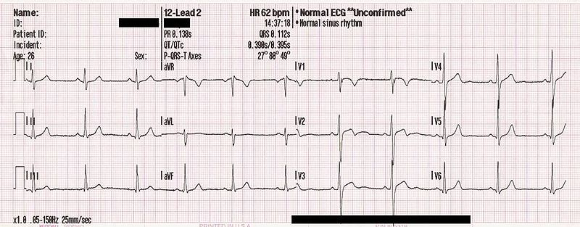

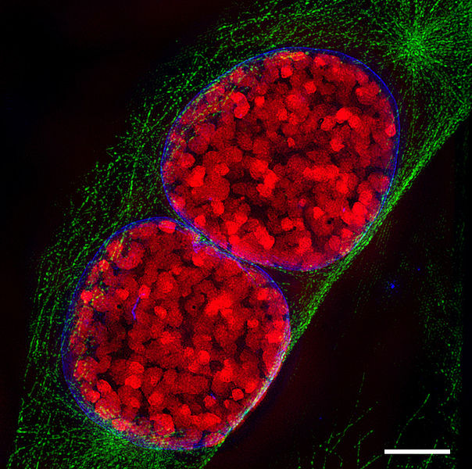
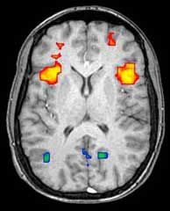
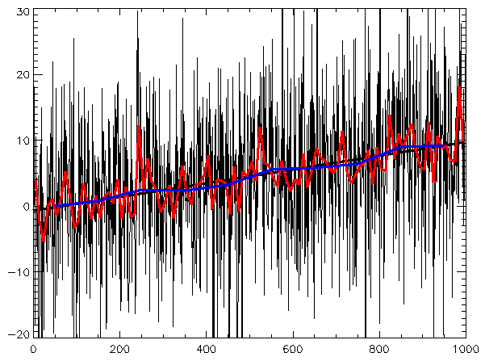
Data Management
BIRN seeks to support data intensive activities including:
  Imaging, Microscopy, Genomics, Time Series, Analytics and more…
BIRN utilities scale:
  TB data sets
  100 MB – 2 GB Files
  Millions of Files

Slide 10
Data Management
Security
  Protect sensitive data: PHI, Researcher identity, IRB restrictions
Scalability
  Support growth in projected data usage: data volumes, file sizes, users, sites, ops/sec
Infrastructure
  Work with commodity networking, storage, etc.; and strict firewalls, etc.

Slide 11
Data Service Architecture
Client Utilities
  UNIX utilities
  Java & C APIs
Shared Services
  Manage File Locations
  Manage User Groups
Local Services
  Integrate with conventional file systems
Client
Utilities
Web
Access
Location
Registry
Group
Management
GridFTP
Policy
Caching
Local File
System
Policy
Enforcement
Storage Service

Slide 12
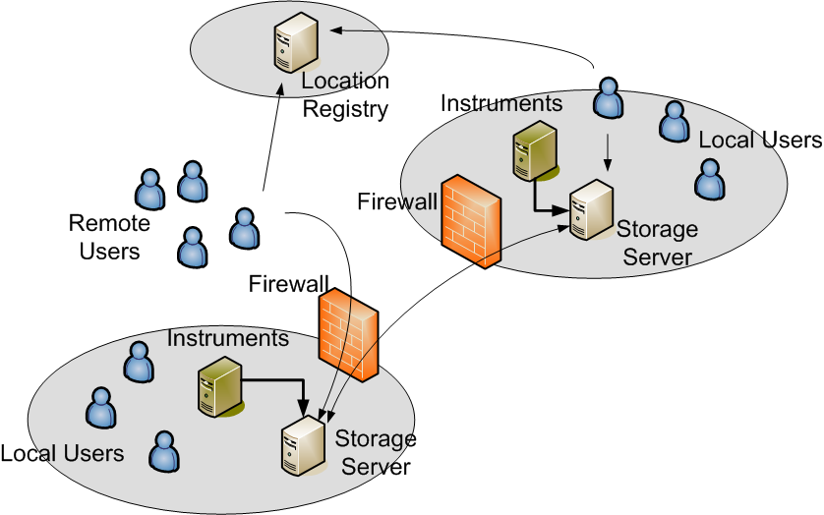
Data Service Deployment

Slide 13
Data Management Summary
High Performance Transfer Protocol
  Strong security
  High performance, proven technology
Location Registry
  Distributed registry to track file locations
  Low overhead, supports 100s ops/s
Group Management
  Centralized user and group management
  Caching at local servers
Policy Enforcement
  Flexible access control policies
  User and group ownership rights
Notes:
Outreach part – what if no PA award?

Slide 14
Information Integration
Mediator: uniform structured query access to heterogeneous sources
Challenges:
Syntactic (Access/Format) heterogeneity: → Wrappers
  Structured Sources: DBMS, XML/XQuery DBs
  Semi-structured Sources: HTML, text, pdf
  Web services → XML, SOAP, WSDL
Semantic heterogeneity → Mediator
  Schema → Source modeling
  Data → Record Linkage
Scalability:
  Mediation
  Security
  Source Addition
  Record Linkage
  Efficient Query Execution
Decision Support
Application Programs
Mediator
Databases
Knowledge
Bases
The Web
Computer
Programs

Slide 15
Information Mediator
Virtual Integration Architecture:
  Virtual organization: community of data providers and consumers that want to share data for specific purpose
  Autonomous sources: data, control remains at sources; no change to access methods, schemas; data accessed real-time in response to user queries
  Mediator: integrator defines domain schema and describes source contents
    Domain schema: agreed upon view of the domain preferred by the virtual organization
    Source descriptions: logical formulas relating source and domain schemas

Slide 16
Information Mediator
Query Answering
  User writes query in domain schema
  Mediator:
    Determines sources relevant to user query
    Rewrites query in sources schemas
    Breaks query into sub-queries for sources
    Optimizes query evaluation plan
    Combines answers from sources
  Efficient query evaluation
    Streaming dataflow

Slide 17
Information Mediator
User queries
Domain
Schema
Logical Source
Descriptions
Reformulation
Optimizer
Execution Engine
Mediator
Sources
schemas
Wrapper
Wrapper
Data
Source
Data
Source
Data
Source
17

Slide 18
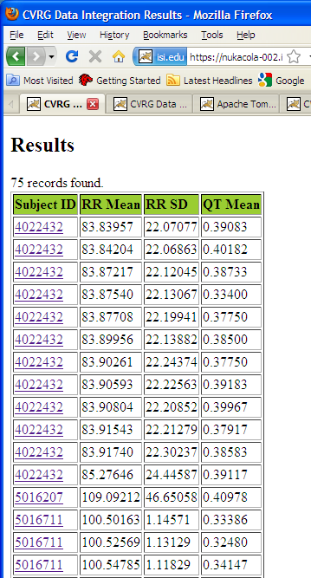
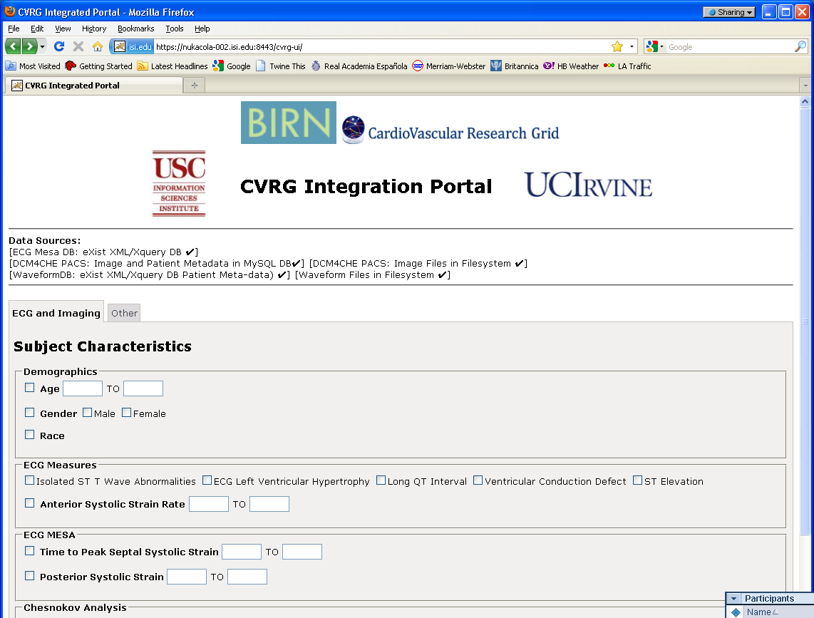
Mediator Use Case - CVRG
Domain
query
Integrated
results
Just plug in
CVRG source
descriptions
Same BIRN mediator
Logical Source
descriptions
BIRN Mediator
WaveformDB
(eXistDB
XML DBMS)
ECG_Mesa
(MySQL DB)
and additional wrapper for
eXistDB (XML/XQuery database)
DICOM Image Files
(file system)
Image Metadata
dcm4che PACS
(MySQL DB)
Chesnokov
Analysis
(eXistDB
XML DBMS)
Waveform Files
(file system)

Slide 19
Knowledge Engineering
Ontology development challenges:
Modeling complex domains is challenging and requires specialized expertise
The community of ontology development efforts is large and somewhat daunting to navigate
Our goal: to provide an ontology development process that
leverages existing ontology development
creates effective dialog between domain users and biomedical ontologists
informs and documents the design of domain models for integration
publishes curated domain ontologies to the community
Notes:
Ontology development: The representation of knowledge in a standard, formal language.

Slide 20
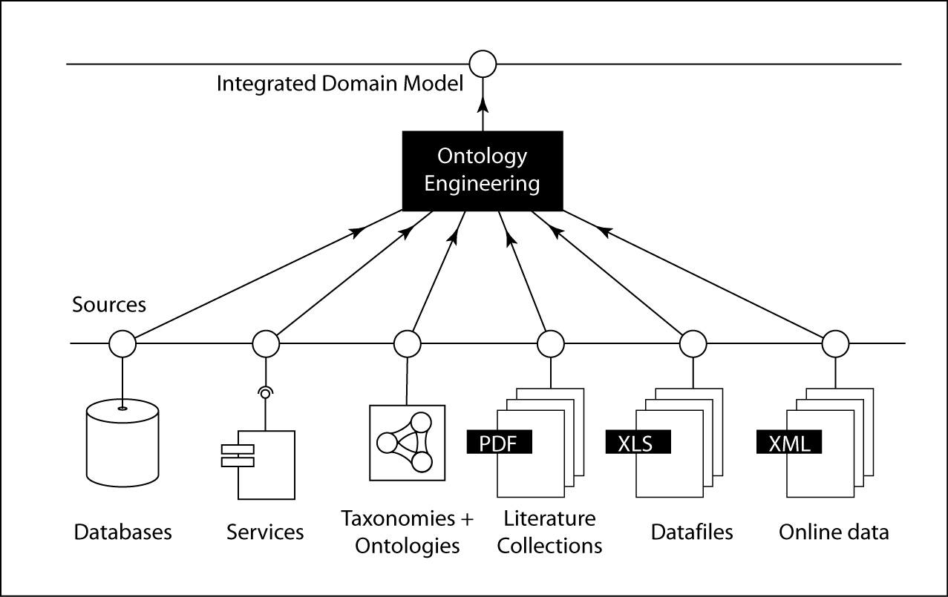
Domain/Ontology Engineering
Notes:
We use a two-stage process: (A) the data integration technology deals with the local structure and mapping of data sources into a well-defined domain model (B) the mapping of that domain model into community-based ontology resources is an important technical challenge that we are addressing in collaboration with members of the OBO Foundry’s Ontology of Biomedical Investigation (OBI).

Slide 21
BIRN Security
Vet new user request for community membership
Provide new user identity
Provide single sign-on for users
Manage access control policy
Enforce access policy on resources
Manage user groups for projects within community
Address potential security issues

Slide 22
BIRN Security
Hosted services for common requirements
Tools and clients for integration with community resources
Security Vulnerability Handling System
Expertise and consultation for community application integration
Notes:
Different types of solution:
Hosted services, no burden on user, BIRN operates – update/debugging, leveraged by multiple communities.
S/W to download and install, to use common services
Forum to report and resolve security issues, in secure manner, limiting public exposure to the issue so it is not used
Application specific integration – consultation services

Slide 23
Function BIRN Security
BIRN Identity Provider
Username/password
FBIRN Site 1 GridFTP Server
BIRN Registration Service
BIRN Credential Service
FBIRN Site 2 GridFTP Server
X.509 Certificates
BIRN Portal
Username/password
BIRN Credential Service Clients
Administrator
End User

Slide 24
BIRN Best Practices Consulting
“We need 8, 40 GB uploads and 4, 10 GB downloads simultaneously” is achievable.
“We need to transfer data…” is not.
Data provenance, data curation, best practices, federated versus repository…
What does it take to get things done?

Slide 25
Working with BIRN
Projects are vetted by BIRN Steering Committee for appropriateness and resource planning
Collaborators are expected to be actively involved in development and deployment.
Collaborators are not expected to use complete BIRN capability kit.

Slide 26
Summary
BIRN provides a capability kit and consulting to facilitate internal and external data sharing.
BIRN takes a bottom-up, modular, capability-based approach that is driven by end user needs.
End users are viewed as collaborators and are actively involved in development process.

Slide 27
BIRN Program Announcements
Provides funds to work with BIRN on projects relating to data sharing (PAR-07-426) and the associated ontology (PAR-07-425) for the data.
Mechanism to fund the leveraging of BIRN capabilities
BIRN provides assistance in framing proposals.

Slide 28
Contact Information
Email address: info@birncommunity.org
BIRN Representatives
Joe Ames: jdames@uci.edu
Karl Helmer: helmer@nmr.mgh.harvard.edu
Seth Ruffins: sruffins@loni.ucla.edu
Web site: www.birncommunity.org

