Slide 1
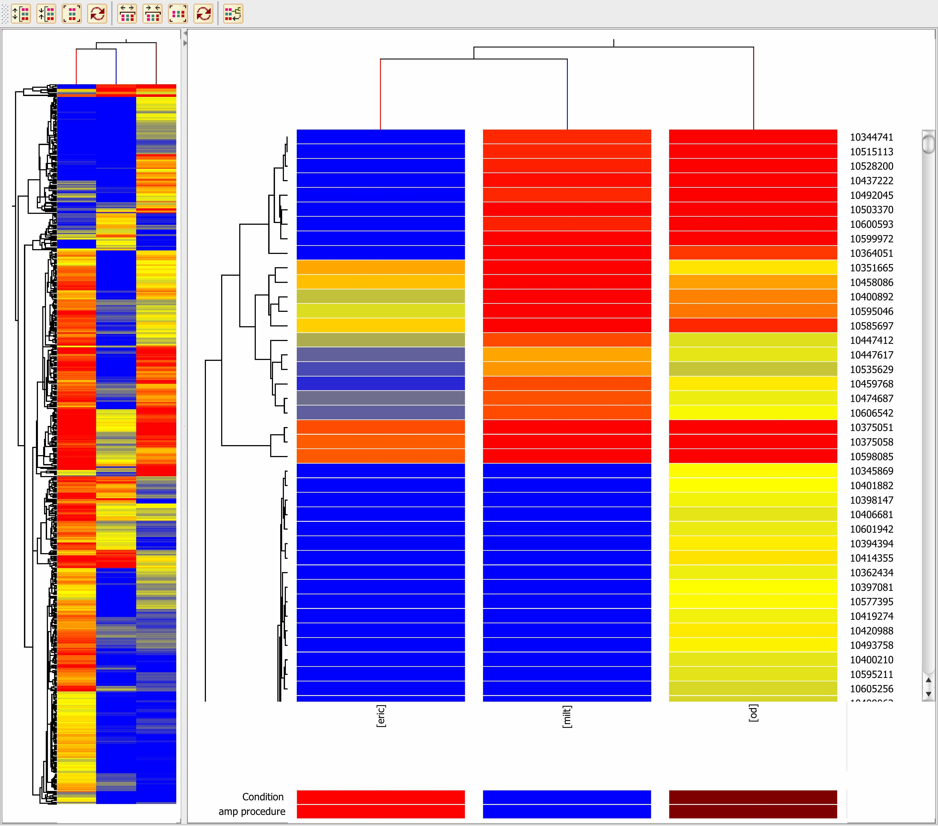
Create an Atlas of Gene Expression during Craniofacial Development
Potter, Brunskill, Trainor, Aronow
Combination Laser Capture/Transgenic-GFP and Microarray/Nex-Gen
Compared three technologies.
  Nugen One Direct RiboSpia technology.
  μMACS Super Amp Kit from Miltenyi.
  Modified Dulac and Axel procedure, developed by Eric Brunskill

Slide 2
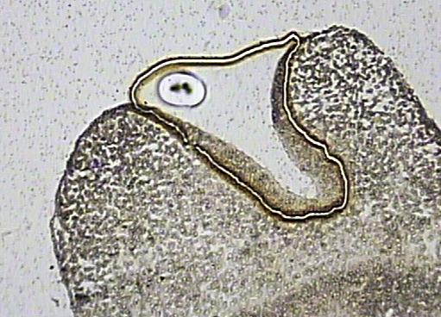
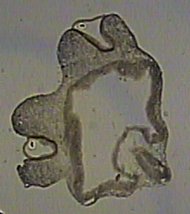
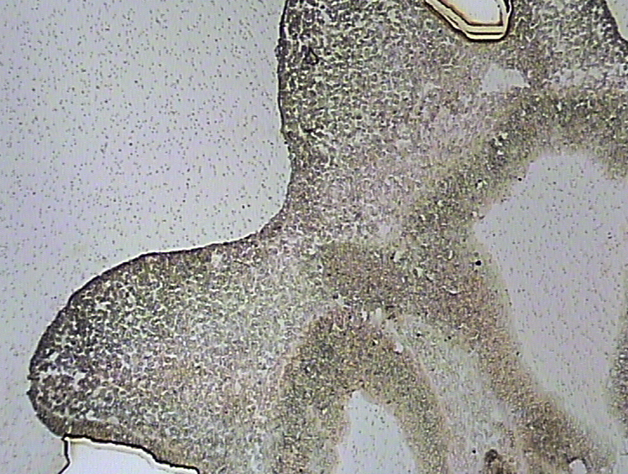
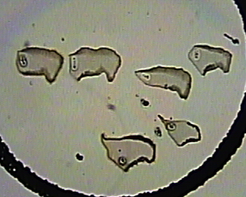
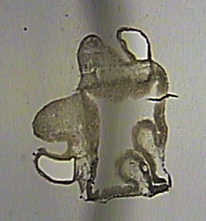
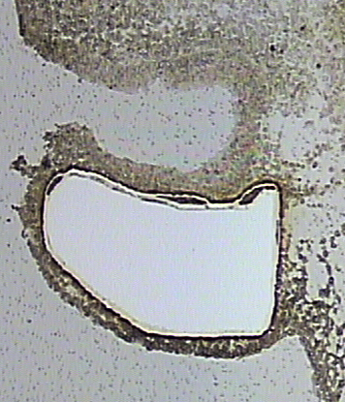
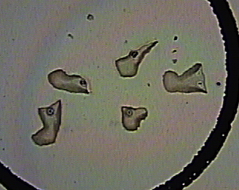
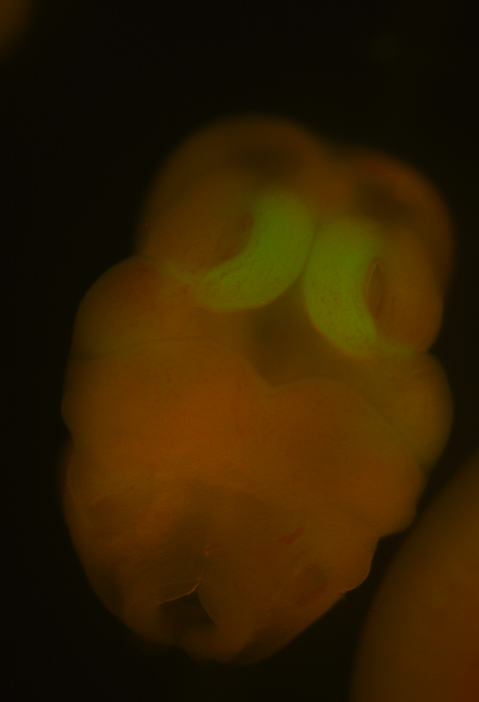
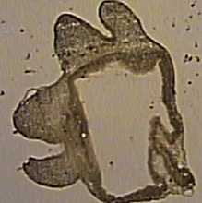
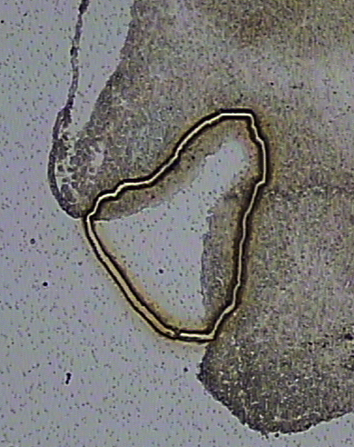
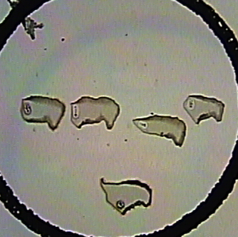
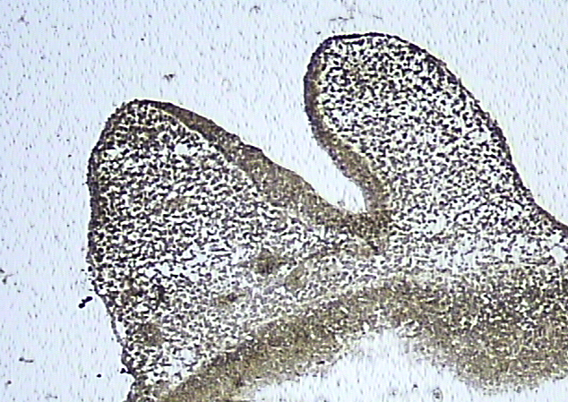
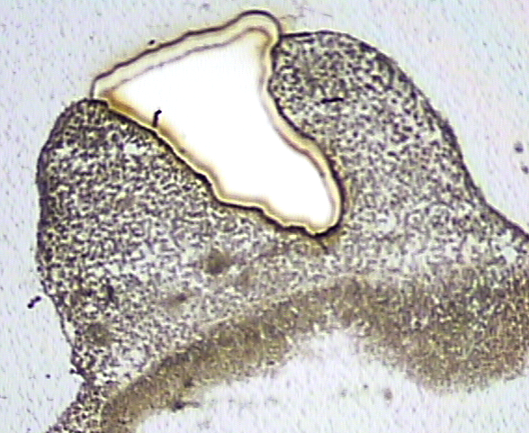
Purifying Cells of interest
Wnt1-cre
Mesp1-cre
Crym-GFP
Krt14-Cre

