Slide 1
3D Analysis of Normal Facial Variation: Data Repository and Genetics
Principal Investigators
Seth M. Weinberg, PhD (U Pitt)
Mary L. Marazita, PhD (U Pitt)
Co-Investigators
Michael Cunningham, MD, PhD (U Wash)
Jacqueline Hecht, PhD (UT Houston)
Karen T.Cuenco, PhD (U Pitt)
Consultants
Chung How Kau, BDS, MScD, PhD (UA Birm)

Slide 2
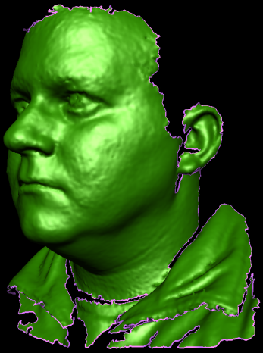
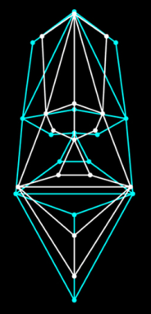
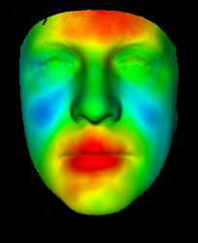
Aims
Create a normative data repository containing 3D facial surface images, facial measurements, GWA markers and demographic descriptors from 3500 individuals aged 5 – 40.
Example of a 3D facial surface captured through stereophotogrammetry
Utilize this data repository to identify genetic loci that influence quantitative variation in facial shape
Using morphometric methods to visualize genotype-phenotype correlations

Slide 3

Progress
IRB approval at all three sites (several rounds of modification)
Built infrastructure at coordinating center (Pitt) to receive data from collection sites
FaceBase Human Data Working Group documents and policies
CSOC approval
Tentative approval from NIDCR to begin recruitment
Revised NGA imminent

