Slide 1
FaceBase Bootcamp
Nov. 18, 2020

Slide 2
Additional FaceBase topics:
Installing DERIVA Client Tools
Exporting Data
Requesting Human-subject protected data
Primer on data submission and uploading data

Slide 3
Installing DERIVA Client Tools
Suite of reliable tools for batch uploading and downloading data
GUI and command line tool for Mac, Windows and Linux
Detailed documentation:
  https://github.com/informatics-isi-edu/facebase-curation/wiki/Deriva-Clients
  Mac and Windows:
    Download bundle from
      https://github.com/informatics-isi-edu/deriva-client-bundle/releases
  Linux:
    Use pip install:
      pip3 install --user deriva-client

Slide 4
Exporting Data from FaceBase
Individual File Download
  Click on a (highlighted) file and the browser will prompt you to save the file to your computer
Bulk Export:
  CSV
    Downloads a CSV file of the metadata of the search results
    Available both at the Results and Detail page
    Most useful to download results of a search in tabular form
  BAG
    Download a BDBag (Big Data Bag) file with metadata and information about the data files (assets)
    The BDBag file is used by our DERIVA Bag Tool to export the all files to your machine
    Available at the Details page (Datasets, Experiment)
    Most useful to download all data from a dataset, especially for large number of files and data volume
    Tool is very robust: performs validation, console shows progress and status, can be restarted from where it left off

Slide 5
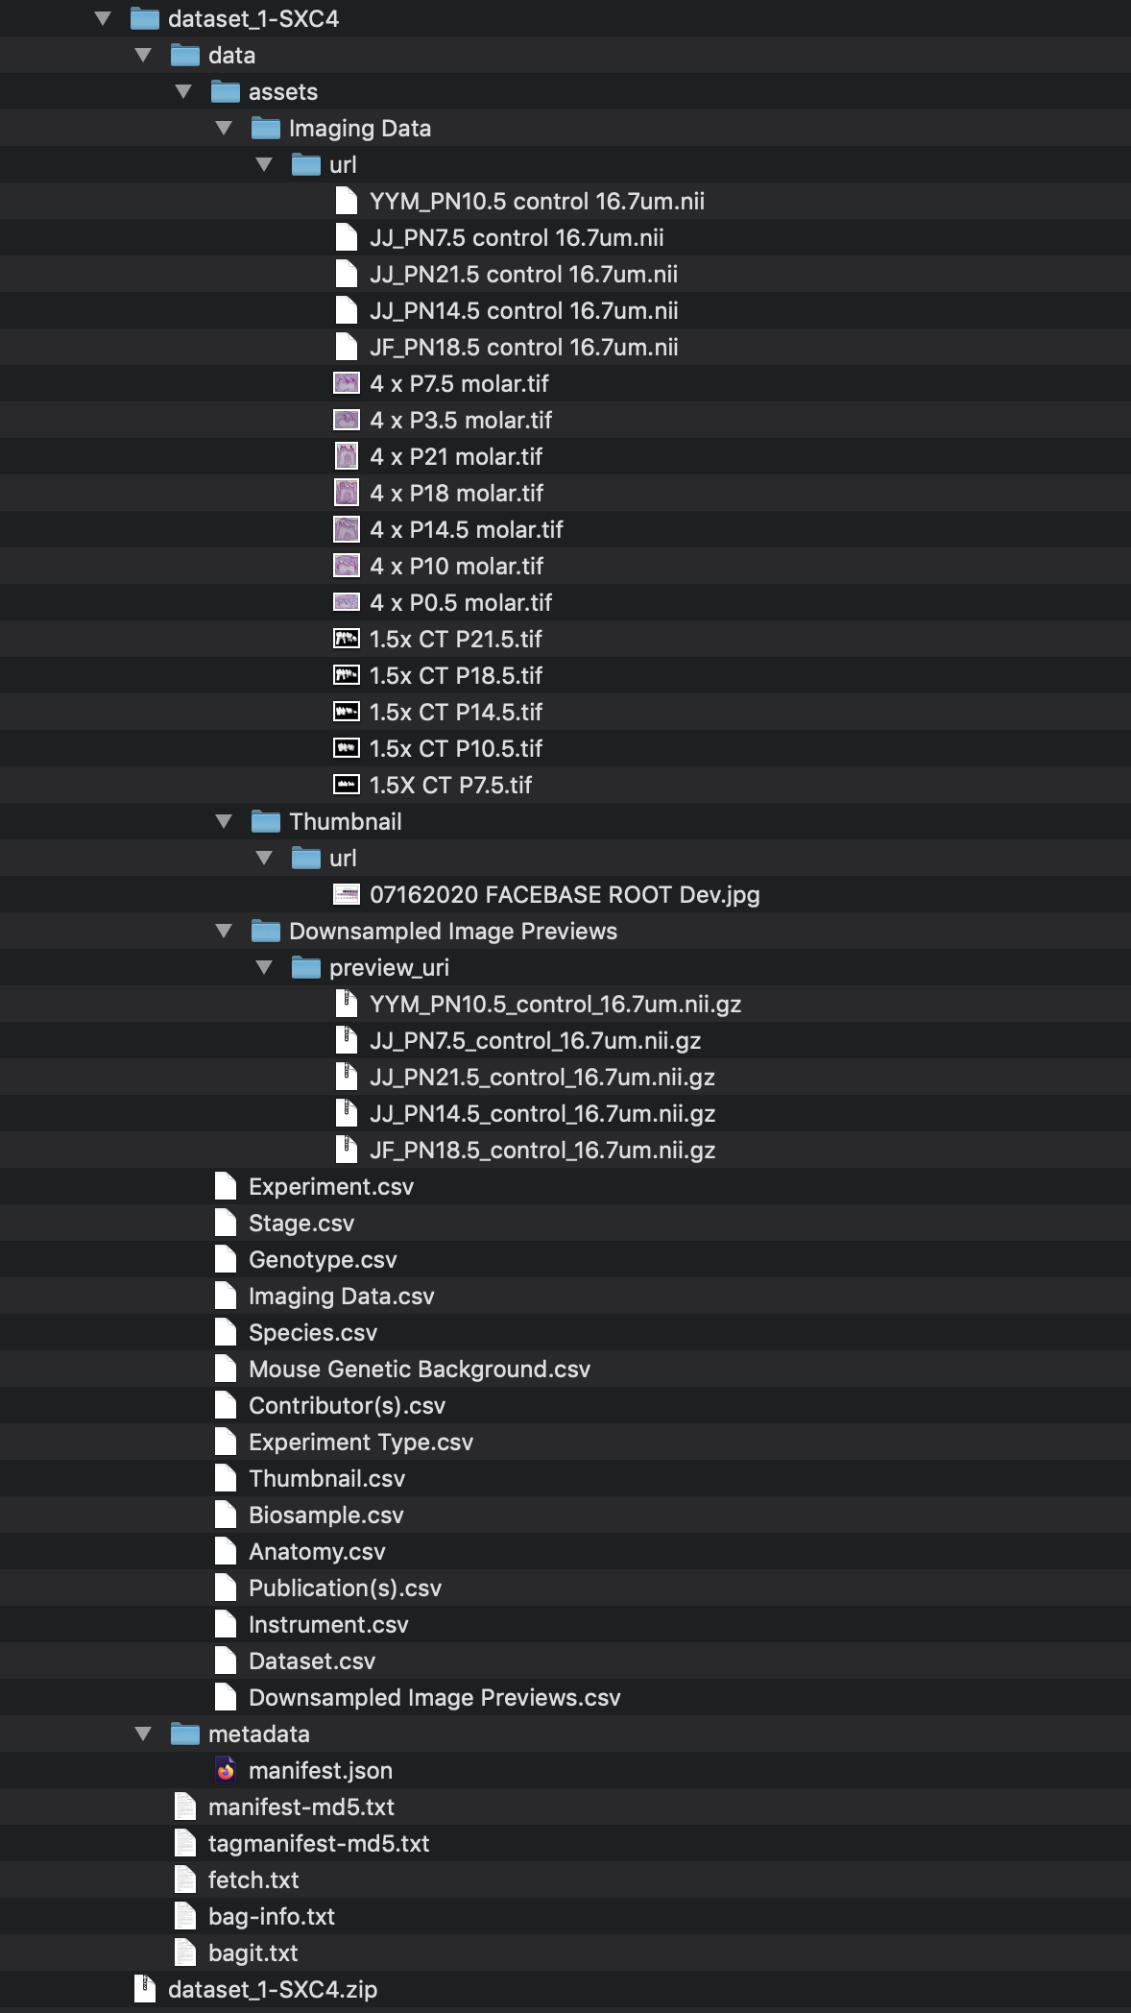
BDBag Export
What is a BDBag?
  BDBag (Big Data Bag) is a standard for reliable sharing of data collections by transferring of a "bag" of digital content
    A BDBag consists of a hierarchical directory containing all data and metadata
    Provides verification that you have all the files you were trying to export AND that they were not corrupted in the process.
  In FaceBase we use them to export in bulk all files from a Dataset (or Experiment, etc).
Materialized BDBag
Downloaded BDBag file

Slide 6
Streamlined Process for Data Submission
Start
Notification
N
Human?
Released?
Submit Form
Review Form
?
Y
?
N
Setup Project
Submit (Meta)Data
Quality Control
?
Y
Released
Accepted?
Y
N
IRB Certification
Process
Timeline (approximate)
T0: Form submitted
T+2 weeks: Review decision
T+3 weeks: Project setup
T+5 weeks: Submit data*
T+6 weeks: QC review
* Based on user averages
IRB Certification Process
Individual level data classified as human subjects
Requires USC certification of your IRB decision
Tracks are not considered restricted data
Timeline Varies
User Activity
Hub Activity

Slide 7
Data Submission Resources
Starting point
  https://www.facebase.org/submit/submitting-data/
FaceBase data curation Wiki
  https://github.com/informatics-isi-edu/facebase-curation/wiki
  Detailed step-by-step documentation
Feel like need a tutorial?
  Contact the Hub (help@facebase.org) to setup a 1-hour walk-through conference call

Slide 8
Requesting Human-Subject Protected Data
Main Flow:
  Fill in Data Access Request (DAR) and submit required documentation
    Documentation depends on Data Use Limitations of requested dataset
  Once the request is approved by the FaceBase Data Access Committee (DAC), we package and encrypt the data
  Direct the requested to download the dataset(s)
Current process is being revised and a new streamlined procedure will be in production within a few weeks.

Slide 9
END

