Slide 1
Contributing to FaceBase
2023 FaceBase Bootcamp
Notes:
Orig: April 27, 2022

Slide 2
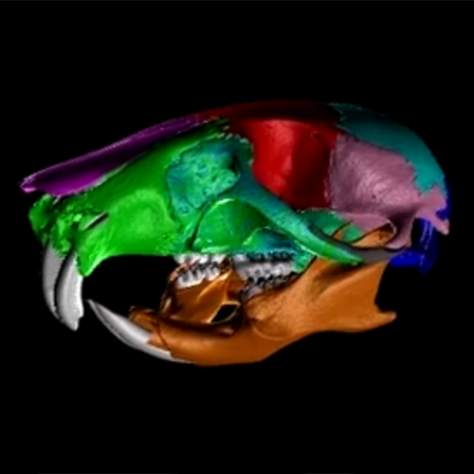
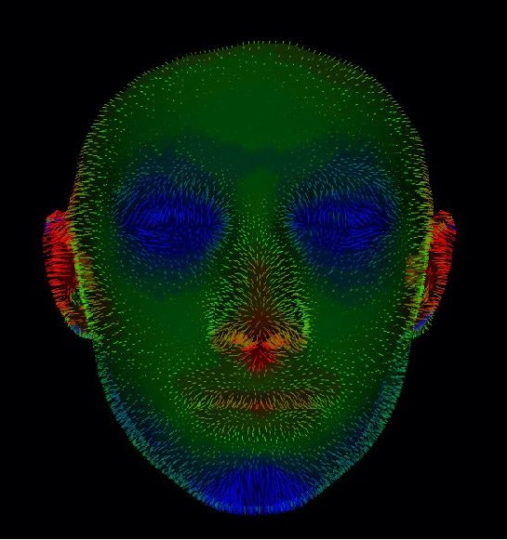
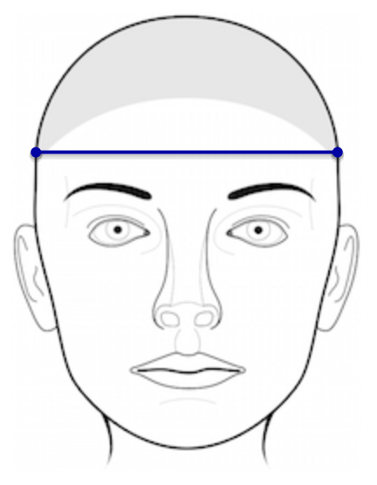
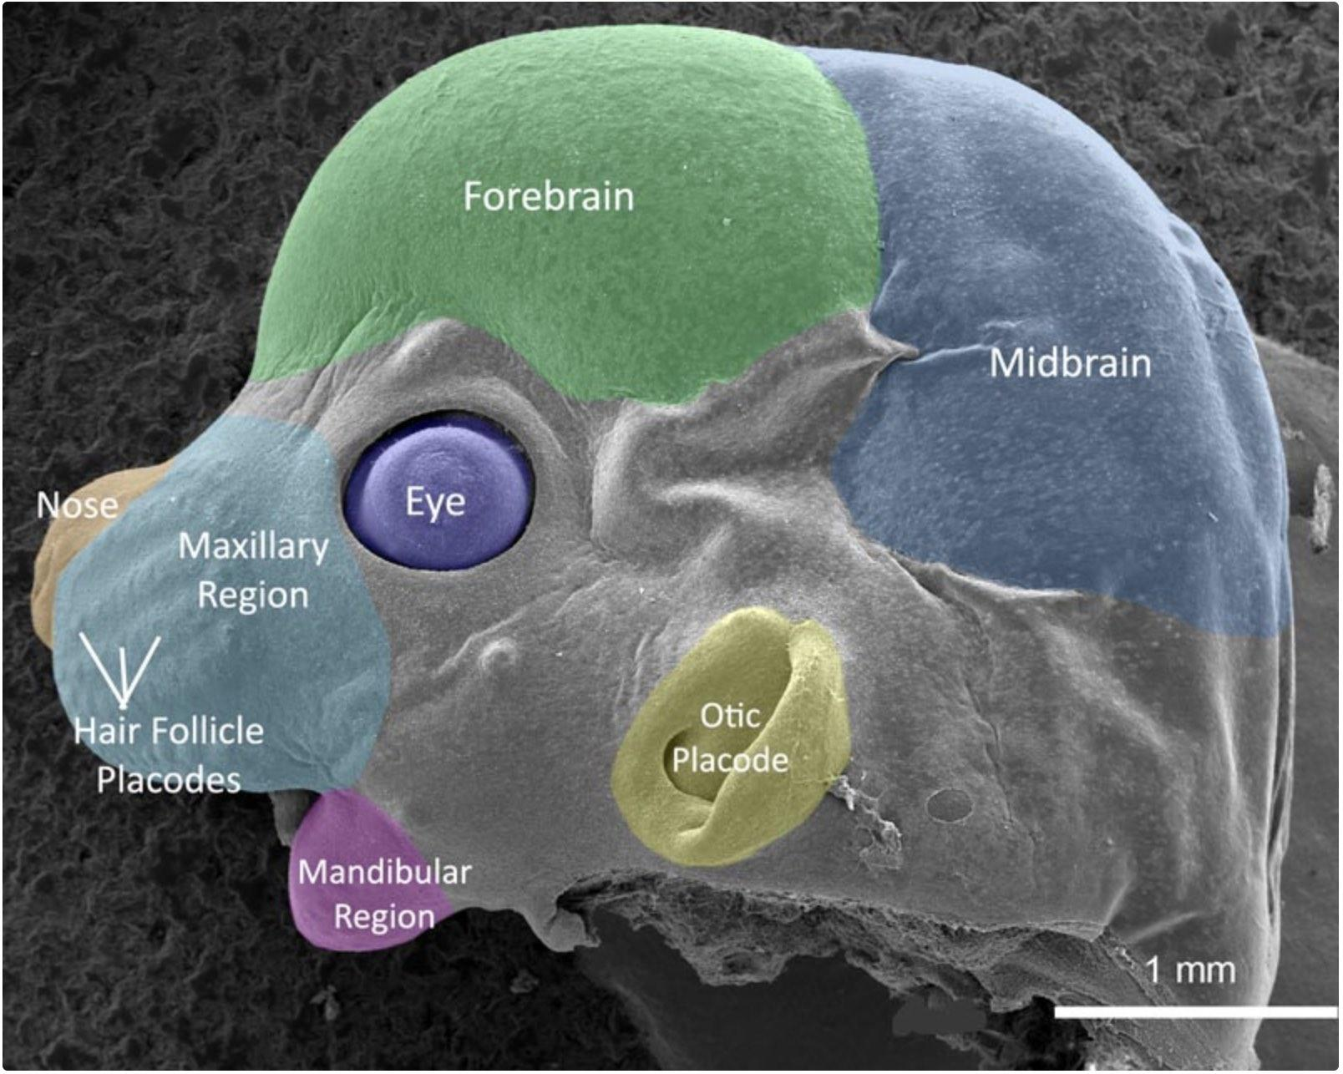
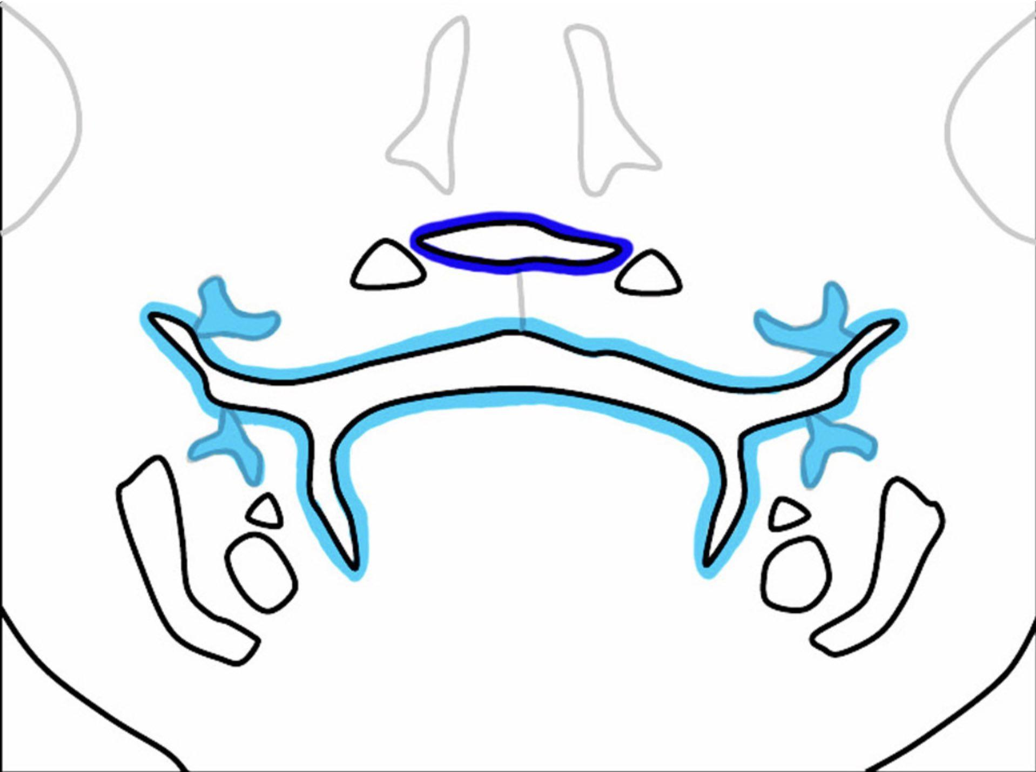


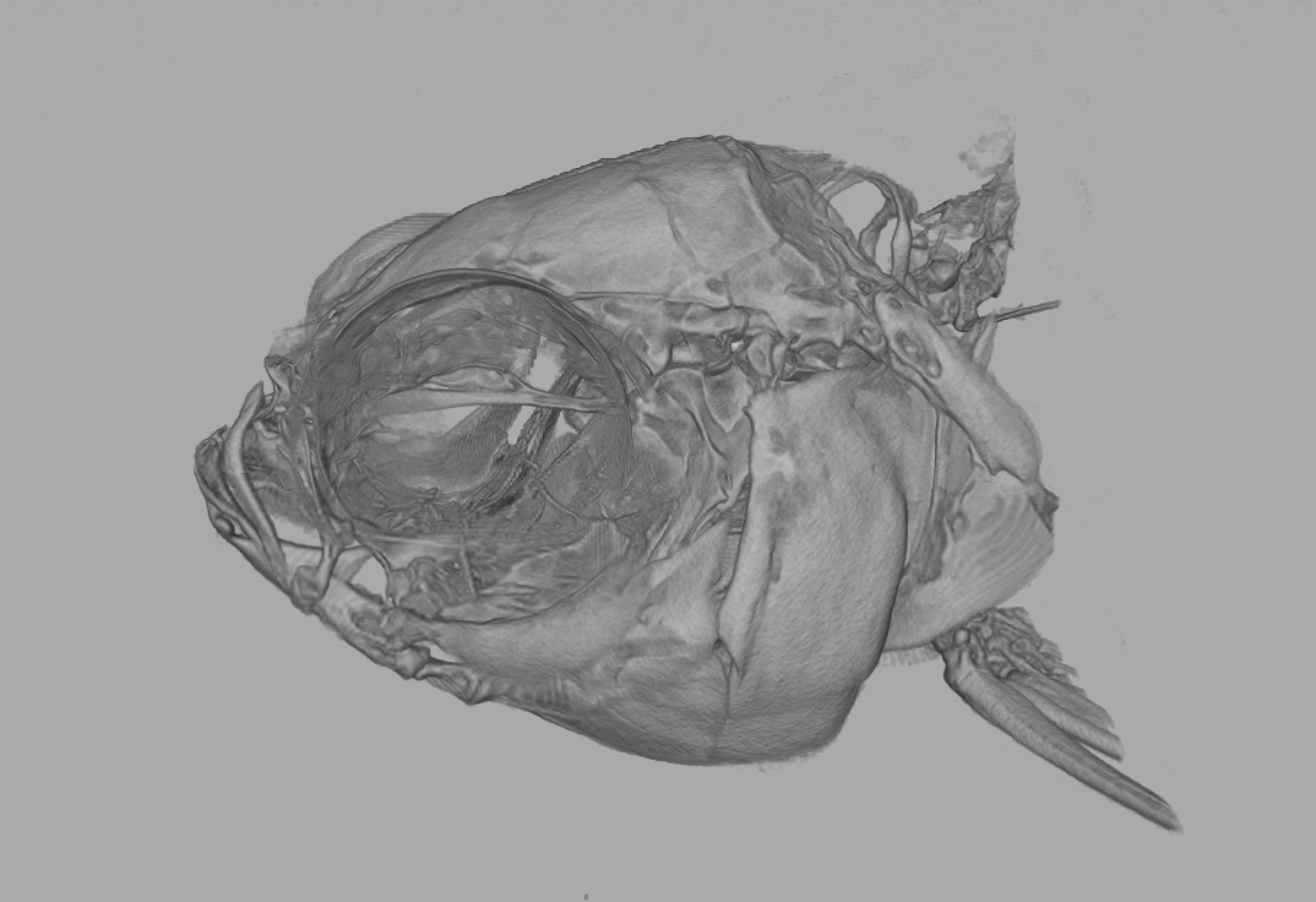
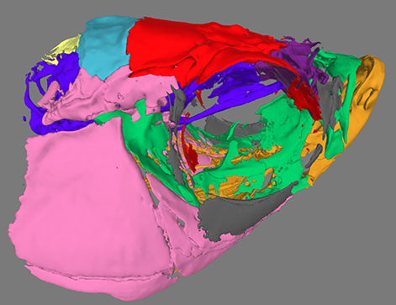
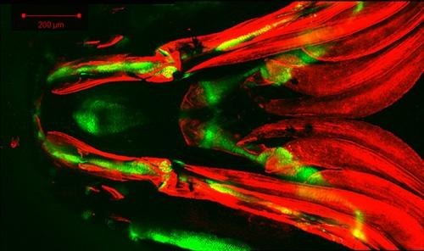
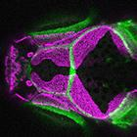
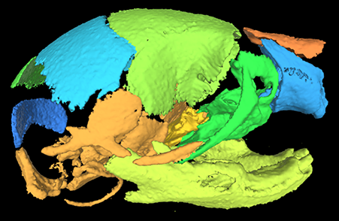
A Great Home for Your Data...
Broad collection of data
  Animal models and human subjects
  Imaging, omics, and other experiment types
Commonality: Craniofacial + Dental + Development + Dysmorphology
Your data are “first class” research products
Satisfy data sharing requirements
Skull Fly-through
Facial Scans and Facial Norms
Mouse Anatomy
Cell Lineage
Imaging Data
Sequencing Data and Genome Browser
See Website for Data Priorities
Fish Face
Surface Models
Microscopy Data

Slide 3
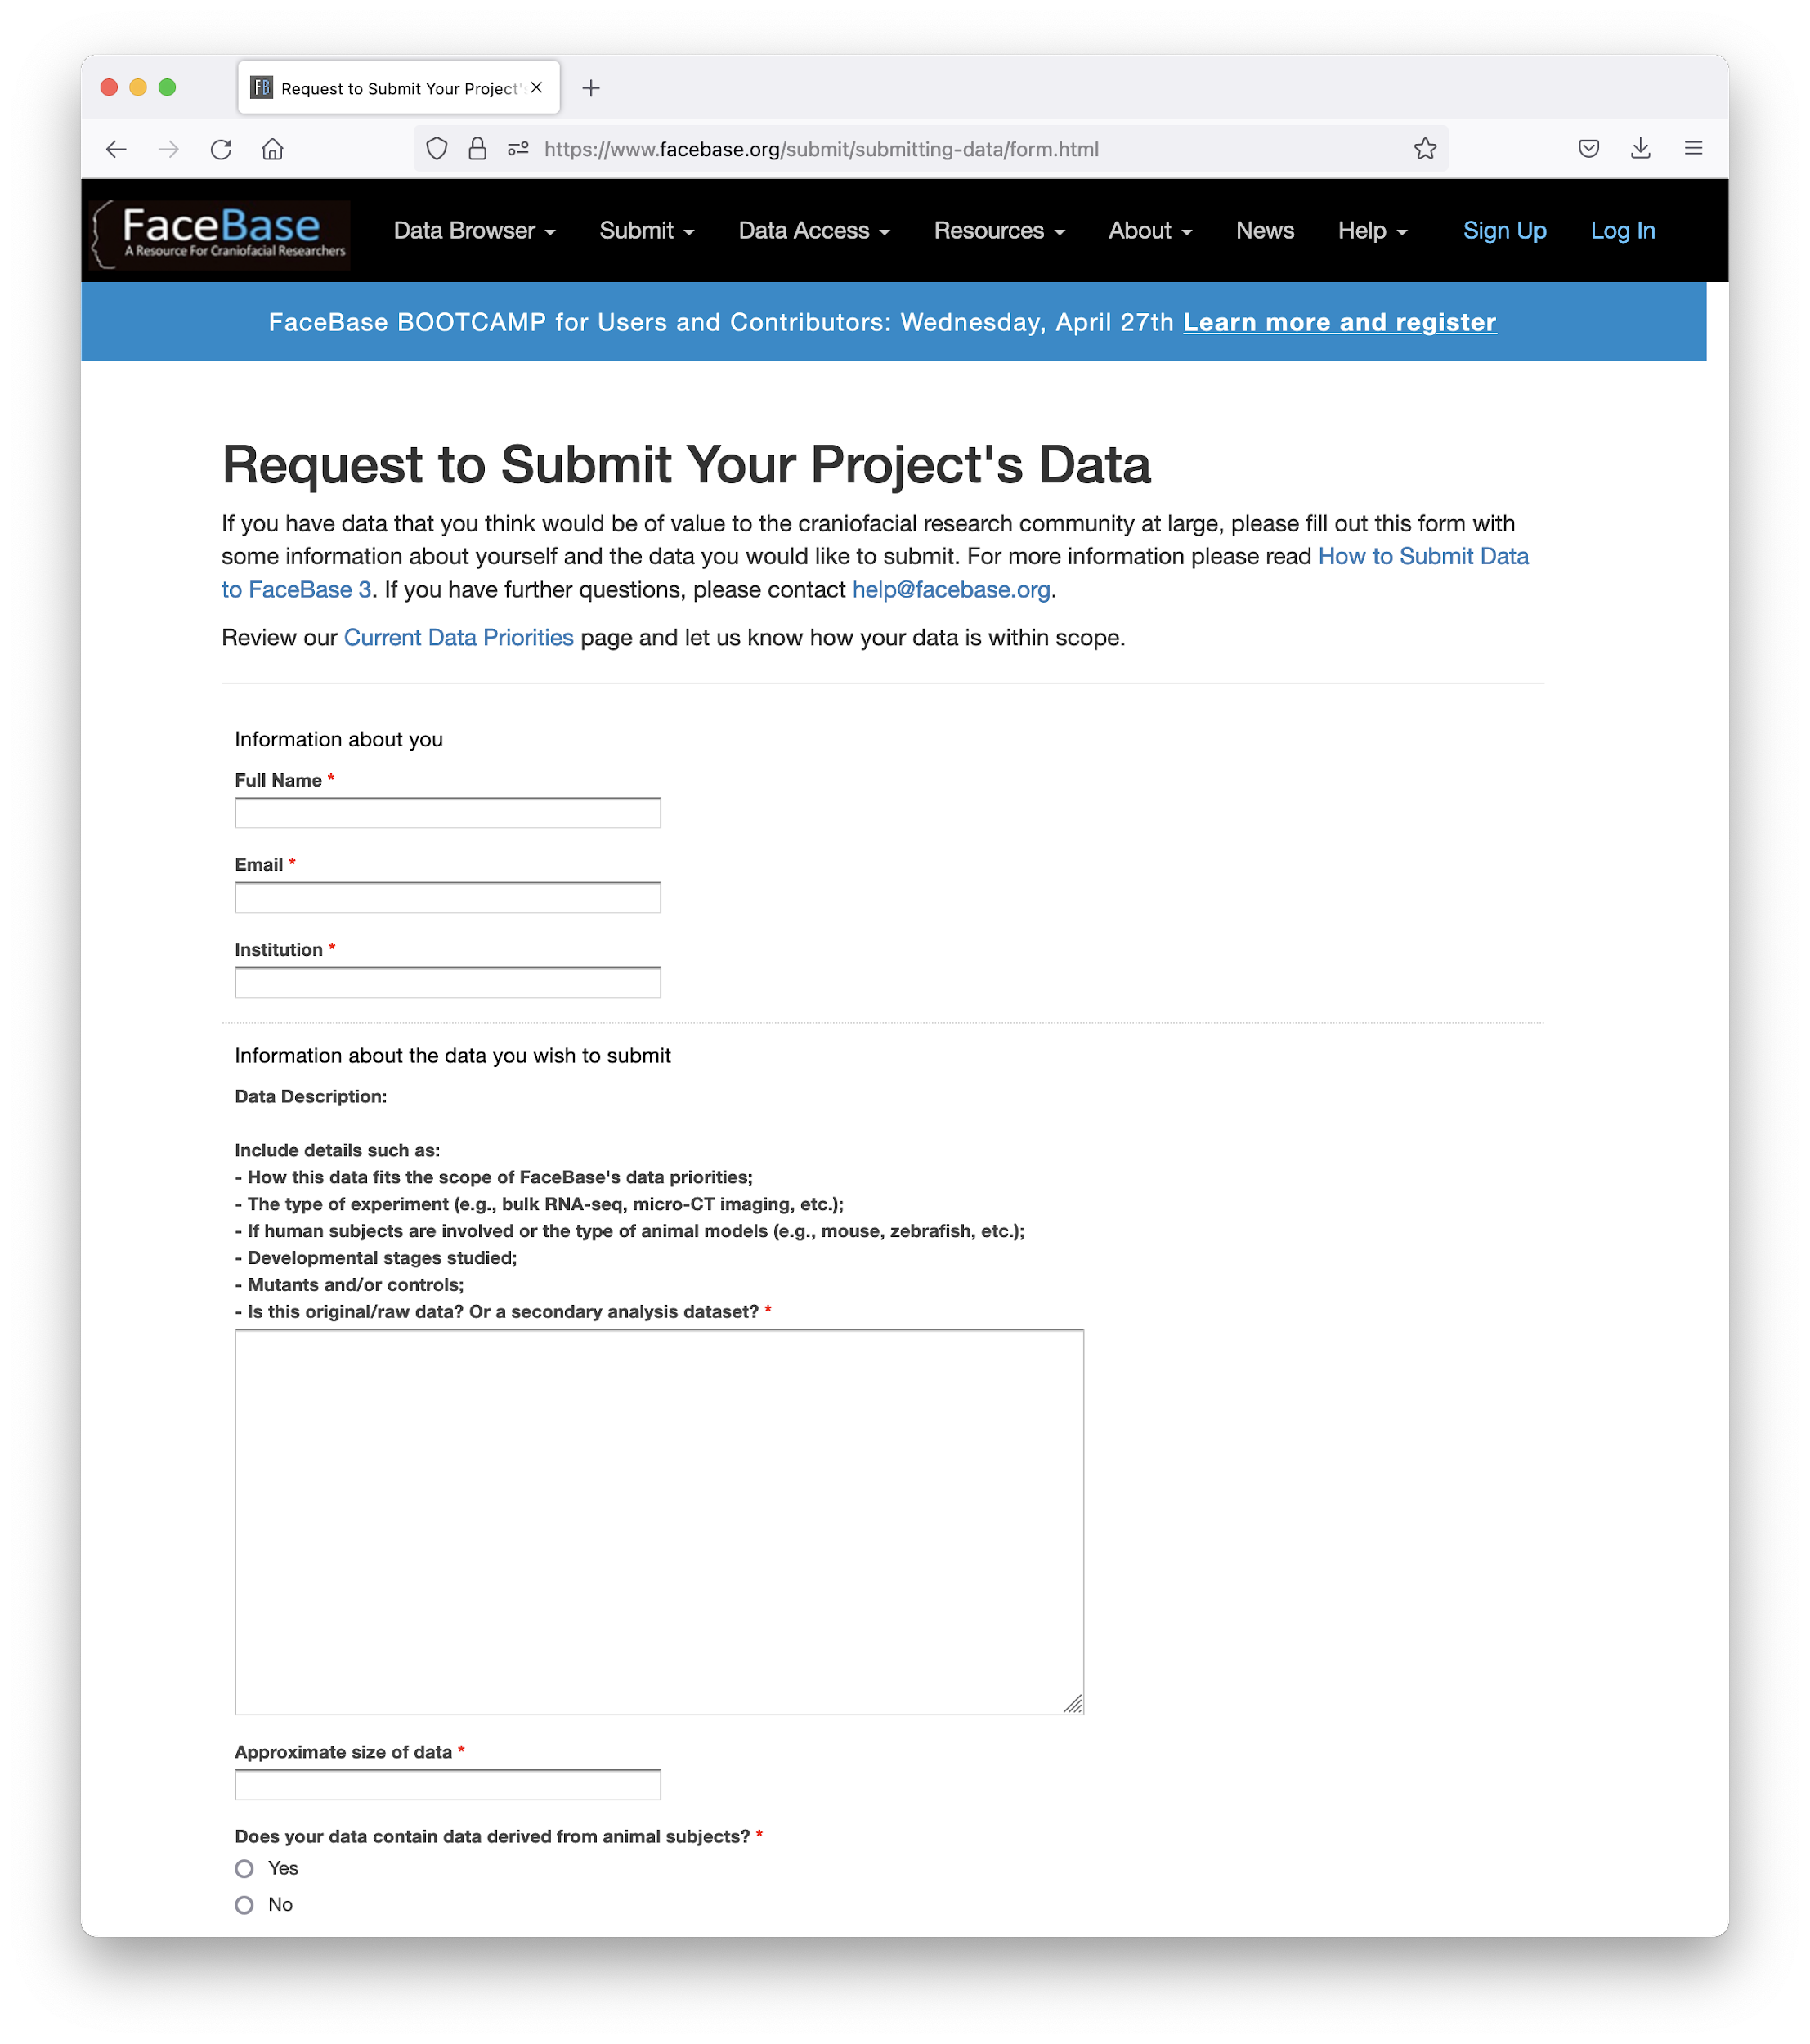
Initiate a Data Submission to FaceBase
www.facebase.org / Contribute
Brief Overview of Your Data
Review by FB Steering Committee
Response in approx. 2 weeks

Slide 4
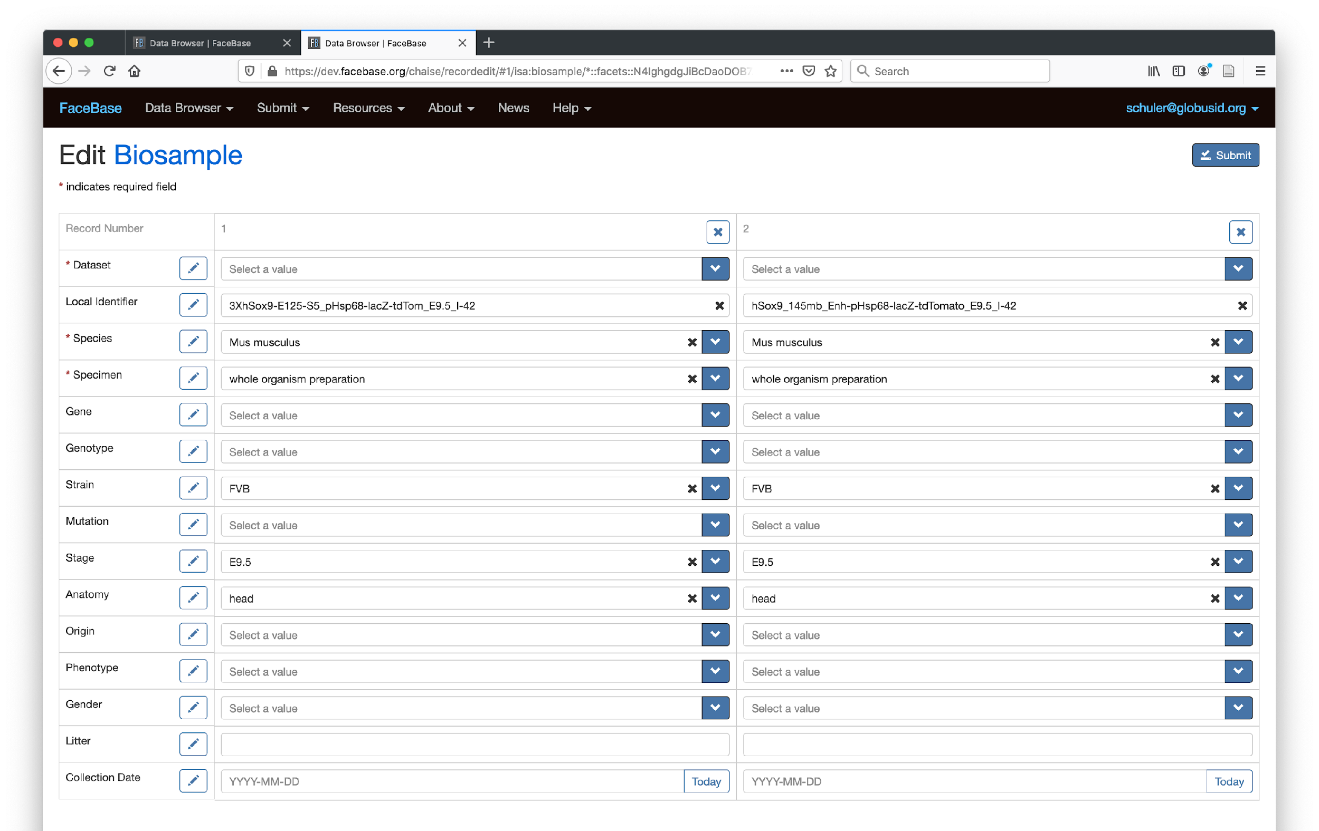


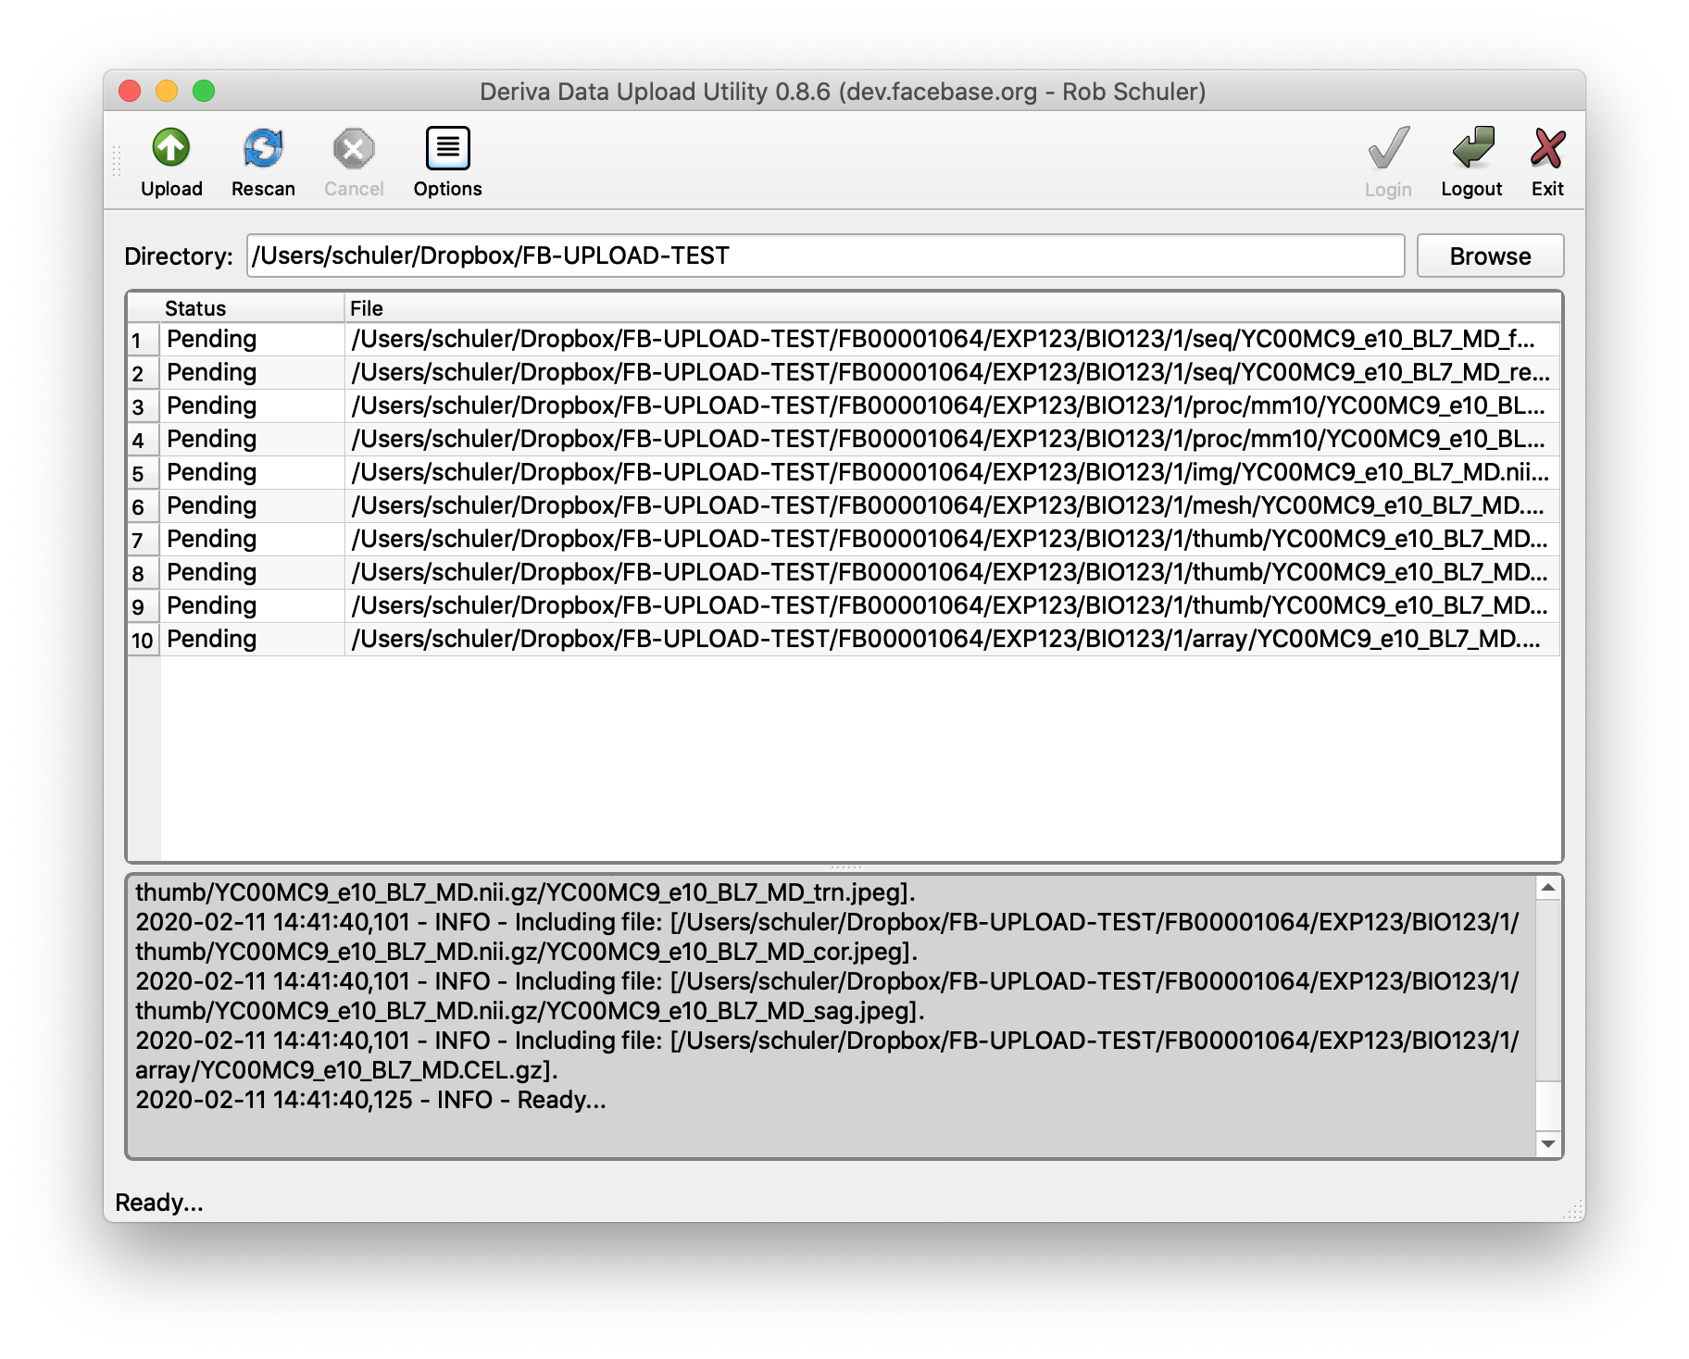


Self-Serve Data Submission w/ Support
Optional Embargo to Sync w/ Publication?
Almost Done!
ONLINE FORMS
Tutorial
Describe Experiments & Biosamples
Upload Data Files
Quality Control Review
Cite Datasets
Release
[Embargo?]
UPLOAD APP
ZOOM.us
Preparing Manuscripts? Include Data Citation
Notes:
Q: Streamline data submission process

Slide 5
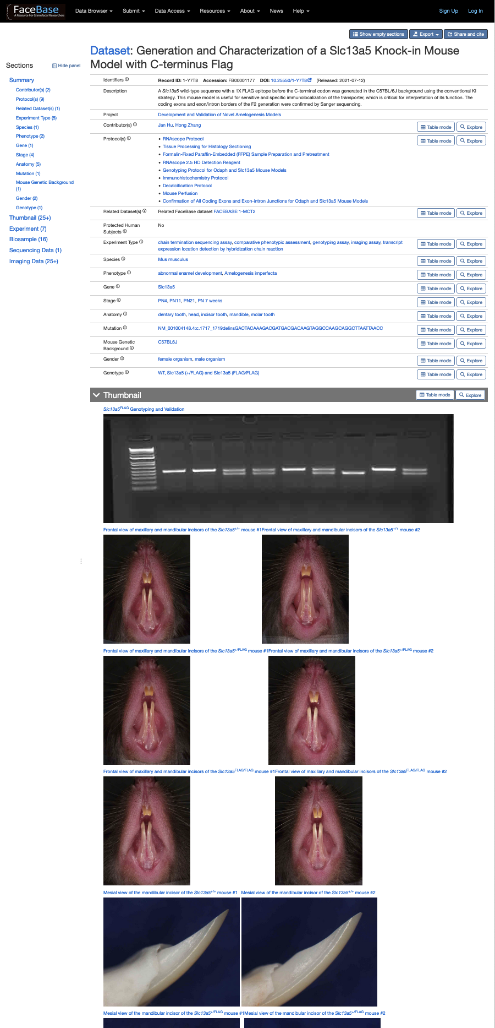
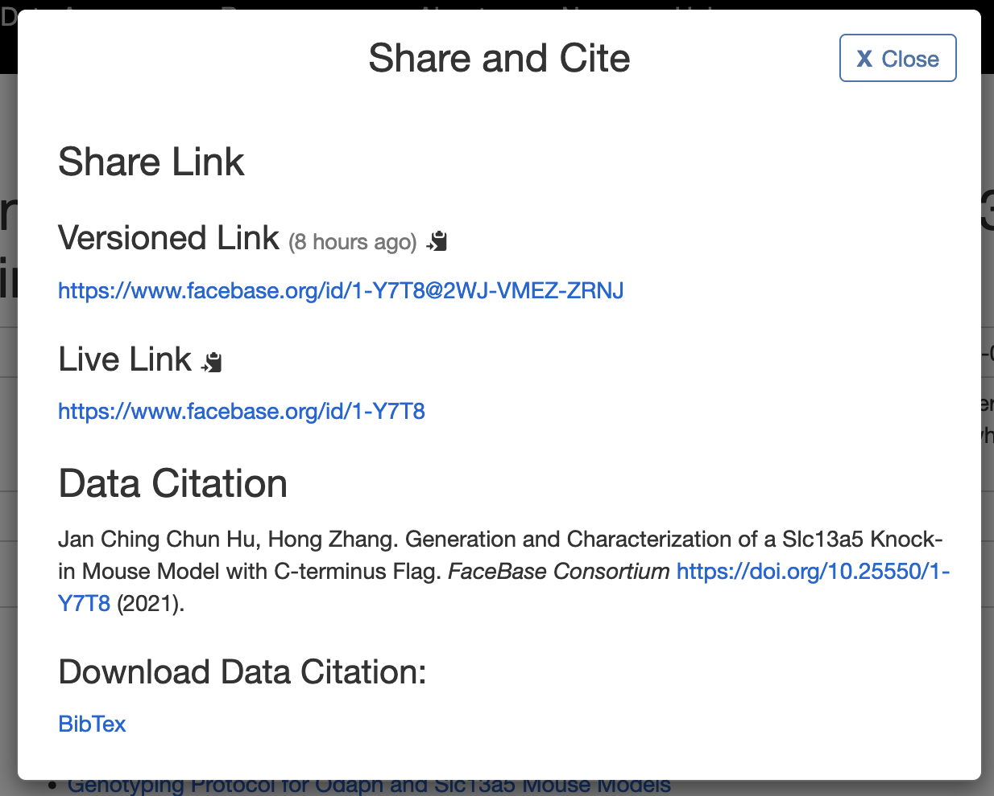
Citing Datasets In Publications
Citable Data IDs:
Globally-unique
Persistent
Actionable
Versioned
Publishable
Plan when manuscript is in preparation
Optionally, embargo dataset to be released in sync with publication
Notes:
Q: Publication/citation, conflicts with later publications

Slide 6
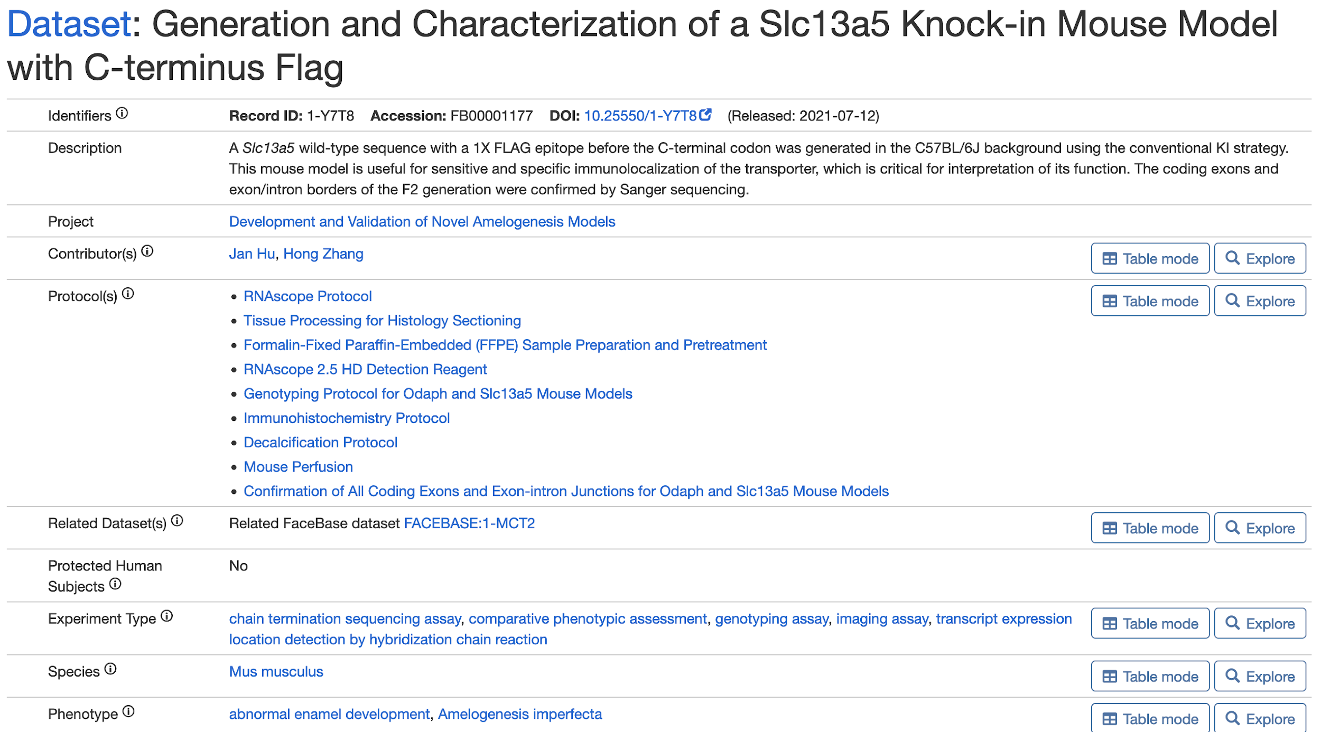
Review of Dataset Display
Digital Object Identifiers
Attribution
Cross-Reference
(GEO, dbGaP, FB, other)
Standardized Terminology
Additional Details
Notes:
Q: Cross-reference data submitted to another site/repository/database

Slide 7
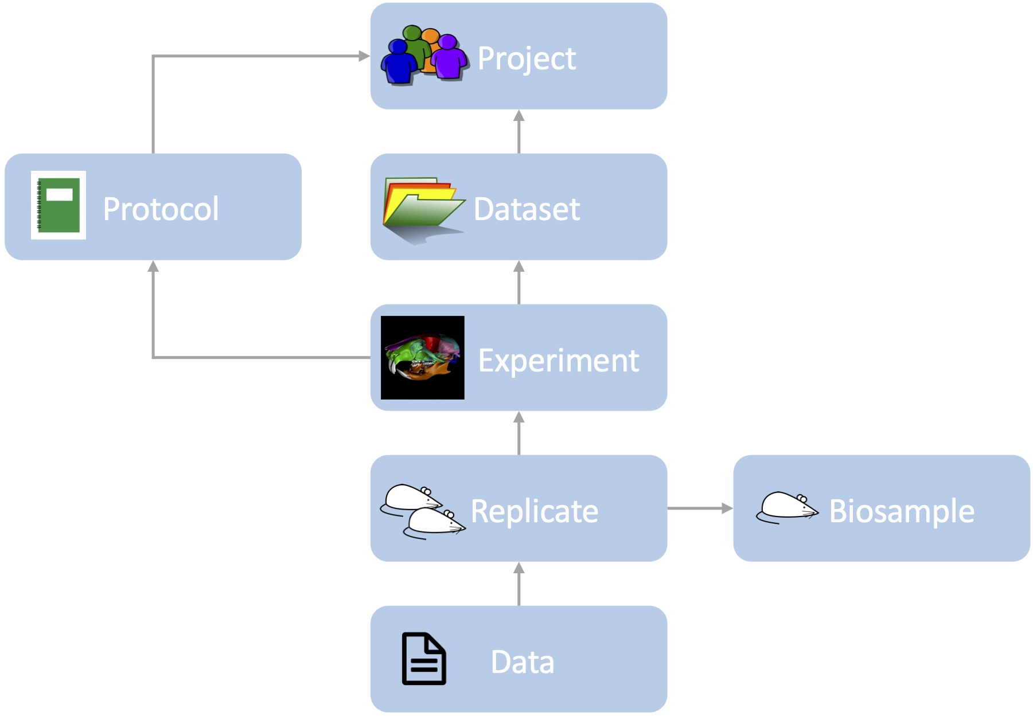
Ready for Reuse, Reproducibility, (Re)analysis
Represents the group contributing data, funding, and team members
Describe or reference protocol(s)
Collection of data and metadata
Specifies assay type, protocol used, instruments, etc for each experiment.
Provides details about the tissue: species, genotype, age stage, anatomy, etc.
Collects data output: imaging, microscopy, sequencing and others…
Based on “FAIR data” principles, for increased scientific utility
Notes:
Q: Sharing PPT in a dataset

Slide 8
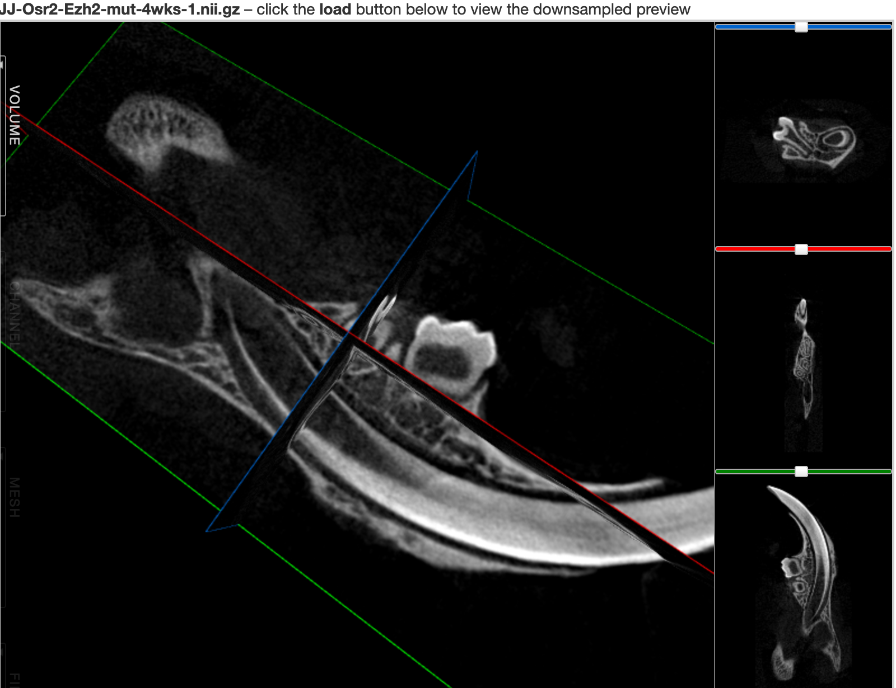
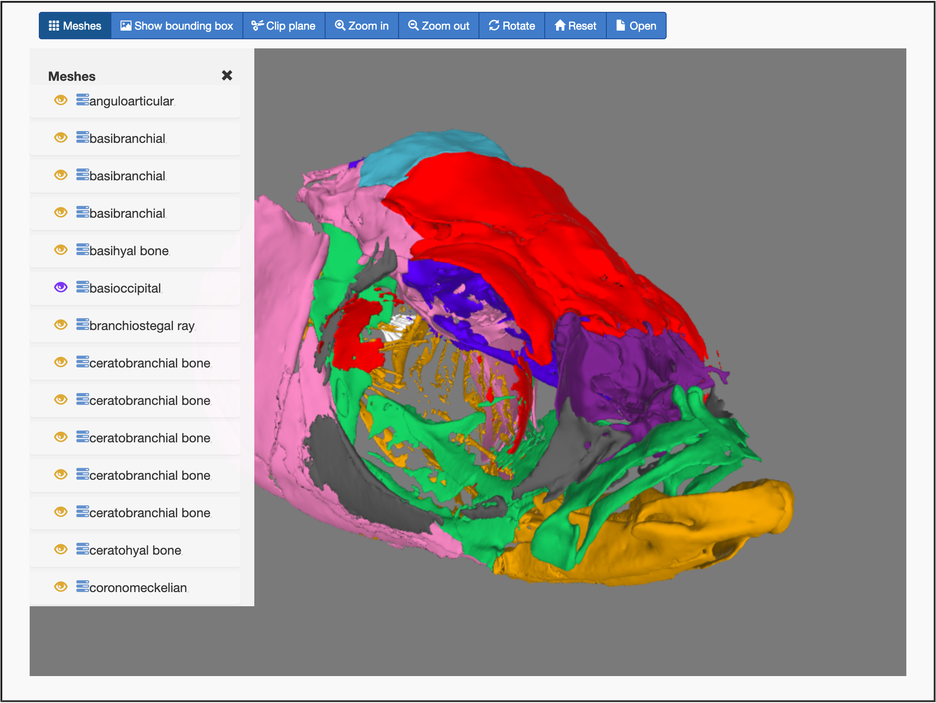
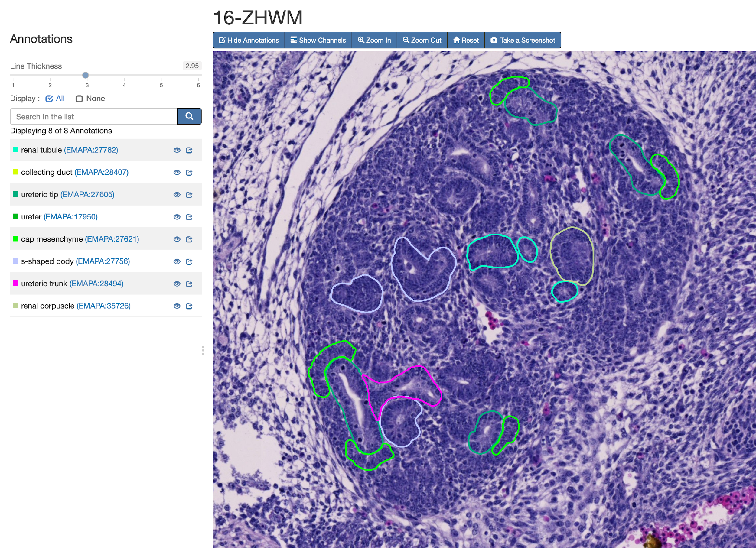
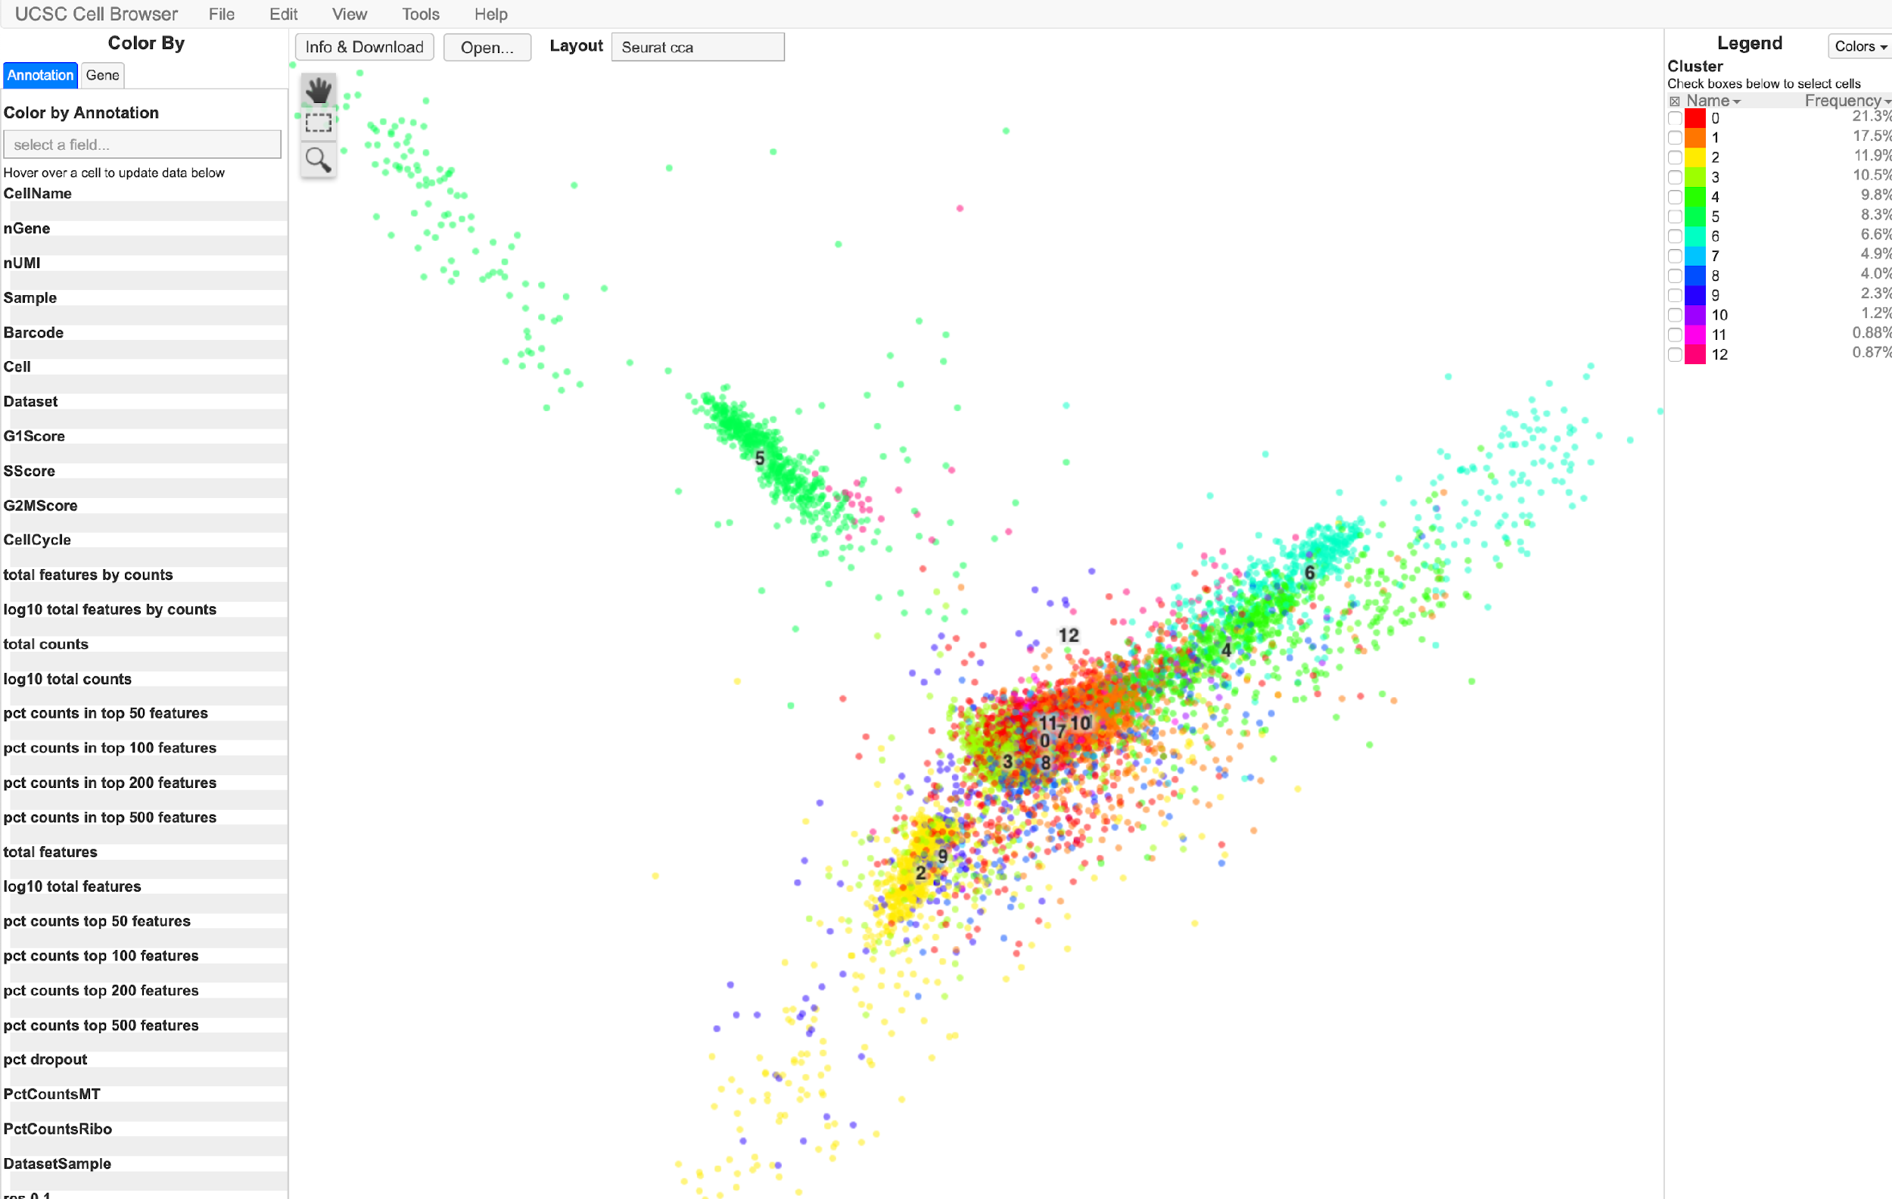
Consider Exploiting Visualization Capabilities
Orthogonal Slice
Viewer
Surface Models
High-resolution Microscopy Images with Annotations
UCSC Single Cell Browser
(Genome Browser, not shown)
Thumbnail Gallery
Notes:
Q: Easier thumbnail submission

Slide 9
Strategies for Successful Data Contributions
Review the metadata/data guidelines early in the process of preparing manuscripts;
Take the 1-hour tutorial with us before you begin creating your first dataset in FaceBase;
Submit (part of) 1 dataset, let us review and give you feedback, then proceed with further data submissions;
Remember: We are here to help! ☺
Point of Contact: Alejandro Bugacov (help@facebase.org)
Notes:
Q: Point of contact

