Slide 1
FaceBase Bootcamp
Sept. 28th 2023
Alejandro Bugacov
University of Southern California, Information Sciences Institute

Slide 2
Requesting Human Subjects Data

Slide 3
Why requesting Human-Subject Data from FaceBase?
FaceBase has a large and diverse collection of human-subject controlled access data
Diverse in cohort population, syndromes and data types
  Examples:
    About 4000 facial scans from a Tanzania population (https://doi.org/10.25550/TX4)
    About 1000 facial scans of North American Children (https://doi.org/10.25550/TK0)
    About 100 facial scan of Phelan-McDermid Syndrome (https://doi.org/10.25550/1A-BWJ8)
    RNA-seq, ChIP-seq and ATAC-seq analysis of human fetal tissue (https://doi.org/10.25550/3C-4G62)
    Oral health study of northern Appalachian households (https://doi.org/10.25550/2Q-M86G)
    Whole exome sequencing assay of female with Robin sequence, microglossia, microstomia structure of the oropharynx (https://doi.org/10.25550/1-415T)
Access to this data is controlled and cannot be made publicly available like all the model organism data that we have in FaceBase
To access this data users need to submit a Data Access Request (DAR)

Slide 4
Requesting FaceBase Controlled Access Data
(https://docs.facebase.org/docs/human-data)
1
2
DAC approves DAR
3
Submit DAR
Gather institutional documentation
Complete Data Access Request (DAR) form
NIDCR Data Access Committee (DAC) reviews submission
User downloads data
Valid for 1 year

Slide 5
Completing the Data Access Request (DAR) form
(https://docs.facebase.org/docs/dar)
Complete the Data Use Certificate Agreement (DUC)
  https://www.facebase.org/policies/data-use-certification
  Requires institutional signatures: Information Technology (IT) Director, Principal Investigator and Institutional Signing Official.
Login as FaceBase user (create new account if don’t have one)
Go to https://docs.facebase.org/docs/dar and create new DAR
  Complete fields 1 to 14 of the DAR form
  If IRB required upload copy of IRB letter and Approved IRB Protocol
  Upload DUC document
  Save the form
Select list of requested datasets
Upload public encryption key file

Slide 6
Demo: Sharing your data through FaceBase

Slide 7
From Submission Request to a New Dataset
Request to Submit data
  https://www.facebase.org/submit/submitting-data/form.html
Once Approved you’ll receive email with link to join the authentication group (Globus) to access your new Project page
New Project is not public by default so you need to Login first to see it
Find your new Project
Navigate to Datasets and click “+ Add Record”
Step-by-step documentation:
  https://docs.facebase.org/docs/Data-Submission-Key-Concepts

Slide 8
Structure of Demo Dataset
2 Mouse samples of root of molar tooth
1 PN14.5 Mutant sample Lhx6-/-
1 PN14.5 Control sample
2 Different experiments on these samples
  Fluorescence microscopy images of both Mutant and Control
  Single-cell RNA-seq of the Mutant samples only

Slide 9
Installing DERIVA Client Tools
Suite of reliable tools for batch uploading and downloading data
GUI and command line tool for Mac, Windows and Linux
Detailed documentation:
  https://github.com/informatics-isi-edu/facebase-curation/wiki/Deriva-Clients
  Mac and Windows:
    Download bundle from
      https://github.com/informatics-isi-edu/deriva-client-bundle/releases
  Linux:
    Use pip install:
      pip3 install --user deriva-client

Slide 10
Data Submission Resources
Starting point
  https://www.facebase.org/submit/submitting-data/
FaceBase data curation Wiki
  https://github.com/informatics-isi-edu/facebase-curation/wiki
  Detailed step-by-step documentation
Material for self-directed tutorial can be found at:
  Email help to be added to the Demo group to do the self-directed tutorial
Need a tutorial?
  Contact the Hub (help@facebase.org) to setup a 1-hour walk-through conference call
Need help while working on your datasets?
  Email us at help@facebase.org !!!
  FaceBase Monthly Office Hours: Last Wednesday of the Month

Slide 11
Installing DERIVA Client Tools
Suite of reliable tools for batch uploading and downloading data
GUI and command line tool for Mac, Windows and Linux
Detailed documentation:
  https://github.com/informatics-isi-edu/facebase-curation/wiki/Deriva-Clients
  Mac and Windows:
    Download bundle from
      https://github.com/informatics-isi-edu/deriva-client-bundle/releases
  Linux:
    Use pip install:
      pip3 install --user deriva-client

Slide 12
Data Submission Resources
Starting point
  https://www.facebase.org/submit/submitting-data/
FaceBase data curation Wiki
  https://github.com/informatics-isi-edu/facebase-curation/wiki
  Detailed step-by-step documentation
Material for self-directed tutorial can be found at:
  Email help to be added to the Demo group to do the self-directed tutorial
Need a tutorial?
  Contact the Hub (help@facebase.org) to setup a 1-hour walk-through conference call
Need help while working on your datasets?
  Email us at help@facebase.org !!!
  FaceBase Monthly Office Hours: Last Wednesday of the Month

Slide 13
Data processing pipelines and visualization
Name | Data Types | Action | Type/Frequency
Imaging pipeline (https://www.facebase.org/id/3KW6) | Image file in large number of imaging formats from single image in PNG, JPG or TIFF to multichannel 3D and 4D stacks | Pipeline creates thumbnails and visualization viewer with annotations. Contributor can manually tag anatomical terms from UBERON, text, regions, etc | Automatic/Daily
Genome Browser (https://doi.org/10.25550/1-7780 ) | bigWig and bigBed files | FaceBase embeds a UCSC Genome Browser visualization of all the uploaded tracks in the Dataset page | Automatic/Daily
Cellbrowser pipeline (https://www.facebase.org/id/V-J7QP , https://www.facebase.org/id/R-W170) | Seurat (v3 and v4) and Cell Ranger matrix files (matrix.mtx, features.tsv and barcodes.tsv) | FaceBase embeds a UCSC Cellbrowser visualization of each uploaded file at the Data File page | Automatic/Triggered by file upload
3D Mesh viewer (https://www.facebase.org/id/1-517M) | 3D meshes in OBJ format | FaceBase shows a 3D visualization of the created model. Multi mesh, can tag anatomical terms from UBERON | Manual model creation, Automatic visualization
3D Volumetric viewer (https://www.facebase.org/id/TY8) | 3D files in NIfTI format | FaceBase shows a 3D volume rendering of the created model | Manual resolution reduction, Automatic visualization
DOI assignment | Each FaceBase Dataset and Project | A unique and persistent Data Object Identifier (DOI) is assigned to each Dataset and Project page | Automatic/Daily

Slide 14
Citing and Referencing your FaceBase DATA
A DOI is assign to your Dataset the moment you create it
  Don’t need to wait for Dataset to be released to the public
You can include the DOI in your manuscript right away
  Contact us at help@facebase.org for anonymous journal reviews
DOIs are assigned at each Dataset and Project level, are unique and persistent
Share Link: Automatically generated for every page
  Click “Share and Cite” (top-right corner). E.g., https://www.facebase.org/id/R-W170
Citation: Automatically generated for every Dataset and Project
  Click “Share and Cite” (top-right corner)
  This is how FaceBase would like you to Cite your data
Data Citation Example:
  Samantha Brugmann, Christian Bonatto Paese. Single cell transcriptomics of the talpid2 avian mutant mandibular prominence. FaceBase Consortium https://doi.org/10.25550/R-PPWJ (2022).

Slide 15
Exporting Data from FaceBase
Individual File Download
  Click on any (highlighted) file and the browser will prompt you to save the file to your computer
  Do not need to be logged in
Bulk Export:
  CSV
    Downloads a CSV file with all metadata from the result of a Search
    Available both at the Results and Record page
    Most useful to download results of a search in tabular form
  BDBAG
    Useful download all data from a dataset or a project
    Very robust tool
      Data validation, console showing progress and status, can be restarted from where it left off
    Need to login with FaceBase User credentials
    First Step: Download a BDBag (Big Data Bag) file to your computer
    Second Step: Use the DERIVA Bag Tool to export the all data files and metadata to your computer
      In the afternoon session we’ll see how to install this tool
Detail documentation: https://www.facebase.org/help/exporting/

Slide 16
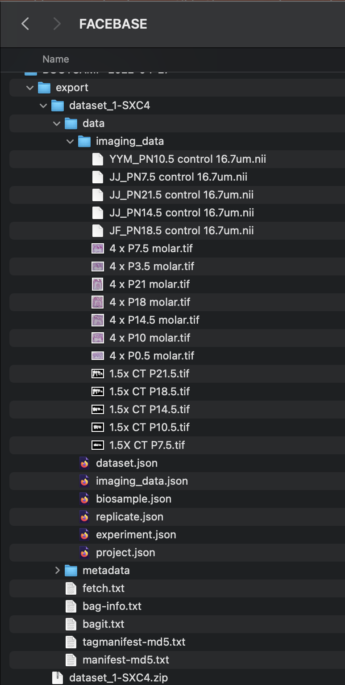
BDBag Export
BDBag (Big Data Bag) is a standard for reliable sharing of data collections by transferring of a "bag" of digital content
    A BDBag consists of a hierarchical directory containing all data and metadata
    Provides verification that you have all the files you were trying to export AND that they were not corrupted in the process.
In FaceBase we use them to export in bulk all files from a Dataset (or Experiment, etc).
Materialized BDBag
Downloaded BDBag file

