Slide 1
Searching for FaceBase Data
2023 FaceBase Bootcamp
Notes:
Orig: April 27, 2022

Slide 2
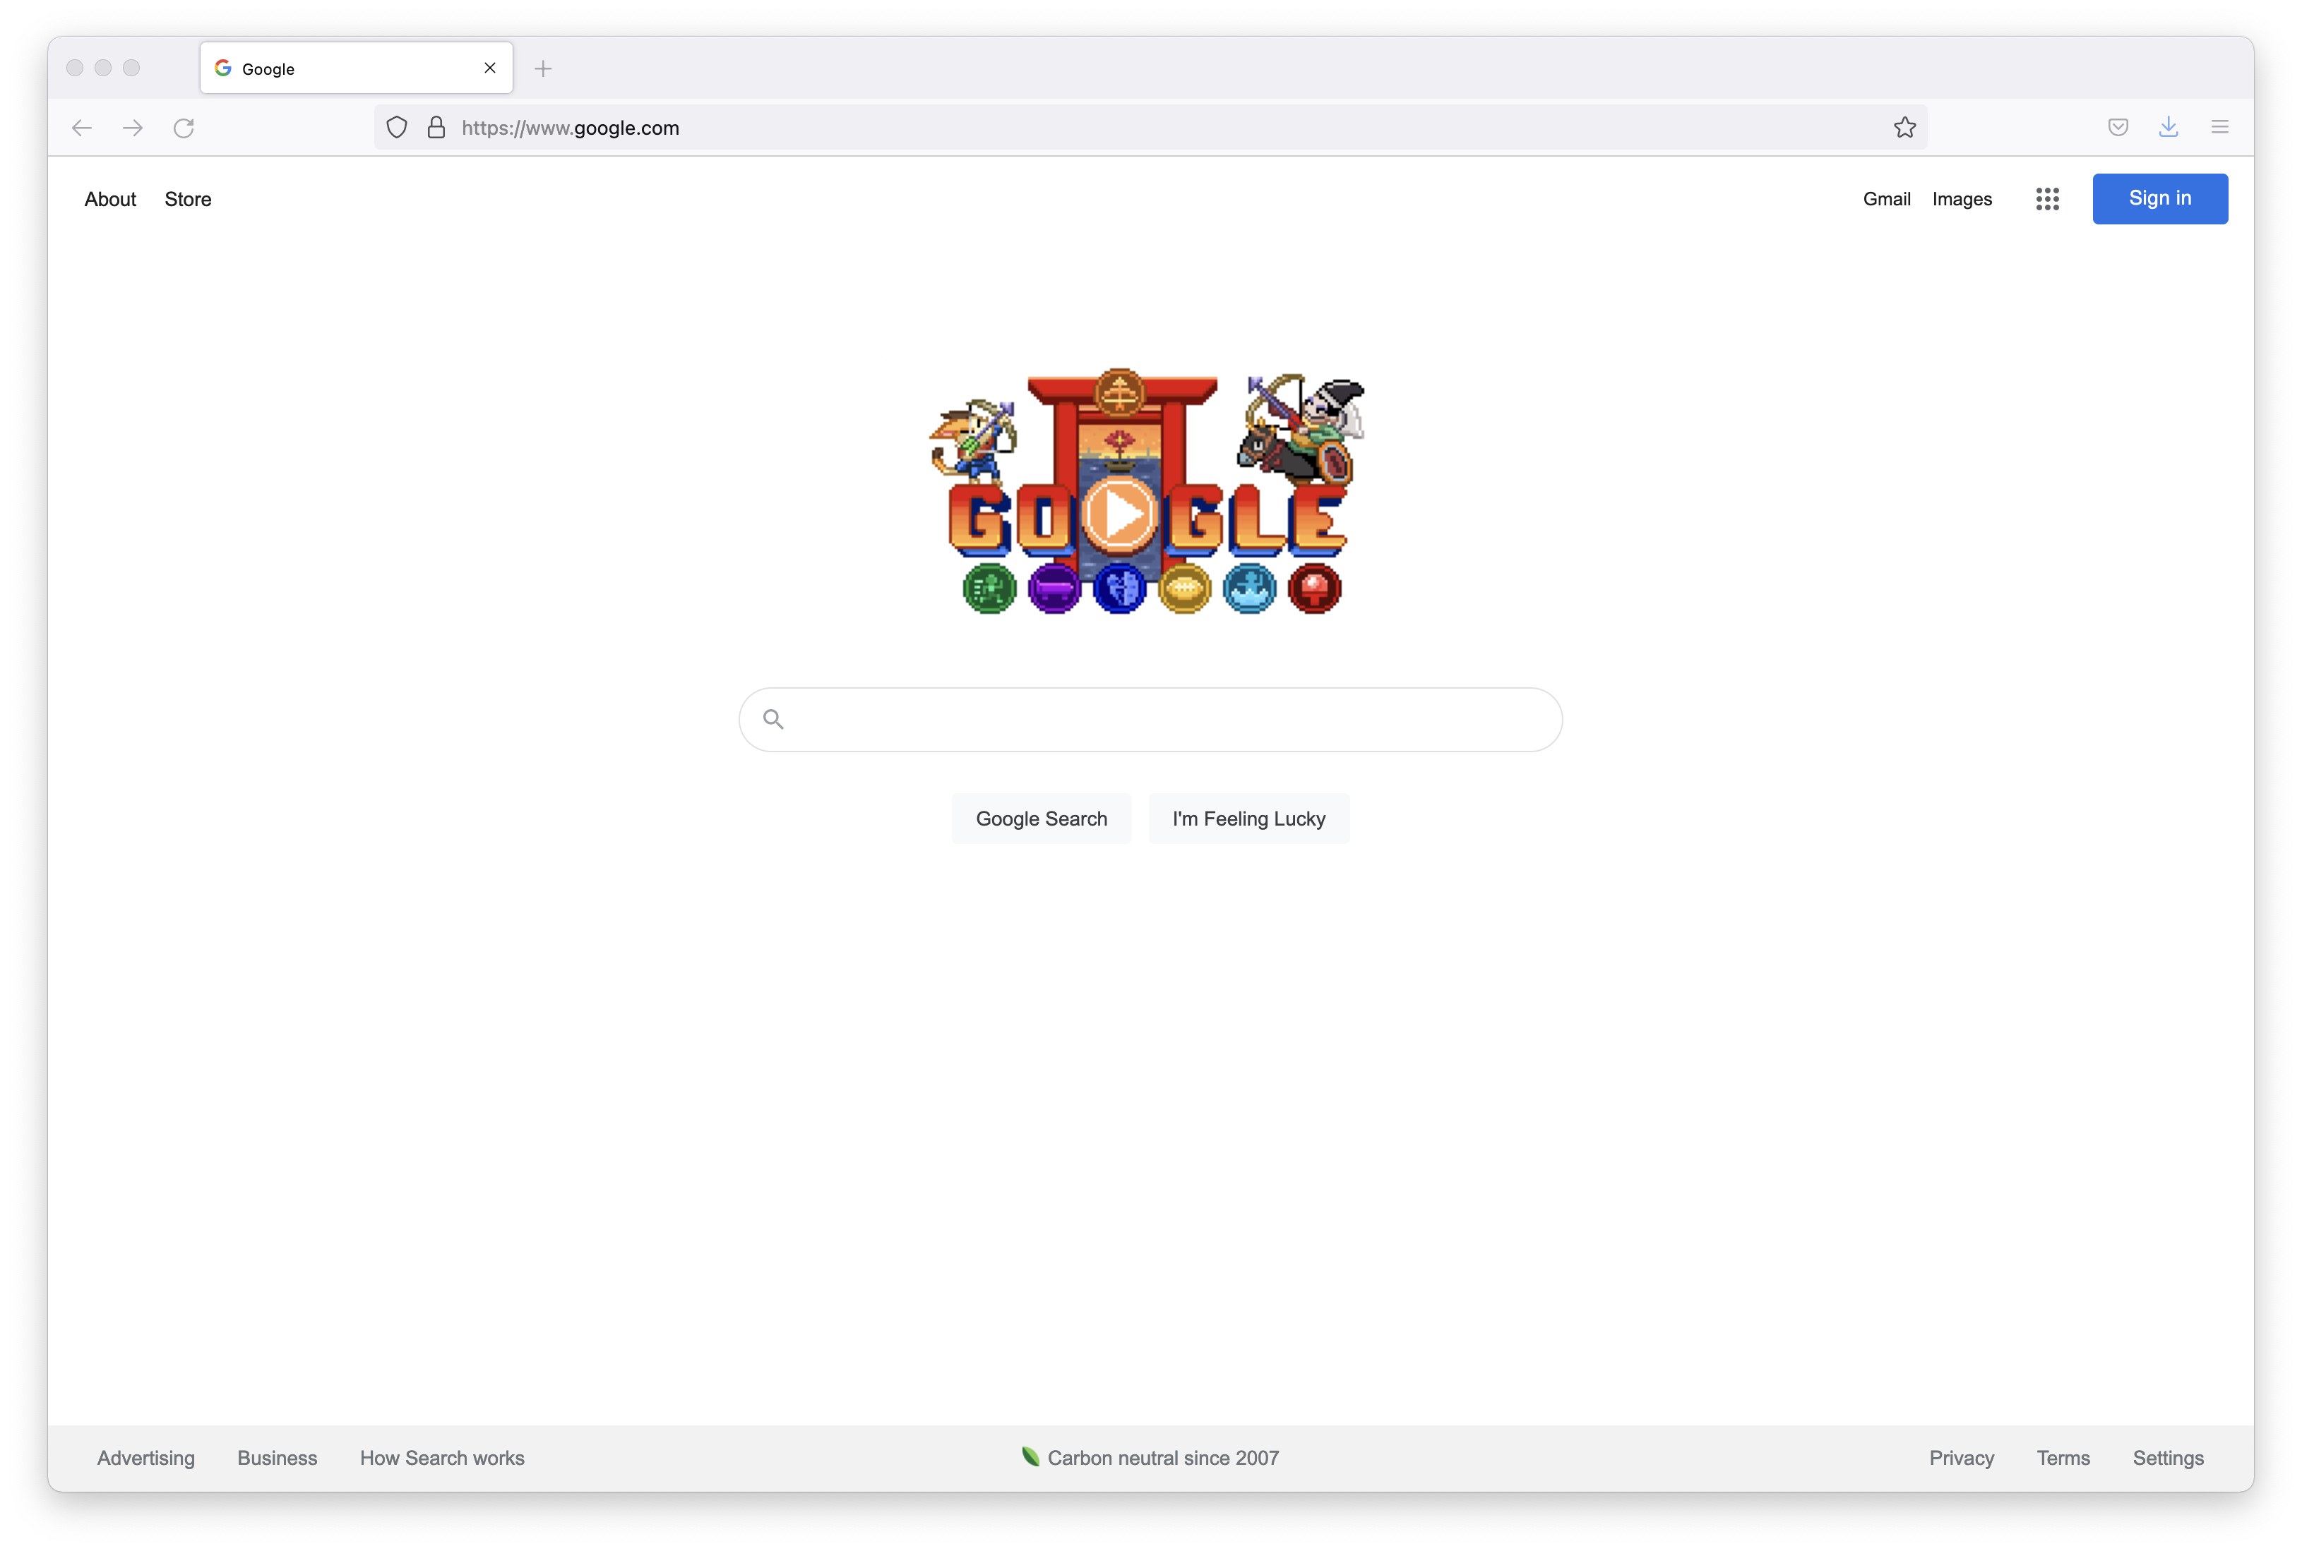
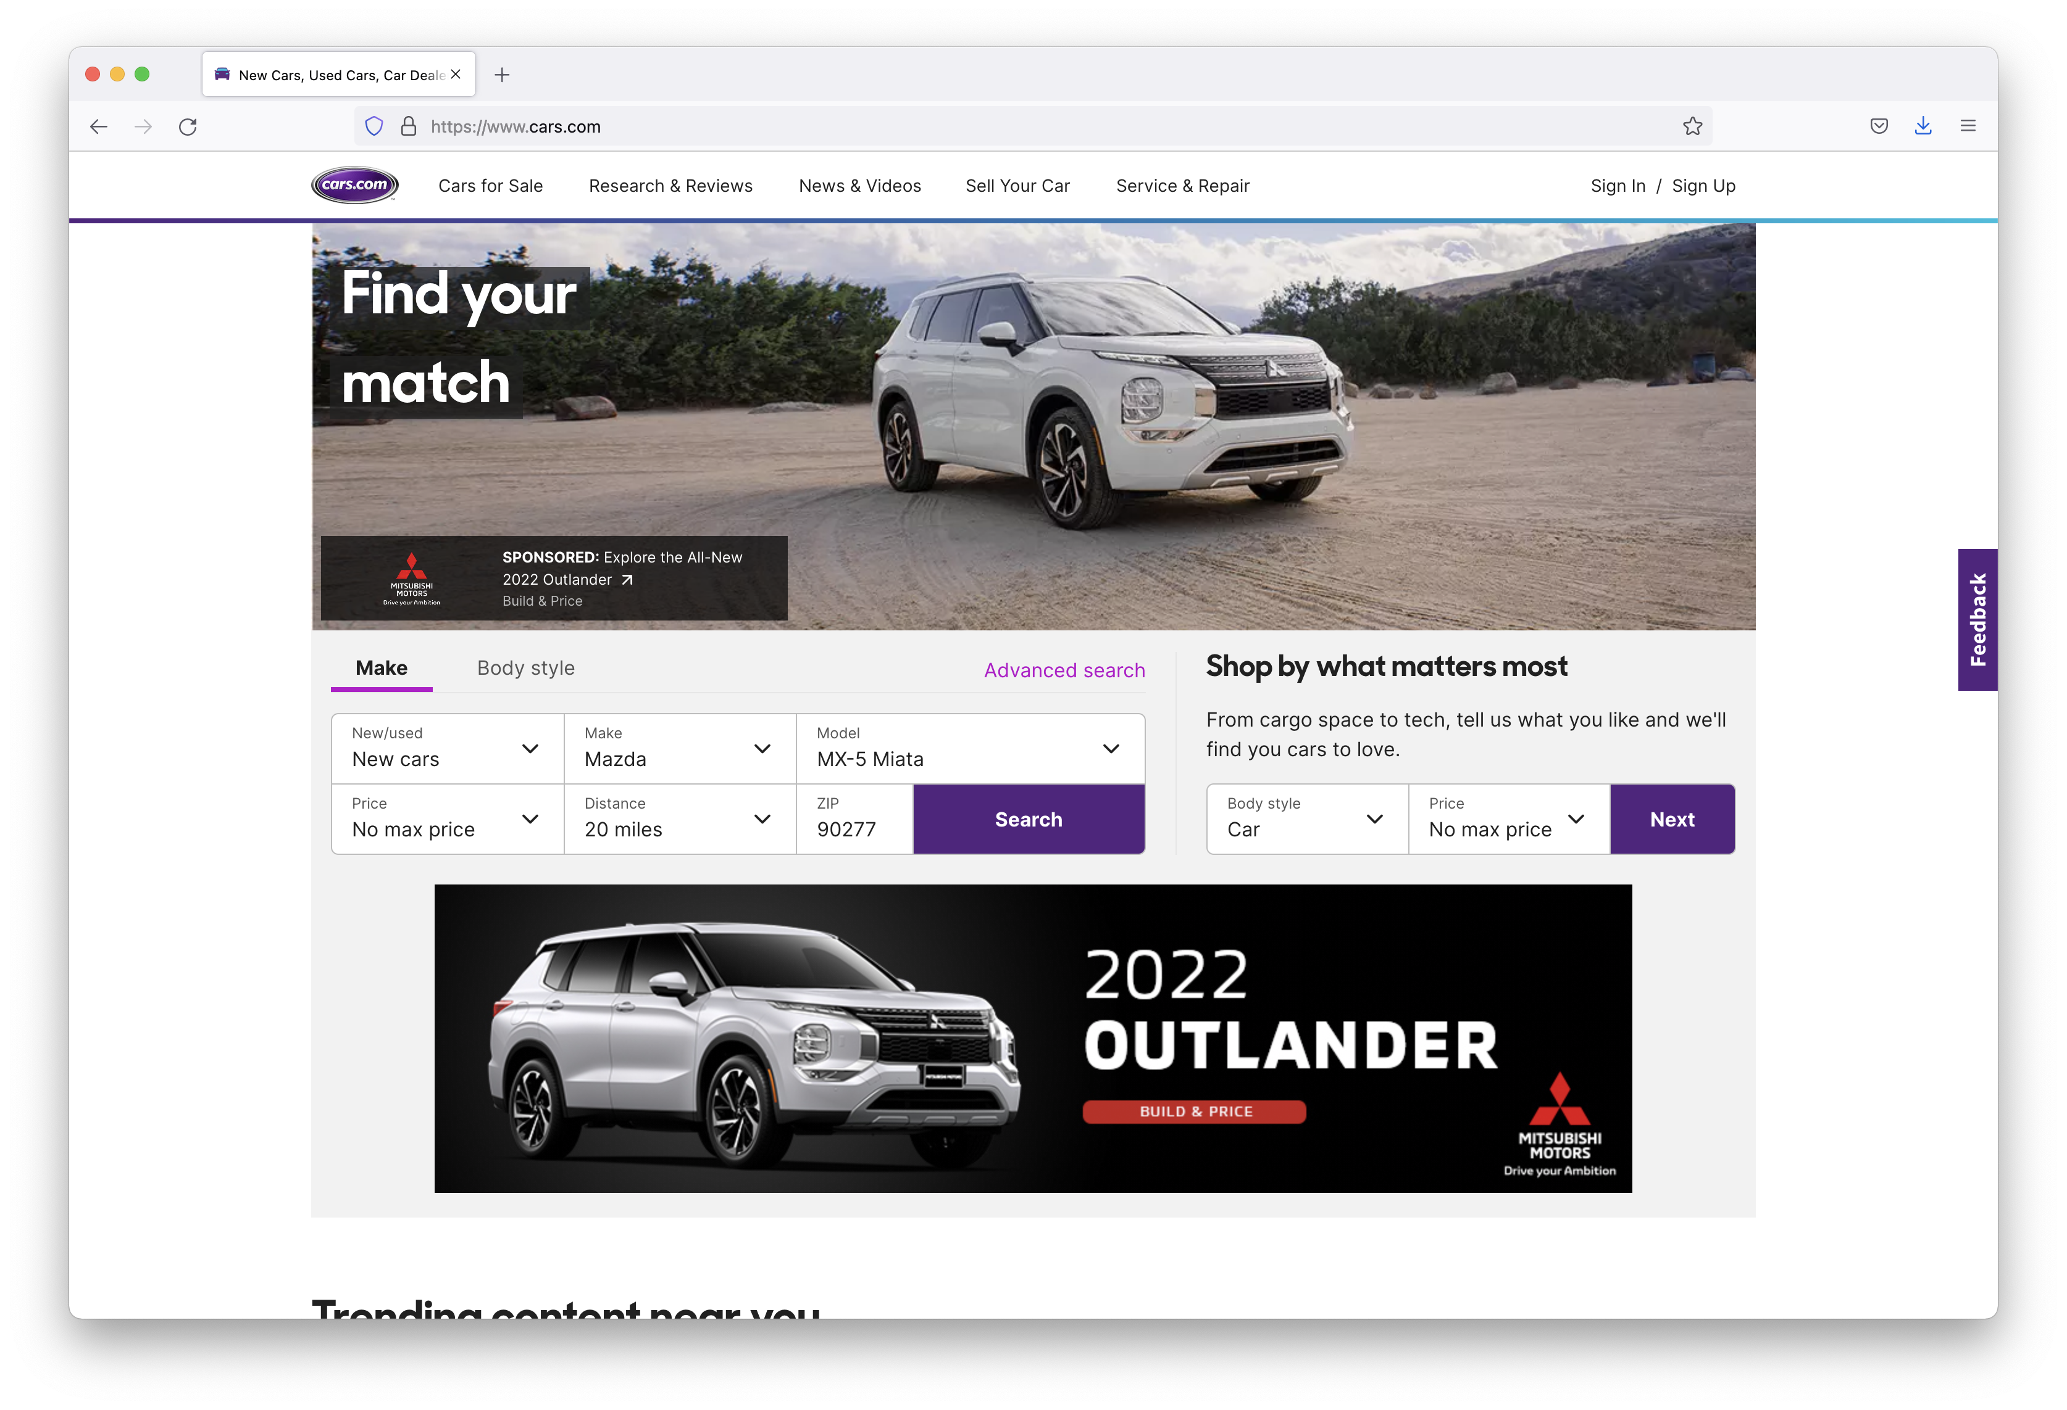
An Analogy… Shopping for a Car Online
Google vs. Cars.com?
“2018 or newer Mazda MX-5 Miata with less than 20,000 miles near 90292”
vs?
Text search works well over a collection of documents, not as well for non-text objects

Slide 3
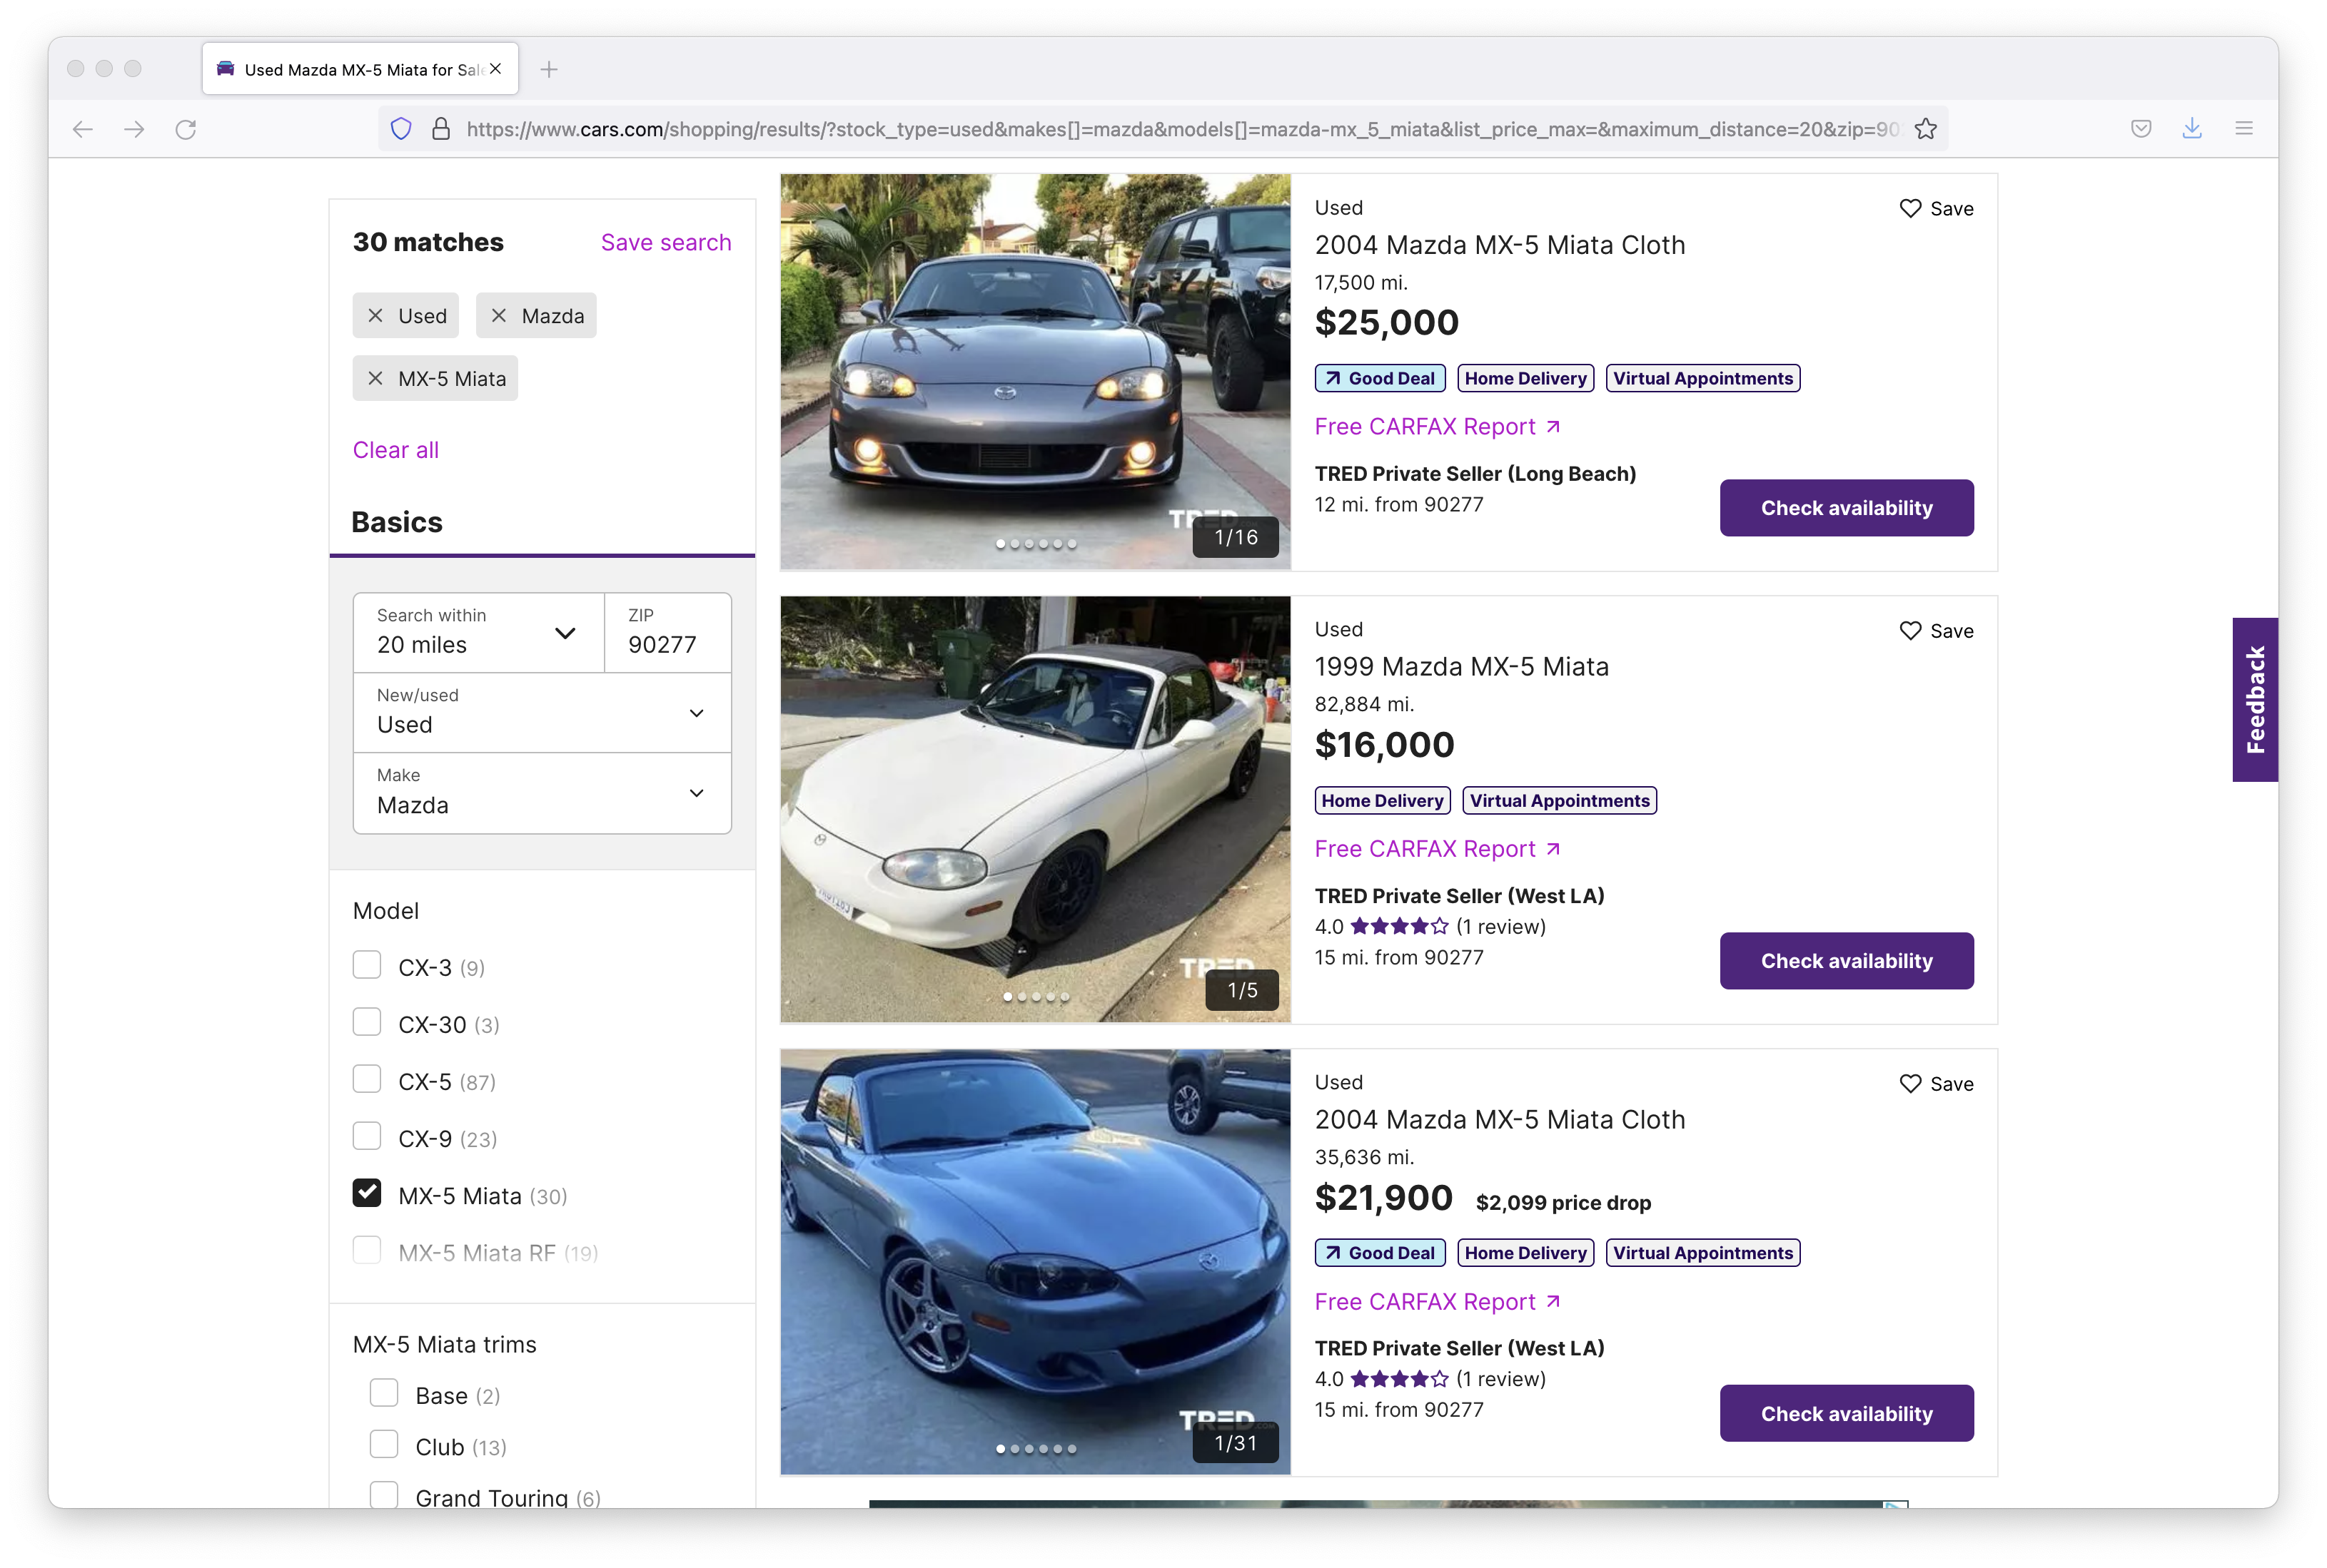
"Faceted Navigation" through Structured Data
Filters by category
Guides the “search” through structured data by their classification or characteristics

Slide 4
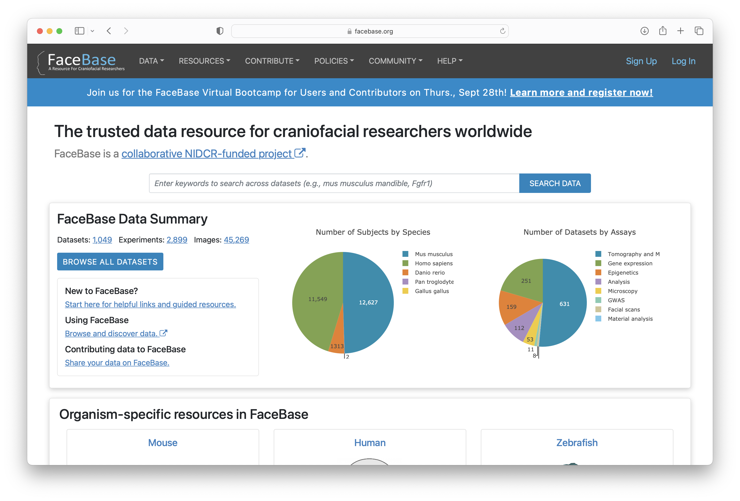
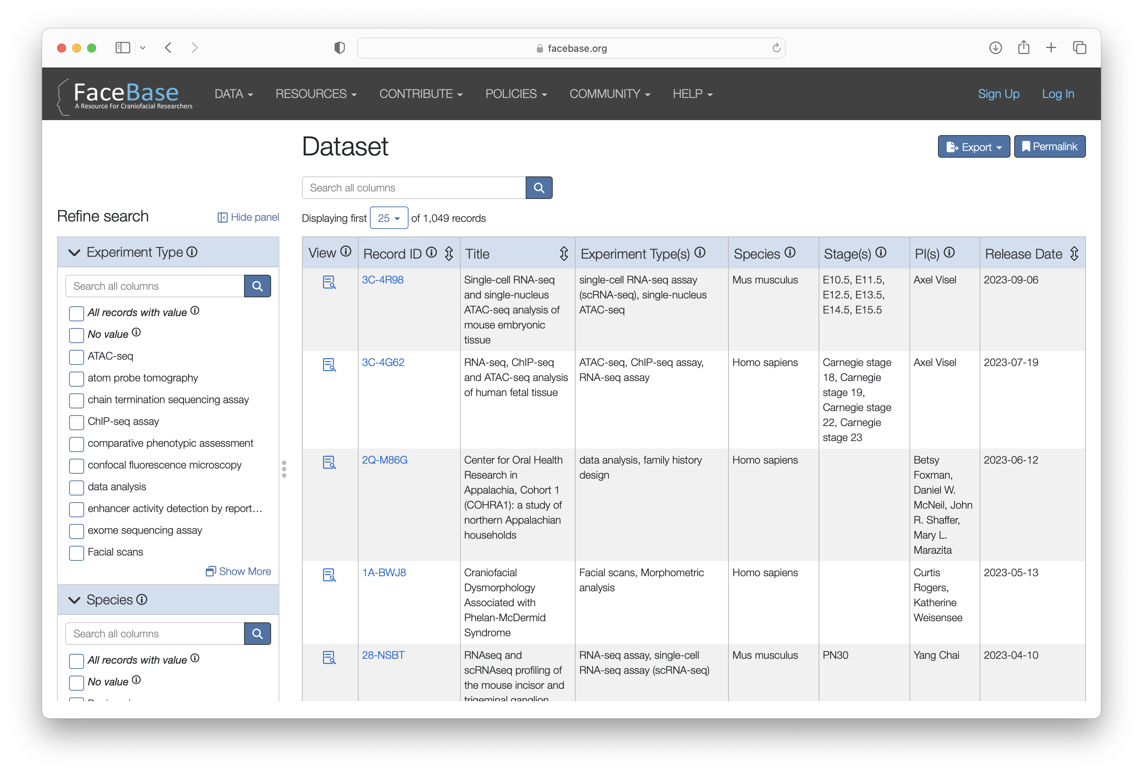
Finding Data in FaceBase
Search & Browse
Filters by category
Guided search through the project-dataset-experiment-biosample data model

Slide 5
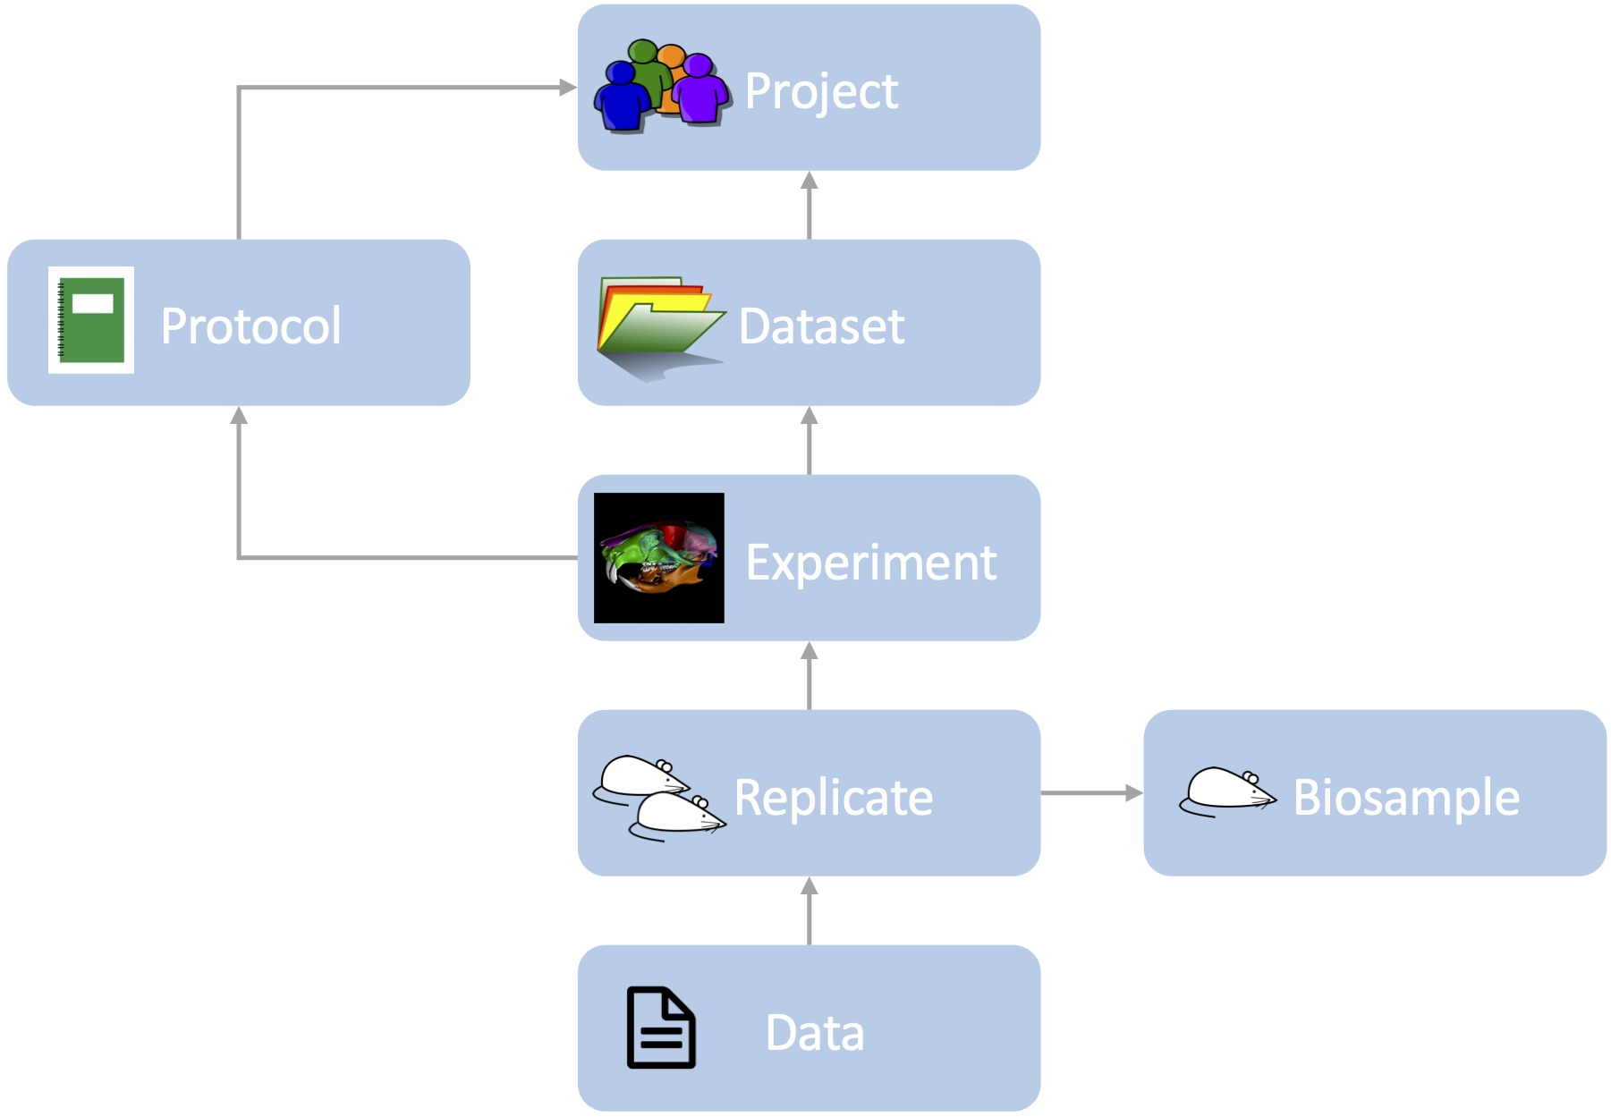
Ready for Reuse, Reproducibility, (Re)analysis
Represents the group contributing data, funding, and team members
Describe or reference protocol(s)
Collection of data and metadata
Specifies assay type, protocol used, instruments, etc for each experiment.
Provides details about the tissue: species, genotype, age stage, anatomy, etc.
Collects data output: imaging, microscopy, sequencing and others…
Based on “FAIR data” principles, for increased scientific utility
Notes:
Q: Sharing PPT in a dataset

Slide 6
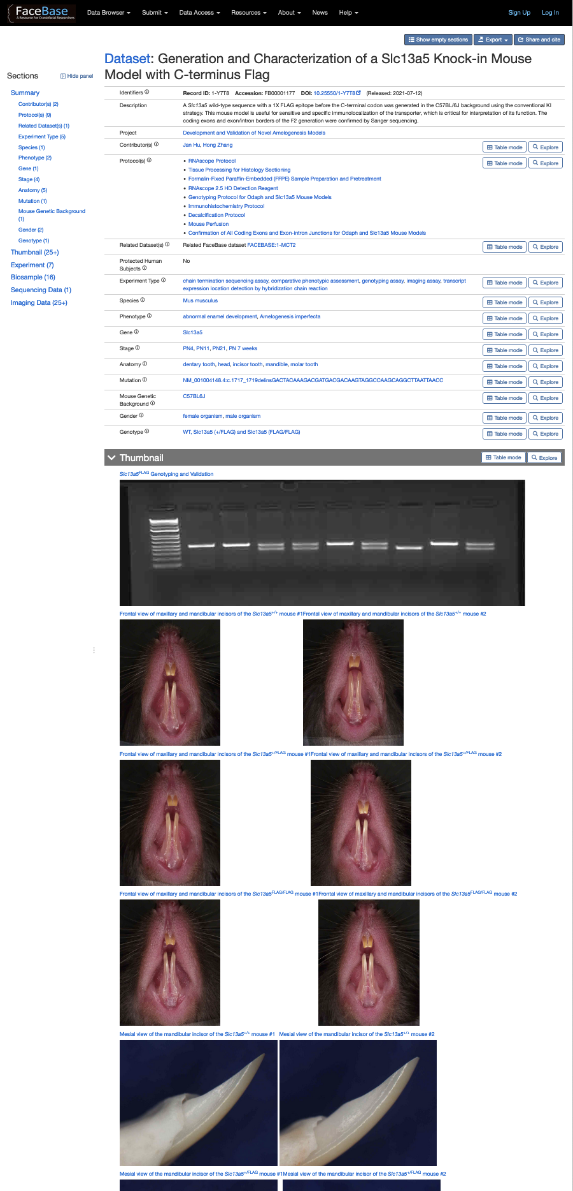
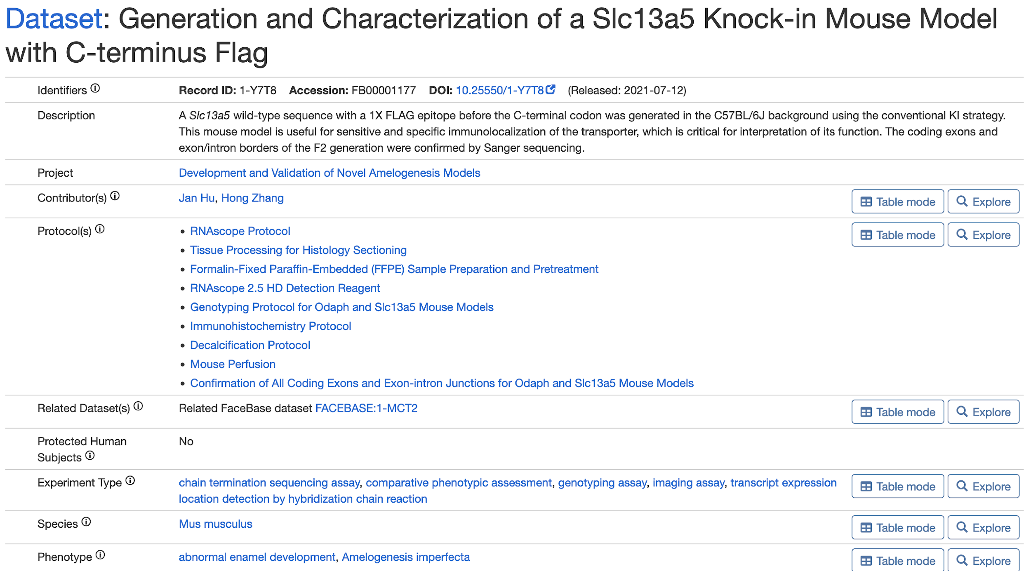
Review of Dataset Display
Persistent Identifiers
(e.g., Digital Object Identifiers)
Protocols
Keywords
Standardized Terminology
Additional Details
Notes:
Q: Cross-reference data submitted to another site/repository/database

Slide 7
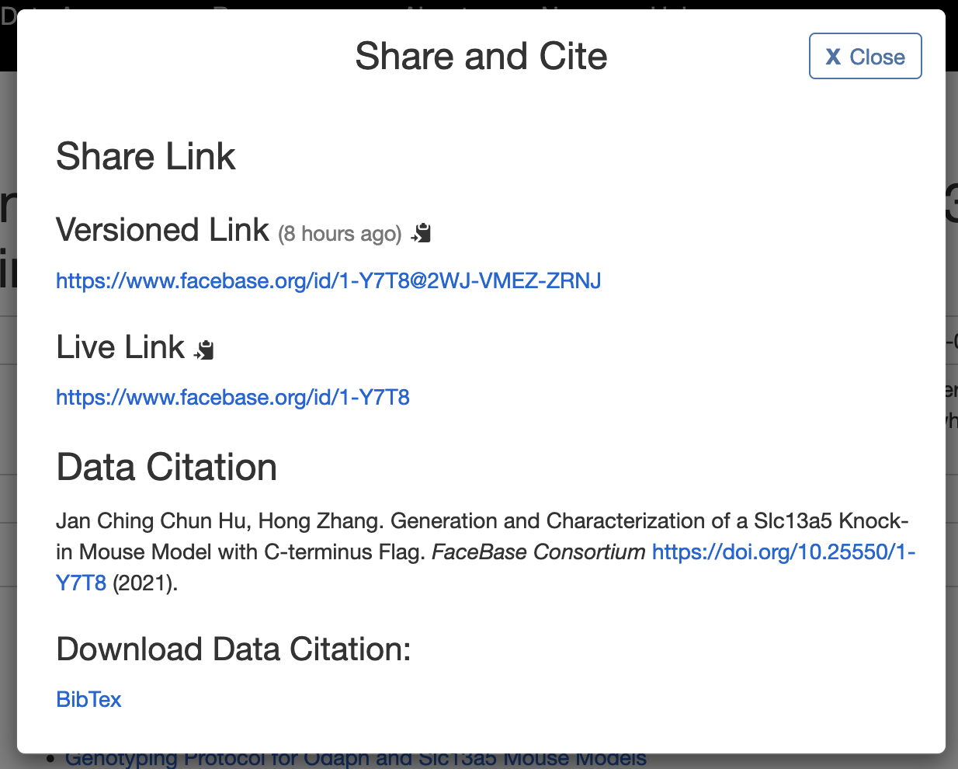
Citing Datasets In Publications
Citable Data IDs:
Globally-unique
Persistent
Actionable
Versioned
Publishable
Cite data as you would any other work that you use
Always include the DOI! ☺
Recommended Citation Format for Data
Notes:
Q: Publication/citation, conflicts with later publications

Slide 8
DEMONSTRATION
General Search
  www.facebase.org → Search Data OR Browse All Datasets
Image Search
  www.facebase.org → Data → Images
Visualization Examples
  Image Volume
    https://www.facebase.org/id/TKT (skull)
    https://www.facebase.org/id/1-SXC4 (dental)
  Histology
    https://www.facebase.org/id/1-W96W
  Surface Model/Mesh
    https://www.facebase.org/id/1-YQK8
  Genome Browser
    https://www.facebase.org/id/TMJ
    https://www.facebase.org/id/1-7780
  Single Cell
    https://www.facebase.org/id/R-PPWJ
    https://www.facebase.org/id/V-J7QP (direct)
Notes:
Single Cell + Mandible + Mandibular Process

