Slide 1

Contributing to FaceBase
FaceBase 2024 Bootcamp for Users and Contributors
Notes:
Welcome back. In this session we will be describing and demonstrating the process for contributing data to FaceBase.

Slide 2
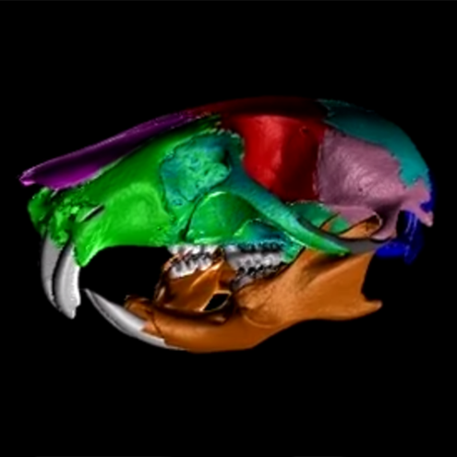
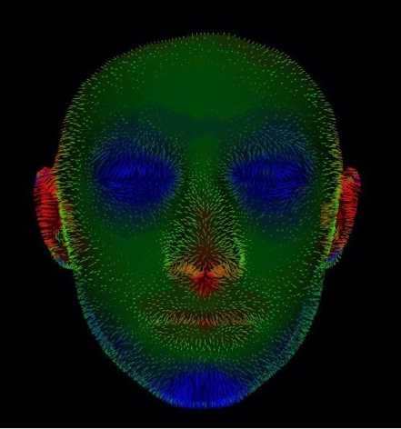
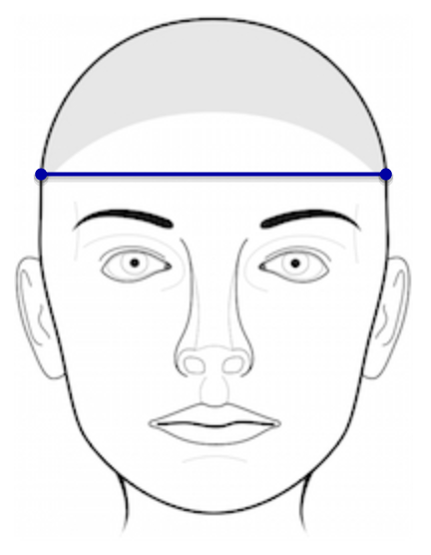
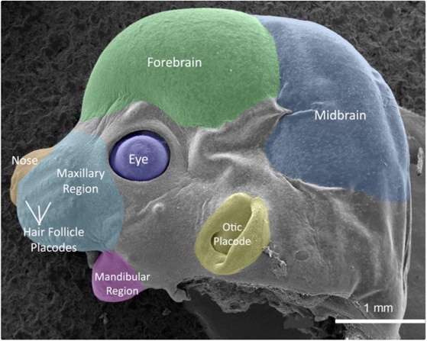
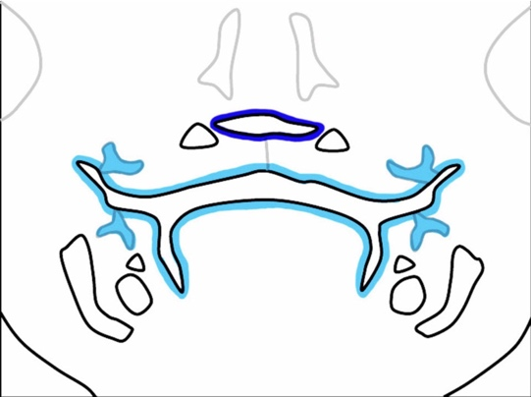


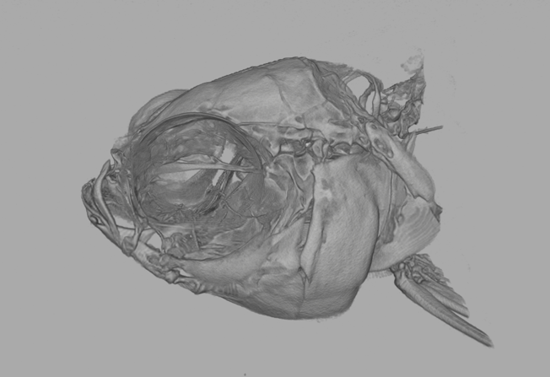
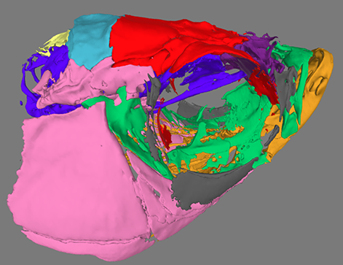
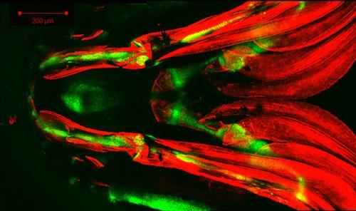
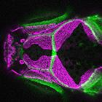
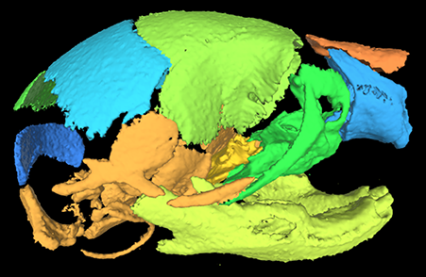
A Great Home for Your Data...
Broad collection of data
  Animal models and human subjects
  Imaging, omics, and other experiment types
Commonality: Craniofacial + Dental + Development + Dysmorphology
Your data are “first class” research products
Satisfy data sharing requirements
Skull Fly-through
Facial Scans and Facial Norms
Mouse Anatomy
Cell Lineage
Imaging Data
Sequencing Data and Genome Browser
See Website for Data Priorities
Fish Face
Surface Models
Microscopy Data
Notes:
First of all, we think FaceBase can provide a great home for your Dental, Oral, Craniofacial, and related data.
While we have a broad collection of data across multiple animal models and human subjects, and multiple experimental assay types and imaging modalities, they are all tied together by their relationship to DOC and closely aligned research objectives.
In FaceBase, data are “first class” research products. Just like a publication they have proper attribution; archive-grade, citable identifiers; and terms of use that inform users to cite your contributions; and all of it is enhanced with online visualization capabilities.

Slide 3
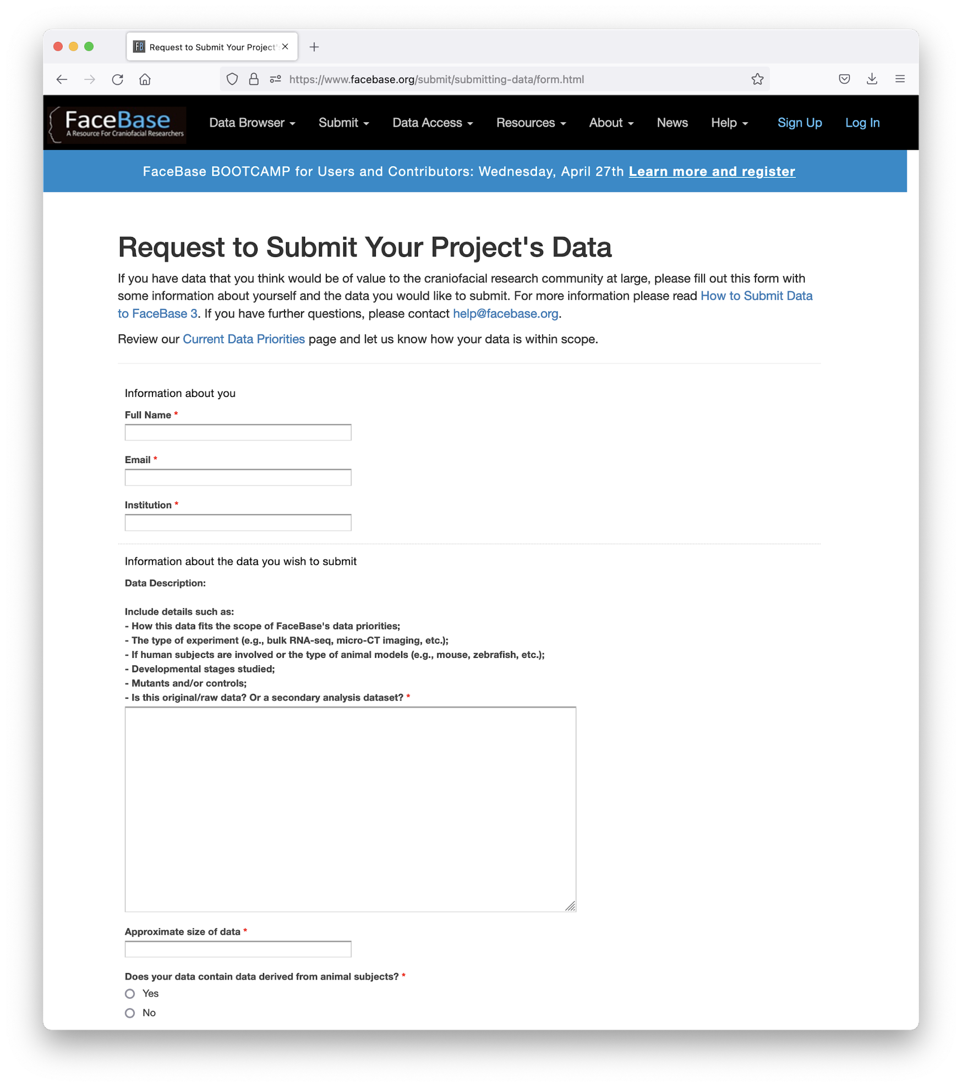
Initiate a Data Submission to FaceBase
Overview
https://www.facebase.org/contributing/
Form
https://www.facebase.org/contributing/submitting/
Brief Overview of Your Data
Review by FB Steering Committee
Response in approx. 2 weeks
Notes:
You initiate a data submission to FaceBase by filling out form. This information gets reviewed by the FaceBase Steering Committee and that vets all proposed contributions to FaceBase.
The main criteria are appropriate handling of human subjects data and ethical handling of animal research – and then making sure the data are aligned with DOC and closely related research areas.
We try to get back to you within 2-3 weeks.

Slide 4
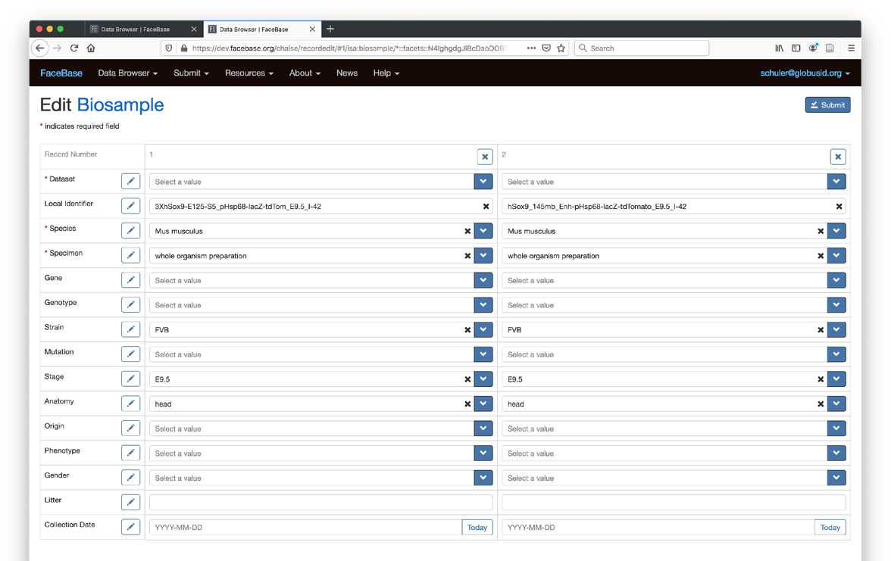


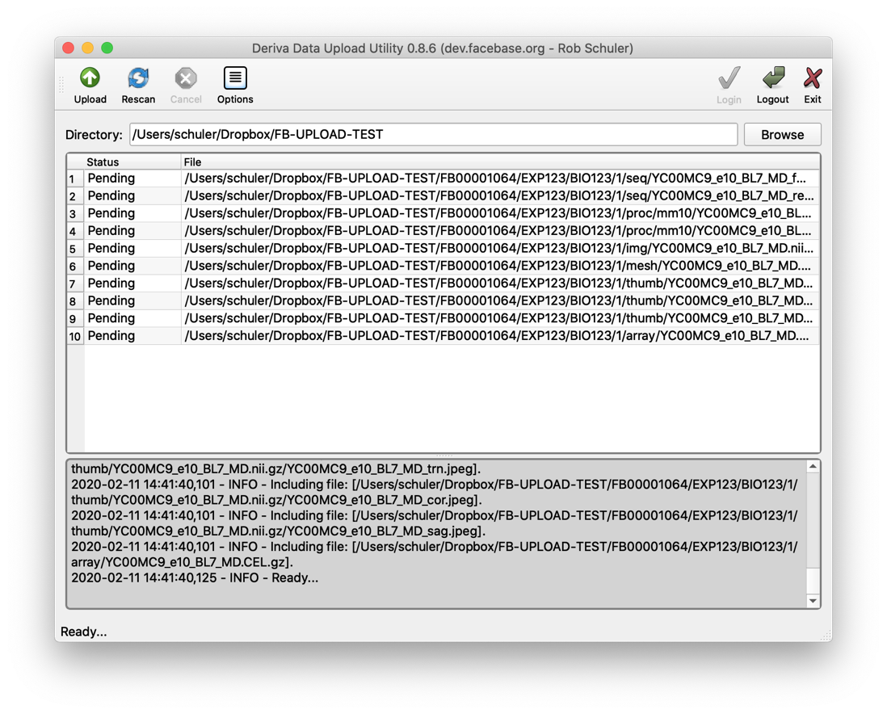


Self-Serve Data Submission w/ Support
Optional Embargo to Sync w/ Publication?
Almost Done!
ONLINE FORMS
Tutorial
Describe Experiments & Biosamples
Upload Data Files
Quality Control Review
Cite Datasets
Release
[Embargo?]
UPLOAD APP
ZOOM.us
Preparing Manuscripts? Include Data Citation
Notes:
We then typically like to meet briefly with someone from your team to just remind you of the process and answer any questions you may have upfront.
The process is “self service” in the sense that you or someone from your team will be filling in online forms and uploading your data. We provide automated quality control feedback daily and when you are ready to make the data public we do a final review to ensure that we release quality curated data to the public.
Before you finalize any publications associated with the data (a) we can keep your data embargoed (private only visible to your team) and (b) we ask that you include proper citations to your own data. This helps to formalize your own “data availability” statement in your publication.

Slide 5
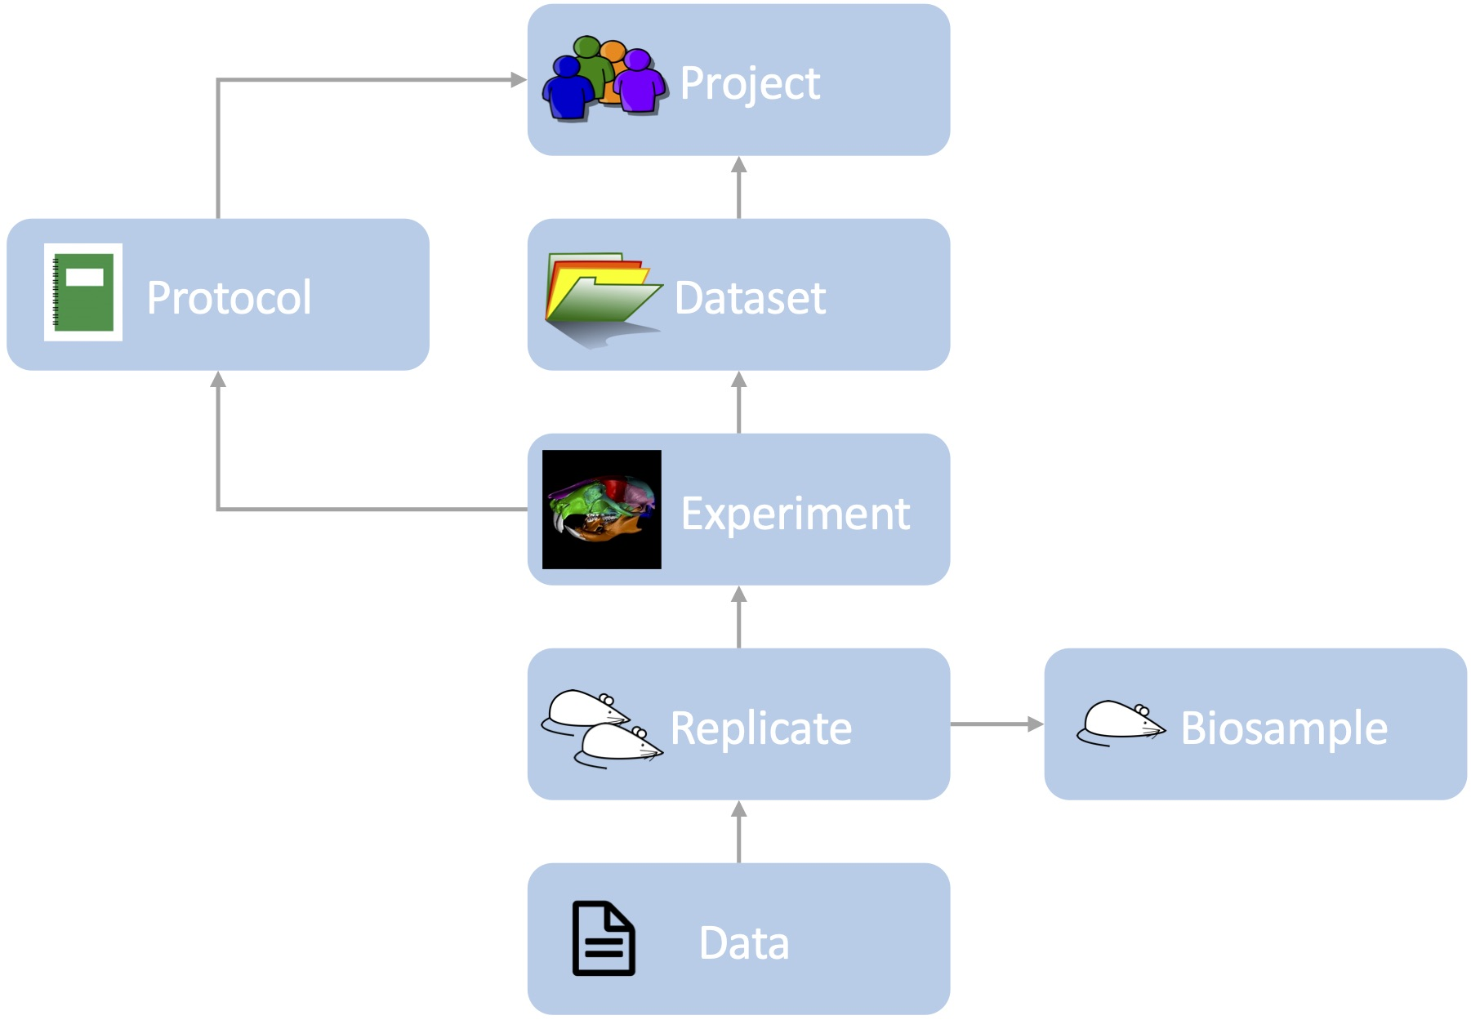
Ready for Reuse, Reproducibility, (Re)analysis
Represents the group contributing data, funding, and team members
Describe or reference protocol(s)
Collection of data and metadata
Specifies assay type, protocol used, instruments, etc for each experiment.
Provides details about the tissue: species, genotype, age stage, anatomy, etc.
Collects data output: imaging, microscopy, sequencing and others…
Based on “FAIR data” principles, for increased scientific utility
Notes:
The way that you will describe your datasets, follows the data model that we showed earlier in the data users session of the bootcamp.
The Project…
We typically find that the data model is fairly intuitive for most contributors as it represents the key concepts for most classes of research in a fairly straightforward manner.

Slide 6
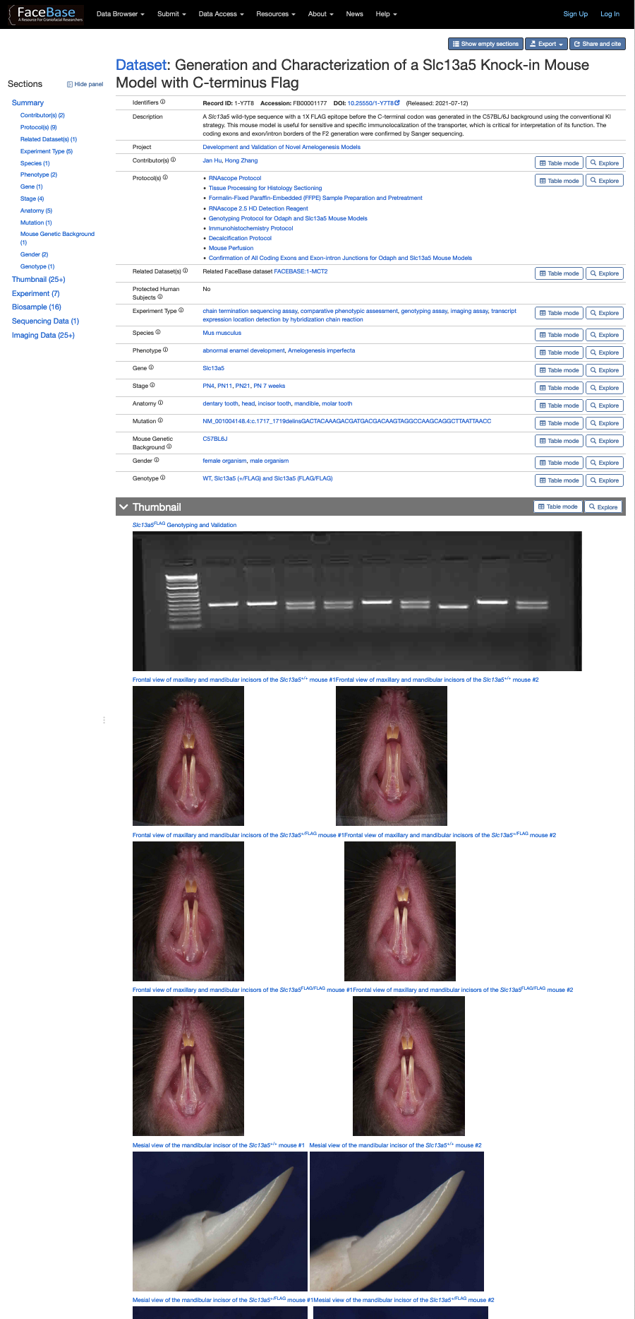
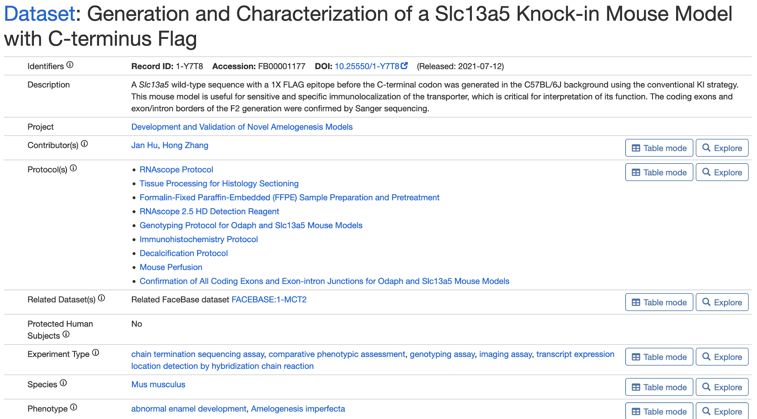
Review of Dataset Display
Digital Object Identifiers
Attribution
Cross-Reference
(GEO, dbGaP, FB, other)
Standardized Terminology
Additional Details
Notes:
When a dataset is composed on FaceBase, it gets a Digital Object Identifier – an archive grade persisted ID for your data – and its resolvable to take readers right to your data on facebase.
In addition to the title, description, and keywords from “standardized terminology”, you may also want to Cross-reference data submitted to another site/repository/database (GEO, dbGaP, etc).
Finally, I also want to point out that every dataset has clearly displayed Attribution so that the contributors to the dataset are given credit. And the contributors are of course included in the citations that we generate (and will look at next).

Slide 7
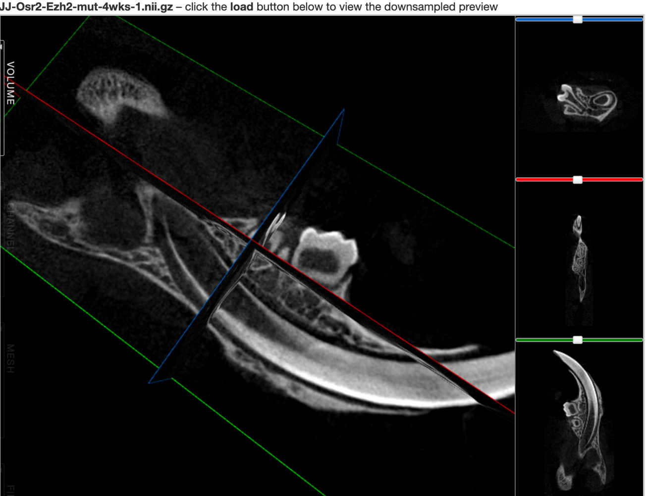
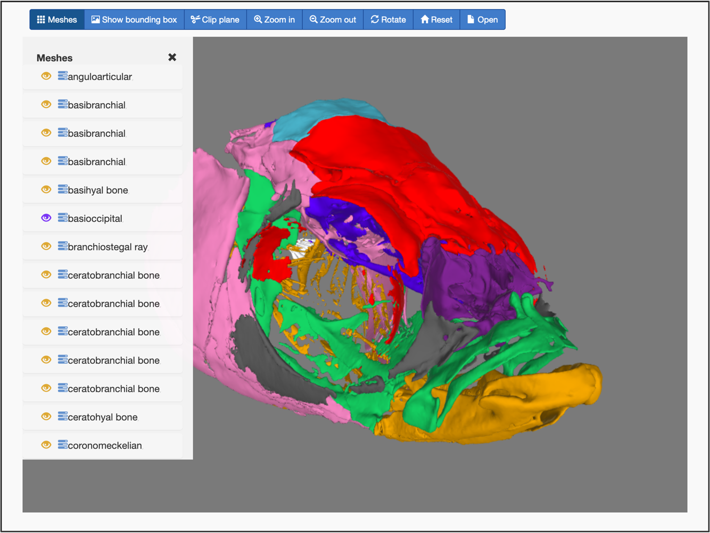
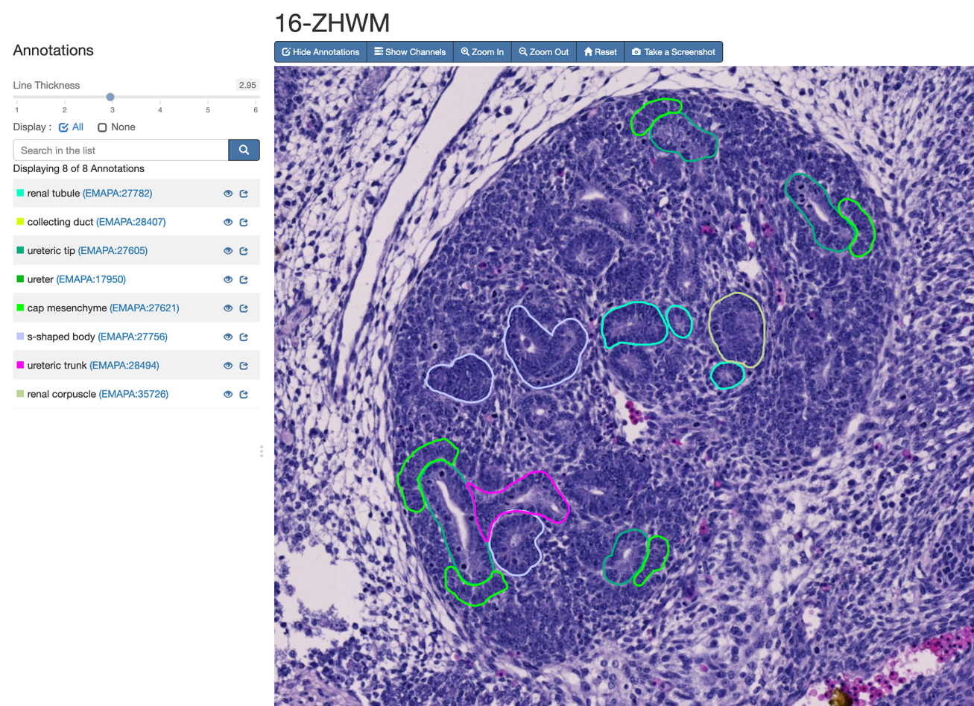
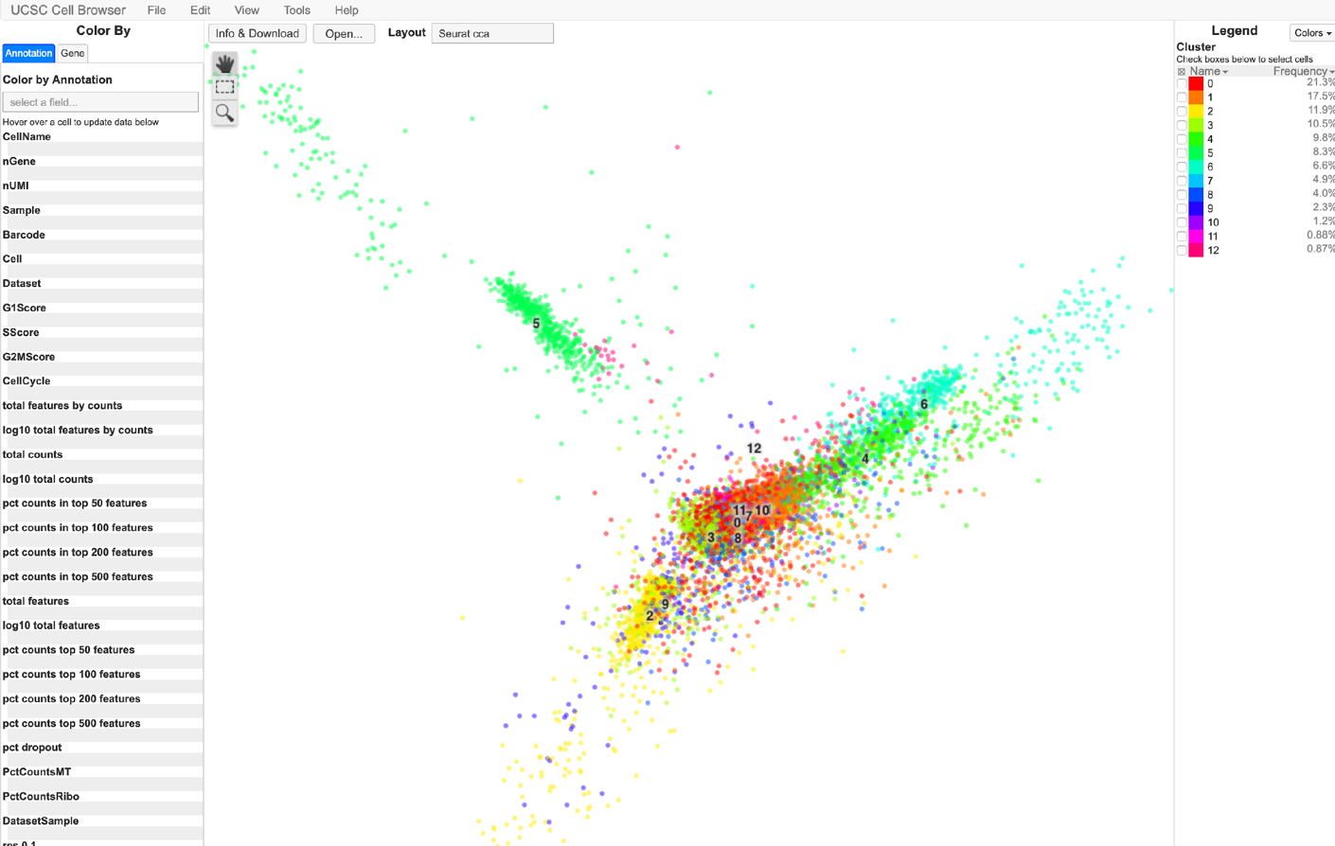
Consider Exploiting Visualization Capabilities
Orthogonal Slice
Viewer
Surface Models
High-resolution Microscopy Images with Annotations
UCSC Single Cell Browser
(Genome Browser, not shown)
Thumbnail Gallery
Notes:
We can also enhance the accessibility and usability of your research data through online visualization.
Orthogonal slice viewer
3D volume viewer
Surface model viewer
High resolution microscopy with annotations
Single Cell Browser
Genome Browser
Our automated data pipelines handle both single cell and high resolution 2D viewer. We are working on additional automated pipelines.

Slide 8
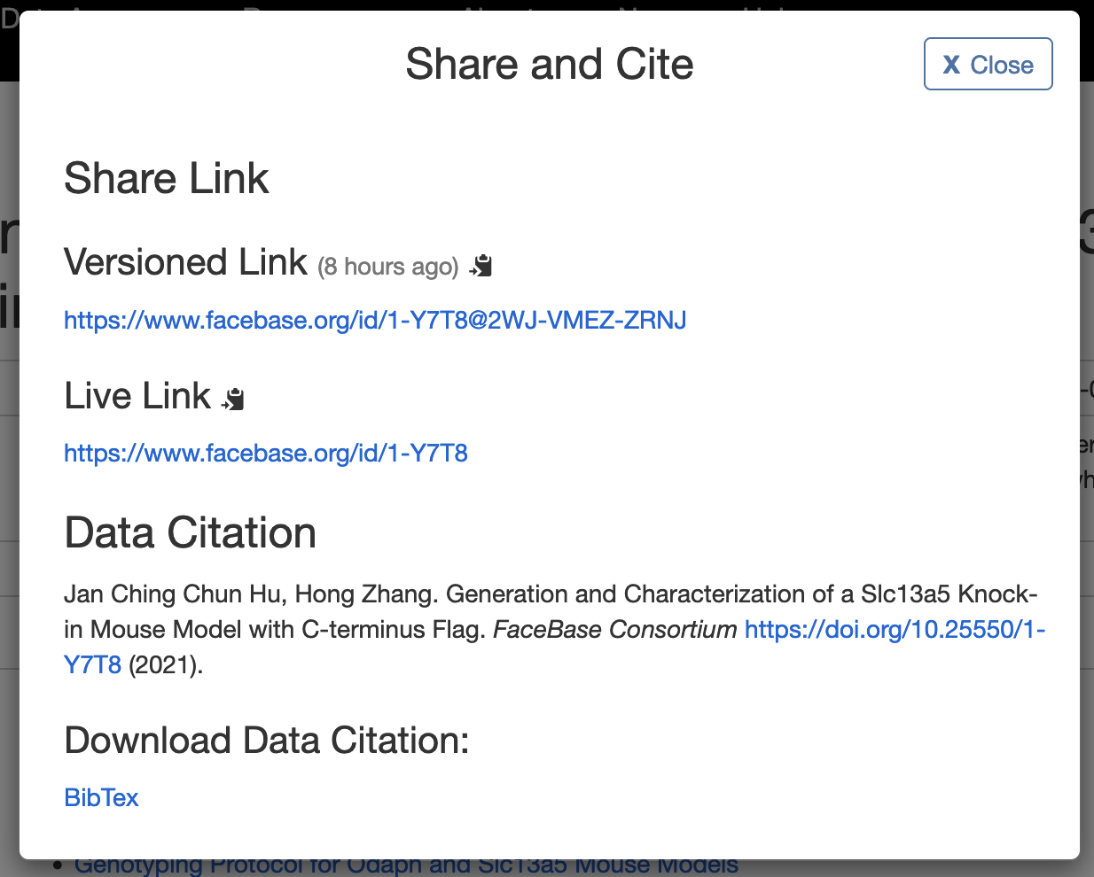
Citing Datasets In Publications
Citable Data IDs:
Globally-unique
Persistent
Actionable
Versioned
Publishable
Plan when manuscript is in preparation
Optionally, embargo dataset to be released in sync with publication
Notes:
Having your data on FaceBase means it is treated and recognized as a citable scholarly work. As I’ve indicated, we generate ready-to-use citations that include the contributors and DOI and title.
Again, plan ahead to include a citation to your dataset while you are preparing a manuscript for publication. Don’t wait until late in the process. We can embargo your data so that it remains privately held until released at a time of your choice to coincide with your publication.

Slide 9
Strategies for Successful Data Contributions
Review the metadata/data guidelines early in the process of preparing manuscripts;
Schedule 1-on-1 with us before you begin creating your first dataset;
Submit (part of) a dataset, let us review and give you feedback, then proceed with further data submissions;
Remember: We are here to help! ☺
Point of Contact: FaceBase Helpline (help@facebase.org)
Notes:
Finally, a few recommendations to streamline your experience contributing to facebase.
1….
And anytime you need, we are here to help – contact us through the FaceBase Helpline (help@...)

