Slide 1

FaceBase Support for NIH’s Data Management and Sharing Policy
FaceBase 2025 Bootcamp for Users and Contributors

Slide 2
Planning for Data Management – Why bother?
Comply with new (2023) NIH Data Management and Sharing Plan requirements
Ensure data is reusable
Standard data formats
Rich metadata
Standard ontologies
Understand and budget for the required level of effort

Slide 3






Elements of a
DMS Plan
Data Type
Identifying data to be preserved and shared
Related tools, software & code
Tools and software needed to access and manipulate data. If needed specify how they can be accessed
Standards
Standards to be applied to scientific data and metadata
Data preservation, access & timelines
Repository to be used, persistent unique identifier, and when/how long data will be available
Access, distribution, reuse consideration
Description of factors for data access, distribution, or reuse
Oversight of data management and sharing
Plan compliance will be monitored/ managed and by whom
See NOT-OD-21-014 for more information (slide courtesy of Alicia Chou)
Notes:
The elements of a DMS Plan cover the full research process, from data generation to data management to data preservation and distribution.
There are 6 elements
Data Type: Identifying data to be preserved and shared (e.g., imaging data, genomic data, survey data, electronic health records, etc.)
Related tools, software & code: Tools and software needed to access and manipulate data. If needed specify how they can be accessed (e.g., open source)
Standards: Standards to be applied to scientific data and metadata (i.e., data formats, data dictionaries, unique IDs, definitions, etc.)
Data preservation, access & timelines: Repository to be used, persistent unique identifier, and when/ how long data will be available (Will talk more about this in next slide)
Access, distribution, reuse consideration: Description of factors for data access, distribution, or reuse (e.g., disease specific limitations, de-identification, use limitations)
Oversight of data management and sharing: Plan compliance will be monitored/ managed and by whom

Slide 4
Planning for Data Management and Sharing
Write DMS plan
Estimate data size
Align metadata terms with FaceBase ontologies
Plan data types and formats
Decide on metadata types
Work out pre-upload operational procedures

Slide 5
Data Management Considerations
When, and how often, will you upload your data?
  We encourage uploads early and often
  But you’ll need to have collected some data before it’s approved for FaceBase
How will you manage your data before it’s uploaded?
  How will you organize your data and metadata before you upload?
  Do you have space for it?
  Do you have security and backup policies in place?
Will you need to do any preprocessing?
  Does this involve tools you’ll develop yourself?
  If so, will you make it available on an open-source repository like github?

Slide 6
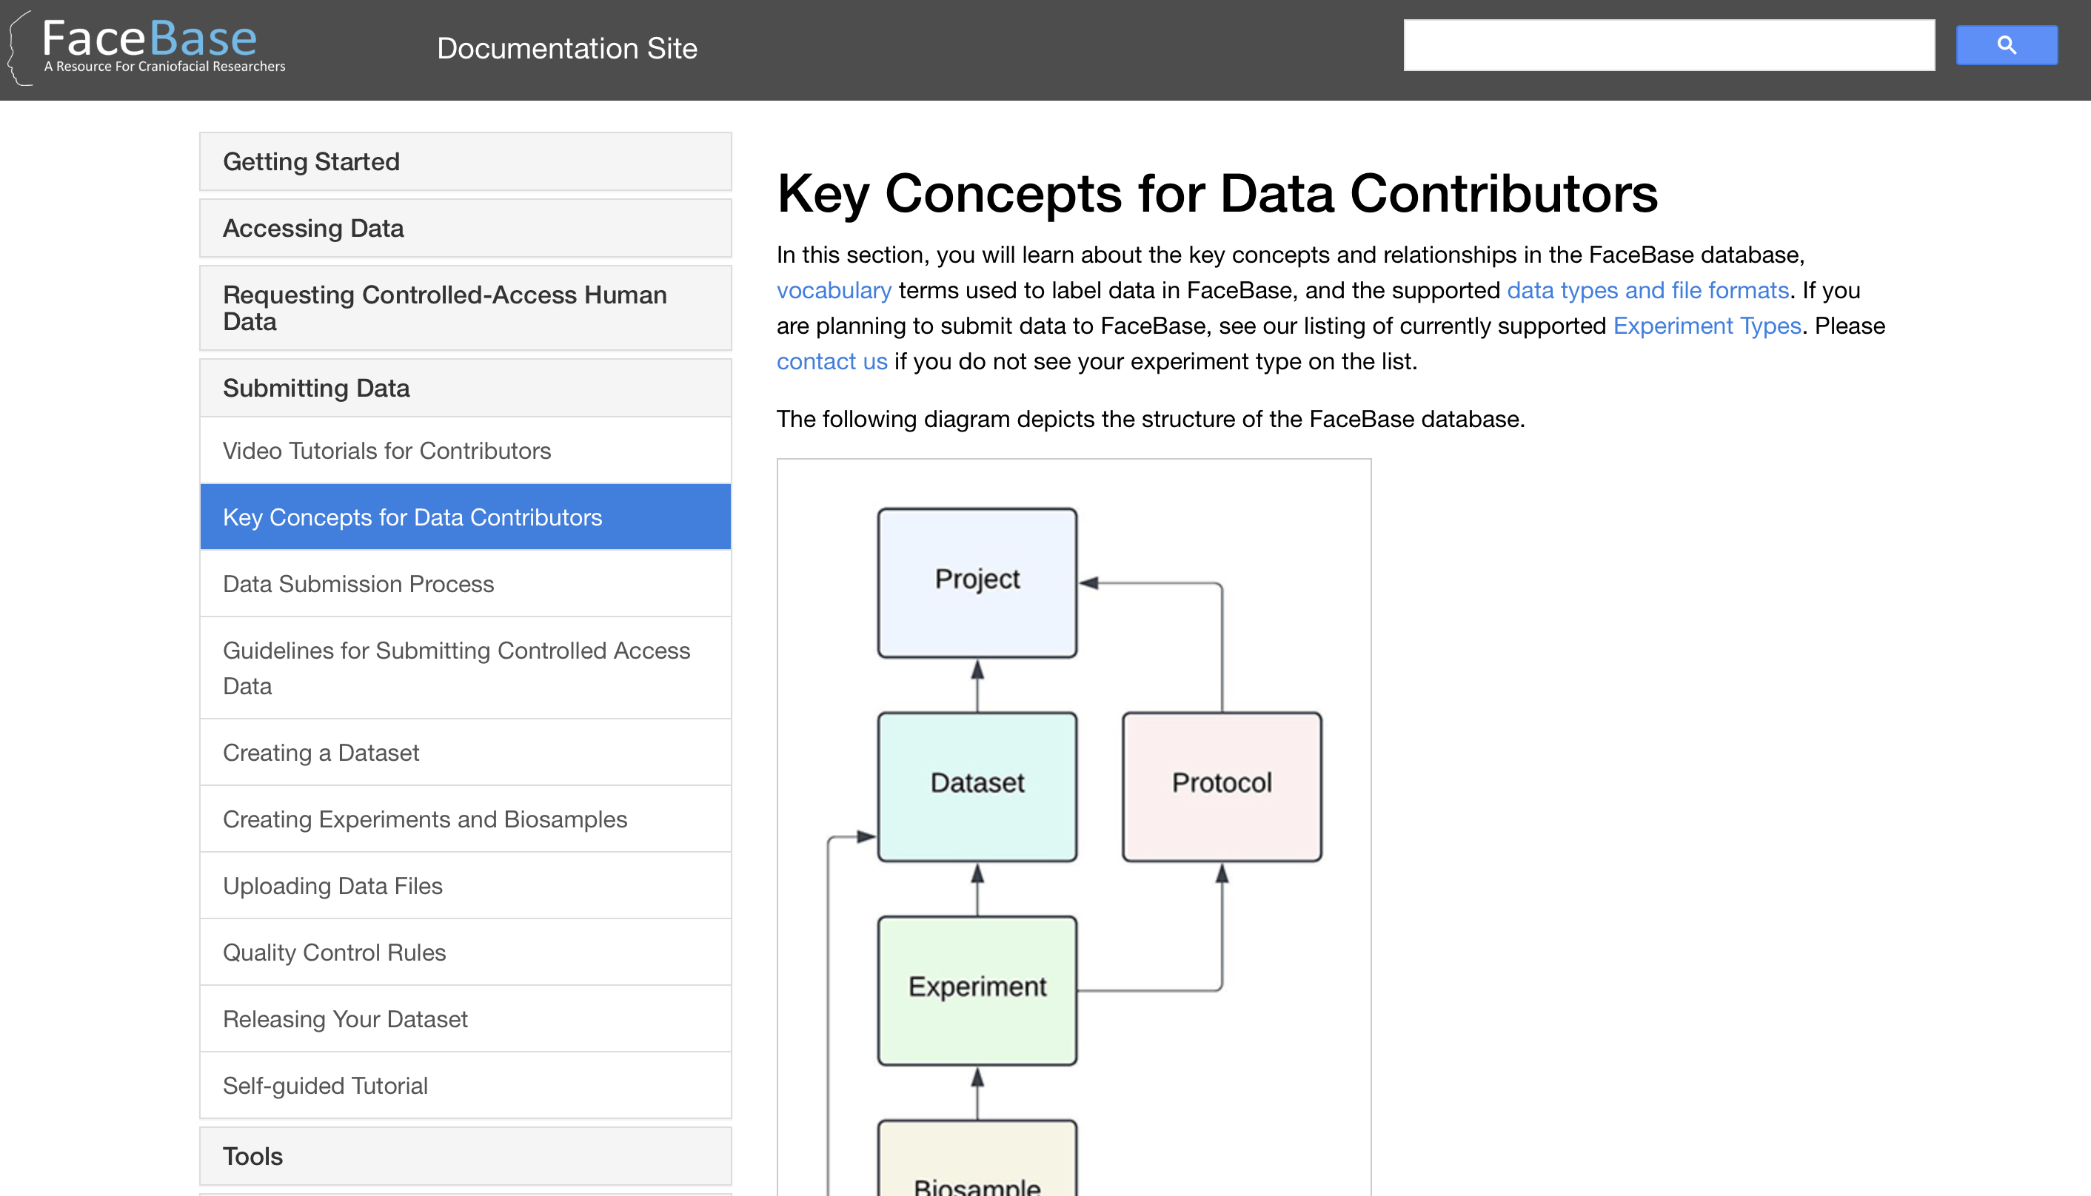
FaceBase-Specific Considerations
The FaceBase repository currently supports certain:
Data Types
File Formats
Metadata elements
  Expressed in specific ontologies
If you have data/metadata that doesn’t quite fit this model, talk to us!
https://docs.facebase.org/docs/Data-Submission-Key-Concepts/

Slide 7
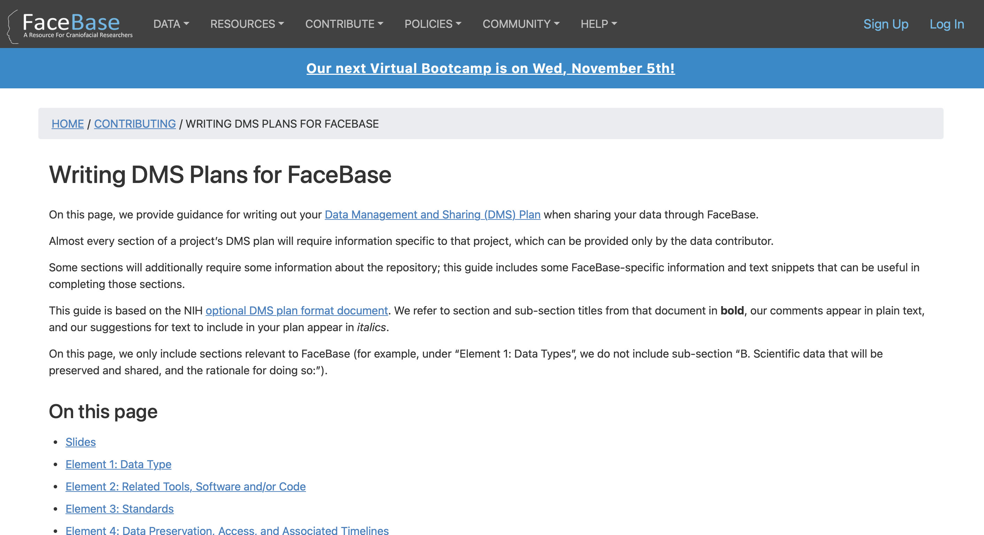
Data Planning
Choose a data repository – is FaceBase the right fit?
FaceBase mission
FaceBase data priorities
Consider some data issues
Data types and formats
Metadata types and ontologies
Pre-upload data management
Write data management plan
Some parts only you can answer
FaceBase provides some boilerplate text
Complete answers to some questions
Snippets that can be used in others
https://www.facebase.org/contributing/dms

Slide 8
Data Types (Not an Exhaustive List)
See “Key Concepts for Data Contributors” for a full list of currently supported data and experiment types and species.
Some currently supported data types:
  Sequencing data (and derived processed and track data)
  Imaging data (2D or 3D)
  Surface/Mesh data
Species: human, mouse, zebrafish, chick, xenopus
Some experiment types:
  Tomography/MRI
  Gene Expression
  Epigenetics
  Microscopy

Slide 9
Data Formats
Some Supported Data Formats:
  Sequencing Data:
    Raw: fastq
    Processed: fastqc, count, tpm, fpkm, bam, bai, and measures in tsv
    Track Data: BED (.bed), bigBed (.bb), and bigWig (.bw)
  Imaging Data: TIFF, OME-TIFF, NIfTI
  Surface Model / Mesh Data: Wavefront OBJ
Considerations for new formats:
  Is the format “open” (via standards or de facto openness)?
  Are free or widely used tools available?

Slide 10
Metadata
FaceBase has some minimum metadata requirements
  Protocols for each experiment (we recommend the Nature Protocol Exchange format)
  Species, developmental stage, and anatomy for each biosample
  Additional requirements depending on data type
FaceBase supports many more optional metadata elements
  The more metadata you provide, the more discoverable and reproduceable your data will be
  If you want to provide more than we currently collect, we’ll probably accommodate those too.
How will you express the metadata?
  FaceBase uses standard ontologies for different metadata types

Slide 11
Some Ontologies Used by FaceBase
Anatomy: UBERON
Chromatin modifier: ZFIN, NGI, HGNC, Ensemble, MGI
Data type: OBI, SMOMEDCT, CHMO
Experiment type: MMO, ERO, CHMO, SCTID, OBI, STATO
Gene: NCBI
Phenotype: chmo, cmmo, fma, MP, HP, DOID
Sex: UBERON
Species: NCBI Taxon
Strain: MGI
Syndrome: MONDO
Transcription factor: MGI, ZFIN, Gene_ORFName, Ensembl, HGNC

Slide 12
Adding New Ontologies
We add new ontologies when necessary.
Considerations:
  Is the ontology standardized and widely used?
  Does the DOC community generally agree that it’s a good fit?
  Does it overlap with currently-supported FaceBase ontologies?

Slide 13
Writing the DMS Plan
Useful resources:
NIH “Writing a Data Management and Sharing Plan”
  Includes format and sample plans
  Includes links to additional requirements for specific institutes, programs, and offices
“Writing a DMS Plan for FaceBase”
  Based on NIH DMS plan format

Slide 14
DMS Plan - Element 1: Data Type
Question | Contributor activity | FaceBase provides
Types and amount of data to be generated | Provides entire answer
Types and amount of data to be shared (and rationale) | Provides bulk of answer | Boilerplate text snippets about supported data types.
Metadata, other relevant data, and associated documentation | Writes answer using FaceBase-provided text snippets based on their data and metadata. | Boilerplate text snippets about required and optional metadata.

Slide 15
DMS Plan - Element 2: Related Tools, Software and/or Code:
Question | Contributor activity | FaceBase provides
Specialized tools, software, and/or code needed to access or manipulate shared scientific data, and how they can be accessed. | Provides bulk of answer | Boilerplate text about FaceBase tools for visualizing and annotating various types of data, which the contributor can include if relevant.

Slide 16
DMS Plan - Element 3: Standards
Question | Contributor activity | FaceBase provides
State what common data standards will be applied to the scientific data and associated metadata to enable interoperability of datasets and resources, and how these data standards will be applied | Constructs answer from text snippets for all relevant metadata types. | Text snippets for the standards that FaceBase supports.

Slide 17
DMS Plan - Element 4: Data Preservation, Access, and Associated Timelines
Question | Contributor activity | FaceBase provides
Repository where data and metadata will be archived |  | FaceBase: www.facebase.org
How scientific data will be findable and identifiable |  | Text about persistent record IDs generated by FaceBase and optional DataCite DOIs.
When and how long the data will be made available. | “When” - either after curation or after publication. | “How long” text

Slide 18
DMS Plan - Element 5: Access, Distribution, or Reuse Considerations
Question | Contributor activity | FaceBase provides
Factors affecting subsequent access, distribution, or reuse of scientific data | Provides entire answer
Whether access to scientific data will be controlled | Provides bulk of answer | Some text about sharing of public and protected human data
Protections for privacy, rights, and confidentiality of human research participants | Provides entire answer

Slide 19
DMS Plan - Element 6: Oversight of Data Management and Sharing
Question | Contributor activity | FaceBase provides
Describe how compliance with this Plan will be monitored and managed, frequency of oversight, and by whom at your institution (e.g., titles, roles). | Provides text specific to their project | Partial (FaceBase-specific) text.

Slide 20
Further Resources
NIH “Writing a Data Management & Sharing Plan”: https://sharing.nih.gov/data-management-and-sharing-policy/planning-and-budgeting-for-data-management-and-sharing/writing-a-data-management-and-sharing-plan
FaceBase “Key Concepts for Contributors”: https://docs.facebase.org/docs/Data-Submission-Key-Concepts/
“Writing a DMS Plan for FaceBase”: https://www.facebase.org/contributing/dms/
FaceBase monthly office hours
help@facebase.org
Contact us at any point in this process, but please fill out our “Request to Submit Your Data to FaceBase” form once you’re funded!

